Slide 1
Gaseous particle detectors
Michele Bianco, CERN EP-CMX-IC
PhD Lectures 2026, Siena, 13th-14th May 2026
1

Slide 2
Lecture #6: MPGDs Applications
The MPGD family
HEP Applications
Gaseaus detector at LHC
The ATLAS NSW MM
GEM: CMS, ALICE TPC, KLOE, LHCb, Totem,
Cylindrical Micromegas: CLAS12 @JLAB
Cylindrical GEM:BESIII
Non-HEP Applications
Muography
Neutrons (only hints)
Medical applications (only hints)

Slide 3
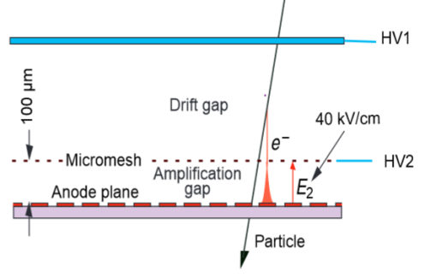
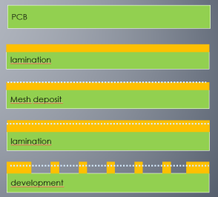
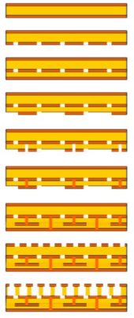
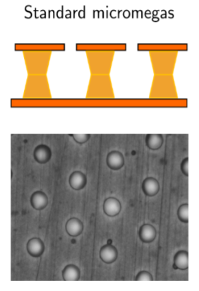
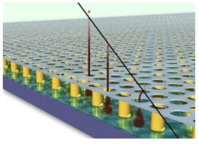
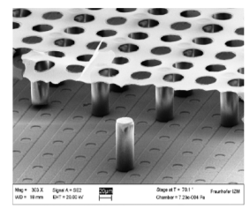
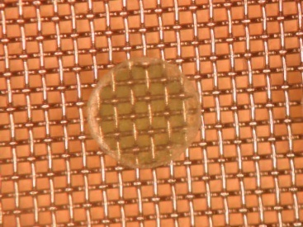
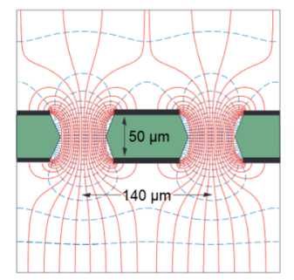
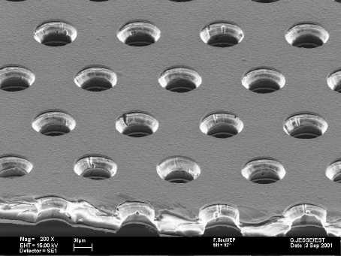
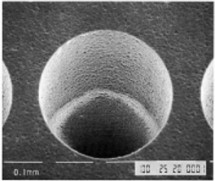
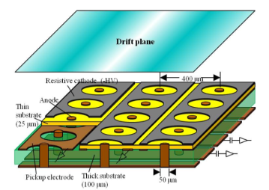
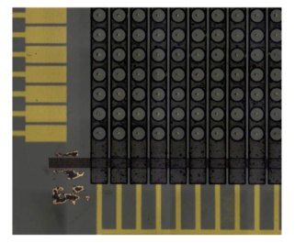
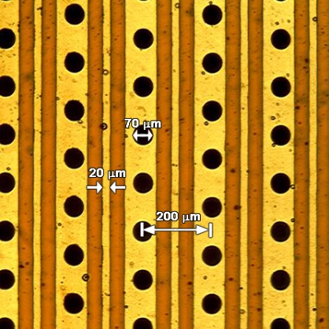
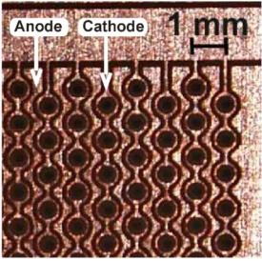
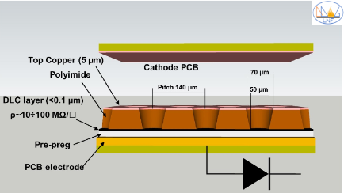
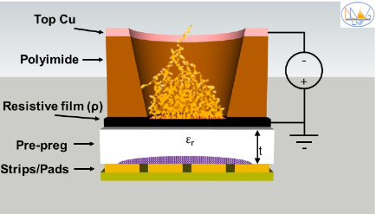
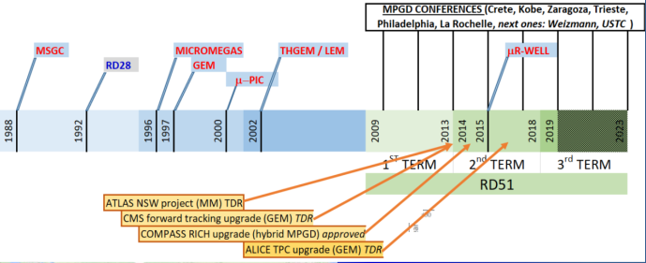
Micro Pattern Gas Detector Family
Micromegas
Bulk
Micro bulk
InGrid
High Rate Capability
High Gain
High Space Resolution
Good Time Resolution
Good Energy Resolution
Excellent Radiation Hardness
Good Ageing Properties
Ion Backflow Reduction
Photon Feedback Reduction
Large size
Low material budget
Low cost
…
Up to MHz/mm² (MIP)
Up to 10⁵ -10⁶
<100μm
In general few ns , sub-ns in specific configuration
10-20% FWHM @ soft X-Ray (6KeV)
% level sort of easy, below % in particular configuration
m²
GEM
50μm GEM
THGEM
GLASS GEM
μPIC
MHSP
THCOBRA
μRWELL
All subjects illustrated by examples:
A fully comprehensive review is impossible!
Technology share-point DRD1

Slide 4
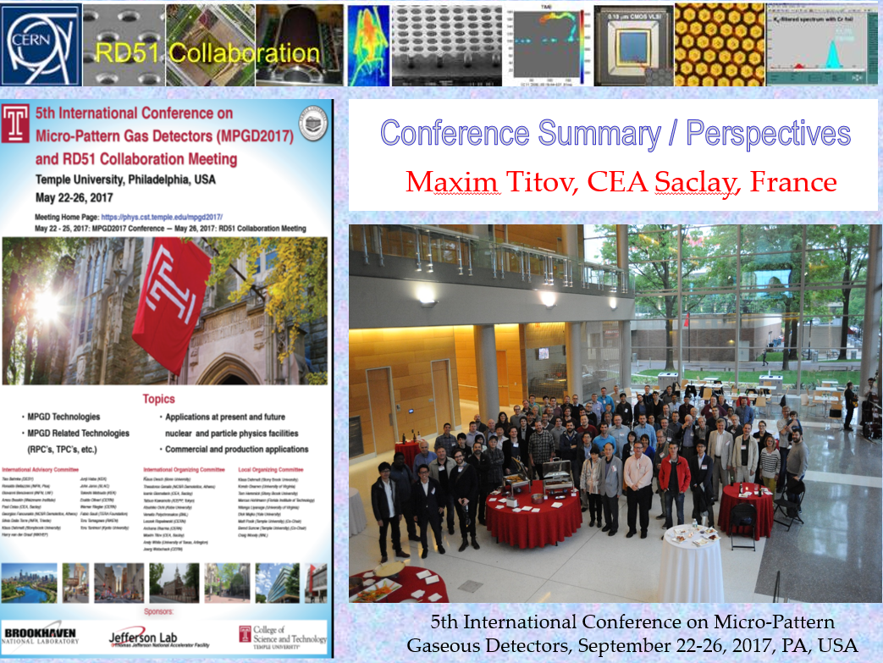
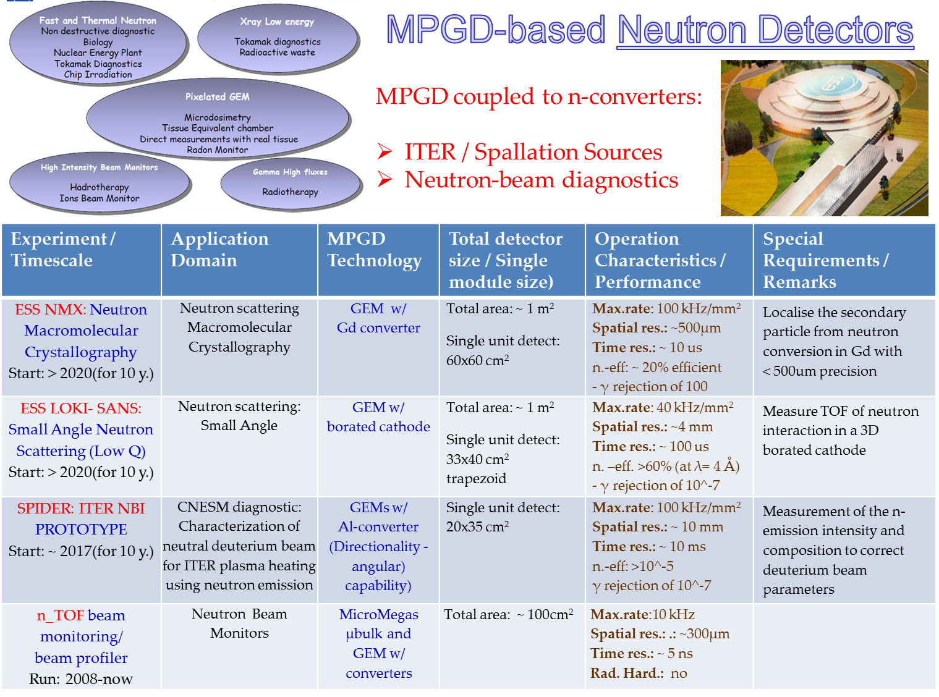
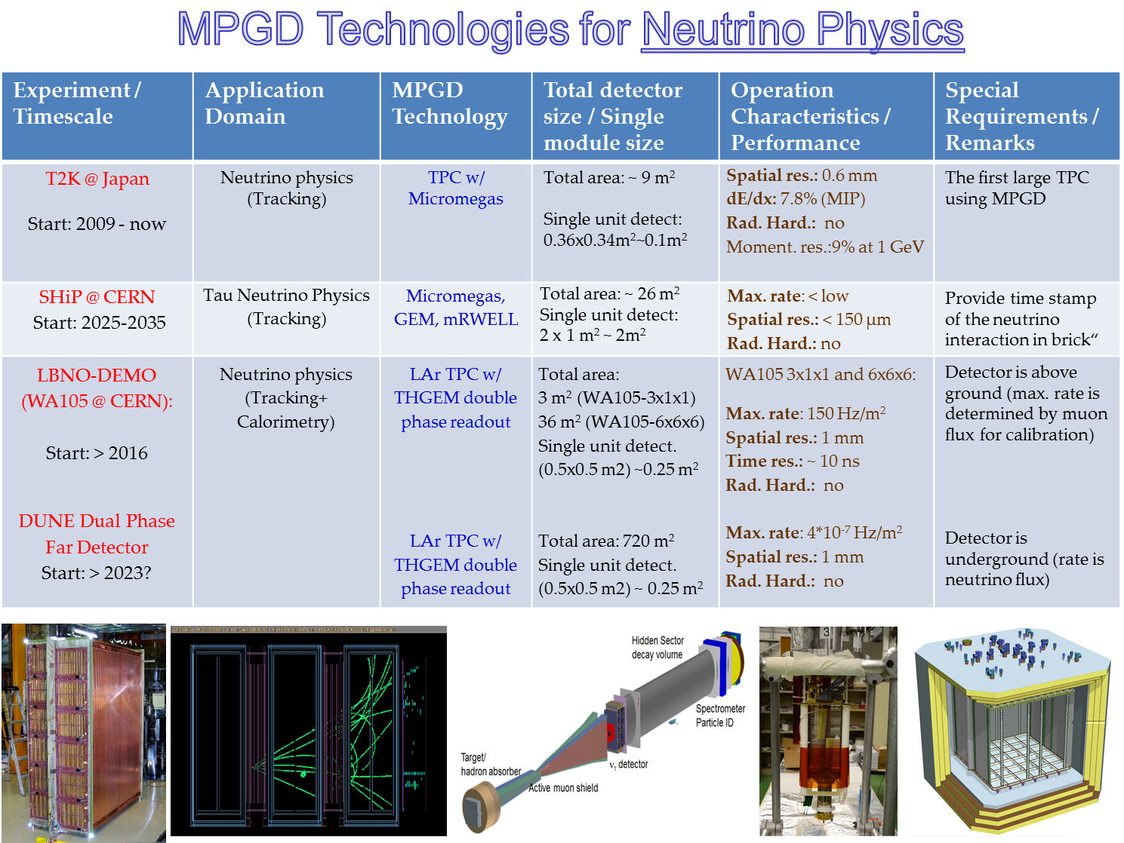
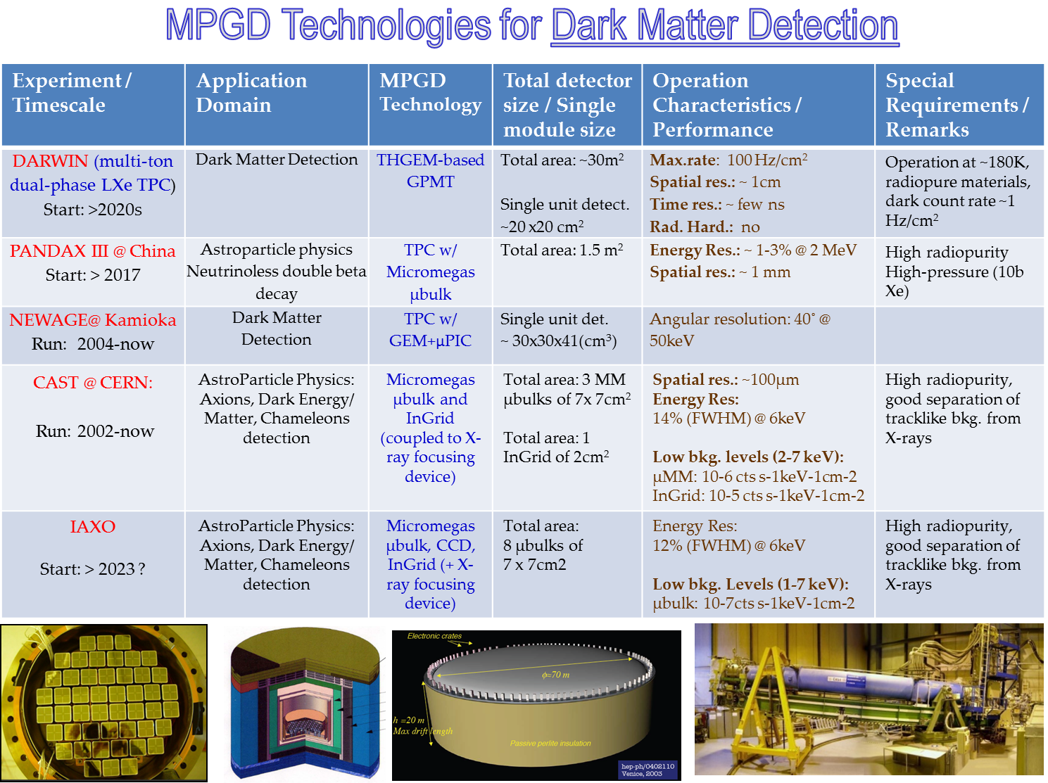
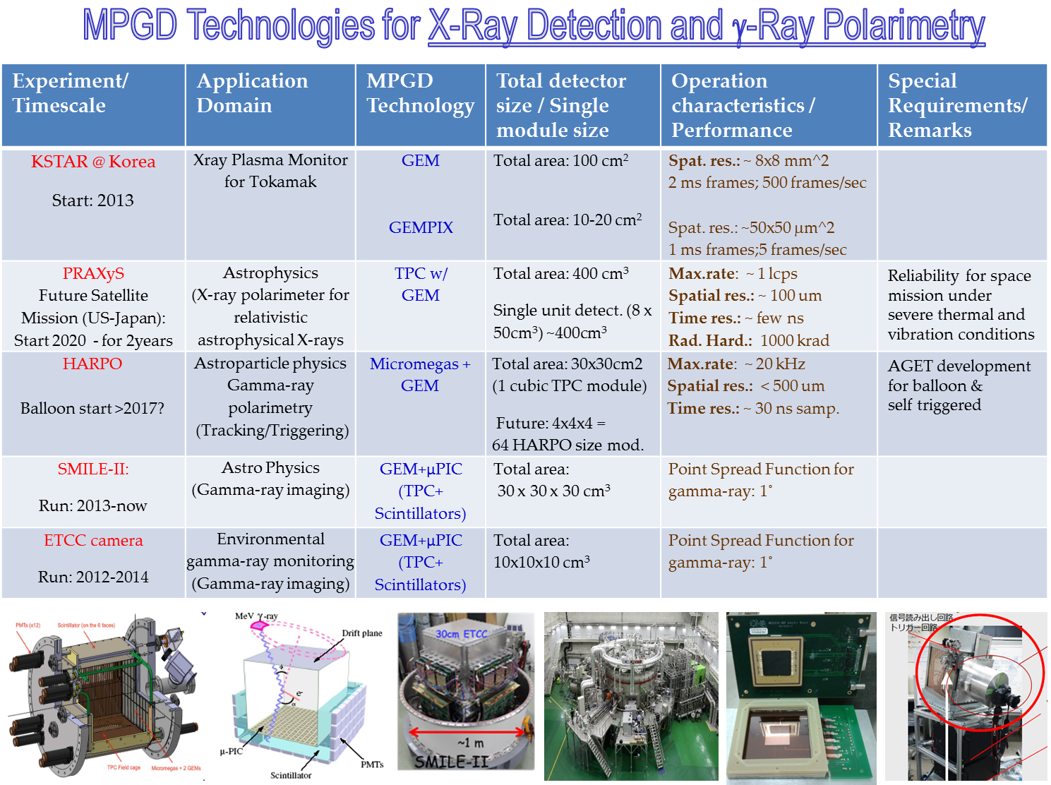
The MPGD family and their applications
Maksym Titov, Conference Summary, 5th International Conference on Micro-Pattern Gas Detectors (MPGD2017), Temple University, Philadelphia, updated at ICFA school 2023
This list is now almost 3 years old, is time to update it ☺
https://indico.cern.ch/event/581417/contributions/2558346/attachments/1465881/2266161/2017_05_Philadelphia_MPGD2017ConferenceSummary_25052017_MS.pdf

Slide 5
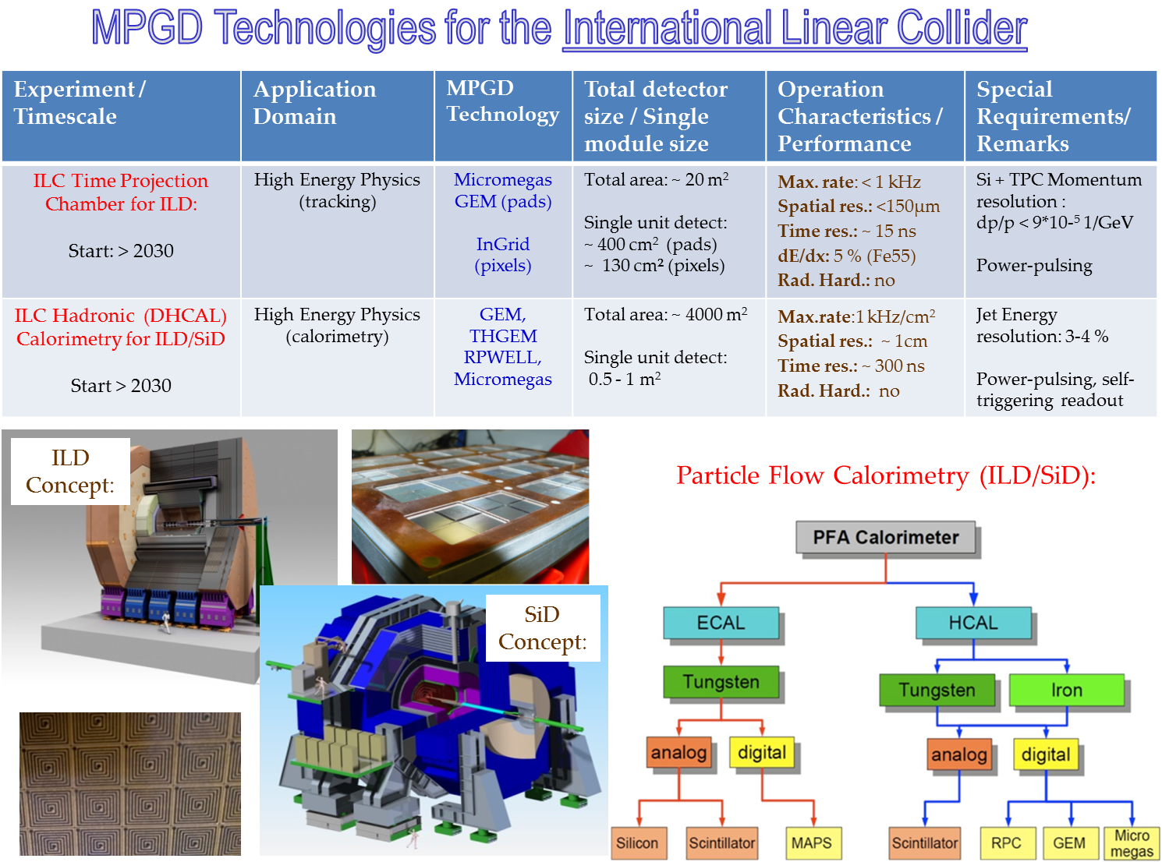
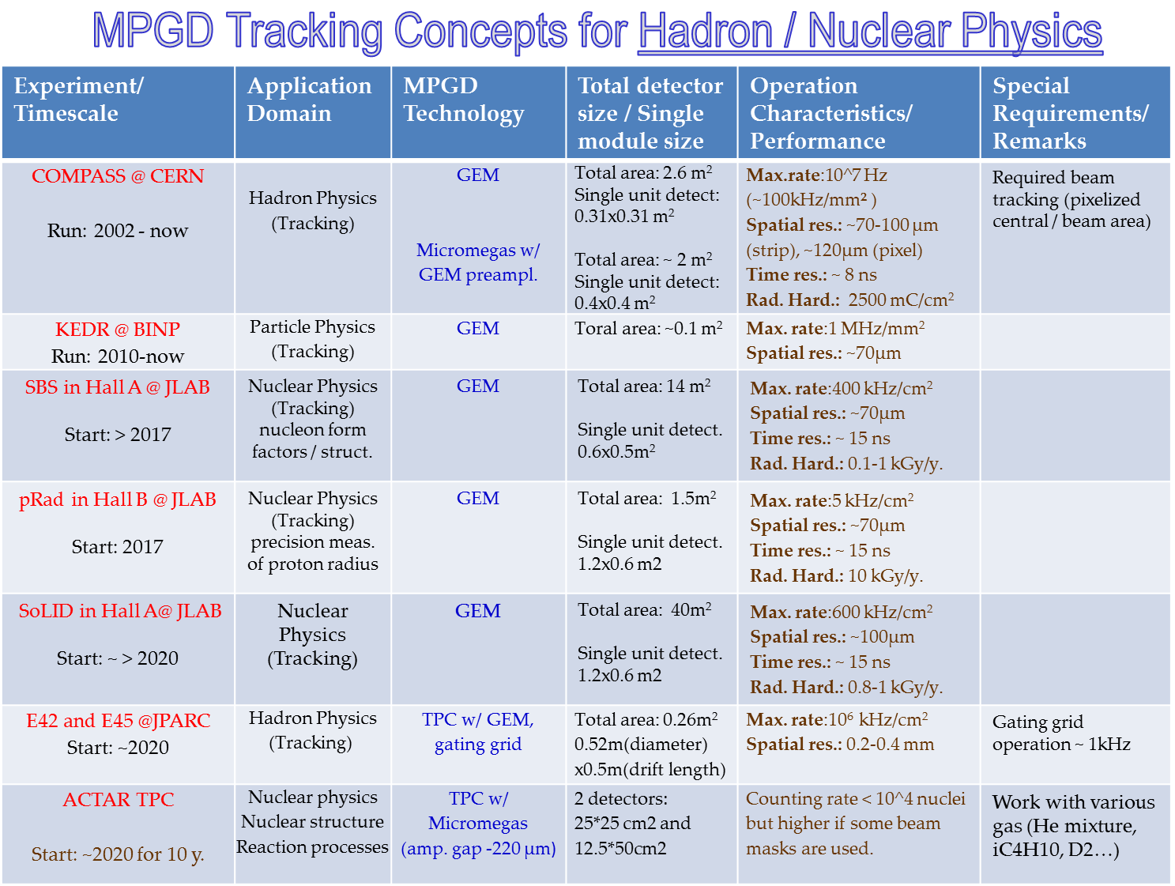
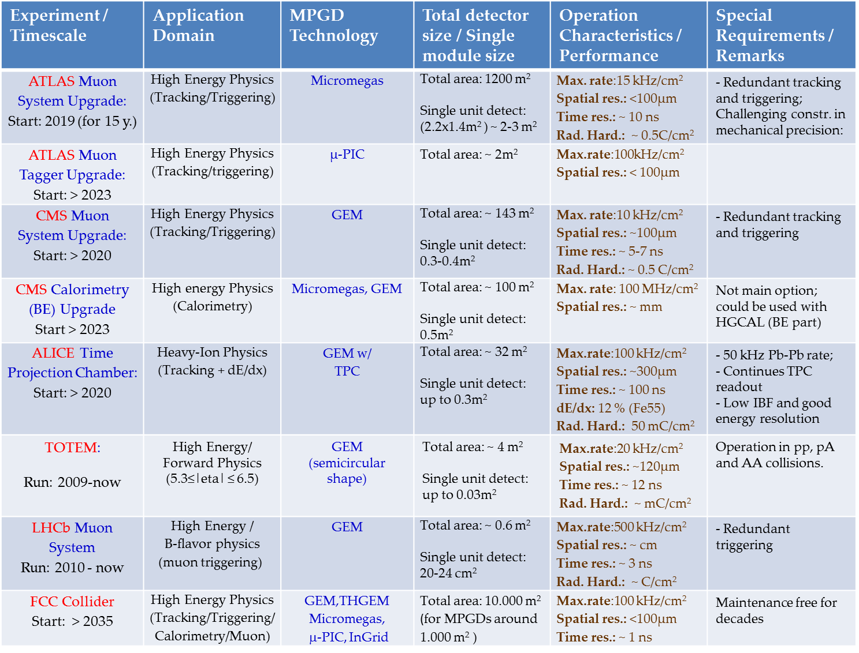
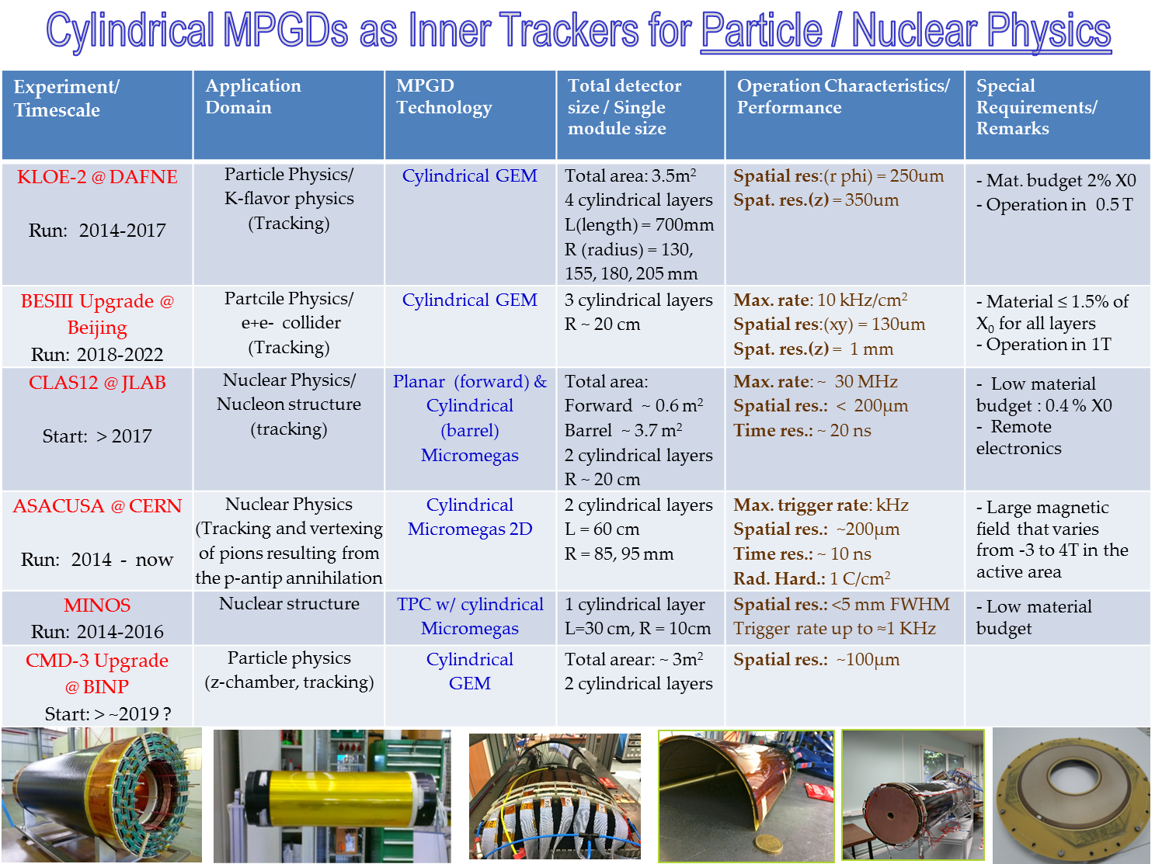
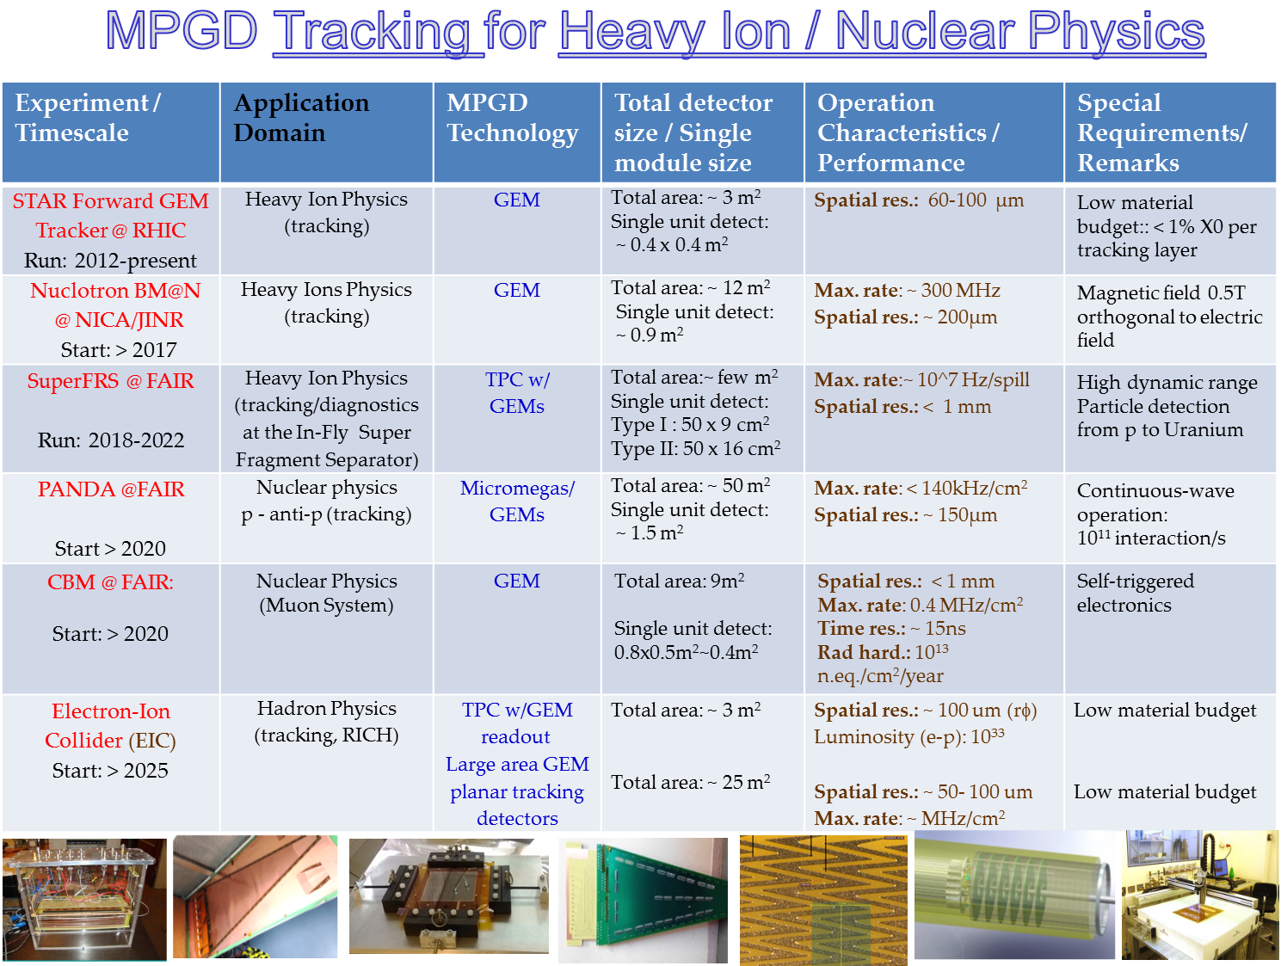
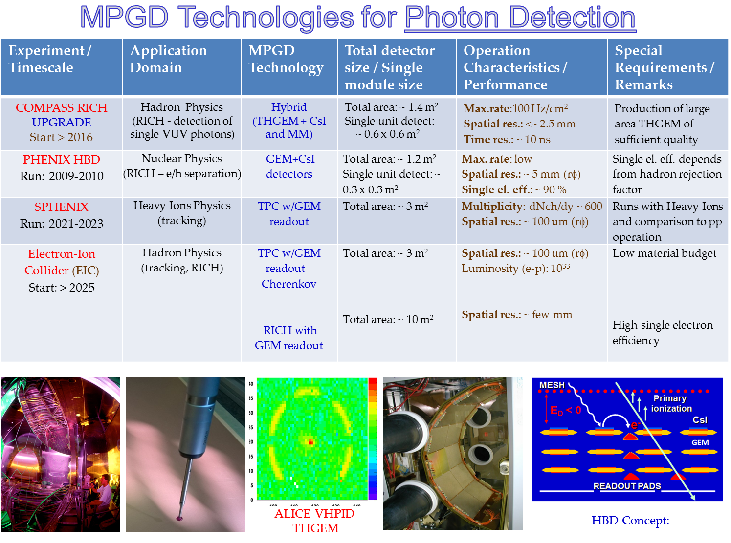
The MPGD family and their applications

Slide 6
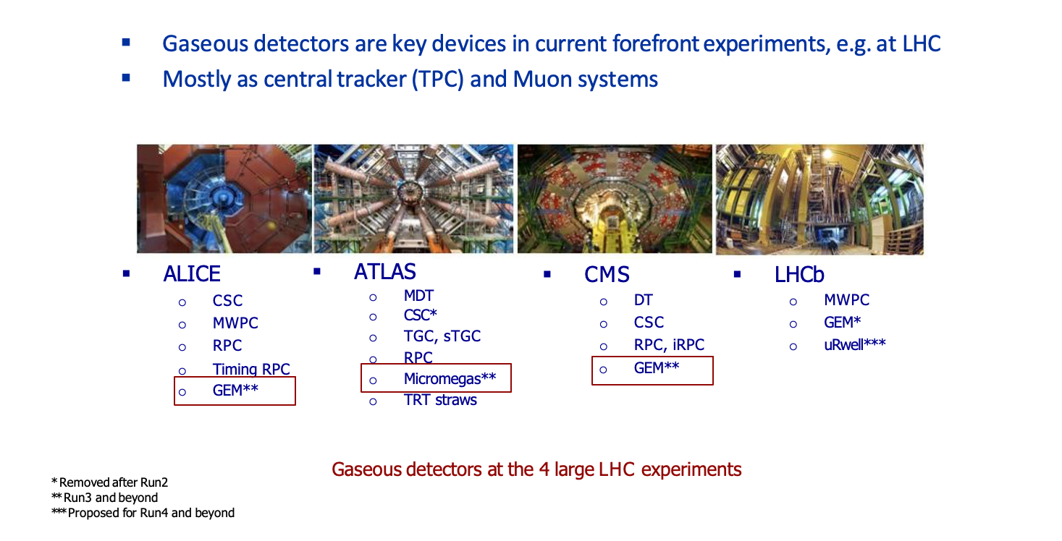
Gaseous & MPGD detectors at LHC

Slide 7





MPDG Application in HEP
Gaseous detectors are used in and are being developed for many HEP experiments
Each one challenging one or more performance or construction limits
Large detector surface for big experiments
Construction technique
Industrialisation
Maintenance
Time resolution
Fast gas
Multistage
Cherenkov
Space resolution
Granularity
Charge sharing
Time info (uTPC)
Si readout
Geometry
Planar
Cylindrical
Spherical
Rate capability
Space-charge reduction
Small-size readout
Fast readout
Gas mixture
Drift velocity
Diffusion
Amplification vs HV stability
Aging…
Spark protection
Resistive coating
Segmentation
Gas mixture
Aging/Longevity
Gas mixture
Materials

Slide 8
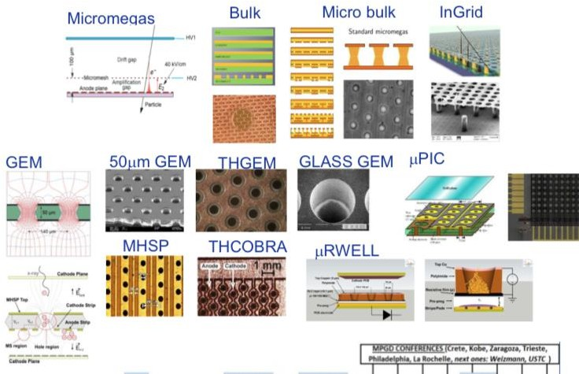
Disclaimer
Today the MPGD family includes a large number of detectors
Well established technologies adopted in HEP experiments
New ideas, R&D for future experiments or specific applications
Impossible to cover all the MPGD HEP applications
Will show few representative examples
Focus on LHC experiments and on GEM and Micromegas
What is not mentioned here is NOT less relevant!
E. Oliveri, ECFA 2021

Slide 9
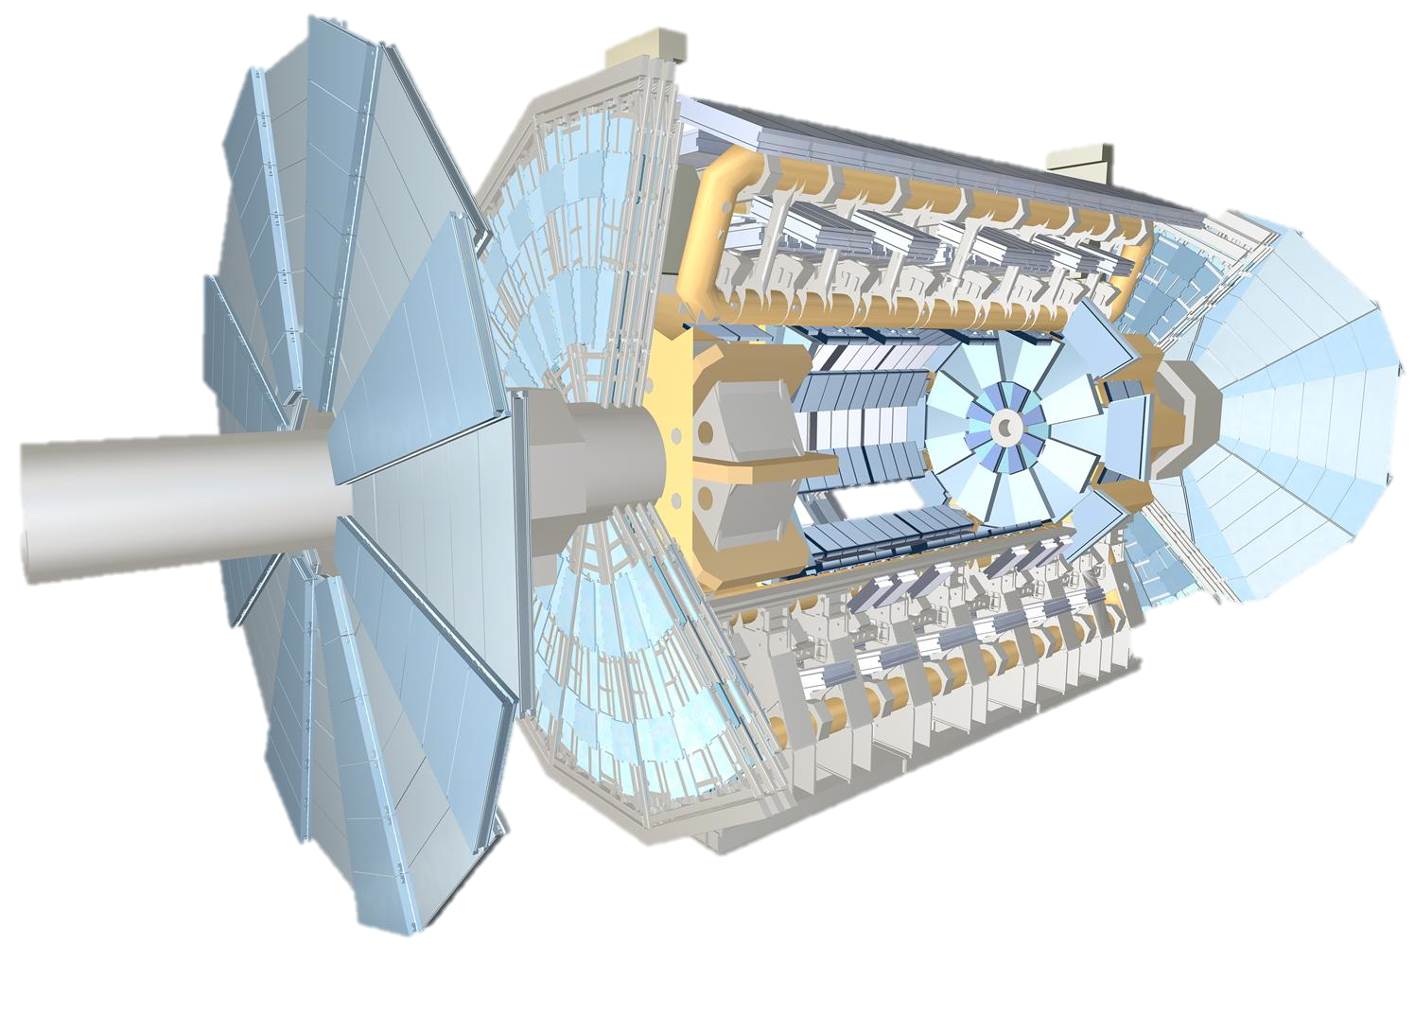
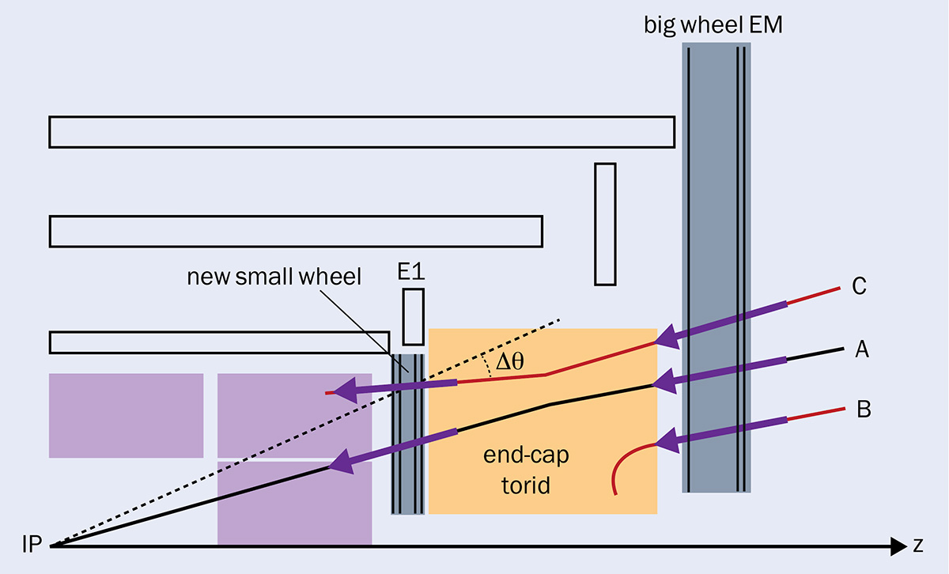
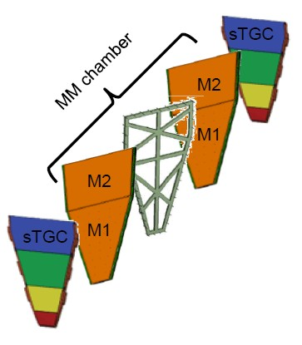
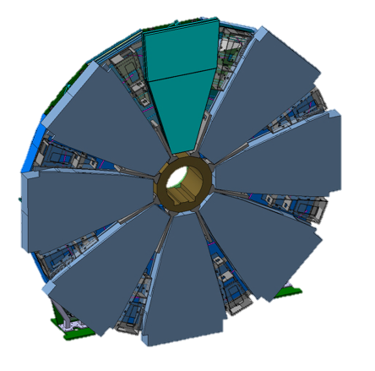

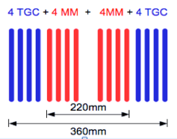
Micromegas for the ATLAS NSW
Main ATLAS upgrade during the Long Shutdown 2 (2019/20) (Phase-1)
SM2
Each NSW has 16 sectors 8 Large + 8 Small
Two diﬀerent technology:
MM (main role tracking)
sTGC (main role trigger)
SM1
LM2 LM1
NSW Requirements
~10 m
15% P_{T} resolution at 1 TeV
→ ~100 μm resolution per plane
Keep single muon trigger under control
→ 1 mrad online angular resolution
About 15kHz / cm² at L ≈ 5 x 10³⁴ cm^{-­‐2}s^{-­‐1}

Slide 10
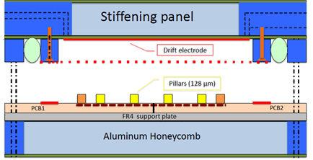
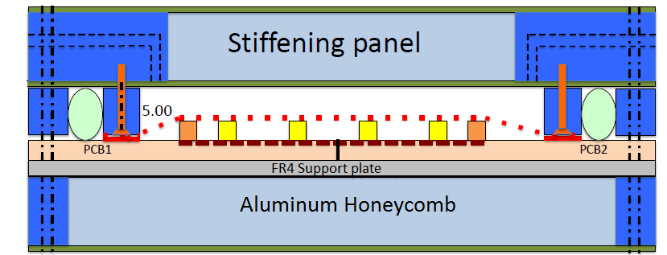
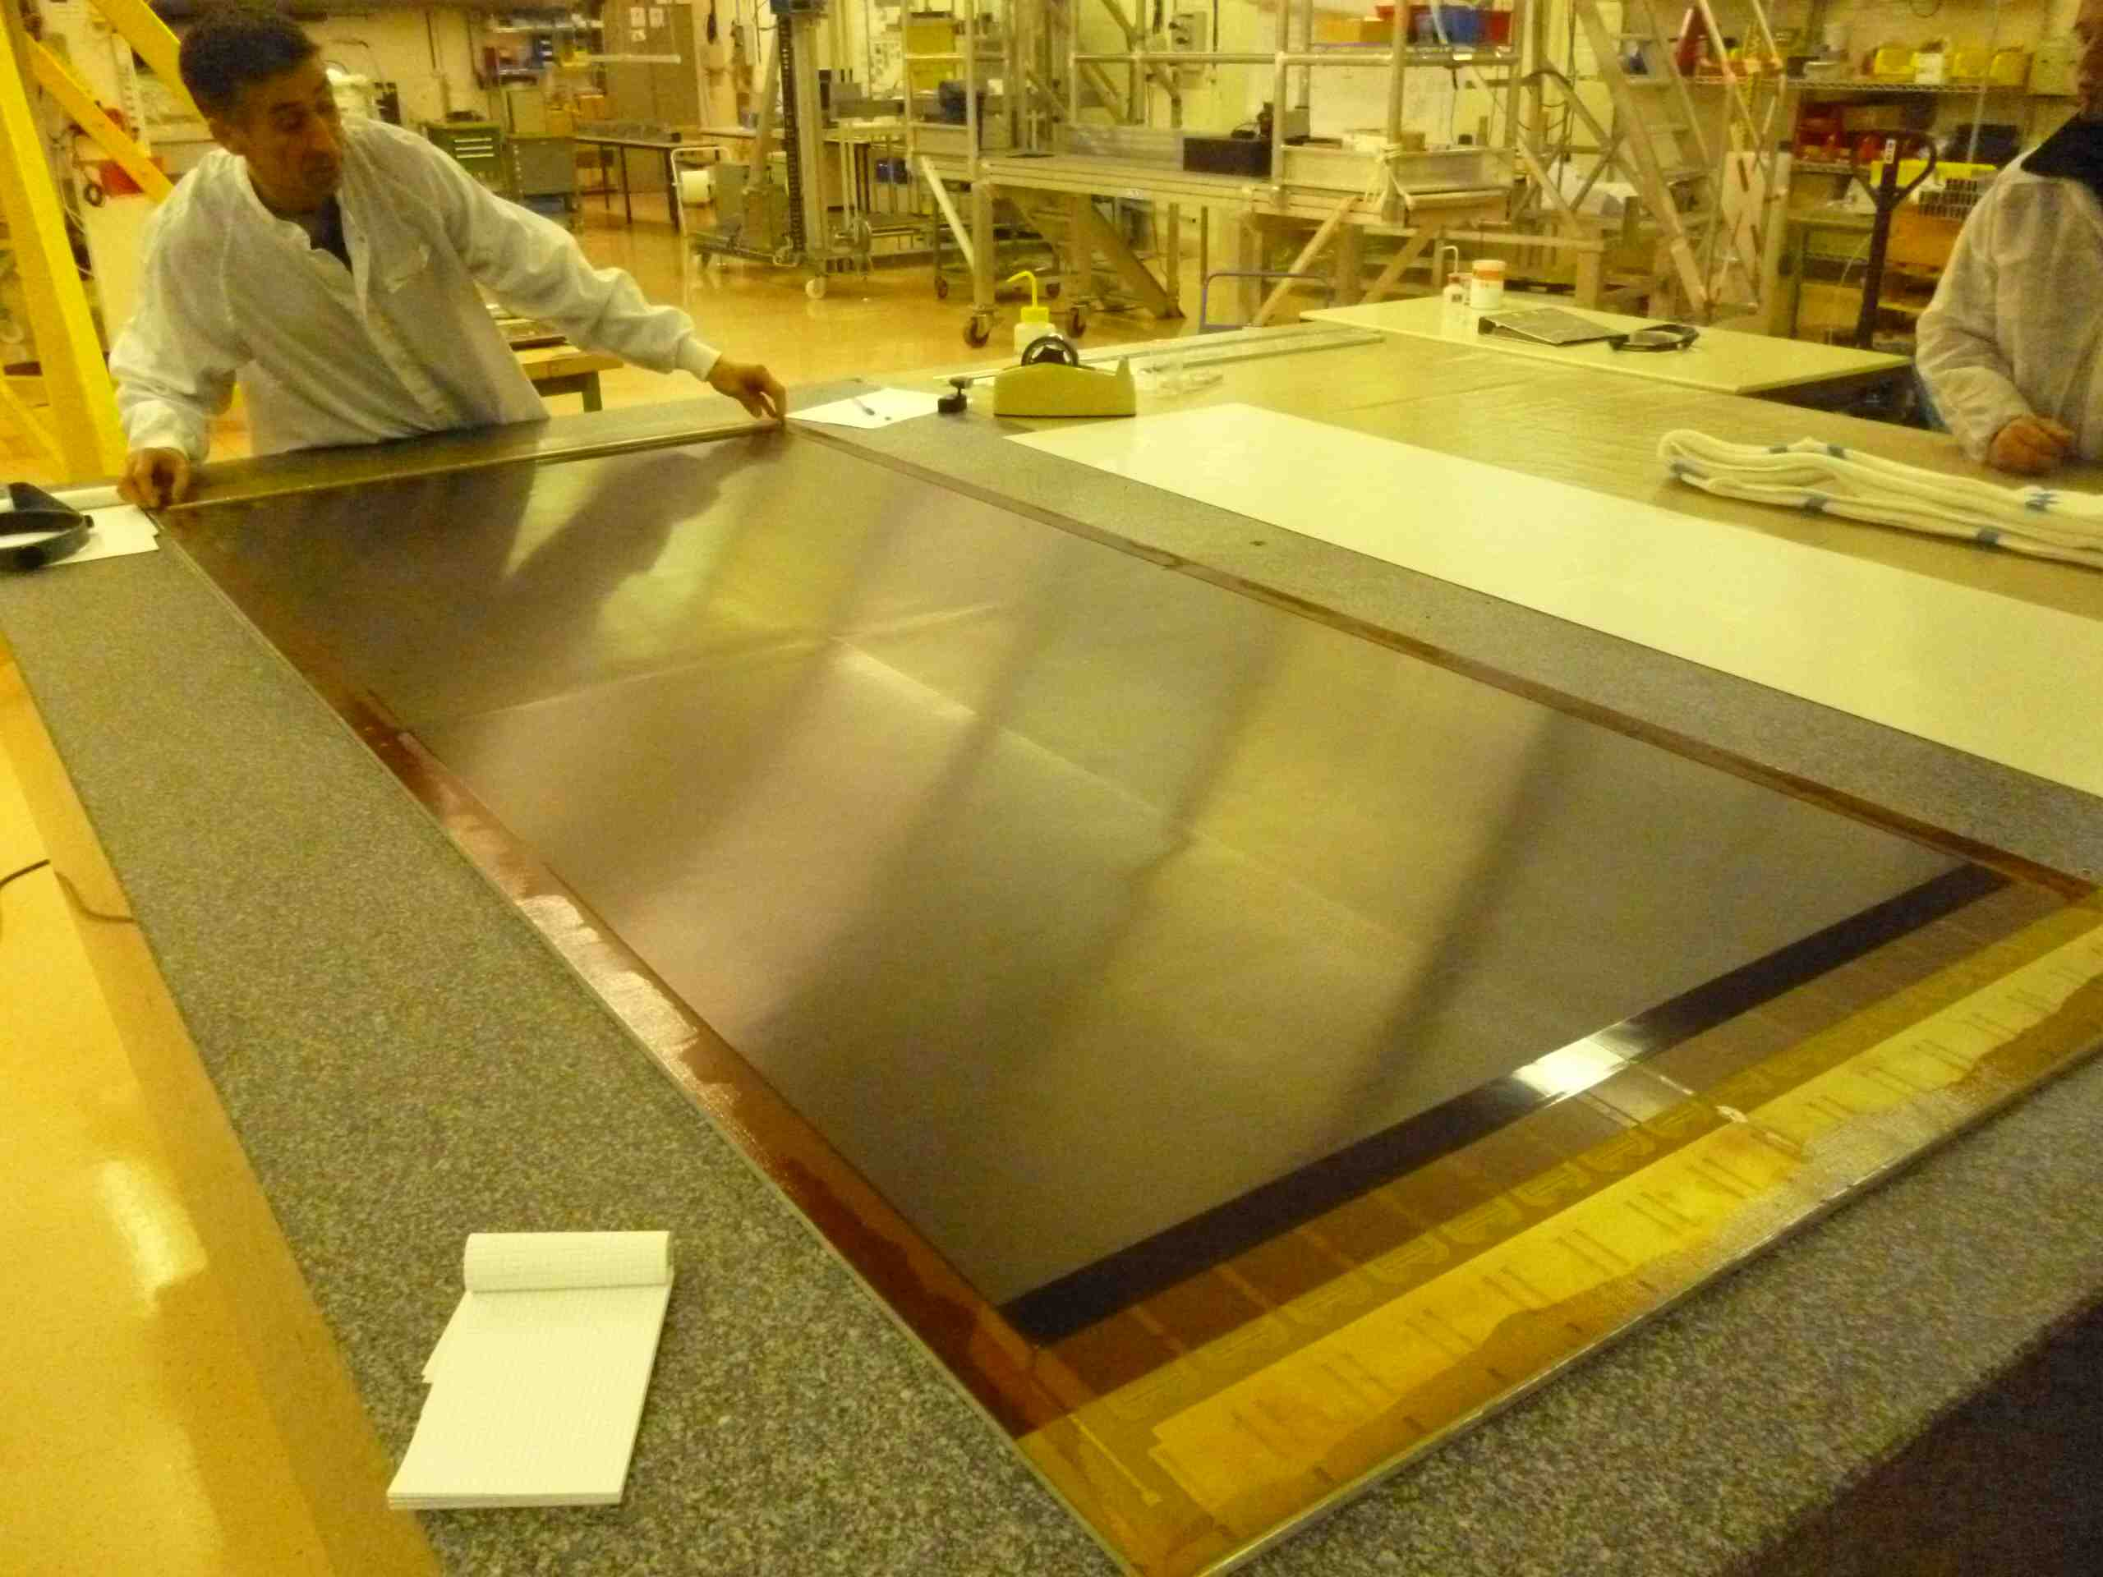
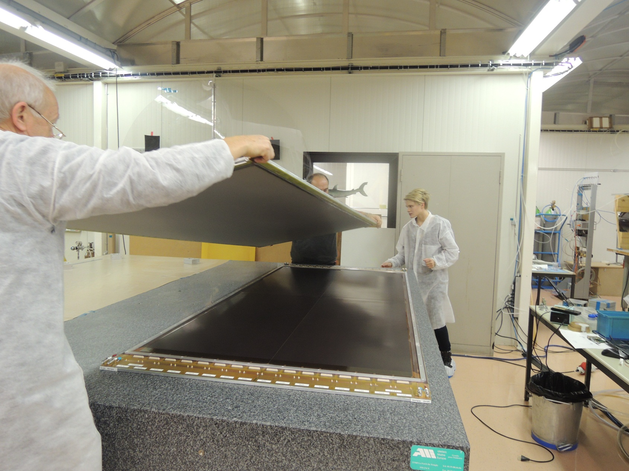
Building large Micromegas: Non-bulk technique
Non-bulk technique (floating mesh) that uses also pillars to keep the mesh at a defined distance from the board, the mesh is integrated with the drift-electrode panel and placed on the pillars when the chamber is closed. This allows us to build very large chambers using standard printed circuit boards (PCB)

Slide 11
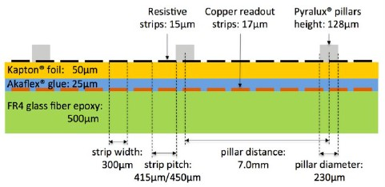






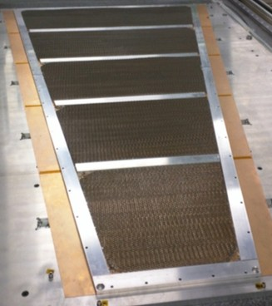
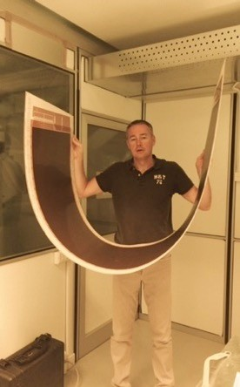




Micromegas for the ATLAS NSW
50µm Kapton with resistive strips
MM Quadruplet Exploded View Building Large Area MM
PCB + readout strips
1 – External Drift Panel
25µm solid Glue
RO PCB
Cathode
Mesh
High temp and high pressure
Gluing
170 degrees
12 kg/cm²
2 – Stereo Read-Out Panel
Stereo Angle : +/- 1.5 degrees
Pillars creation
2 x 64µm Pyralux lamination
3 – Central Drift panel
Each Panel is about 11mm thick
Half Panel
4 – Eta Read-out Panel
Mesh: Steel Wire Dia 30 µm; Pitch 100 µm
5 – External Drift Panel
ρ = 50 kg/m³
Five panels joined to make a detector unit (Quadruplet) with 4 gas layers.
Max PCB Length : 2.2m

Slide 12
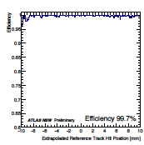
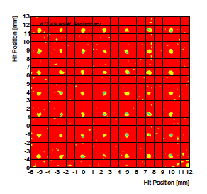
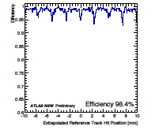
ATLAS MM Efficiency studies
Hit reconstruction efficiency as a function of the extrapolated reference track hit for a single
readout chamber of T type (10 x 10 cm2).
Left plots corresponds to the reconstruction efficiency obtained by using vertical track, while the central plots reports efficiency obtained with 30⁰ inclined track.
The efficiency deeps ( about 5%) appearing every 2,5 mm correspond to the pillar structure supporting the mesh, the effect of the pillars became less evident with the inclined track which produce larger clusters.
On the right side a 2D efficiency plots for a T chamber, the pillar grid is structure is clearly eveident

Slide 13
ATLAS MM performance in magnet field
The MM chambers of the NSW are operated in a magnetic field of a magnitude up to about 0.3 T with different orientations with respect to the chamber planes but a sizable component orthogonal to the MM electric field.
The effect of the magnetic field on the detector operation has been studied with test beam data and simulations.
The drift direction of the ionization electrons is tilted with respect to the electric field direction by the Lorentz angle θL .
The tilt of the drift direction gives a sizable shift (δx) of the reconstructed hit position.
At the singular configuration, the bad performance of the μTPC method is compensated by the good performance of the cluster centroid method, due to the very small cluster size. A combination algorithm can be applied to have a constant resolution through all configurations

Slide 14
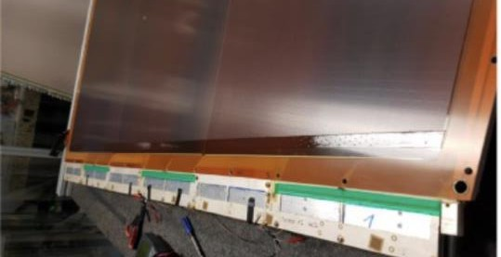
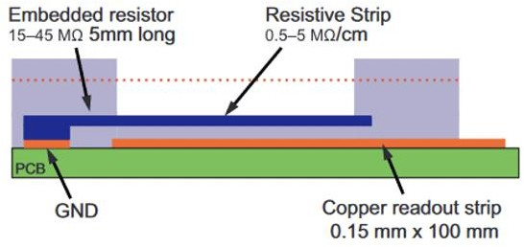

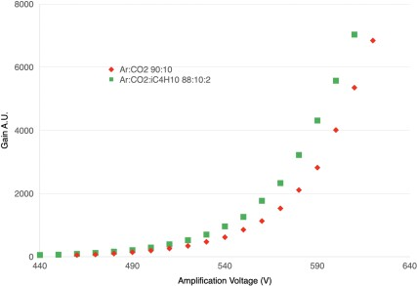
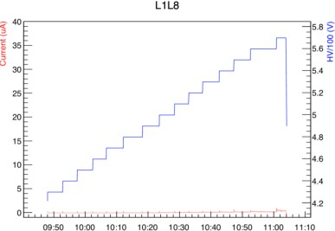
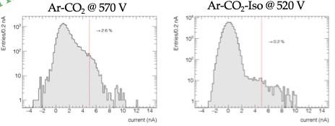

Adding a quencher
Several action taken to further suppress HV instabilities, among which:
Edge passivation
Gas mixture changed from Ar:CO2 93:7 to Ar:CO2:iC4H10 93:5:2
→ reduced voltage at same gain; suppress tail of events with high charge
Passivation technique: increase the minimum distance between the active area and the HV line (DOCA= Distance Of Closest Approach) → increase of minimum resistance
Ar:CO2 93:7
Ar:CO2:iC4H10 93:5:2
HV stability improved by adding 2% of iC₄H₁₀

Slide 15



Micromegas for the ATLAS NSW
Spatial Resolution of the precision coordinate
Entries / (0.02 mm)
500
χ² / ndf 27.54 / 9
Prob 0.001139
Constant 489.9 ± 11.8
Mean 0.02562 ± 0.00158
Sigma 0.08136 ± 0.00141
Well within requirements
χ² / ndf 27.54 / 9
Prob 0.001139
Constant 489.9 ± 11.8
Mean 0.02562 ± 0.00158
Sigma 0.08136 ± 0.00141
400
ATLAS NSW Internal
300
σ = 81 μm
Precision
200
gaussian
coordinate from
Evts in Fit range = 95%
Eta Layer 1-­‐2
100
diﬀerence /√2
0.4 0.6 0.8
(L1_x - L2_x)/sqrt(2) [mm]
0
−1
−0.8
−0.6
−0.4
−0.2
0
0.2
1
Efficiency turn on curve comparing the performances of the 2 gas mixture under study: Ar: CO2 (93: 7) (red) and Ar: CO2: iC4H10 (93: 5: 2)
Cluster width (top left), mean cluster charge (top right) and efficiency (bottom) of different layers of the NSW as a function of the amplification voltage

Slide 16




ATLAS Micromegas
NSW does the job in fake trigger suppression
Resolution vs track impact angle with cluster centroid in pp collision in ATLAS (no alignment correction, no time correction).
uTPC technique not exploited yet in ATLAS

Slide 17



Data from ATLAS NSW
T. Vafeiadis, The New Small Wheel project of ATLAS, CERN EP Detector Seminar 17/6/2022, https://indico.cern.ch/event/1168778/attachments/2464624/4227403/_2022_0 6_17-TV-DetSeminar.pdf
151st LHCC Meeting - OPEN Session, ATLAS Status Report by T. J. Khoo, https://indico.cern.ch/event/1192325/contributions/5012980/attachments/2507852/4309670/LHCC_ 20220914.pdf

Slide 18

ATLAS NSW

Slide 19







GEM for CMS Experiment
Two different shapes (long and short) to fit the CMS mechanical structure
The GEM upgrade: three new stations GE1/1, GE2/1 and ME0 based on the triple-GEM technology
10º
ORT AND LONG SCs
tonio Conde 15/10/2013
RO board
Frame
GEM foils
+ spacers
Drift board

Slide 20





GEM for CMS Experiment
https://indico.cern.ch/event/1175363/attachments/2477073/4252122/MBianco_CMS_GEM.pdf

Slide 21




GE1/1 Production and QA/QC
“Single-chamber” production summary:
Successful and on-time production of both endcaps from Sept. 2017 to Dec. 2018
In total 161/144 GE1/1 detectors:
2 used for R&D activities
(aging and discharge studies)
3 required in-depth investigation (discarded)
156 fully validated up to QC5
(yield $>97\%$)
“Super-chamber” production summary:
100% completed (76/72 needed in CMS)

Slide 22


The process and the manuals
Manual for production site inspection and validation
Manual for chamber assembly (+ dedicated papers)
Manual for chamber qualification and certification
Assembly video tutorial illustrates the preparation and the assembly (1,5 h video)
Assembly training at CERN, 10 sessions, components of all production sites

Slide 23



GE1/1 Installation

Slide 24


Data from CMS GEM GE1/1
M. Bianco, The GEM detectors within the CMS Experiment, CERN EP Detector Seminar, 8/7/2022, https://indico.cern.ch/event/1175363/

Slide 25



CMS GE2/1 Station
Triple-GEM technology (same as GE1/1)
36 GE2/1 chambers per end-cap, organized in two layers of 18 chambers
Each chamber consists of 4 GE2/1 modules
288 modules in total
Two different types of chambers to avoid the overlapping of dead areas
8 different module designs called M1 to M8
Installation after LS3
GE2/1 First Design (M. Bianco 2016)

Slide 26


CMS ME0 Station
The ME0 detector system is a layered
Expected Hit Rate → [2, 144] kHz/cm²
Average primary energy deposit 5.8 keV i.e. 200 e-ion pairs
stack of 6 triple-GEM detectors (70:30 Ar/CO2 fill gas)
18 stacks per endcap (36 total stacks; 216
modules total)
ME0 detector system to increase coverage from 2.0 < |η| < 2.8
HIP: Heavily Ionizing Particle which deposits >30 keV in the detector
HIP rate → [0.05, 4] kHz/cm²
Module segmented into 8 readout partitions in η and 3 in φ (24 total RO sectors)
Need to evaluate the impact on detector operation
ME0

Slide 27





Rate capability and HV-drop compensation
Gas gain drop estimated evaluating the HV drop on the protection resistors due to the current flowing on the electrodes -> possibility to compensate for HV drop
But in ME0 each HV sectors, as a function of the eta are expected to get different integrated flux, depending on the background shape
How to compensate different drop with a unique HV channels?
A) Different HV sector area, to equalize the flux?
B) Different protection resistors, to equalize the HV drop across the sectors?
Combination of A) & B)?
Possible HV drop equalization playing with the HV sectors area (case A)

Slide 28






New HV segmentation for ME0 GEM Foils
ME0 environment:
- Large rate variation between the coolest and the hottest HV segments ( about two orders of magnitude)
ME0 prototype
ME0 expected range
New segmentation introduced
→ Change the orientation of the HV segment → “vertical pattern”
→ Each segment will see the full BKG gradient i.e. collect the same current as the neighbor segments
→ No dependency with the BKG shape
→ Uniform current across all segment
→ Uniform voltage drop that can be globally compensated
Measured effective gas gain as a function of the expected hit rate on the whole electrode area in the ME0 station.
The compensation is obtained by applying overvoltages to each electrode separately to compensate the voltage drop induced by the moving charges in the gas.
→ A first prototype was assembled and tested in summer 2021
→ Reduced protection resistors based on past discharges studies (2 MΩ top, 100 kΩ bottom)
→ Both filter resistance and protection resistance are “merged” to minimize the overall HV resistance
The egg of Columbus

Slide 29




GEM in ALICE Experiment
σ (%)
20
U
/U =0.8
U
/U =0.95
18
GEM3 GEM4
GEM3 GEM4
U =235 V
U =235 V
GEM2
U =255 V
GEM2
U =255 V
16
GEM2
GEM2
For TPC fundamental the IBF suppression!!!
U =285 V
U =285 V
14
GEM2
GEM2
12
10
Three measures to suppress the ion back flow into drift region:
Low gain in GEM 1, highest in GEM 4
Two layers of large pitch (LP) foils (GEM2 and GEM 3) block ions from GEM 4
Very low transfer filed E_{T3} (100 V/cm) between GEM3 and GEM4
8
6
0.0 0.5 1.0 1.5 2.0 2.5 3.0
IBF (%)
Performance with optimized HV configuration
IBF = Ion BackFlow, σ = energy resolution for ⁵⁵Fe

Slide 30





GEM in ALICE
https://indico.cern.ch/event/1172978/attachments/2468524/4234156/2022_06_24_CERN_Seminar_rmunzer_v4.pdf

Slide 31







GEM: KLOE, Totem, LHCb, …..
KLOE Cylindrical Triple-GEM
Totem Circular Triple-GEM
Beam pipe
LHCb Rectangular Triple-GEM

Slide 32

Cylindrical Micromegas

Slide 33

Cylindrical GEM

Slide 34
Application beyond HEP

Slide 35


Muon Tomography
cosmic muons: primary cosmic radiation (mainly protons) hit atmosphere → hadronic interactions → pions & kaons → decay into muons
lifetime 2.2µs but p_{µ} ~ 4GeV → decay length O(20km)
rate ~ 1/s dm²
angular distribution ~ cos² ϑ
no hadronic interactions, no bremsstrahlung → can traverse large scale or shielded structures
Procureur, NIMA878

Slide 36




“Muography”: Concept
1) Scattering process at the base of the Muon Tomography
● tracklet upstream & downstream of object → point of closest approach
● object thin enough: only one major scattering event
2) muon metrology
●no object, compare tracklets in two trackers → determine relative position
3) absorption-based (transmission)
● muons have finite range in matter + polyenergetic spectrum → more muons absorbed by more opaque material
● determine change in muon flux w.r.t. free sky measurement → opacity along line of sight
● objects of several 100m thickness

Slide 37

Which Detector and Instrument?
nuclear emulsions
no power during acquisition very
good spatial resolution
lengthy off-line readout (scanning)
50x50cm² resistive multiplexed Micromegas CEA Saclay
plastic scintillators
online events
coarse spatial resolution
gaseous detectors
good spatial resolution
online events
power & gas supplies needed temperature & pressure dependence
Bouteille NIMA834

Slide 38



Saclay water tower “Muography”
Four 50x50cm² Micromegas
test autonomous operation
implement correction for pressure & temperature variations
image water tower at Saclay, also during yearly emptying
→ dynamic imaging outdoors possible
Bouteille NIMA834

Slide 39


Muography: Khufu's Pyramid
Scan Pyramids project
new void
combined measurements with emulsion, scintillators, Micromegas
Unknown void (length>30m) discovered
Two Micromegas telescopes
four 50x50cm² resistive multiplexed Micromegas each
10⁷ track candidates in 2 months
35W power consumption
known void
Mosishima 10.1038/nature24647

Slide 40

Neutron detection
Neutron interaction in typical gas mixtures quite unlikely
→ „convert” into charged particle
→ use MPGD features (spatial resolution, timing, …) to register charged products
Solid converters ⁶Li(n,α)³H, ¹⁰B(n,α)⁷Li, U(n,f), ...
→ strongly ionizing charged particles
charged particles only useful inside gas
→ limited thickness → single layer efficiency ~ 5%
multi-layer grazed incidence
Solid converter Gd: (n,gamma) → electrons, photon
High energy n: elastic interaction
similar-mass interaction partners
add He or protons (CH₄, C₄H₁₀) to gas mixture
(thick) plastic + (thin) aluminum window
Croci MPGD19

Slide 41
Clinical-medical applications
Diagnostics and treatment monitoring heavily based on particle and photon detectors
Different level of reliability, accuracy and fail safety needed, if radiation used on
Living being's non-laboratory environment: supplies, operation by non-experts,
Construction, certification medicine is conservative environment
Experimental operation ethically difficult
New technologies only accepted, if considerably better than previous
Imaging
pre-clinical photon imaging
(non-clinical) positron emission imaging
ion radiography and tomography
Beam monitoring and control
beam monitor chambers for pre-clinical and clinical radiation
Dosimetry and beam characterization
characterization of (pre-)clinical treatment beams

Slide 42



It’s a long, long way… from a personal perspective
…almost a quarter of a century spent among gas detectors
ATLAS RPC 2002-2012
Mass-Production / Certification / Installation / Commissioning / Operation
ATLAS Micromegas 2012-2015 (& 2021)
Design / R&D / Characterization / Final Prototype /bInstallation
CMS GEM 2016-2026
Design / R&D / Characterization /Mass-Production / Certification / Installation / Commissioning / Operation

Slide 43
Reference (Talks/Workshops)
CERN EP Department - R&D on experimental technologies 1st WG2 Meeting https://indico.cern.ch/event/702148
CERN EP Department - R&D on experimental technologies https://indico.cern.ch/event/696066/contributions/2927894/attachments/1618327/2573211/RDonGaseousDetectorTechnologies.pdf
ECFA Detector R&D Roadmap Symposium of Task Force 1 Gaseous Detectors https://indico.cern.ch/event/999799/
Mini-Workshop on gas transport parameters for present and future generation of experiments https://indico.cern.ch/event/1022051/timetable/?view=standard
https://indico.desy.de/event/22513/contributions/46788/attachments/30337/38104/20200224-EDIT-GaseousDetectors.pdf
https://indico.cern.ch/event/1120714/contributions/4867134/attachments/2469534/4236245/MBianco_Poster_for_iWorid2022_V2.pdf
https://indico.cern.ch/event/999799/contributions/4204334/attachments/2236247/3790326/infrastructures.pdf
CERN Detector Seminar: https://indico.cern.ch/event/1175363/attachments/2477073/4252122/MBianco_CMS_GEM.pdf
CERN Detector Seminar: https://indico.cern.ch/event/1168778/attachments/2464624/4227403/_2022_06_17-TV-DetSeminar.pdf
CERN Detector Seminar: https://indico.cern.ch/event/1172978/attachments/2468524/4234156/2022_06_24_CERN_Seminar_rmunzer_v4.pdf
Workshop on Resistive Coatings for Gaseous Detectors : https://agenda.infn.it/event/18156/timetable/?view=standard
M. Bianco, EURIZON Detector School | Gaseous Detectors | 17th-28th 2023 Wuppertal

Slide 44
References:
-) G. Macini, et al,. “Validation of the New Small Wheel Micromegas sectors for the phase1 upgrade of the muon forward spectrometer of the ATLAS experiment at CERN” Phys. Scr. 98 (2023) 044007
-) Bencivenni, R. De Oliveira, G. Morello and M.P. Lener, “The micro-Resistive WELL detector: a compact spark-protected single amplification-stage MPGD”, 2015 JINST 10 P02008
-) G. Bencivenni et al, “The μ-RWELL layouts for high particle rate”, 2019 JINST14 P05014
-) K. Dehmelt, et. al,“Snowmass 2021 White Paper Instrumentation Frontier 05 White Paper 1: MPGDs: Recent advances and current R&D”, arXiv.2203.06562v3
-) S Duarte Pinto et al 2009 JINST 4 P12009
-) Paolo Iengo, Givi Sekhniaidze “Irradiation and longevity test of Resistive Micromegas detectors”, PoS (ICHEP2022)351
-) E. Farina, et. al,. “Resistive Micromegas high-rate and long-term ageing studies at the CERN Gamma Irradiation Facility”, NIM A 1042 (2022) 167423
-) F. Sauli, “The gas electron multiplier (GEM): Operating principles and applications”, NIM A, 386 (1997), p. 531
-) S. Bachmann, et al. “Charge amplification and transfer processes in the gas electron multiplier”’ NIM A, 438 (1999), p. 376
-) A. Bressan, et al. “Two-dimensional readout of GEM detectors”, NIM A, 425 (1999), p. 254
-) A. Bondar, et al. “Study of ion feedback in multi-GEM structures”’, NIM A, 496 (2003), p. 325

Slide 45
References:
-) M. Villa, et al. “Progress on large area GEMs ”, NIM A, 628 (2011), p. 182
-) H. Fenker, et al. “BoNus: Development and use of a radial TPC using cylindrical GEMs”, NIM A, 592 (2008), p. 273
-) A. Balla, et al. “Construction and test of the cylindrical-GEM detectors for the KLOE-2 Inner Tracker”, NIM A, 732 (2013), p. 221
-) P. Everaerts, “Rate capability and ion feedback in GEM detectors”, (Thesis at Gent University 2006)
-) F. Sauli, “GEM readout of the time projection chamber”, CERN-EP-TA1 Internal Report (1999)
-) ALICE_Collaboration, “Technical Design Report for the Alice Time Projection Chamber”, 2014.
-) Va’vra, A. Sharma “Single electron detection in quadruple-GEM detector with pad readout”, NIM A, 478 (2002), p. 235
-) R. Bellazzini, et al. “Imaging with the invisible light”, NIM, 581 (2007), p. 246
-) Murtas, F. “The GEMPix Detector”, https://doi.org/10.1016/j.radmeas.2020.106421
-) Leidner, J., Murtas, F., Silari, M., “Medical Applications of the GEMPix”, Appl. Sci. 2021,11, 440. https://doi.org/10.3390/app11010440
-) Leidner, J., Ciocca, M., Mairani, A., Murtas, F. and Silari, M., “A GEMPix‐based integrated system for measurements of 3D dose distributions in water for carbon ion scanning beam radiotherapy”, (2020) Med. Phys., 47: 2516-2525. https://doi.org/10.1002/mp.14119

Slide 46
References:
-) F.Sauli, Yellow Report, CERN-77-09 (1977)
-) F. Fallavollita, “Novel triple-GEM mechanical design for the CMS-ME0 detector and its preliminary performance”, 2020 JINST 15 C08002
-) M. Bianco, et. al.,”Rate capability of large-area triple-GEM detectors and new foil design for the innermost station, ME0, of the CMS endcap muon system”, arXiv:2201.09021v1
-) F. Fallavollita, “Aging phenomena and discharge probability studies of the triple-GEM detectors for future upgrades of the CMS muon high rate region at the HL-LHC”, NIM , A 936 (2019) 427–42
-) A. Colaleo, P.Verwilligen, et al, “Diamond-Like Carbon for the Fast Timing MPGD” 2020 J. Phys.: Conf. Ser. 1498 012015
-) M. Iodice et. al., “Small-Pad Resistive Micromegas: rate capability for different spark protection resistive schemes”, 2020 JINST 15 C09043
-) R. De Oliveira, M.Maggi, A. Sharma, “A novel fast timing micropattern gaseous detector: FTM”. arXiv:1503.05330 (2015)
-) J. Bortfeldt, et. al., “PICOSEC: Charged particle timing at sub-25 picosecond precision with a Micromegas based detector”, arXiv:1712.05256v

Slide 47
Backup

Slide 48









Lessons Learnt: Discharge Protection, GEM Foils double segmented
In GE1/1 Slice test observation of discharge propagation and experienced VFAT3 channel loss
Discharge probability
Propagation probability
Damage probability
Channel loss
∝
x
x
The most effective mitigation consists of reducing the probability of discharge propagation
Step 1: initial GEM discharge Step 2: precursor current Step 3: discharge propagation
𝑡~10 𝑛𝑠
Hot spot
𝑡~5 𝜇𝑠
𝑡~15 𝜇𝑠
Basic principle:
HV segments on the top: GEM protection against regular discharges
HV segments on the bottom: protection against discharge propagation

Slide 49





Lessons Learnt: Discharge Protection, GEM Foils double segmented
Side Effect - Crosstalk
Reducing the size of the HV segments on the last GEM increases the HF impedance to ground → Induces cross-talk; In case of large signal amplitudes, the corresponding crosstalk signals can trigger the electronics
Other HV partitions are not affected
Trigger rate
Threshold (DAC units)
X-talk
GE1/1 triple-GEM Ar/CO2 (70/30%)
241_{Am}
VFAT3
Source signal
Detector Strip Number
SOLUTION: the “mixed” design
GEM1 and GEM2 are double-segmented to prevent the discharge propagation
GEM3 is single-segmented to suppress the crosstalk
Full description @ https://indico.cern.ch/event/976526/ Summary of discharge studies in CMS GEM in (Annex D)

Slide 50





Lessons Learnt: Internal Frames
Fraction of Intrinsic Noise from the Internal Frames
Old shape Internal frame
New shape Internal frame

Slide 51








Lessons Learnt: Pillars
GE1/1 bending:
DRIFT and RO PCBs tend to bend when submitted to stretching forces, causing non-negligible variations of gain across the detector surface
(Different level of non uniformity)
Typical GE1/1 Uniformity
Pillar to constraint Drift Vs RO
FR4 pillar with SS cylinder
Stratified FR4 pillar with SS cylinder
GE2/1 ( M2 )Uniformity

Slide 52



GEM Rate Capability
The rate capability of GEM-based detectors has been extensively studied in the last decade for different sizes, geometries, and configurations
Ar/CO2(70/30) – 3/2/2/2mm
J.Merlin
https://cds.cern.ch/record/2155685/files/CERN- THESIS-2016-041.pdf
Ar/CO2(70/30) – 3/2/2/2mm
P. Everaerts
https://cds.cern.ch/record/1316179/files/CERN-THESIS- 2006-088.pdf
Ar/CO2(70/30) –
3/2/2/2mm
P. Thuiner
https://cds.cern.ch/record/2238855/files/CERN-
THESIS-2016-199.pdf

Slide 53


GEM Rate Capability
The rate capability of GEM-based detectors has been extensively studied in the last decade for different sizes, geometries, and configurations … but:
Common experimental procedure:
source: X-ray generator (soft X-ray photons)
irradiated area: $≈{mm}^{2}$
$→$ reaching very high X-ray flux
gain ramains stable up to a flux above $MHz/{cm}^{2}$
$→$ demonstrating the absence of space
charge phenomena!
but one observes ...
a low ion current flowing through the protection resistors due to the small irradiated area
$→$ inconsistent with a real experiment
a negligible voltage drop across the GEM-foils
$→$ as a result: high-rate capability up to tens or
hundreds of $MHz/{cm}^{2}$
We need to stress the following points …
rather than the space charge, the ion current, flowing through the protect. resistors, strongly affect the detector rate capability!
a local irradiation ${O(3 mm}^{2})$ is drastically different to a global irradiation ${O(3000 cm}^{2})$!

Slide 54
home.cern

