Slide 1
Gaseous particle detectors
Michele Bianco, CERN EP-CMX-IC
PhD Lectures 2026, Siena, 13th-14th May 2026
1

Slide 2
Lecture #5: Micropattern Gaseous Detectors Technologies
From wire and planar detectors to MPDGs
Micromegas: operation and performance, ageing, discharge and breakdown, resistive MM;
GEM: operation and performance, ageing, discharge and breakdown
2nd generation MPGD: micro-RWELL, RPWELL, Large Size Pixelized Micromegas for high-rate application, PICOSEC detector
Current Trends in Micro-Pattern Gaseous Detectors (Technologies): Photolithography, Etching, Coating, Doping, …
MPGD: Manufacturing and relations with industries

Slide 3
Why MPGD???
… from the 3rd lecture
Let’s try to summarize the previous slides:
Complexity in mechanical construction
Resolution
Relative low rate capability
Ageing
A new family of detector (without wires) is needed!!!

Slide 4
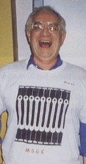
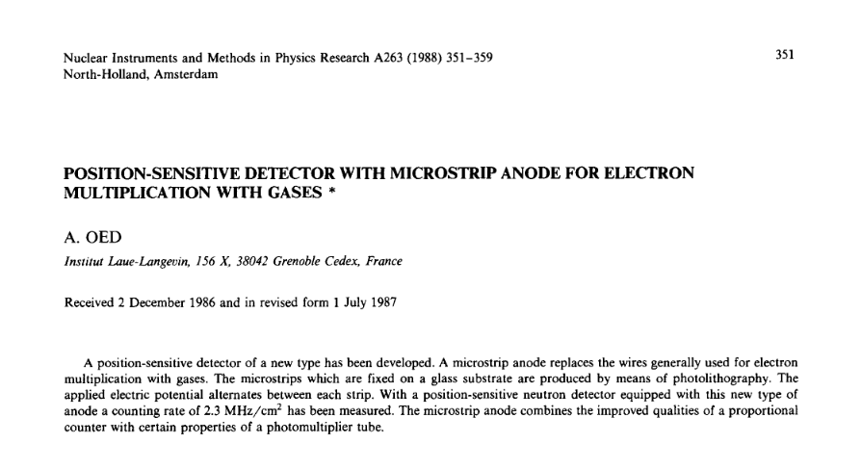
Micro-Strip Gas Chamber (MSGC)
A. Oed

Slide 5
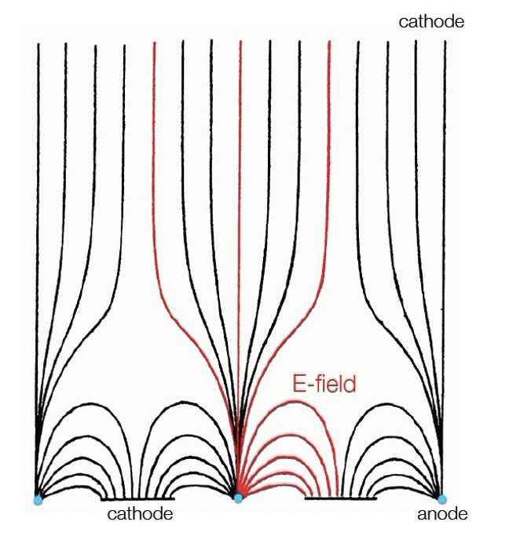
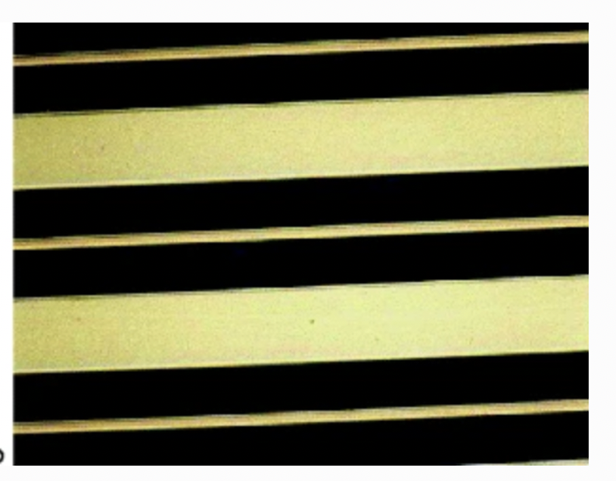
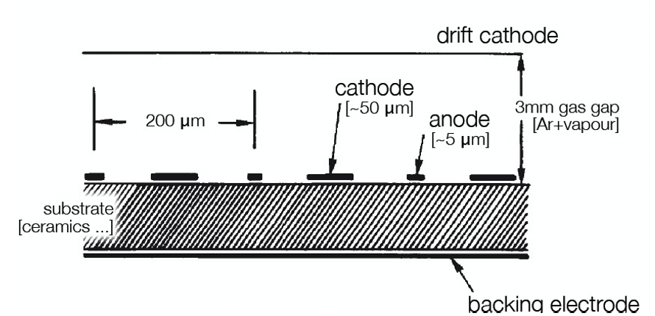
Micro-Strip Gas Chamber (MSGC)
In 1988, Anton Oed, at the Institute Laue-Langevin (ILL) in Grenoble, introduced a novel concept in detection:
Micro-Strip Gas Chamber (MSGC)
Consisting of a set of tiny metal strips engraved on a thin insulating support, and alternatively connected as anodes and cathodes
Relies for its operation on the same processes of avalanche multiplication as the multi-wire devices
Photolithography technology used for manufacturing, permits to reduce the electrode spacing by at least an order of magnitude, improving the multi-hit capability.
Fast collection of most positive ions by the nearby cathode strips reduces space charge build-up and provides a largely increased rate capability
Introduced coincidentally with the first projects of high luminosity colliders, MSGCs filled a gap in the available detector technologies, between solid state strip detectors, having excellent performances but high costs, and the cheap but rate-limited traditional gas devices

Slide 6
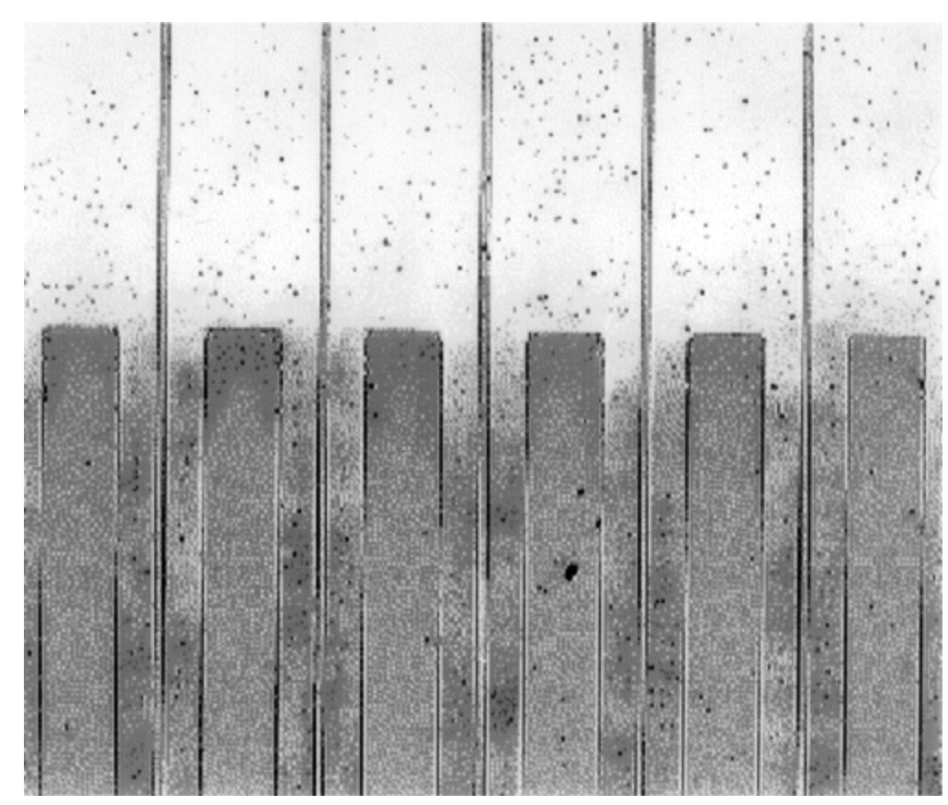
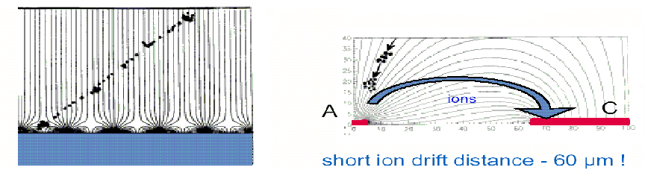
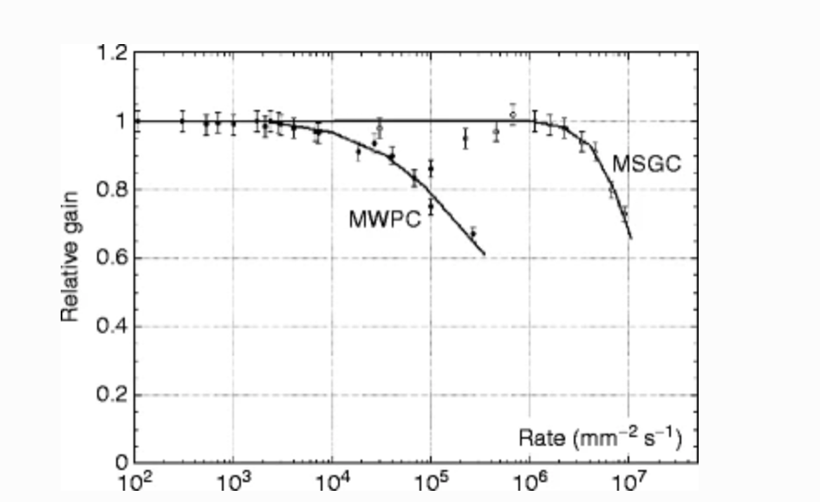
MSGC
Cathode strips are arranged between the anode strips for an improved field quality and to improve the rate by fast removal of positive ions
Reduced dead time between signals
Rate and spatial resolution improved w.r.t. MWPCs by more than an order of magnitude
Spatial resolution can be a few tens of microns
Segmentation of the cathodes also possible to allow 2-dimensional readout
Close view of one of the first microstrip plates developed by Oed at the Institute Laue-Langevin. On an insulating substrate, thin metallic anode strips alternate with wider cathodes; the pitch is 200 μm.
Rate Capability comparison for MWPC and MSGC

Slide 7
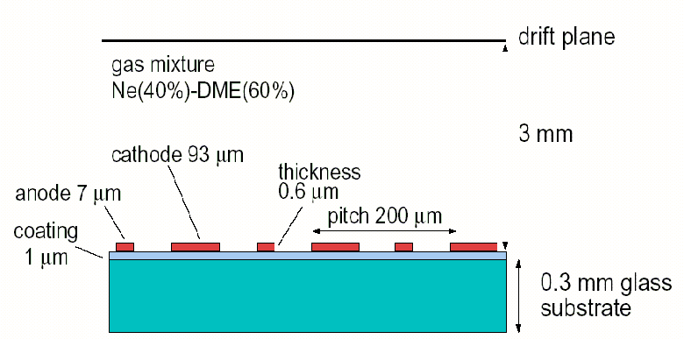
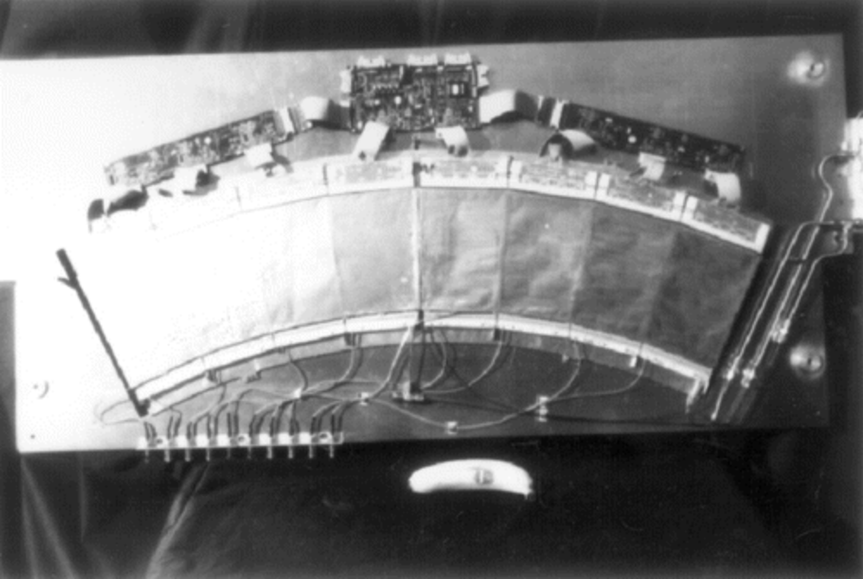
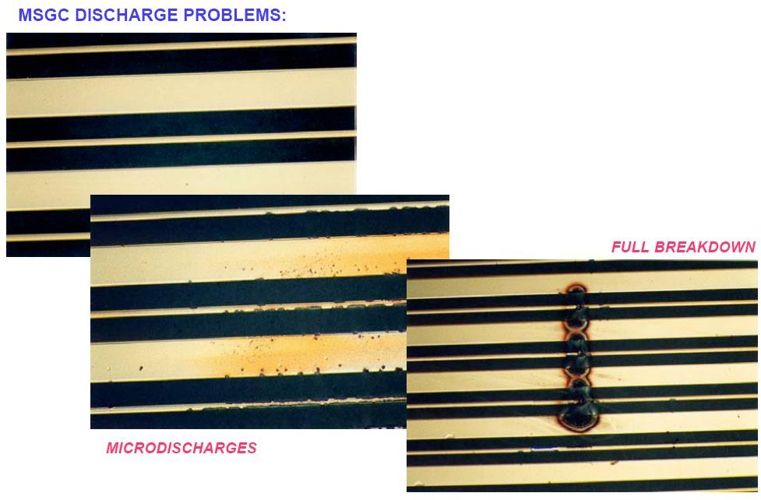
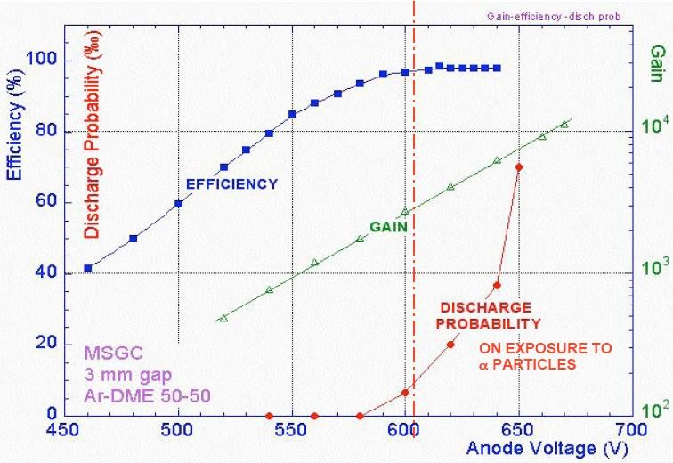
Micro-Strip Gas Chamber (MSGC)
Considered by CMS experiment,
but ageing problems…(replace by Si)
Ar:DME 50:50
Resolution ~30 to 40μm
Gain <10000
Anode: 0V
Cathodes: -520 V
Drift Cathodes: -3500V
Rate up to 10^6 particles/mm²/s

Slide 8
Micro-Strip Gas Chamber: A door toward a new era of gas detectors
Operating properties of MGCs manufactured with different metals and a range of geometrical parameters, as well as the resistance of the devices to local discharges have been widely studied
Several variants of the basic microgap structures have been tested to improve their performance and reliability, with particular attention to the onset of discharges, which was the major limitation for reliable application in HEP
Nevertheless, the detailed studies on their properties, and, in particular, on the radiation-induced processes leading to discharge breakdown, led to the development of more powerful devices with improved reliability and radiation hardness.
On the basis of the MSGC Photolithography technology have been further developed and used for manufacturing particle detectors and in particular gaseous based particle detectors
Modern MPGD structures can be grouped into two large families: hole-type structures and micromesh-based detectors
The hole-type structures are GEMs, THGEM, RETGEM, Micro-Hole, …..
The micromesh-based structures include: Micromegas, “Bulk” Micromegas, “Microbulk” Micromegas, ….

Slide 9
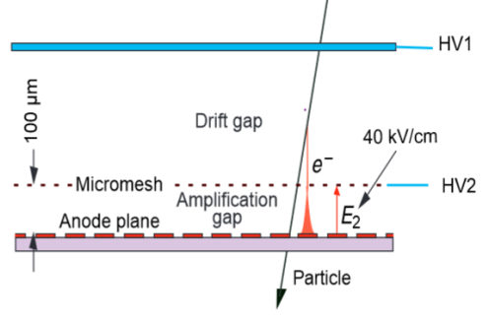
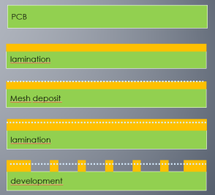
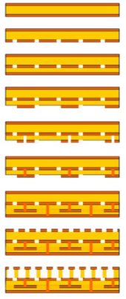
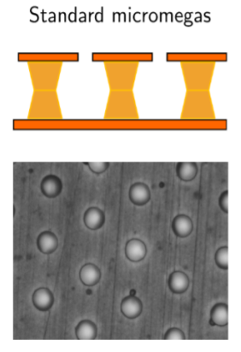
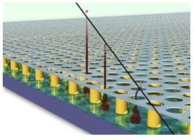
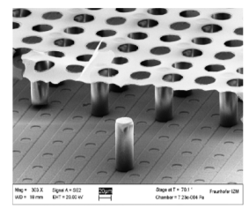
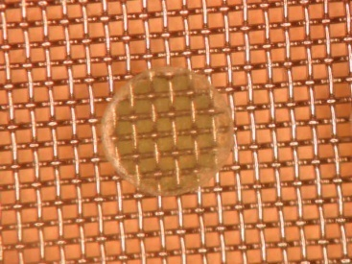
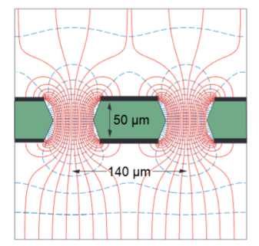
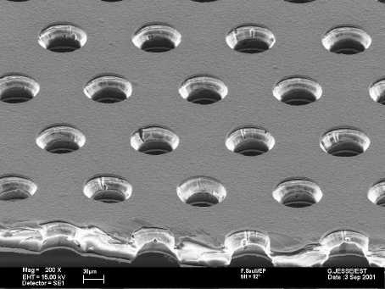
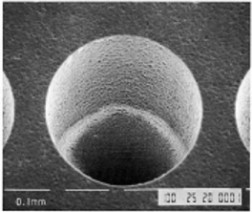
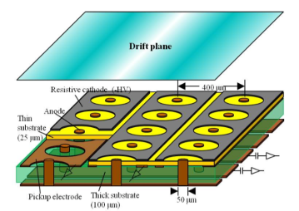
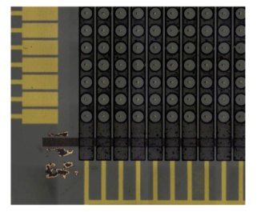
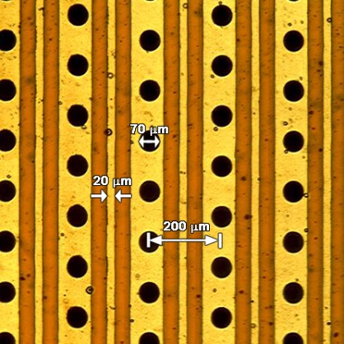
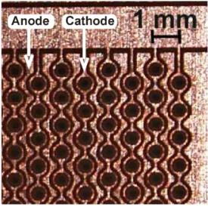
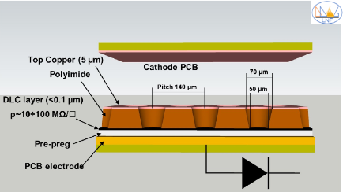
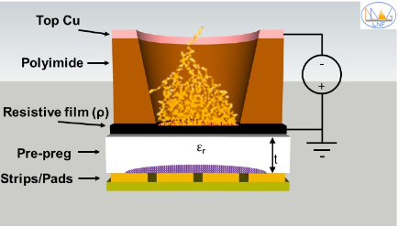
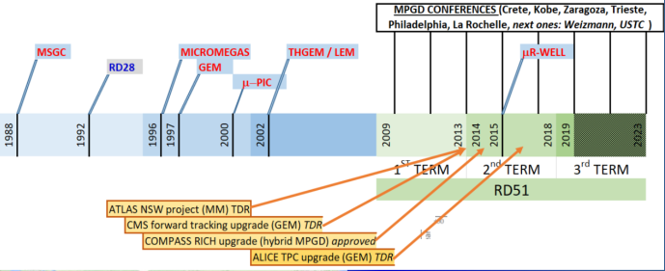
Micro Pattern Gas Detector Family
Micromegas
Bulk
Micro bulk
InGrid
High Rate Capability
High Gain
High Space Resolution
Good Time Resolution
Good Energy Resolution
Excellent Radiation Hardness
Good Ageing Properties
Ion Backflow Reduction
Photon Feedback Reduction
Large size
Low material budget
Low cost
…
Up to MHz/mm² (MIP)
Up to 10⁵ -10⁶
<100μm
In general few ns , sub-ns in specific configuration
10-20% FWHM @ soft X-Ray (6KeV)
% level sort of easy, below % in particular configuration
m²
GEM
50μm GEM
THGEM
GLASS GEM
μPIC
MHSP
THCOBRA
μRWELL
All subjects illustrated by examples:
A fully comprehensive review is impossible!
Technology share-point R&D51

Slide 10
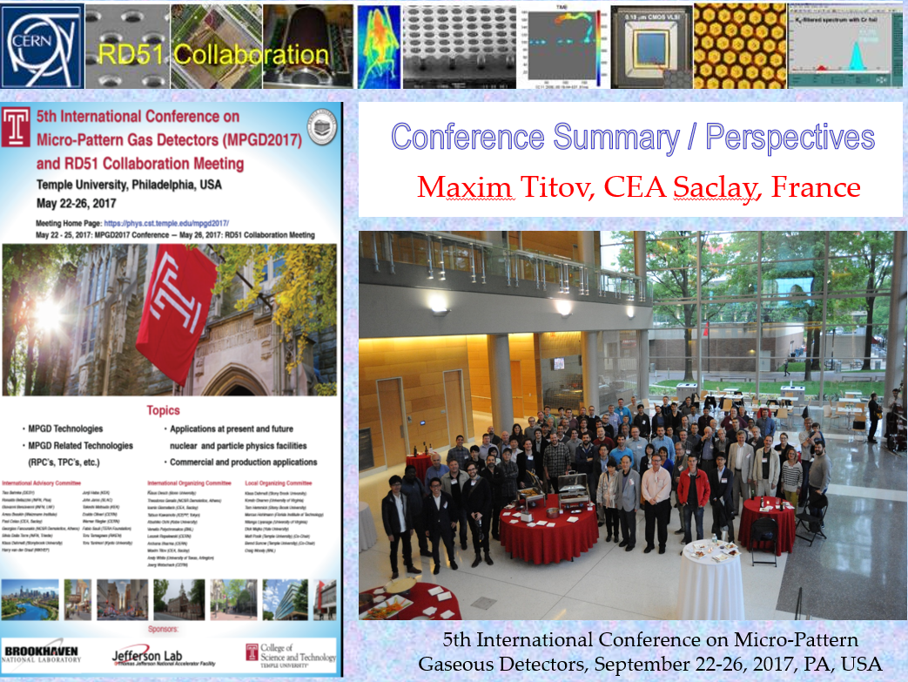
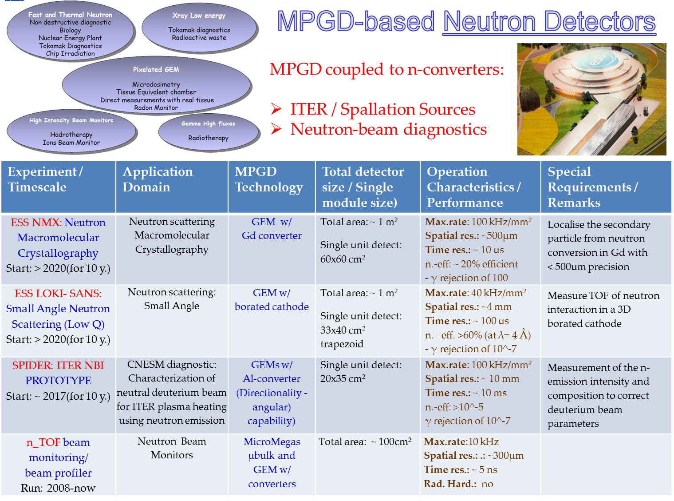
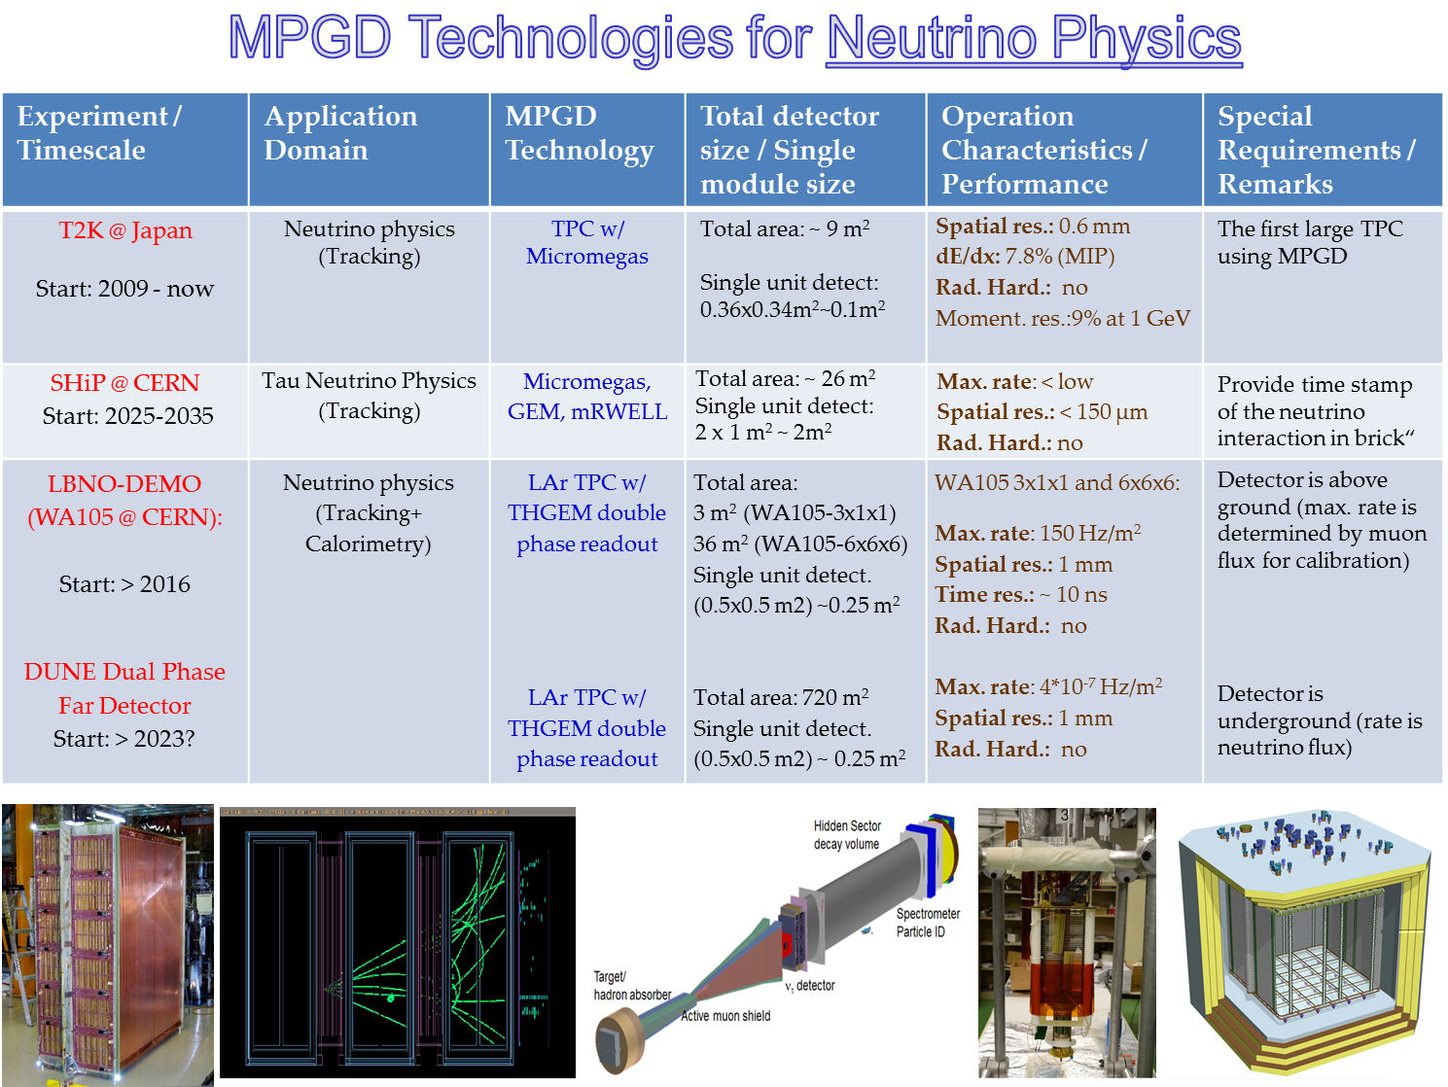
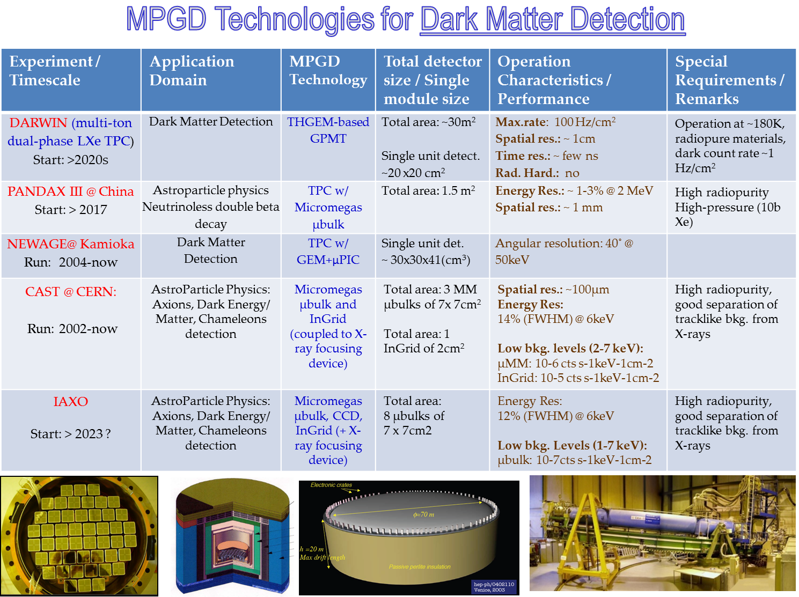
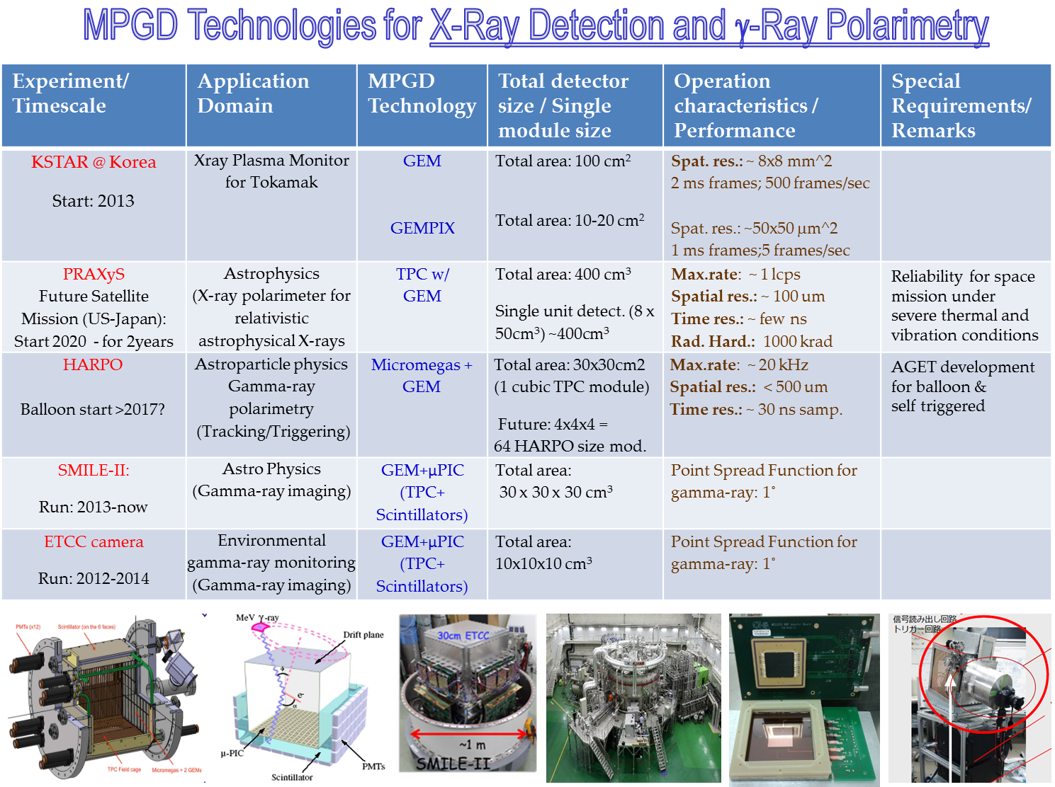
The MPGD family and their applications
Maksym Titov, Conference Summary, 5th International Conference on Micro-Pattern Gas Detectors (MPGD2017), Temple University, Philadelphia
This list is now almost 8 years old, is time to update it ☺
https://indico.cern.ch/event/581417/contributions/2558346/attachments/1465881/2266161/2017_05_Philadelphia_MPGD2017ConferenceSummary_25052017_MS.pdf

Slide 11
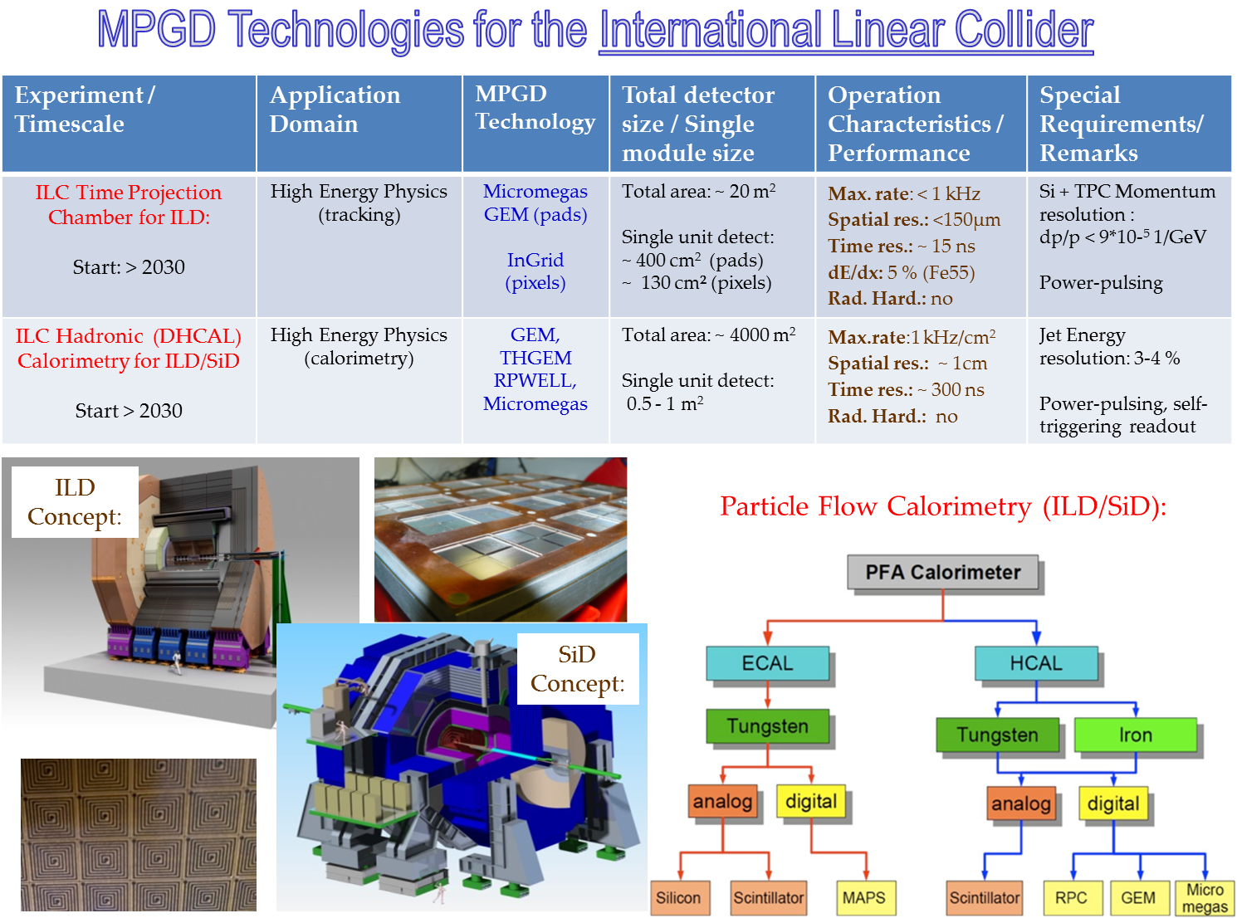
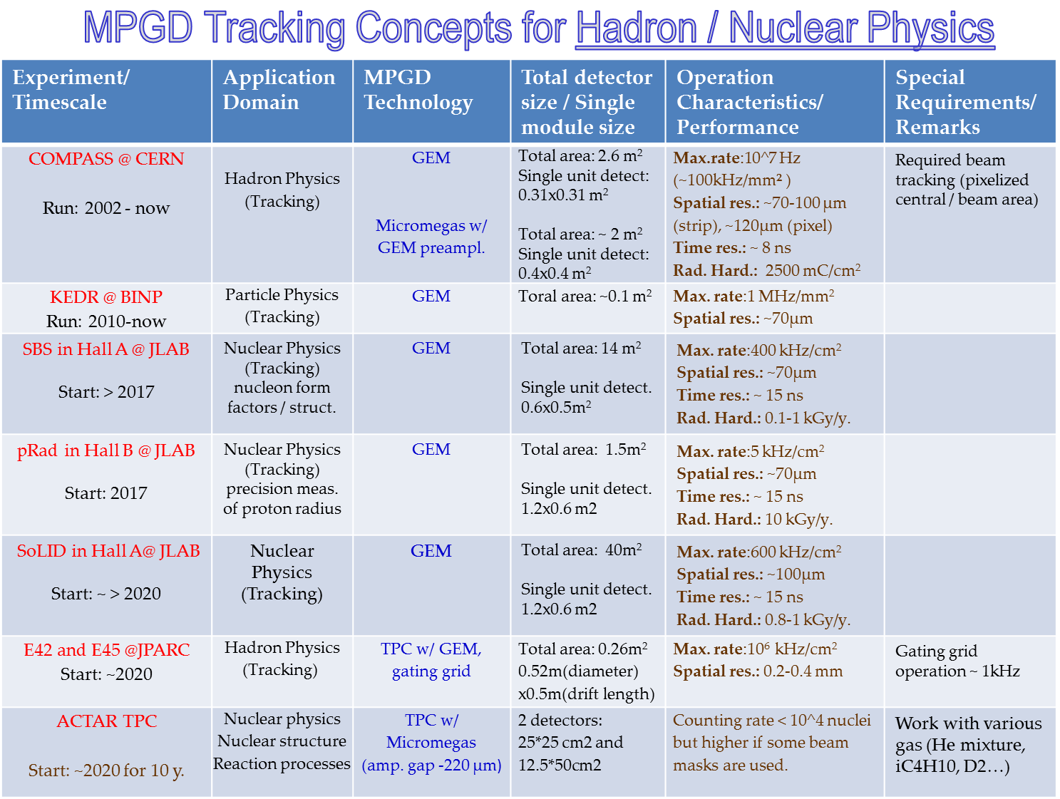
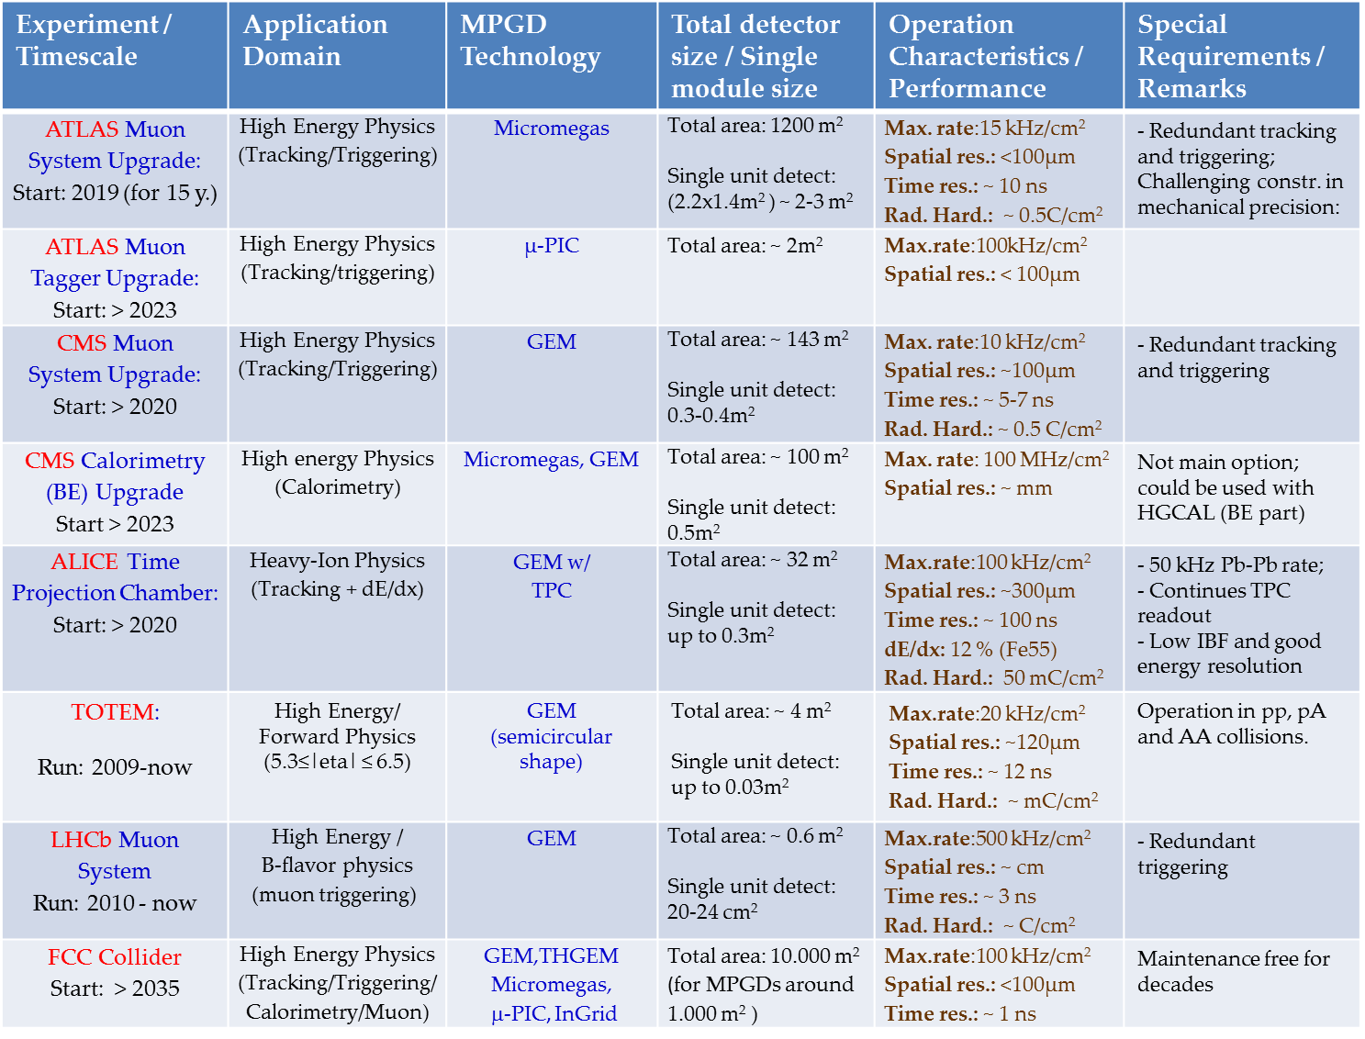
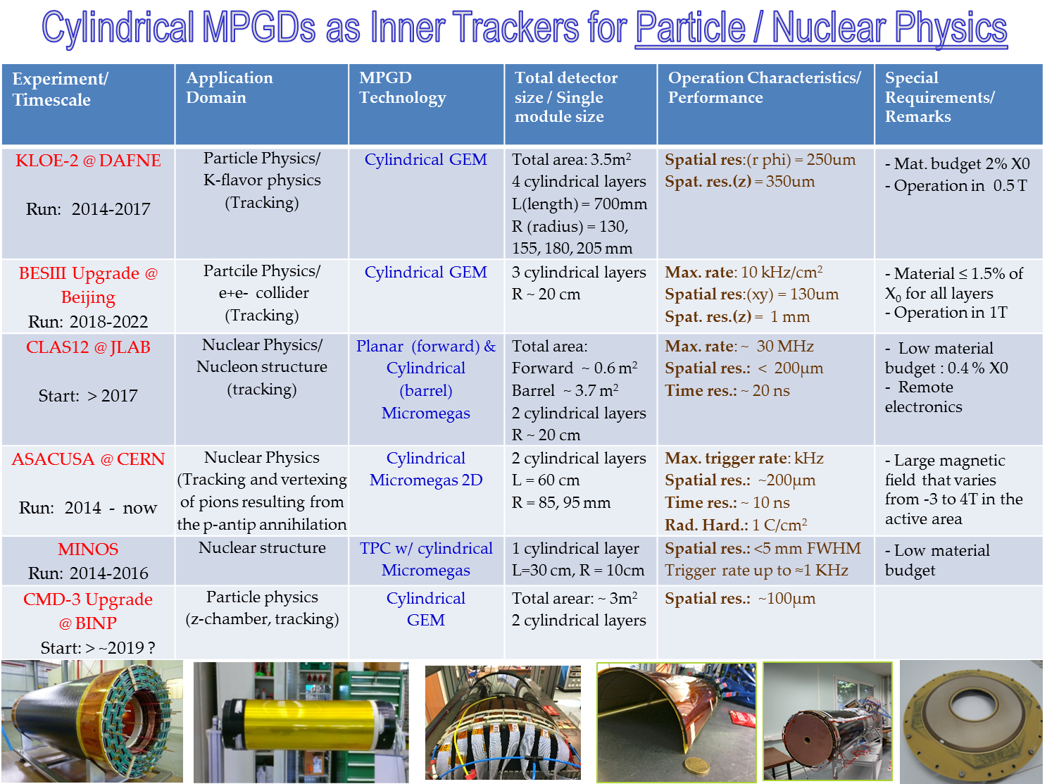
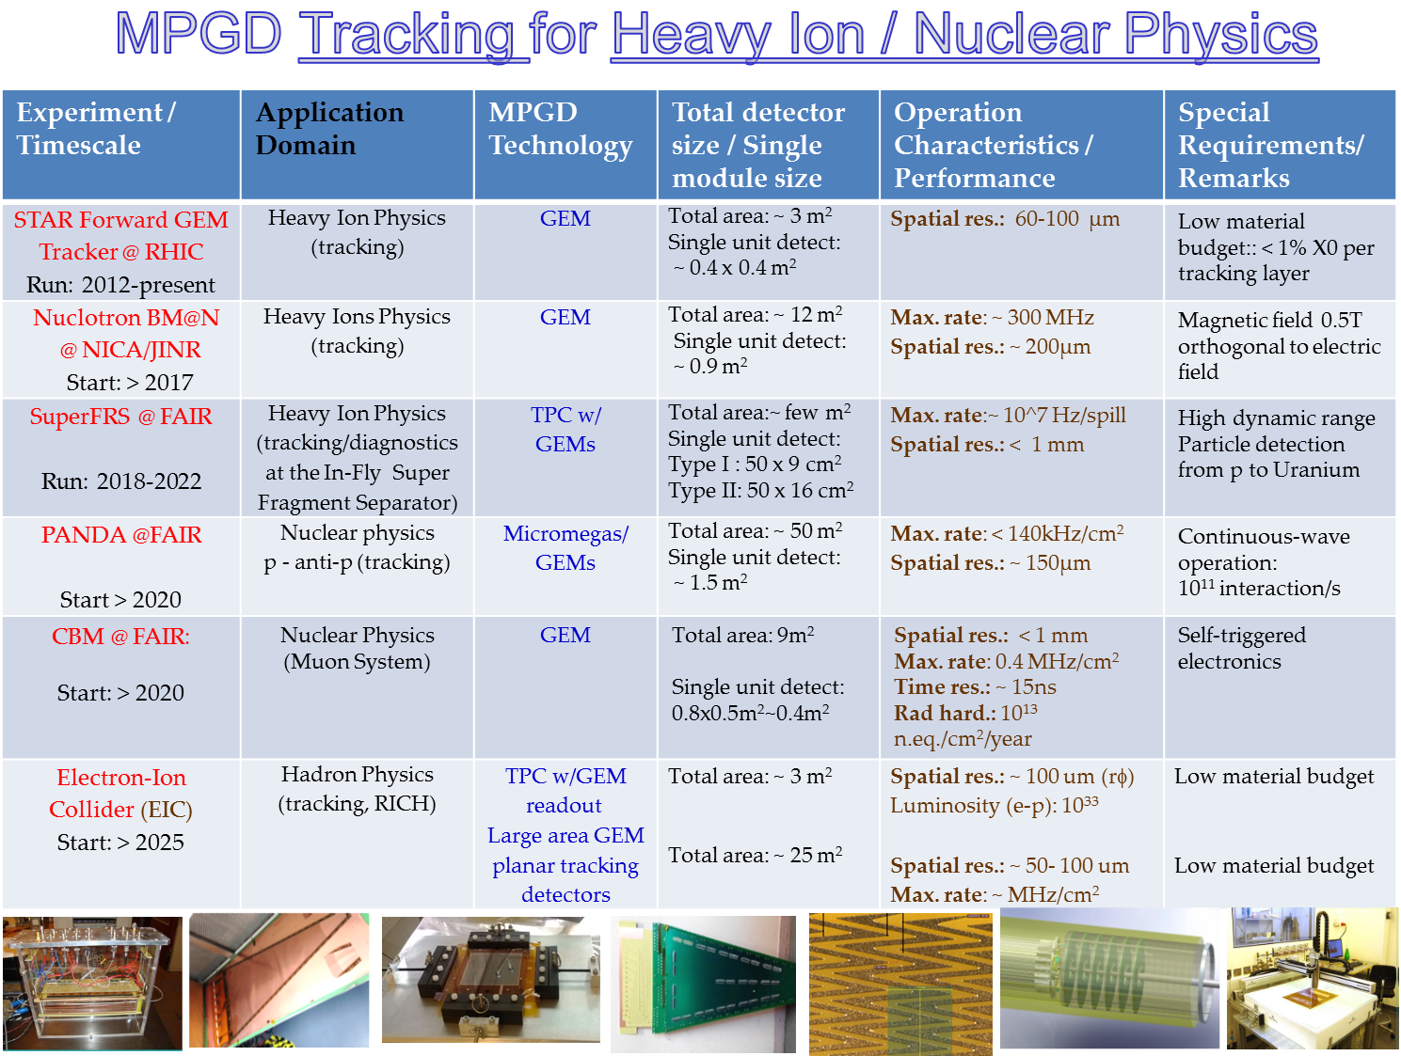
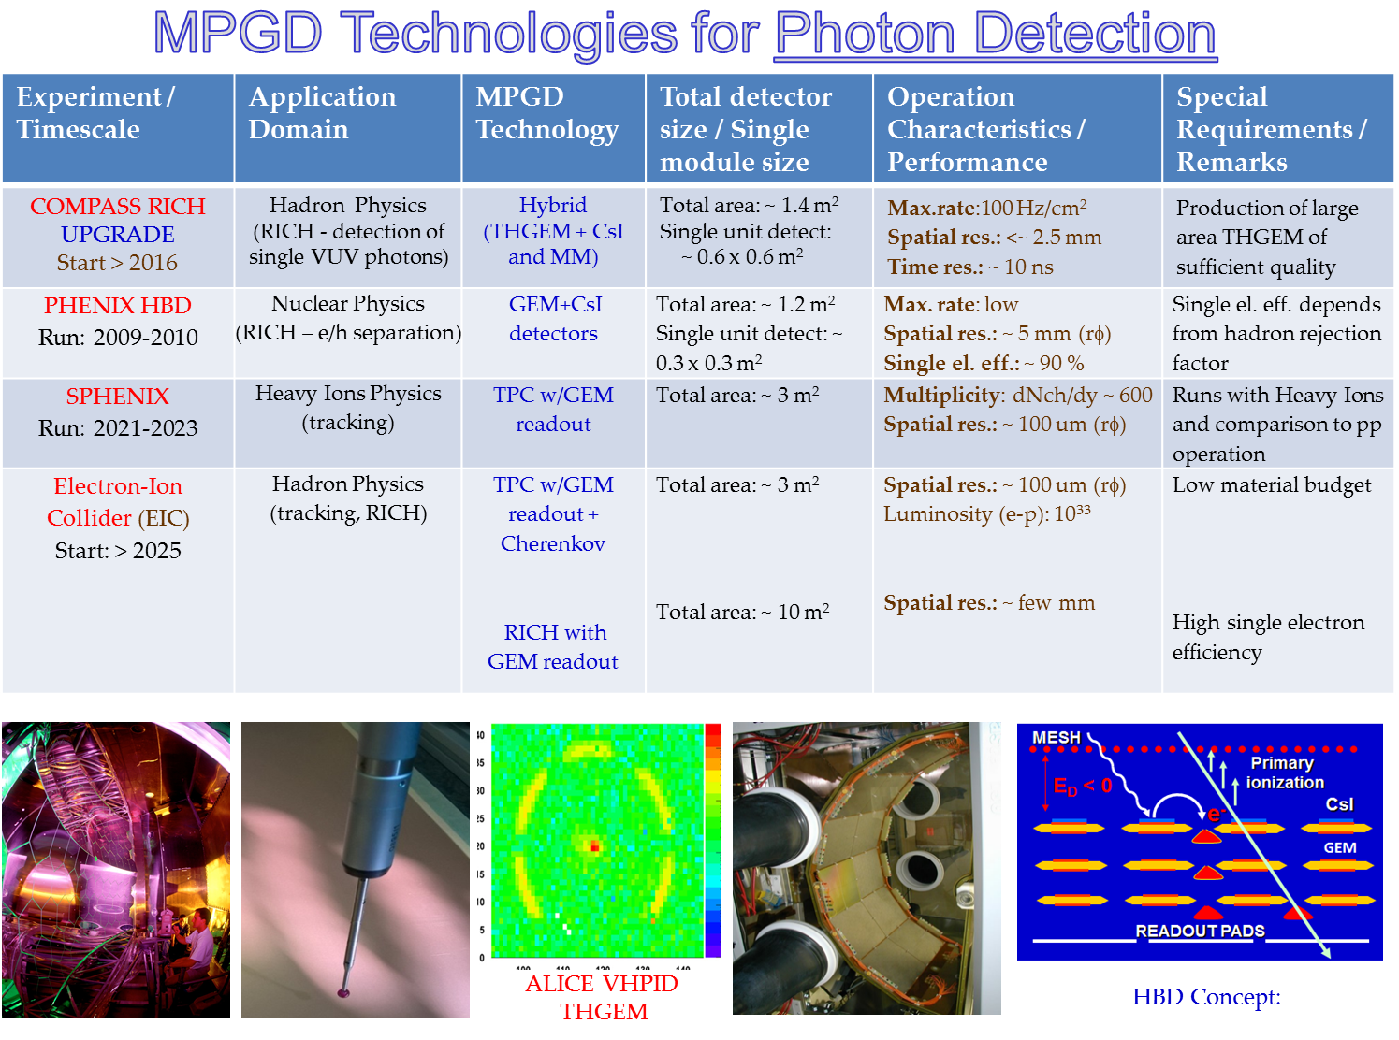
The MPGD family and their applications

Slide 12

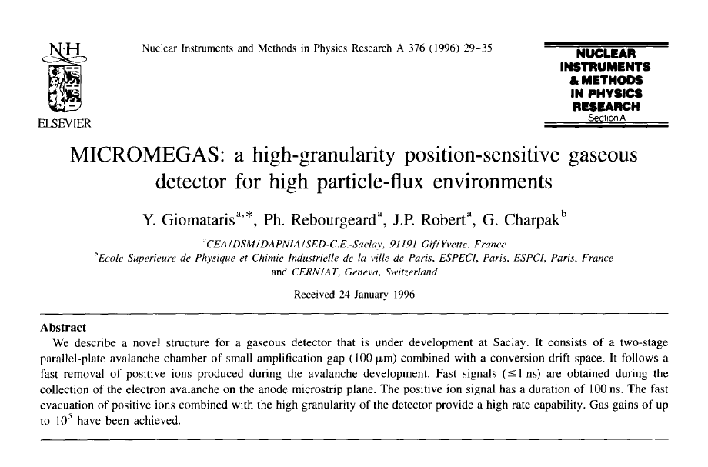
Micromegas
Y. Giomataris

Slide 13
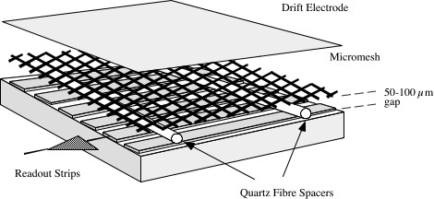
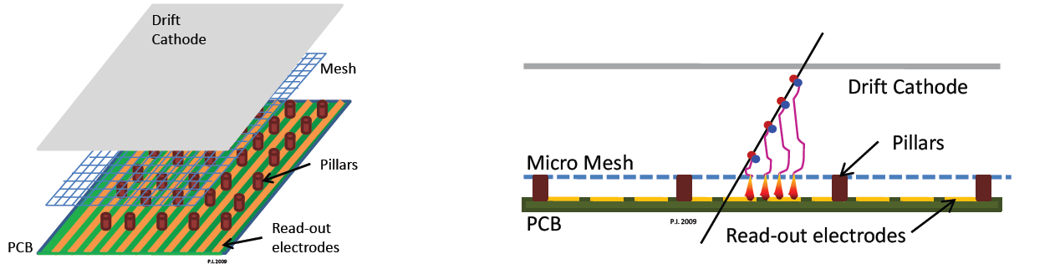
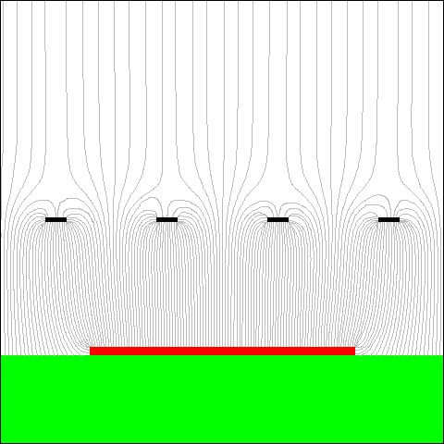
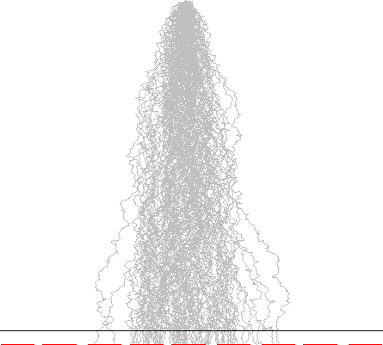
Micromegas: Detector Principles
Micromegas are parallel-plate chambers where the amplification takes place in a thin gap, separated from the conversion region by a fine metallic mesh
The thin amplification gap (short drift times and fast absorption of the positive ions) makes it particularly suited for high-rate applications
-800 V
-550 V
Field line
~1kV/cm
~few 10kV/cm

Slide 14
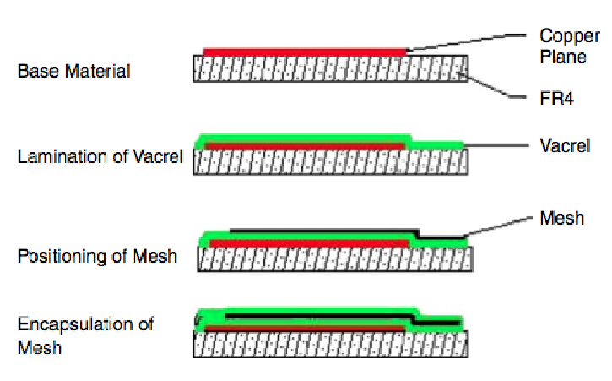


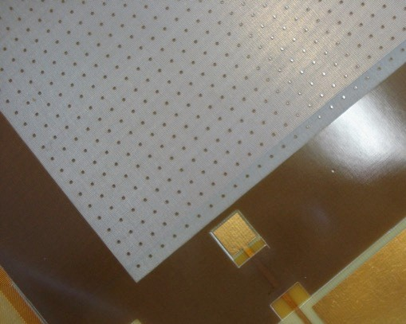
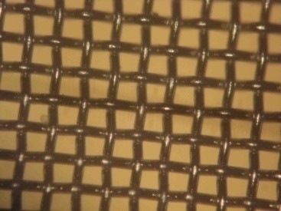
Micromegas: Detector Principles
MM Evolution: Bulk Technology
NIM A560 (2006) 405
The Insulator (Vacrel 8100 in this case) is photosensitive and can be removed by etching, creating the pillars.
Distance between pillars = 2.5 mm Pillar diameter = 0.3 mm
New mesh used for bulk MM.
Woven wire mesh, wire diameter about 20-­‐30 μm and about 80% transparency.
Largely produced for serigraphic application.
Electroformed micromesh was normally used before.
Mesh

Slide 15
Micromegas: Resistive MM (spark resistant)
Mesh support pillars
Mesh
Sparks between mesh and readout strips may damage the detector and readout electronics and/or lead to large dead times as a result of HV breakdown
Several protection/suppression schemes tested
A large variety of resistive coatings of anode
Double/triple amplification stages to disperse charge, as used in GEMs (MM+MM, GEM+MM)
Finally settled on a protection layer with resistive strips
To avoid spark effect the readout strips were covered with the 64 µm thick insulator layer with resistive strips on top of it connected to the +HV via discharge resistor and mesh is connected to GND
PCB
Read-out strip
Resistive strip
0.5-5 MΩ/cm
PCB
Read-out strip
Insulator

Slide 16
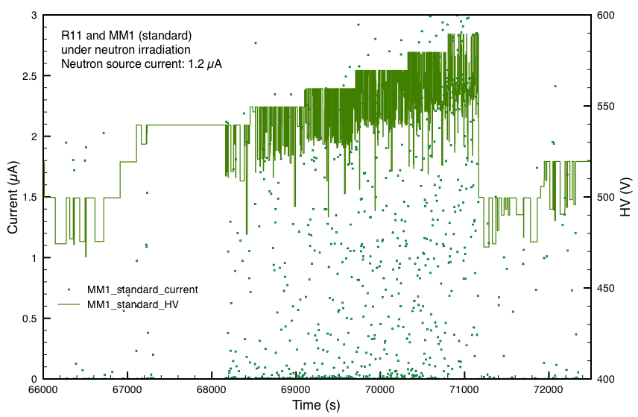
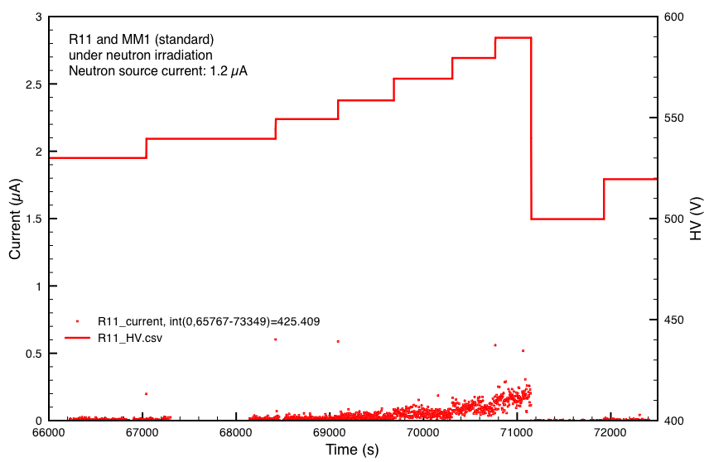
Micromegas: resistive MM
MicroMegas mesh currents and HV drop in neutron beam
Gas: Ar:CO₂ (85:15) Neutron flux: ≈ 10⁶ n/cm²/sec
Standard MM:
Large currents
Large HV drops, recovery time O(1s)
Chamber could not be operated stably
Resistive MM:
Low currents
Despite discharges, but no HV drop
Chamber operated stably up to max HV
HV values
Mesh currents

Slide 17


Micromegas: resistive MM
Sparks in 120 GeV pion & muon beams
Standard MM
Resistive MM
Gain ≈ 4000
8000
Gain ≈ 10⁴
Stable, no HV drops, low currents for resistive MM
Same behavior up to gas gains of > 10⁴
Pions, no beam, muons
Chamber inefficient for O(1s) when sparks occur

Slide 18

Micromegas: spark resistant
Equivalent scheme of resistive Micromegas chambers (Reversed HV schema, more stable during the operation)
Mesh
C2
Induced charge
HV (+)
Resistive strip
C1
C3
Amp
R1
Copper strip
CA
C4
C1 – capacitance Mesh to ground
C2 – capacitance R-strip to ground
C3 – capacitance R-strip to readout strip
C4 – capacitance readout strip to ground
CA – input capacitance of preamplifier

Slide 19



Micromegas: Performance and MicroTPC
Working with analog FE, two different methods are used in order to extract the correct spatial information:
Using charge amplitude (Centroid hit)
Accuracy rapidly decreasing for larger track angles.
Using time information (μTPC segment).
Performance improving with increasing cluster size
Resolution achieved with centroid method for perpendicular track using chamber with 400 μm strip pitch
Resolution achieved with μTPC method for 30 ⁰ inclined track using chamber with 400 μm strip pitch

Slide 20




Micromegas Aging studies
Aging test for MM chambers using ATLAS gas mixture Ar:CO₂:iC₄H₁₀ 93:5:2
A resistive-strip MM has been exposed at CEA Saclay to 5.28 keV X-rays for 12 and 21 days. In parallel, an ‘identical’ chamber was measured without being irradiated continuously
Accumulated charge: 765 + 918 mC/4 cm² (>20 years of ATLAS MM at HL-LHC)
Integrated charge Vs time
Energy resolution
Effective gain for irradiated chamber (T8) versus reference not integrated chamber (T2), the drop of gain during the first part of the irradiation test is attributed a large charge-up effect due to the very high (MHz/cm²) irradiation flux

Slide 21


Gas Electron Multipliers (GEM)
F. Sauli

Slide 22




What are the GEM: Principles
Concept of Gas Electron Multipliers
Gas Electron Multipliers (GEM) was introduced by Fabio Sauli in 1996-97
Gas Electron Multiplier electrode is a thin polymer foil, metal-coated on both sides and pierced with a high density of holes, typically 50–100 mm⁻²
Inserted between a drift and a charge collection electrode, and with the application of appropriate potentials, the GEM electrode develops near the holes equipotential field lines
The large difference of potential applied between the two sides of the foil creates a high field in the holes; electrons released in the upper region drift towards the holes and acquire sufficient energy to cause ionizing collisions with the molecules of the gas filling the structure
A sizeable fraction of the electrons produced in the avalanche׳s front leave the multiplication region and transfer into the lower section of the structure, where they can be collected by an electrode, or injected into a second multiplying region, schematically a single GEM detector, with a two-dimensional patterned charge detection anode

Slide 23






What are the GEM
SEM picture of a GEM foil
SEM picture of a GEM hole
140 μm
60 μm
50 μm
5 µm
50 µm
70 μm
55 µm
70 µm
Electrons entering the GEM holes will accelerate in the intense electric field (~80 kV/cm) and provoke the ionization of gas molecules, giving rise to an electron avalanche
Multiplication: 1 e⁻ input to > 1000 e⁻ output (as a function of gas and HV)

Slide 24


Gas Electron Multipliers
Full decoupling of amplification stage (GEM) and readout stage (PCB, anode)
Amplification and readout structures can be optimized independently

Slide 25



GEM: Operation and Performance
Performance in single GEM
Cascade of GEM electrodes, allows attaining higher gain with each GEM at lower voltage; Discharges disfavoured

Slide 26





GEM: Operation and Performance
TRIPLE GEM A-CO₂-CF₄
σ ~ 4.5 ns
CMS TECHNICAL DESIGN REPORT FOR THE MUON ENDCAP GEM UPGRADE
CMS-TDR-013
V.N. Kudryavtsev et al 2020 JINST15 C05018
M. Alfonsi et al, Nucl. Instr. and Meth. A535(2004)319
CMS-TDR-013
M. Bianco 2020 JINST 15 C09045
M. Bianco 2020 JINST 15 C09045

Slide 27




GEM: Discharge & Ageing
Defects (or rarely very high charge density), can generate discharges at the level of GEM holes.
If we exclude the possible FE damages, if not correctly protected, the effect of the discharges is to modify the hole shape, making it larger (after hundreds of discharges) and leading to gain reduction. Problems can come from the sputtering of copper and polyamide around (and inside the hole) which could generate shorts.
Basic principle:
HV segments on the top: GEM protection against regular discharges
HV segments on the bottom: protection against discharge propagation
In Aachen irradiation/ageing tests, collected up to 8 C/cm² on the ME0-CERN-0001 prototype. The chamber effective gain, has not been affected

Slide 28






Master of GEM
CERN’s Printed Circuit Workshop
Rui De Oliveira
https://indico.cern.ch/event/1175363/attachments/2477073/4252122/MBianco_CMS_GEM.pdf

Slide 29

GEM: Improving segmentation technique

Slide 30

GEM: Operation and Performance
https://indico.cern.ch/event/1120714/contributions/4867134/attachments/2469534/4236245/MBianco_Poster_for_iWorid2022_V2.pdf

Slide 31


The micro-Resistive Well detector
G. Bencivenni

Slide 32


The µ-RWELL technology
The device is composed of two elements:
µ-RWELL_PCB
drift/cathode PCB defining the gas gap
µ-RWELL_PCB = amplification-stage ⊕ resistive stage ⊕ readout PCB
large area & flexible geometry
The “WELL” acts as a multiplication channel for the ionization produced in the gas of the drift gap
The charge induced on the resistive layer is spread with a time constant, $τ \sim ρ×C$
$C= ε_{0}×ε_{r}×\frac{S}{t}=35 pF×S({cm}^{2}$ )

Slide 33
















µ-RWELL story
R&D on low-rate layout
R&D on high-rate layout
New MPGD idea in collaboration with GDD
PEP
SRL
DRL
SG
R&D start
TT @ ELTOS
2009
2014
2015
2016
2017
2018
2019
2020
2021
2022
2023
TB @ CERN
TB @ high rate @ PSI
TT @ ELTOS

Slide 34





µ-RWELL High-Rate Layout
The purpose of these HR versions is to reduce the distance to be “travelled” by the charge towards the ground
Double Resistive layer (DRL)
Silver Grid (SG)
3·10⁵ 3·10⁶ 3·10⁷ 3·10⁸
Mip Flux[Hz/cm²]
3-D grounding
Double DLC layers connected through matrices of conductive vias to the readout electrodes (density 1/cm2)
2-D grounding
Single DLC layer grounded by means conductive strip lines realized on the DLC layer (density 1/cm)
Silver Grid design introduced to simplify the e technology transfer, since the TT of the DRL industrial production is difficult, The new design, is based on the simple single-resistive layout with a suitable surface current evacuation scheme, the Grid layout (to avoid sparks) introduce dead area which reduce the geometrical acceptance

Slide 35




The µ-RWELL technology
The PEP (Patterning – Etching – Plating^{h})
Single DLC layer
Grounding from top by kapton etching and plating
No alignment problems
Scalable to large size
Measured dead zone > 1.6 mm wrt 0.8 mm (by design)
LATEST DEVELOPMENT, RESULTS STILL PRELIMINARY
PEP zone vs HV
PEP zone vs Ed
Efficiency (%)
Efficiency (%)
Δ∼1.6 mm
Δ∼1.5 mm
Position (cm)
Position (cm)
3·10⁵
3·10⁶
3·10⁷
3·10⁸
Mip Flux [Hz/cm²]

Slide 36




µ-RWELL Performances
Gas gain of the uRwell (different HR layout) characterized at PSI
Efficiency as a function of the gas gain for the HR layouts (SG1 affected by geometrical acceptance)
gain ≥10⁴
space resolution < 60 μm
time resolution < 6 ns
Thanks to the resistive plane:
very reliable
very low discharge rate
adequate for high particle rates O(1MHz/cm2)

Slide 37






Current Trends in Micro-Pattern Gaseous Detectors (Technologies)
Key role played by CERN EP-DT MPT workshop
Aspects covered by MPT:
New developments (MPGD structures and architectures)
Production for R&D
Production for experiments and large (large for us large but not for industry) volumes
Micro Pattern Technology (MPT) workshop Research/Development/Production of MPGD
C → TT toward industry explored/done/ongoing…
A & B (& C) → consolidating cooperation and sharing with MPT workshop
sharing between CERN & INFN of a DLC sputtering machine (costs and use sharing / personnel training)
A & B → TT towards/between institutes & national laboratories workshops…
(MPT/Saclay/LNF/ LNGS/FTD Bonn/… ? …)
C.I.D: the joint CERN-INFN DLC facility

Slide 38


Current Trends in Micro-Pattern Gaseous Detectors (Technologies)
MPGD processes at CERN MPT
Examples of MPT activities
https://indico.cern.ch/event/999799/contributions/4204334/attachments/2236247/3790326/infrastructures.pdf

Slide 39

Current Trends in Micro-Pattern Gaseous Detectors
Pulsed DC magnetron reactive PVD New fundamental tool for substrate deposition
Resistive layers:
-DLC, semiconductors.
Photocathodes:
-Metallic, DLC, B4C, GaN, mix?
Metals:
-AL, Cu, Ni, etc..
Budget (CERN INFN Project):
-25% INFN
-25% CERN EP/DT group
-50% CERN MPT workshop self financing
Max foil size:
-1.7m x 0.6m.
Useful size:
-1.7m x 0.5m.
5 targets.
3 simultaneous deposition.
3 gas inputs:
H2,N2,CH4,C4H10,Ne,Ar etc..
300deg heater.

Slide 40




Current Trends in Micro-Pattern Gaseous Detectors
Development topics at MPT workshop
Additive
Micro-structuring
Laser machine on the market are still too slow and too small to compete with chemical etching
MPGD concepts/ideas compatible with micro printing are welcome!!!!!

Slide 41













The DRD1 Collaboration: The Place!!!
Technological developments often need large infrastructures
International collaboration on MPGD Started in 2008 (white paper/CERN) Common facilities (lab/GDD, test beam/SPS) developments (simulation/electronics) and
workshop (MPT) @ CERN
MPGD technologies spread over LHC experiments (existing or planned)
EP-DT-FS
Gas Group
Micro Pattern Technology (MPT) workshop Research/Development/Production of MPGD
Thin Film and Glass lab
Irradiation Facilities
Gas
Group
GDD Gas Detector Development team R&D on MPGD, RD51 Support
Strategic R&D on MPGD (large systems, novel solution, framework and tools)
https://indico.cern.ch/event/999799/contributions/4204424/attachments/2236130/3790095/Networking.pdf

Slide 42
Technology Transfer and Relations with Industries
Preamble
Academic physics researchers usually do not have dedicated training (or in theory are not supposed to have) for interaction with industries, this could lead to multiple unexpected problems when R&D or Mass Production process, which require interaction with company, need to be launched.
While the technical/bureaucratic aspects could be effectively improved by appropriate training, knowledge of the market which could support development and production of Gas Detectors is often the result of previous experiences and interaction with collaborators
The following slides do not want to make a list of good/bad companies (the assessment could be the results of particular lucky or not well-prepared collaboration) rather examples, hints and tips for process preparation and interactions with the companies

Slide 43
Technology Transfer and Relations with Industries
… before and during the engineering process
Do something similar have been already designed produced?
When? By whom? For which project?
Inquire the involved people for feedback and detailed summary of lesson learnt
Are the technical solutions adopted affordable by standard company?
Often engineers and technicians in our Institute, with similar tools regularly available in the market are able to achieve much better results
Do you have already in mind possible company for the production?
Yes: Involve them in the engineering process
No: Too bad, looks asap on the market
Are the technical/manufacturing specifications in line with the documentations/specs adopted by the company ?
Compatibility of design and production tools is a key point

Slide 44
Technology Transfer and Relations with Industries
…before to start a production process
Do the production will require a dedicated Technological Transfer?
The process should start asap, possibly with a pre-series production as qualification step for a possible call for tender
Single supplier or splits order?
Both solutions have pro and cons, correct risk analysis should be carried out before adopting one or the other strategy
Production in batches, per components types, mixed, …
Projects needs could not match the “modus operandi” of the company, for large production of several different components, companies use to work in series completing the production of each single type before to move to the next one; This could not fit with the general project plan. Switching continuously production between different type of similar but not identical components could easily lead to production mistake and cost increase. Production planning, with adequate float, should be steered and submitted to the company at the time of the contract
Logistic and communication matter!!!

Slide 45



ATLAS NSW MM anode boards production
Largest industrial production of MPGD ever: 1300 m2 detector surface
Resistive Micromegas fully produced in industries (first time)
Mass production: 2112 boards of unprecedented size: up to 45 x 220 cm²
Technology developed at CERN and transferred to industries
Two companies selected: ELVIA (F), ELTOS (IT)
Choice to split production in 2 sites
Pros:
Helped in keeping the schedule. None of the firms could stand the full production in the required time
Each firm knew about the other → helped in promoting a good competition
Allows to find a quick fallback solution in case of failure of one company (saving the time for the technology transfer to a new company, still slowing down the total production)
Experimenting different technical solutions to adapt production to the specific firm → knowledge improvement
Allowed to quickly disentangle issues coming from components (common) wrt firm production specific issues
Cons:
Double efforts to follow up production at the two firm's premises
Develop firm-specific adaptation of production (facing different problems)
Establish two communication lines
Final comment: was the right choice

Slide 46

ATLAS NSW MM anode boards production
Main problems:
Schedule!
Production steps were new/unusual for the companies.
Complex logistics
Problems with subcontractor
The technical responsible of production frequently change
Two companies -> Two had different styles and policy. Need to adapt to them.
A constant follow-up at the companies during the whole production (>3 years) from experts was needed
Huge follow-up and QC effort (manpower and cost)
Final remarks: both companies considered the ATLAS production as an R&D, not a series production.
Their main goad was to acquire (‘for free’) new expertise and potentially open up new market. Another advantage was to get credit from known research institutes (CERN & others)
Both reached a yield >80%, larger than expected by both at the start of production. They are potentially interested in other similar commitments, based on the acquired knowledge.

Slide 47



GEM Production in Industry (CMS Experience)
Technological Transfer process very long, the company tried to master the single mask etching technique as at CERN but than moved to the double mask technique, this extended quite a lot the R&D and startup time
GEM foils production expected for GE1/1 project didn’t arrive on time
The CMS-GEM collaboration didn’t push too much the company because backup solution was in place (full production at CERN)
Facility refurbishment during the R&D process required long interruption of the tests
Modification of local environmental protection rules imposed additional stop and delay
GEM foils size limited by machine/infrastructure and glass masks (~ 1 m long )
Company extremely collaborative along all the time of the process
Several Internship with the SEUL University
At the end production rate quite high > 30 large GEM foils/month
MECARO was qualified for GE2/1 and ME0 projects project

Slide 48
GEM Production in Industry (CMS Experience)
GE2/1 Production started in 2020/21, regularly running for about one year and half
Suddenly in Aug 2022 the company changed ownership, and the new management didn't want to continue production of GEM foils, considered not profitable and out of the core project
Collaboration interrupted; production relocated at CERN!!!
Currently SEUL University insourced the production in his institute
Long path and big investment with, so far, limited results

Slide 49
Relations with Industries
Extremely challenging requirements of future HEP experiments call for close collaboration between academia and industry. This collaboration should start as early as possible and address prototyping at the R&D stage, through to qualification testing and later tendering and purchasing.
Good knowledge of the possible industrial applications are required to increase the chances of successful collaborations with industry.
To motivate industrial partners to invest in sophisticated production lines for building detectors, scientific collaboration must convince (ideally prove) industry that such detectors have a real market potential beyond particle physics
some time the goal with industry seem to be the outsourcing of complete detector production …But
Are (or can be) HEP detectors (Gas detector in our case) a real Industrial Product?
Academia attitude is to push over the limits / Industrial attitude is to produce standardized & very well qualified products; may non-convergent views ?
Could an “exaggerated industrialization” revert in reduction of our community attitude to detectors innovation?

Slide 50
Reference (Talks/Workshops)
CERN EP Department - R&D on experimental technologies 1st WG2 Meeting https://indico.cern.ch/event/702148
CERN EP Department - R&D on experimental technologies https://indico.cern.ch/event/696066/contributions/2927894/attachments/1618327/2573211/RDonGaseousDetectorTechnologies.pdf
ECFA Detector R&D Roadmap Symposium of Task Force 1 Gaseous Detectors https://indico.cern.ch/event/999799/
Mini-Workshop on gas transport parameters for present and future generation of experiments https://indico.cern.ch/event/1022051/timetable/?view=standard
https://indico.desy.de/event/22513/contributions/46788/attachments/30337/38104/20200224-EDIT-GaseousDetectors.pdf
https://indico.cern.ch/event/1120714/contributions/4867134/attachments/2469534/4236245/MBianco_Poster_for_iWorid2022_V2.pdf
https://indico.cern.ch/event/999799/contributions/4204334/attachments/2236247/3790326/infrastructures.pdf
CERN Detector Seminar: https://indico.cern.ch/event/1175363/attachments/2477073/4252122/MBianco_CMS_GEM.pdf
CERN Detector Seminar: https://indico.cern.ch/event/1168778/attachments/2464624/4227403/_2022_06_17-TV-DetSeminar.pdf
CERN Detector Seminar: https://indico.cern.ch/event/1172978/attachments/2468524/4234156/2022_06_24_CERN_Seminar_rmunzer_v4.pdf
Workshop on Resistive Coatings for Gaseous Detectors : https://agenda.infn.it/event/18156/timetable/?view=standard
M. Bianco, EURIZON Detector School | Gaseous Detectors | 17th-28th 2023 Wuppertal

Slide 51
References:
-) G. Macini, et al,. “Validation of the New Small Wheel Micromegas sectors for the phase1 upgrade of the muon forward spectrometer of the ATLAS experiment at CERN” Phys. Scr. 98 (2023) 044007
-) Bencivenni, R. De Oliveira, G. Morello and M.P. Lener, “The micro-Resistive WELL detector: a compact spark-protected single amplification-stage MPGD”, 2015 JINST 10 P02008
-) G. Bencivenni et al, “The μ-RWELL layouts for high particle rate”, 2019 JINST14 P05014
-) K. Dehmelt, et. al,“Snowmass 2021 White Paper Instrumentation Frontier 05 White Paper 1: MPGDs: Recent advances and current R&D”, arXiv.2203.06562v3
-) S Duarte Pinto et al 2009 JINST 4 P12009
-) Paolo Iengo, Givi Sekhniaidze “Irradiation and longevity test of Resistive Micromegas detectors”, PoS (ICHEP2022)351
-) E. Farina, et. al,. “Resistive Micromegas high-rate and long-term ageing studies at the CERN Gamma Irradiation Facility”, NIM A 1042 (2022) 167423
-) F. Sauli, “The gas electron multiplier (GEM): Operating principles and applications”, NIM A, 386 (1997), p. 531
-) S. Bachmann, et al. “Charge amplification and transfer processes in the gas electron multiplier”’ NIM A, 438 (1999), p. 376
-) A. Bressan, et al. “Two-dimensional readout of GEM detectors”, NIM A, 425 (1999), p. 254
-) A. Bondar, et al. “Study of ion feedback in multi-GEM structures”’, NIM A, 496 (2003), p. 325

Slide 52
References:
-) M. Villa, et al. “Progress on large area GEMs ”, NIM A, 628 (2011), p. 182
-) H. Fenker, et al. “BoNus: Development and use of a radial TPC using cylindrical GEMs”, NIM A, 592 (2008), p. 273
-) A. Balla, et al. “Construction and test of the cylindrical-GEM detectors for the KLOE-2 Inner Tracker”, NIM A, 732 (2013), p. 221
-) P. Everaerts, “Rate capability and ion feedback in GEM detectors”, (Thesis at Gent University 2006)
-) F. Sauli, “GEM readout of the time projection chamber”, CERN-EP-TA1 Internal Report (1999)
-) ALICE_Collaboration, “Technical Design Report for the Alice Time Projection Chamber”, 2014.
-) Va’vra, A. Sharma “Single electron detection in quadruple-GEM detector with pad readout”, NIM A, 478 (2002), p. 235
-) R. Bellazzini, et al. “Imaging with the invisible light”, NIM, 581 (2007), p. 246
-) Murtas, F. “The GEMPix Detector”, https://doi.org/10.1016/j.radmeas.2020.106421
-) Leidner, J., Murtas, F., Silari, M., “Medical Applications of the GEMPix”, Appl. Sci. 2021,11, 440. https://doi.org/10.3390/app11010440
-) Leidner, J., Ciocca, M., Mairani, A., Murtas, F. and Silari, M., “A GEMPix‐based integrated system for measurements of 3D dose distributions in water for carbon ion scanning beam radiotherapy”, (2020) Med. Phys., 47: 2516-2525. https://doi.org/10.1002/mp.14119

Slide 53
References:
-) F.Sauli, Yellow Report, CERN-77-09 (1977)
-) F. Fallavollita, “Novel triple-GEM mechanical design for the CMS-ME0 detector and its preliminary performance”, 2020 JINST 15 C08002
-) M. Bianco, et. al.,”Rate capability of large-area triple-GEM detectors and new foil design for the innermost station, ME0, of the CMS endcap muon system”, arXiv:2201.09021v1
-) F. Fallavollita, “Aging phenomena and discharge probability studies of the triple-GEM detectors for future upgrades of the CMS muon high rate region at the HL-LHC”, NIM , A 936 (2019) 427–42
-) A. Colaleo, P.Verwilligen, et al, “Diamond-Like Carbon for the Fast Timing MPGD” 2020 J. Phys.: Conf. Ser. 1498 012015
-) M. Iodice et. al., “Small-Pad Resistive Micromegas: rate capability for different spark protection resistive schemes”, 2020 JINST 15 C09043
-) R. De Oliveira, M.Maggi, A. Sharma, “A novel fast timing micropattern gaseous detector: FTM”. arXiv:1503.05330 (2015)
-) J. Bortfeldt, et. al., “PICOSEC: Charged particle timing at sub-25 picosecond precision with a Micromegas based detector”, arXiv:1712.05256v

Slide 54
Backup

Slide 55



PICOSEC
Primary electrons at the same time in the same place
The PICOSEC detection concept
The passage of a charged particle through the Cherenkov radiator produces UV photons, which are then absorbed at the photocathode and partially converted into electrons. These electrons are subsequently preamplified and then amplified in the two high-field drift stages and induce a signal which is measured between the anode and the mesh.
Sketch of the first prototype of the PICOSEC detector,

Slide 56




PICOSEC
An example of an induced signal from the PICOSEC detector generated by 150 GeV muons (blue points), recorded together with the timing reference of the microchannel plate MCP signal (red points)
An example of the signal arrival time distribution for 150 GeV muons, and the superimposed fit with a two Gaussian function, for an anode and drift voltage of275 V and 475 V, respectively.
Dependence of the time resolution on the drift and anode voltage fora PICOSEC detector irradiated by 150 GeV muons.

Slide 57



PICOSEC Large Area
Planarity is one of the most challenging parameters for large surface PICOSEC detectors. PICOSEC based on uRWell instead of MM to improve reduce planarity issue has been proposed
Aiming at large area detectors, multi-pad PICOSEC prototypes were developed, which comprise segmented anodes divided into either hexagonal or square pads
Extensive tests in particle beams revealed that a detector with 19 hexagonal pads, each with 1 cm diameter, offers similar time resolution to the single-pad PICOSEC prototype
Also true in the case that the incoming MIP induces signals in more than one of the neighboring pads
Particle-beam tests of an improved, larger prototype (comprising 100 1cm×1cm pads) demonstrated even better timing capabilities

Slide 58







Small-PAD Resistive MM
MPGD for very high-rate application
Scheme 1:
PAD-Patterned embedded resistor
Scheme 2:
Double DLC uniform resistive layer
Scheme32:
Mixed solution (PAD-P-Mix
Top resistive pad
Coverley Insulator
Segmented DLC layer
Copper readout pads
Two planes of independent screen printed carbon resistive pads with the same geometry of copper readout pads;
Two continuous resistive DLC layers (5 - 50 MΩ/◻) interconnected between them and to the readout pads with network of conducting links with the pitch of few mm, to evacuate the charge;
The resistive pad facing the amplification gap is always screen printed. The intermediate resistor is done by DLC layer
Much more similar to scheme 1

Slide 59


Small-PAD Resistive MM
Rate capability performances
PAD-P shows a sizeable gain drop due to the charging-up at lower rates (up to few MHz/cm²) but a lower ohmic drop due to the fact that each pads behaves as an independent resistor to ground.
DLC20, SBU (Sequential Build Up process) have a comparable behaviour in the explored region (up to ~100 MHz/cm²):
Mean values of the resistance between first and second DLC protection foils are almost the same
For rates greater than 20-30 MHz/cm² they shown a higher gain drop w.r.t. PAD-P

Slide 60
home.cern

