Slide 1
Gaseous particle detectors
Michele Bianco, CERN EP-CMX-IC
PhD Lectures 2026, Siena, 13th-14th May 2026
1

Slide 2
Lecture #4: Resistive Plate Chambers
From cylindrical to planar geometry
Planar gaseous detectors, principle of operation
Parallel Plate Chambers (PPC)
Keuffel’s PPC
Use of resistive elements: basic principle and features
Pestov’s Planar Spark Chambers
The Resistive Plate Chambers (RPC)
Avalanche and streamer process in RPC
Saturated avalanche regime as a way to improve the rate capability
Multigap-RPCs (also a way to improve time resolution)
Manufacturing RPC
RPC in HEP and not only
RPC drawback: GHG and Aging

Slide 3
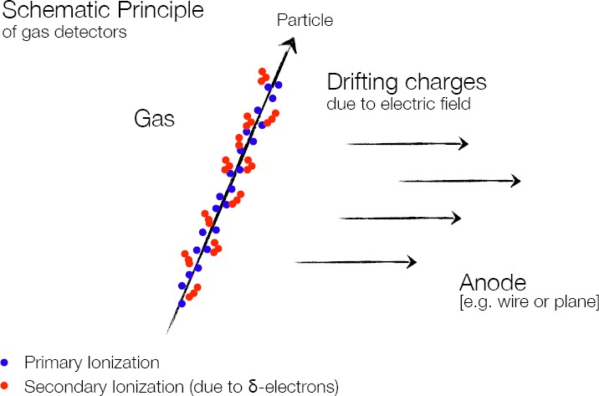
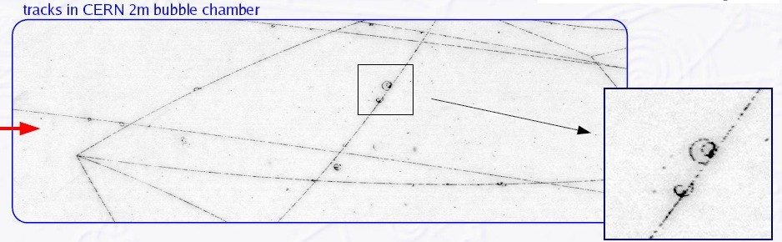
Ionization
δ-electron

Slide 4
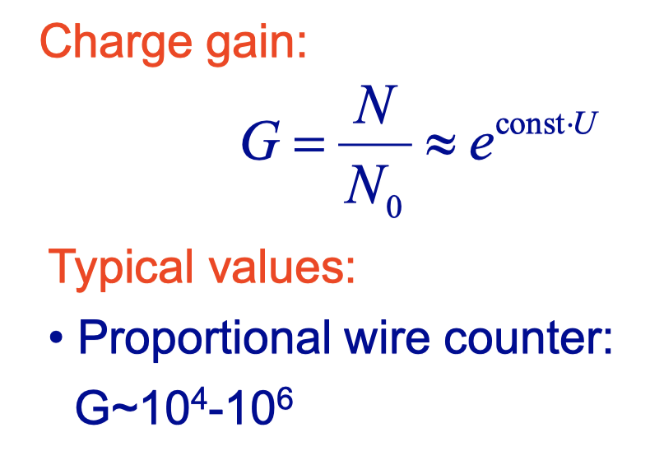
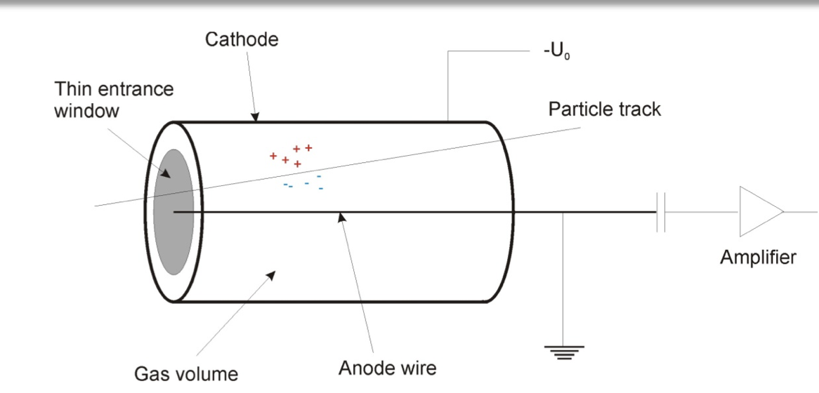
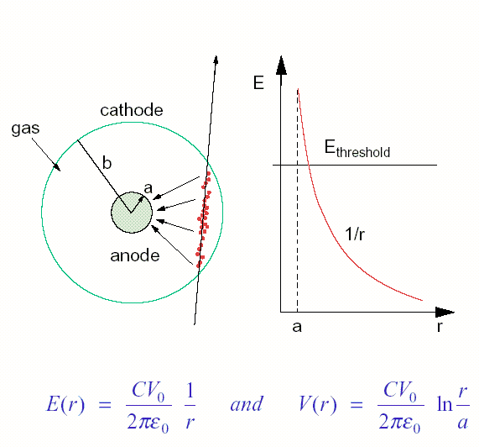
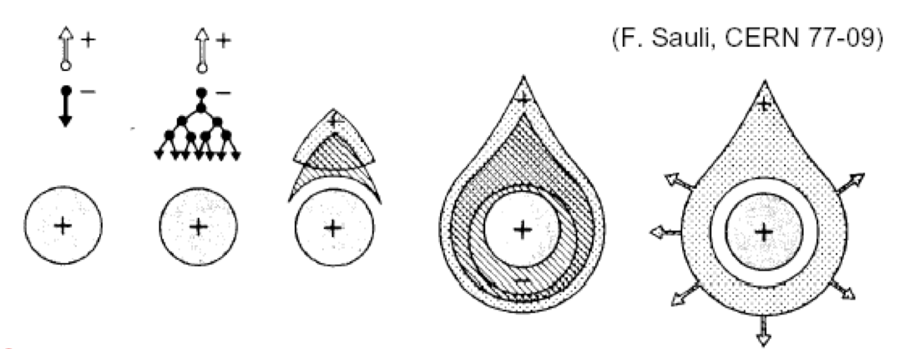

Drift Tube
Electric field
Using «typical» parameters
a = 20 μm
b = 5 cm
HV = 1000 V
E(a)~ 6.4 x 10 ⁶ V/m

Slide 5
Time Resolution
Time resolution in cylindrical gaseous detectors is limited by the variable amount of time the electrons need to drift from the points where they are produced to the region where multiplication takes place.
Electrons drift and arrive at the wire, one after another, depending on drift distance.
The signal on the wire comprises a series of signals (and typically the first is used for timing)
A 1 cm drift length variability, considering a drift velocity v_{d} ≈ 5 cm/μs, implies a time uncertainty of around 200 ns.
It was clear from the beginning that the way to increase time resolution was using a uniform electric field.
HV electrodes
If the electric field is intense enough everywhere, avalanches can grow everywhere
All clusters drift toward the anode with the same velocity and simultaneously originate avalanches.

Slide 6



How thick should be?
In a Parallel Plate gaseous detector, the whole detector volume is at the SAME time drift region and multiplication region, to reach electrical field similar required for the amplification, like wire detectors (~ 5-6x10^6 V/m in case of gas gap of 1 cm 50-60 kV are needed, challenging and costly power supply.
suitable solution is to reduce the gap thickness
Typically, down to 1-2 mm
1 mm gas gap → ≈ 5 kV of applied voltage
Primary ionization follows Poisson statistics, therefore the probability of NOT having any primary ion-electron pair in a thickness g (intrinsic inefficiency) is:
$${1−ε=e}^{−λg}$$
Where λ is the number of primaries per unit lenght (around 5-6/mm for the gas typically used in these devices).
For 1 mm, $1−ε=0.6 \%$
For 0.5 mm, $1−ε=8 \%$
(!!!)

Slide 7
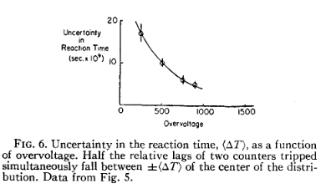
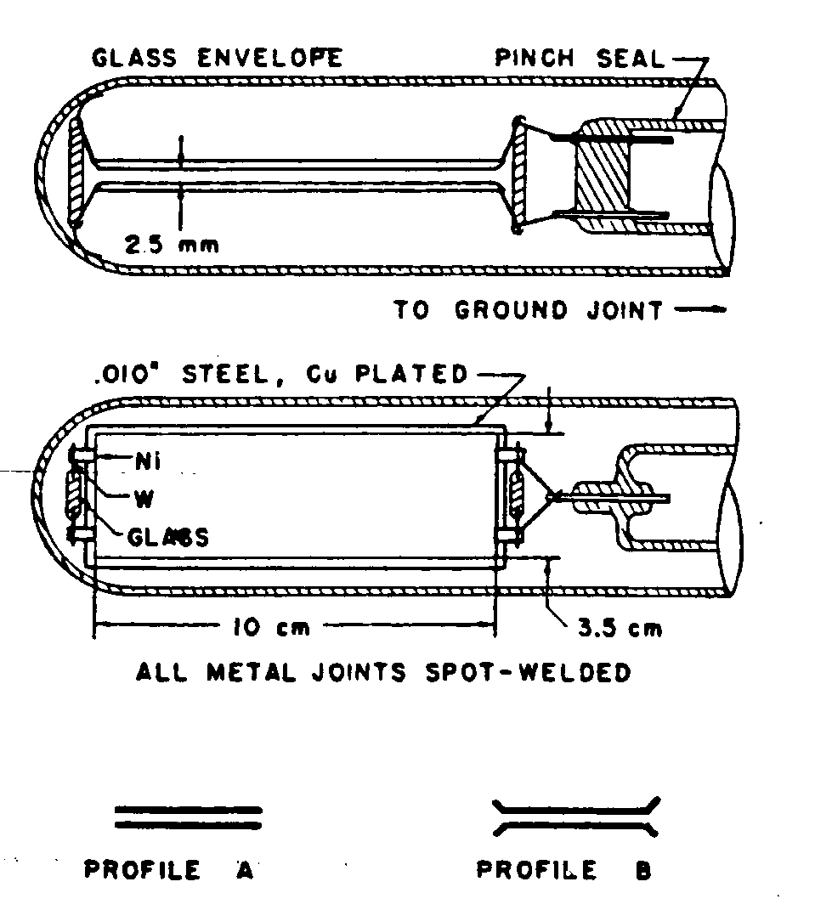
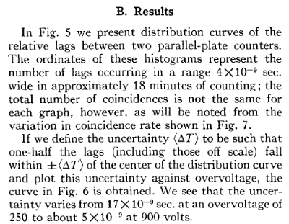
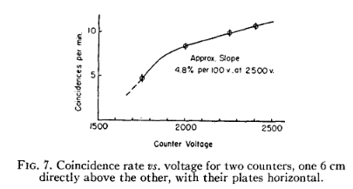
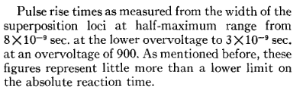
Keuffel’s Parallel Plate Chamber
Keuffel’s spark counters, introduced in 1949, featured two metal electrodes (Molybdenum disks) separated by 3 mm and with an area of 31 cm², using a Xilene (C₆H₁₂(CH₃)₂), Ar gas mixture, where the primary electrons deposited in the gap provoke a fast discharge and therefore a detectable signal.

Slide 8
Keuffel’s Parallel Plate Chamber
Characteristics of Keuffel’s PPC:
large signals ≈ 100 V (on 50 Ω)
time resolution ≈ 5 × 10⁻⁹ s
efficiency ≈ 90%
plateau from 0.9 to 3 kV
Extremely laborious surface preparation
cleaning of the electrodes with increasingly fine sandpaper;
washing with xylene
vacuum tube assembly
re-washing with xylene, alcohol, and distilled water;
evacuation of the tube under vacuum and heating for two hours at 200 °C
introduction of hydrogen (to reduce any oxides)
evacuation down to 10⁻⁵ mm Hg (or better)
cooling
filling with the active mixture: first xylene and then Ar, to form a layer of xylene on the electrodes
Problems:
To get intense electric fields, the electrodes are at few mm distance
Detector lifetime: few months
Limited because of the formation of a (micro) point on the electrodes where a discharge always originates

Slide 9
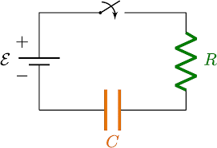
PPC and rate capability
A typical PPC is a planar capacitor: hence the equivalent circuit is an RC circuit.
A discharge in the gas volume behaves like a short circuit connecting anode and cathode of the capacitor.
PPC
Differently to what happens in cylindrical gaseous detectors, in planar gaseous detectors a discharge continues until the applied HV is removed.
After the passage of an ionizing particle, the applied HV was removed for a certain time (0.01-0.05 s) → suitable switch-off electronic circuits
The time needed to charge up again a capacitor is related to the time constant of the circuit τ=RC
The maximum frequency of particle detection (rate capability) is limited.

Slide 10
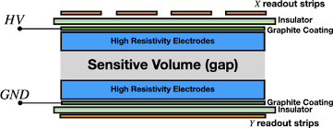
Introducing resistive elements
Put between planar conductive electrodes, resistive plates of suitable material.
In this configuration, the detector is still a planar capacitor but partially filled with a resistive material.
Once that the capacitor representing the gas gap is discharged because of the passage of an ionizing particle and subsequent discharge, its re-charging time is related to the time constant of this circuit:
d is the thickness of the resistive plates
g is the thickness of the gas gap
Electrons are collected on the anode in times of the order of few tens of ns
Ions are collected on the anode in times of the order of few tens of μs
For d=g=2 mm and ρ = 10 ¹¹ Ωcm, τ is few ms (milliseconds)!

Slide 11



Introducing resistive elements
During the discharge, and well after even the ions are collected, the resistive material behaves of all the cells not involved in the discharge acts like an insulator.
There is no more a complete short circuit between anode and cathode.
No need to switch ON and OFF the applied HV voltage.
HV
Ionizing particle
τ_{discharge} = 1/ηv_{d} ~ 10 ns
Time constant for charge development is related to drift velocity and multiplication
τ
<< τ
→
discharge
recharge
_{τ}
Time constant for recharge the elementary cell is related to the RC
recharge
=ρε ~ 10 ms
Since τ_{recharge} >> τ_{discharge} the arrival of the electrons on the anode is reducing the electric field and therefore the discharge will be locally extinguished.
The electrode are like insulator after the first charge development
Self-extinguish mechanism

Slide 12
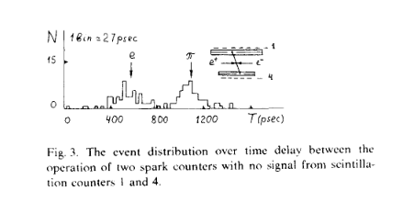
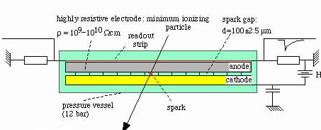
Pestov Spark Chambers
The Pestov spark counter, introduced in 1970, uses the same parallel plate geometry, with one electrode made from resistive material having a volume resistivity of ρ = 10⁹ − 10¹⁰ cm. The charge deposited locally on this resistive layer takes a time of τ ≈ ρε to be removed, where ε is the permittivity of the resistive plate. This time is very long compared to the timescale of the avalanche process, the electric field is therefore reduced at the location of the avalanche, avoiding a discharge of the entire counter. This allows stable operation of the detector at very high fields and particle rates. A counter with a size of 600 cm2 and a gas gap of 1 mm, operated at atmospheric pressure achieved a time resolution of <0.5 ns and efficiency of 98%. By decreasing the size of the gas gap to 0.1 mm and operating the detector at 12 bar pressure, a time resolution of 52 ps was achieved with this detector

Slide 13
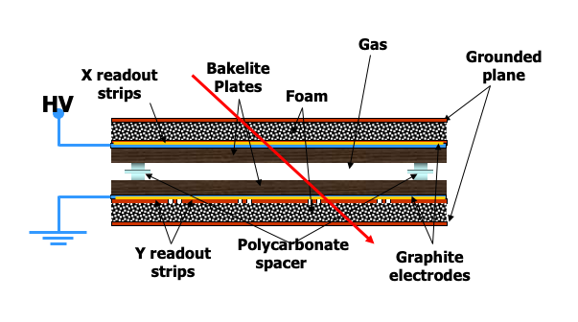
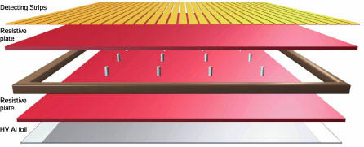
Resistive Plate Chambers
Resistive Plate Chambers (RPCs), introduced in 1982 by R. Santonico & R. Cardarelli are built on this same principle and they are widely used as trigger detectors and for time-of-flight measurements, as they allow relatively cheap large area construction. Large detector systems of several hundred m² surface have been built with Bakelite plates (ρ = 10¹⁰ − 10¹² cm) or window glass (ρ = 10¹² − 10¹³ cm).
Easy to build and not expensive
2 mm gap, 8-10 HV applied
Ar/isobutane/CF₃Br mixture
Full efficiency
Time resolution around 1-2 ns
Made planar gaseous detectors very «democratic», i.e. easy to build
Immediately used in many experiments, both at accelerators and for cosmic rays.

Slide 14
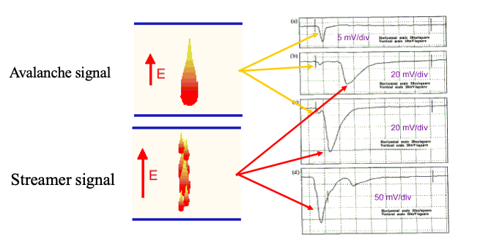
Resistive Plate Chambers
Originally RPC were operated in Streamer mode:
Ar-based mixture
Higher signal (100 pC) but also high current in the detector
Voltage drop at high particle rate → loss of efficiency
Operation with high particle rate possible in Avalanche mode:
Freon-based mixture
lower signal (~ pC) but also lower current in the detector
Less important high voltage drop at high particle rate
→ poor rate capability (< 100 Hz/cm²
→ good rate capability (∼ 1 kHz/cm²

Slide 15
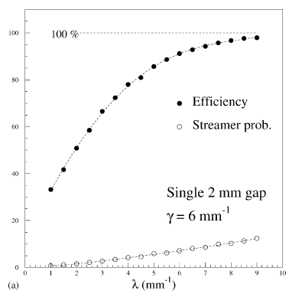
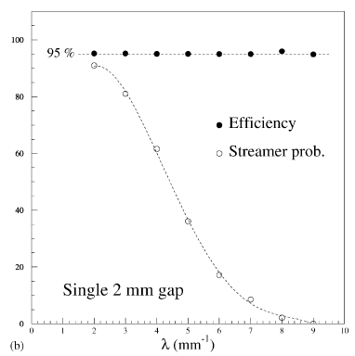
The RPC detector: gas mixture
Key parameters:
λ cluster density (primary clusters) – only gas dependent
α first Townsend coefficient (charge multiplication) – gas, HV dependent
β attachment coefficient – gas (electronegative and/or quencher), pressure dependent
η effective Townsend coefficient = α - β
➔ High λ gas:
high efficiency and low streamer probability at the same η!
i.e. for avalanche regime: better Freon (λ = 5.5 mm⁻¹) than Ar (λ = 2.5 mm⁻¹)

Slide 16
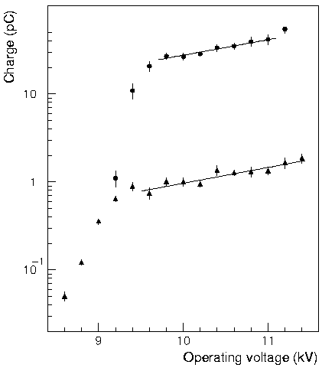
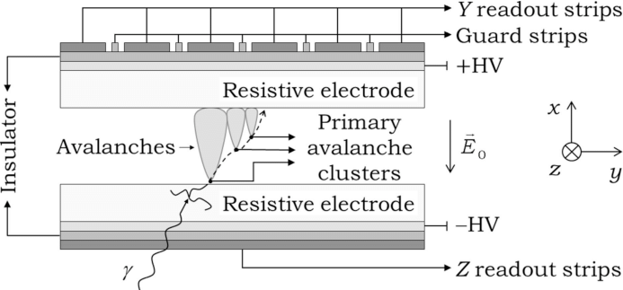
Streamer mode and rate capability
The localized voltage drop in and RPC is proportional to the size of the avalanche/streamer developed.
Note: an RPC is NOT a proportional counter, the final size of the avalanches depend on the distance from the anode the are originated.
Total charge (avalanche +streamer)
Charge avalanche only
Solution? You must reduce was as much as possible the percentage of streamers

Slide 17
The RPC detector: gas mixture and rate capability
Quencher (iC₄H₁₀) is not enough to keep the total charge at the level required to allow reasonable rate capability.
At the beginning of ‘90s RPCs represented an attractive solution for the muon system of the LHC experiments, but they were to be operated at fluxes around hundred(s) Hz/cm^{2,} LHC required kHz/cm²
The limitation in the time constant of an RPC
Reduce resistivity
On the AVERAGE, the voltage drop in the resistive plates is given by:

Slide 18
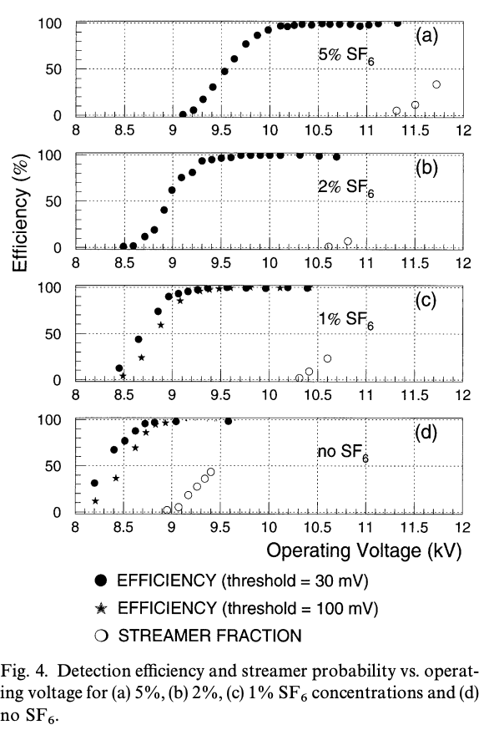
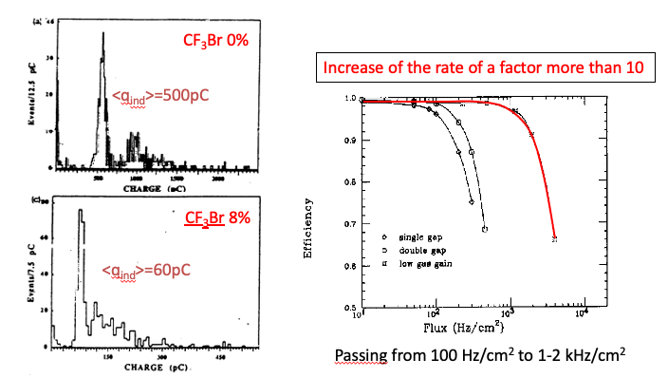
Streamer mode and rate capability
From Argon based mixture to «Freon» mixture and finally the SF₆
It was found that using strongly quenching gas mixtures helped in reducing the total charges
Increasing fractions of CF₃Br
Then replaced with mixtures made almost all of C₂H₂F₄ (tetrafluoroethane)
SF6 suppress the formation of streamers

Slide 19
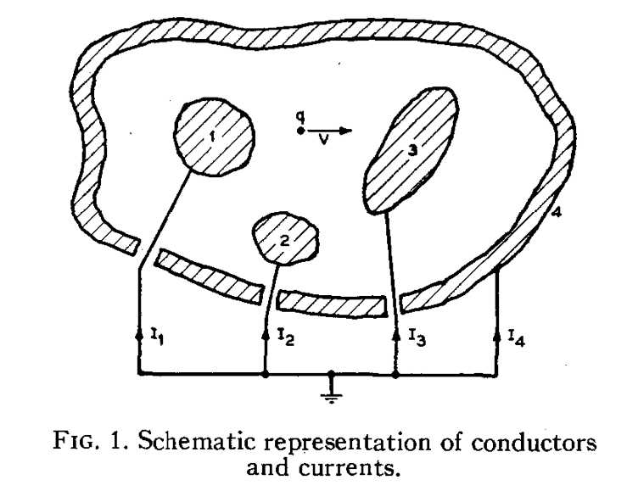
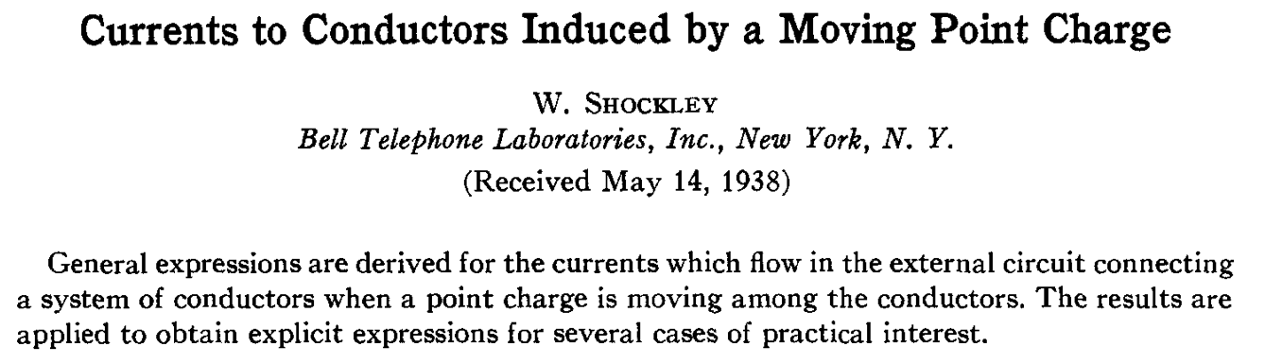
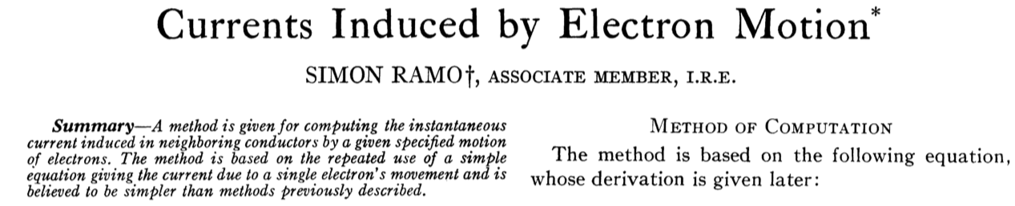

Why planar detector perform so well in timing ?
In ANY detector the signal is NOT generated when the charges are collected by the readout electrodes.
The signal is generated when the charges drift in the detector volume: when they are collected by the readout electrodes, everything is OVER.
V_{d}
O V
1 V
O V
Shockley–Ramo theorem:
The instantaneous current i induced on a given electrode due to the motion of a charge is given by.
i is NOT given by the arrival of the electrons!
The total signal is the SUM of the signal generated by multiple avalanches.

Slide 20
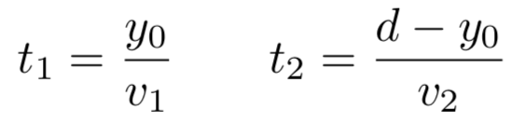

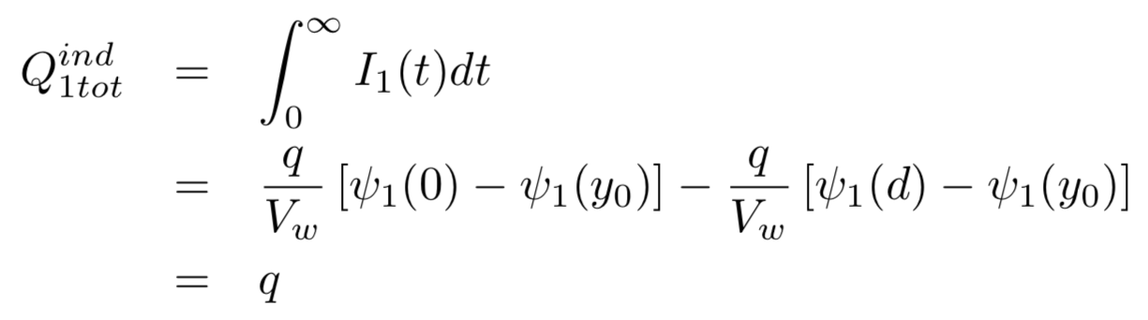
Why planar detector perform so well in timing ?
y
Two charges +q, -q moving from y₀ to the electrodes with velocities v₁ and v₂, arriving at the electrodes at times t₁ and t₂
Induced currents
Total induced charges
In all physics processes, pairs of charges with opposite sign are produced at the same position, which results in the fact that the total induced charge is equal to the charge that has arrived at the electrode, once ALL charges have arrived at the electrodes.
I₂^{ind}(t)
d
v₂
Q₂^{ind}(t)
y₀
+q
-q
v₁
Q₁^{ind}(t)
0
I₁^{ind}(t)
x
I₁(t)
0
t

Slide 21
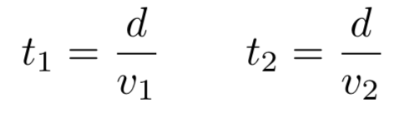
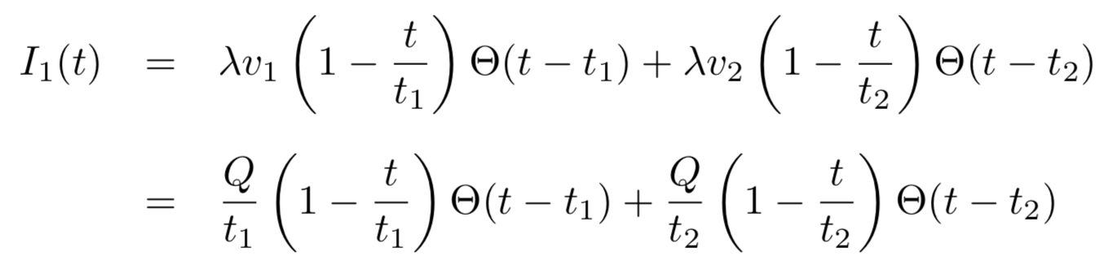
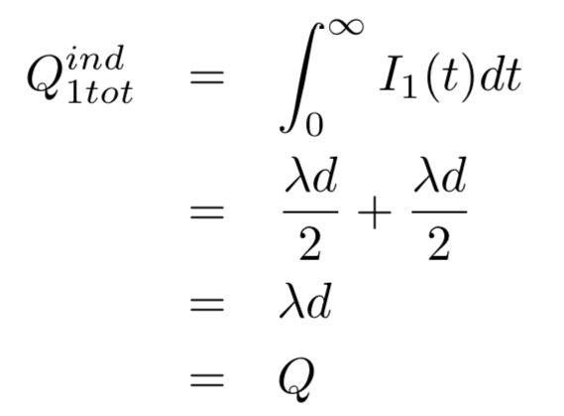

Why planar detector perform so well in timing ?
y
Charge particles passing sensors leave a trail of positive and negative charges (electrons/Ions, electrons/holes). Assuming a uniform distribution along the track we have two ‘line charges’ + λ, - λ (C/cm), moving with velocities v₁ and v₂, with the last charges arriving at the electrode at t₁ and t₂
The induced current due to the movement of these charges is the sum of two ‘triangles’, Q= λd
The total induced charge on electrode 1 is
I₂^{ind}(t)
d
v₂
Q₂^{ind}(t)
y₀
+λ
-λ
v₁
Q₁^{ind}(t)
0
I₁^{ind}(t)
x
I₁(t)
t

Slide 22

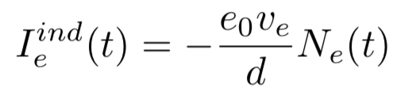
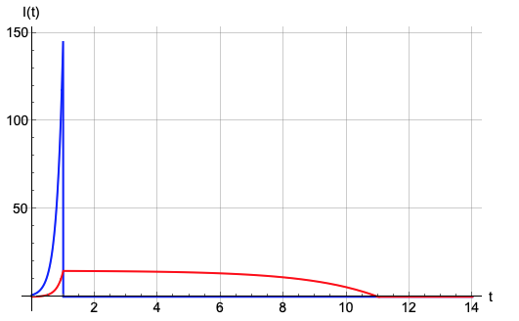
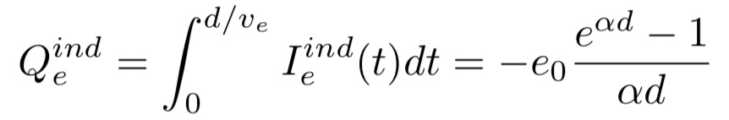

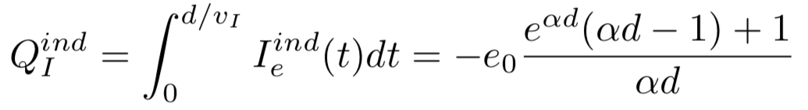
Why planar detector perform so well in timing ?
At sufficiently high electric fields (100kV/cm) the electrons gain energy in excess of the ionization energy → secondary ionization etc. etc. → exponential increase → avalanche → Townsend coefficient ⍺
The current induced by these moving electrons is
The ions move from the point of creation in opposite direction from the point of creation and the induced current is
The total charge induced by the electrons and the ions is
x
Ions
Electrons
E
I₁^{ind}(t)
Gain 10³: αd=7
Gain 10⁴: αd=9.2
electrons
Ions

Slide 23
Why planar detector perform so well in timing ?
Given the fact that the electric field is uniform in the gas gap of a planar gaseous detector (at least at low rate), semi-analytical description of its behaviour can be found. Signals developed can be approximated like follows:
Here, we neglect saturation effects (correct if we consider the initial stages of the avalanches), and:
v_{d} is the electron drift velocity (assumed constant with time);
E_{w} is the weighting field (assumed uniform in space);
η is the first effective Townsend coefficient
M_{j} is the avalanche fluctuation coefficient
t is the time elapsed since the passage of the ionizing particle

Slide 24
Why planar detector perform so well in timing ?
Inverting the previous equation (with some approximations), one can deduce an estimate for the time resolution for planar gaseous detectors:
Factors under the square root depend on the specific gas or statistic and little can be done.
Here it is clear what an experimentalist can do to improve time resolution:
Improve drift velocity v_{d} (choose the suitable gas, since it tends to saturate at high fields)
Increase first Townsend coefficient → high electric fields
The applied HV is somehow limited by technological reasons, (Pestov used a very narrow gap with a quite intense electric field.)

Slide 25
Multigap RPCs
ALL electron avalanche processes start immediately: the induced signal (due to movement of charge) is the sum of all avalanches: thus, all ionisation produced in chamber plays a role.
The avalanches originating close to the anode might not grow large enough to give rise to a detectable signal.
The avalanches originating close to the cathode might
To get all these avalanches to produce EACH a detectable signal, the gain (namely the electric field) is set very high.
This implies production of streamers or sparks from the avalanches starting close to the cathode.
Solution: add barriers within the gas gap to stop the development of the avalanche.
Reduce the dynamic range
Since the gap is narrow, the gain can be set very (VERY) high.

Slide 26
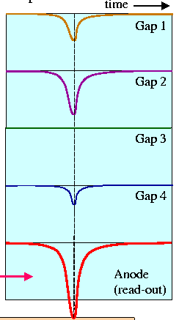
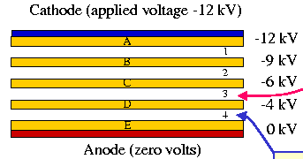
Multigap RPCs
Stack of equally-spaced resistive plates with voltage applied to external surfaces (all internal plates electrically floating)
Pickup electrodes on external surfaces (resistive plates transparent to fast signal)
Internal plates take correct voltage - initially due to electrostatics but kept at correct voltage by flow of electrons and positive ions – feedback principle that dictates equal gain in all gas gaps
The signal is the analogic SUM of the signals from all the gaps.
The signal is generated when the charges drift in the detector volume
Shockley–Ramo theorem:
The instantaneous current i induced on a given electrode due to the motion of a charge is given by.
i is NOT given by the arrival of the electrons!

Slide 27
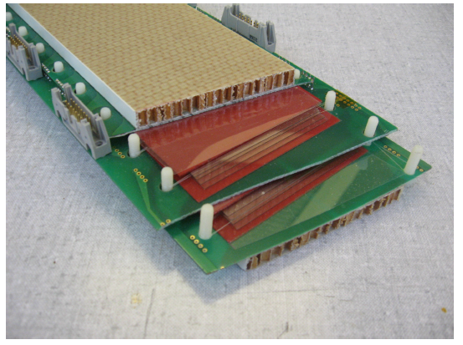
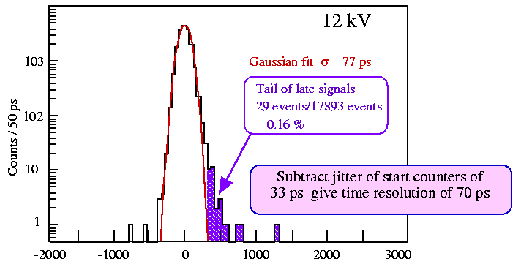
Multigap RPCs
Using tiny gap, the electric field can be increased quite high
The first Townsend coefficient is really (REALLY) high.
Excellent time resolution

Slide 28
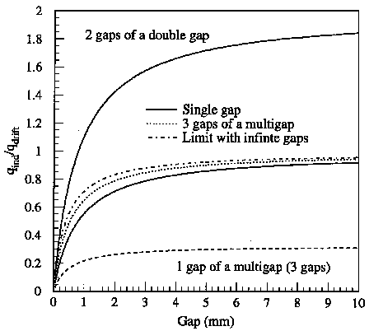
Multigap RPCs
It might seem that increasing the number of gaps to infinite we would get the perfect detector. Actually, the contribution of each gap to the induced signal reduces increasing the number of gap.
Single gap
ΔV_{w}=1V
Ratio between induced and drifting charges
Double gap
ΔV_{w}=1V
ΔV_{w}=1V
Multigap (3 gaps)
ΔV_{w}=1/3V
ΔV_{w}=1/3V
ΔV_{w}=1/3V

Slide 29
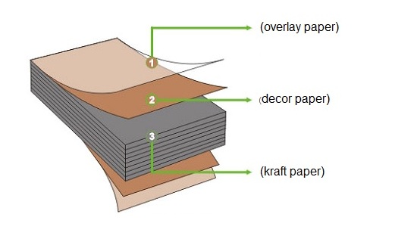
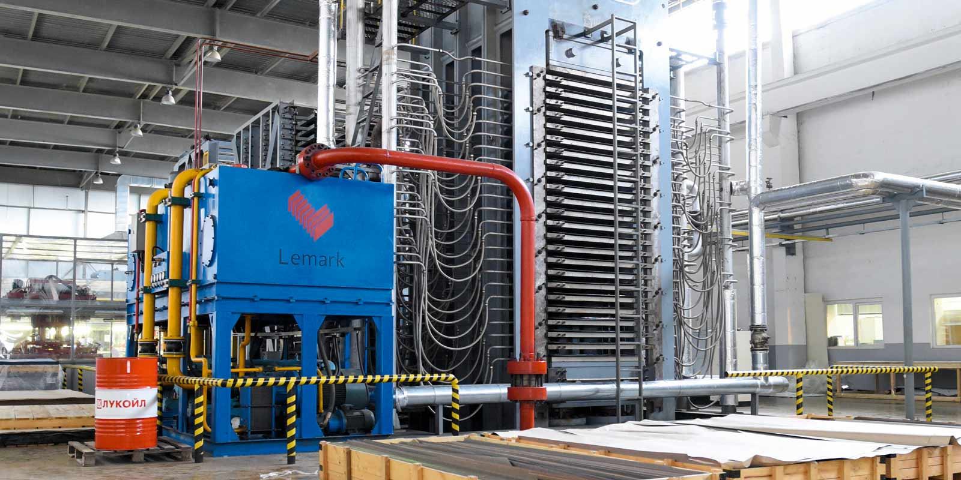
Manufacturing RPC
Bakelite: The basic element
High Pressure Laminate ranging between 10^9 and 10^12 Ohm cm
Such resistivity range is not common
High Pressure Laminate :
Low cost per unit surface
High mechanical stability
Carriers are water ions (internal water concentration goes in equilibrium with the environment)
The plate is in between 1 and 2 mm
It is produced by pressing together at high temperature a core of several layers of kraft paper impregnated with phenolic resin, finished externally with melamine impregnated paper.
The hot press produces the resin polymerization
The melamine provides a harder surface and carries most of the resistivity

Slide 30
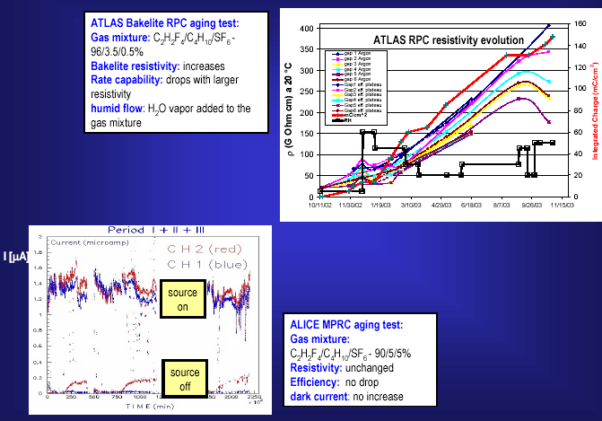
Manufacturing RPC
HPL is hygroscopic
It behaves as porous water container setting surrounding environment to an equilibrium point around 40% RH
Experimentally, bakelite resistivity seems to increase with time.
This is increase can be controlled by enriching with H₂O vapor the gas mixture used.

Slide 31
Manufacturing RPC
The other characterizing feature is the uniform and strong electric field → plate configuration.
The advantage is the production of a signal without delay and the naturally achieved 3D+t localization of the hit with high space-time resolution, on large surfaces.
The disadvantage is that it is difficult to maintain such a configuration in a stable way, due to the spontaneous electron emission from the electrode surface, by edge effect (cold electron extraction)
The resistive plate prevents the lateral propagation of the discharge, but the spontaneous discharges may overwhelm the detector response
This is affecting in particular HPL electrodes → the surface finishing is determined mechanically determined by the press iron plate finishing. Moreover, HPL is a multilayer polymer. The expected local roughness distribution is wide, with an average of the order of 1 mm
For glass RPC not a problem, glass is a liquid so naturally smooth (roughness from 10 to 100 nm)

Slide 32
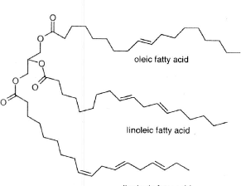
Manufacturing RPC
Treat the surface with linseed oil
What is the linseed oil:
Drying oil (consists basically of triglycerides )
Drying is related to C=C group in fatty acid
Cross-linking (polymerization) in presence of air (O₂ play important role) due to C=C
RPC electrodes are usually treated with linseed oil:
better quality of the internal electrode surface
it acts as a quencher for UV photons
better detector performance
…but…
More time needed during construction
Ageing problems? (Not observed)

Slide 33
Manufacturing RPC
Treat the surface with linseed oil
HPL was the first material used for RPCs
A very special procedure has been invented to have a glass-like finishing
Varnishing the internal surface with a few μm layer of linseed oil
Linseed oil was the “secret” of the Flemish painters in the XVI century…
Upon polymerization, linseed oil forms a hard and glossy surface, and its resistivity is similar to the one of HPL
Oiling is applied by slowly filling and emptying gas volumes vertically held, with a mixture of linseed oil and heptane, and subsequently stimulating the polymerization (oxygen driven) by flushing the gas volumes with clean air.
The polymerization lasts a few days and is performed at T> 30 °C

Slide 34
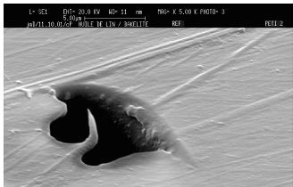
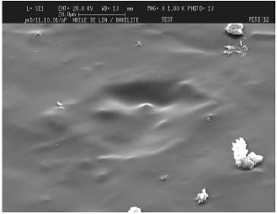

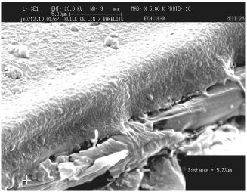
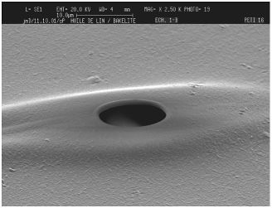
Manufacturing RPC
Treat the surface with linseed oil
Defect on Bakelite surface possibly covered with linseed oil
Few SEM photos (S.Ilie, C.Petitjean EST/SM-CP EDMS 344297):
Thickness of the layer: ~ 5 μm
The linseed oil layer is damaged
by a surface outgassing

Slide 35
An historical achievement
First plateau using linseed oil (by R. Cardarelli)

Slide 36
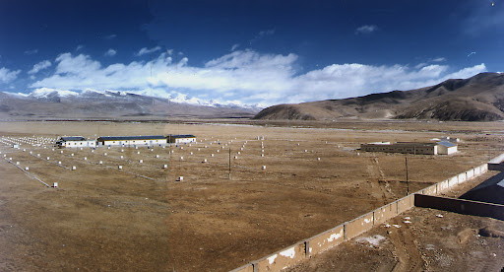

RPC in HEP and not only
Argo-YBJ experiment, on the Tibet, fully implemented with RPCs
RPC applications:
‘85: Nadir (n-n\bar oscillation) – 120 m² (Triga Mark II –Pavia)
‘90: Fenice (J/Ψ → n-n\bar) – 300 m² (Adone – Frascati)
‘90: WA92 – 72 m² (CERN SPS)
‘90: E771– 60 m²; E831 – 60 m² (Fermilab)
1992: development of RPC detector suitable to work with high particle rate
→ towards application at LHC
1994-1996: L3 – 300 m² (CERN-LEP)
1996-2002: BaBar – 2000 m² (SLAC)
E771
Three planes of RPCs

Slide 37









RPC in HEP and not only
Mostly used as extensive (up to ~ 200 m²) TOF systems with time resolution up to 50 ps
ALICE@CERN
10.1016/S0168-9002(01)01753-3
FD-HADES@GSI
CBM@FAIR 10.1088/1748-0221/14/09/C09020
HADES@GSI
10.1016/j.nima.2008.12.090
FOPI@GSI
10.1016/j.nima.2004.07.002
MPD, BM@N at NICA facility 10.1051/epjconf/201817112001
SoLID (Jefferson Labs)
arXiv:1409.7741v1 [nucl-ex] 26 Sep 2014

Slide 38
RPC drawback: Aging
The presence of tetrafluoroethene and SF₆ in the gas mixture used for the RPCs, which is also humidified, leads to the formation of HF (hydrofluoric acid), which can attack the internal surfaces of the gas gap, in particular the thin linseed oil film
Surface defects, possibly generated by HF (hydrofluoric acid), can distort the electric field and locally increase its intensity, leading to local variations in gain and the formation of streamers. These streamers can in turn damage the surfaces at specific points, creating a negative feedback loop that results in continuous, albeit localized, discharges in the RPCs.
Initially, this manifests as a local increase in background and dark current (since RPCs are resistive, they discharge locally). However, over time, the production of HF can damage larger areas of the detector, while the dark current can alter the resistivity of the bakelite or, in some cases, lead to the evaporation of the graphite layer deposited on the outer surface of the bakelite, which is used as the conductive material for generating the electric field.

Slide 39



RPC drawback: Aging
BaBar RPCs: Effects of improperly polymerized linseed oil

Slide 40





RPC drawback: Aging
BaBar RPCs: Sudden drop in gap current and detector failure
Here is a key point: the graphite evaporates in high-current regions.

Slide 41

RPC drawback: GHG

Slide 42





RPC drawback: GHG
increase of HFO
increase of w.p.
R134a (C2H2F4) GWP 1430
HFO-1234ze (C3H2F4) GWP 6
11% streamer
5% streamer
0.3% streamer
HFO cannot directly replace C2H2F4
Higher applied voltage necessary (>14 kV)
- In std gas mix ~9.5 kV
Addition of an “inert” gas to lower the w.p.
Helium and CO2 help in reducing the w.p
- + 10% CO2 —> ~1 kV
Eco-friendly gas mixtures have higher charge with respect to standard gas mixture
Higher streamer fraction
Higher currents
Higher production of fluoride
increase of currents
Concerns about possible aging eﬀects

Slide 43


RPC drawback: GHG
SF₆ has a very high GWP and it contributes for ~5% in the GWP of RPC gas mixture even if it is used in very small concentration
SF6 has excellent dielectric properties and it is the strongest electronegative gas present in nature
3MTM NovecTM Dielectric fluids: alternatives to SF6 for arc quenching and insulation applications
Developed few years ago and used in HV industrial plants
Under discussion their use in the future
Excellent performance for NOVEC 4710 in RPC but reactivity under study
Reactions with H2O and UV light
CF3I also very promising
But toxic so not suitable for LHC experiments
Studies have to be pursued on chemical aspects of these gases (and HFO)
Streamer at w.p. 0.3% SF6: 0.4%
1.5% C4F8O: 1.8%
0.3% CF3I: 1%
2% NOVEC 5110: 0.7%
0.1% NOVEC 4710: 0.2%
0.3% HFO1224YD: 1.6%
Until now no eco-friendly gas mixtures have been found to completely fulfil the requirements for already installed RPCs at LHC experiments

Slide 44



ATLAS RPC Personal experience
Facility built in the Lecce INFN and Physics Department High Energy Laboratory to test (> 500 RPCs) part of the Resistive Plate Counters (RPCs) of the ATLAS barrel muon spectrometer is presented. In this cosmic ray test stand the chambers were operated for the first time, after being assembled and equipped with all required services for gas and electrical connections. A complete set of measurements performed on each chamber in order to certificate its quality and performances before the installation in the experiment.

Slide 45
References
J.W. Keuffel, Rev. Sci. Instrum. 20 (1949) 202; (b) J. Christiansen, Z. Angew. Phys. 4 (1952) 326.
V.V. Parkhomchuk, Y.N. Pestov and N.V. Petrovykh, A spark counter with large area, Nucl. Instr. and Meth. A 93 (1971) 269–270
Yu.N. Pestov, Status and future developments of spark counters with localized discharge, Nucl. Instr. and Meth. A 196 (1982) 45–47
R. Santonico, R. Cardarelli, Development of Resistive Plate Counters, Nucl. Instr. and Meth. A 187 (1981) 377
P. Camarri et al./Nucl. Instr. and Meth. in Phys. Res. A 414 (1998) 317—324
E. Cerron Zeballos, I. Crotty, D. Hatzifotiadou, J. Lamas Valverde, S. Neupane, M.C.S. Williams, A. Zichichi
Nucl. Instr. and Meth. A, 374 (1996), p. 132
M.C.S. Williams, et al. Nucl. Phys. A, 661 (1999), p. 707
F. Ferroni, Lezioni sui rivelatori, V. Gualino 2006
3rd International Conference on Detector Stability and Aging Phenomena in Gaseous Detectors

Slide 46
Backup

Slide 47

Back to rate capability
In a Parallel Plate Detector, with metallic electrodes, the whole electrodes as discharged as a consequence of the development of a discharge.
In a Resistive Plate Chamber (RPC), only a localized region is discharged, with dimensions close to the avalanche disk size.
BUT it remains discharged for much longer time, because the resistive component of the time constant τ is much (MUCH) larger.
Low resistivity
Net result is a decrease of the efficiency vs. rate of impinging particles, depending on the resistivity value.
High resistivity
Note: this is a result of the beginning of 1990s: now we can do much better!

Slide 48
home.cern

