Slide 1
Gaseous particle detectors
Michele Bianco, CERN EP-CMX-IC
PhD Lectures 2026, Siena, 13th-14th May 2026

Slide 2
Lecture #3: Wire chambers (and not only)
Ionization and proportional gaseous detectors
  (Recap from lecture 1)
Multiwire Proportional Chamber
Cathode Readout
CMS Cathodic Strip Chamber (CSC) and ATLAS Thin Gap Chambers (TGC)
Straw Tubes
Large Volume Chambers
Drift chambers, Time Projection Chambers
Limitations of Wire-based Detectors
Rate limitation vs gas mixtures, Aging/discharge
Toward a new family of gaseous detectors
Spare material: Very precision tracking with gaseous detectors
Straw tubes + TRT; Cluster counting technique

Slide 3
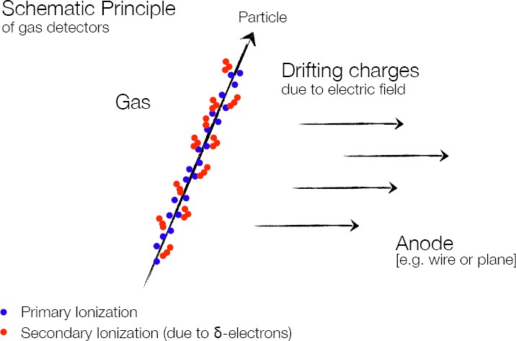
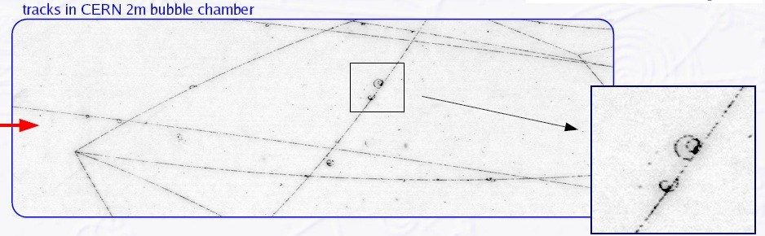
Ionization
δ-electron

Slide 4
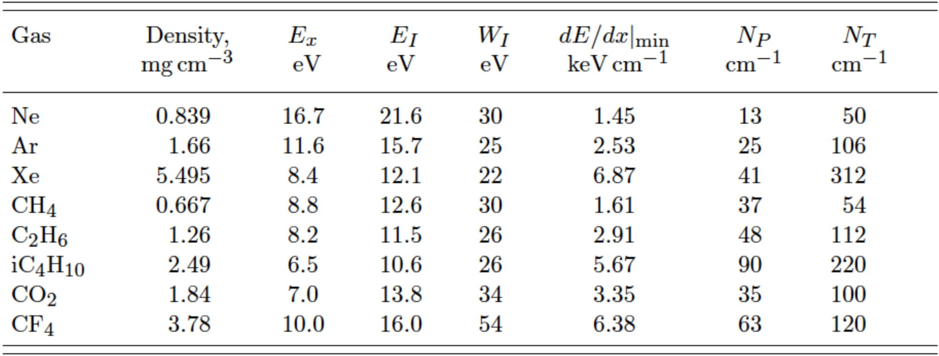
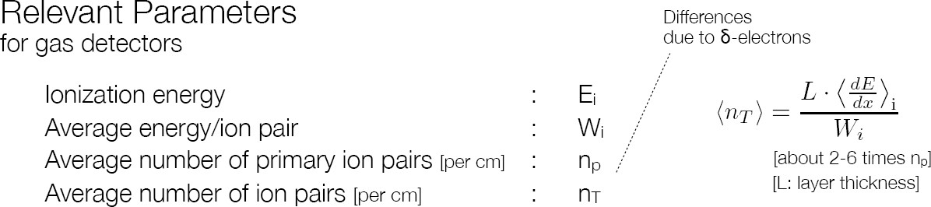
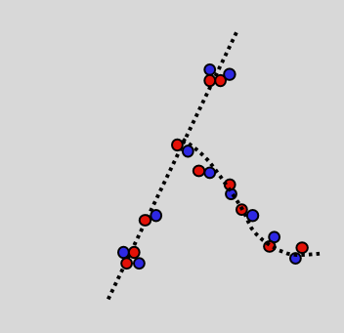
Ionization
Primary ionization
X +p → X⁺ +p + e⁻
p = charge particle traversing the gas X = gas atom
e⁻ = delta-electron (δ)
if E_{δ} is high enough (E_{δ}>E_{i})
Secondary ionization
X + e⁻ → X⁺
+ e⁻ + e⁻
PRIMARY IONIZATION:
TOTAL IONIZATION:
Typical values:
E_{i} ~ 20 eV, Wi ~ 25 eV
n_{T} ~ 100 pairs/cm / 3 keV incident particle

Slide 5
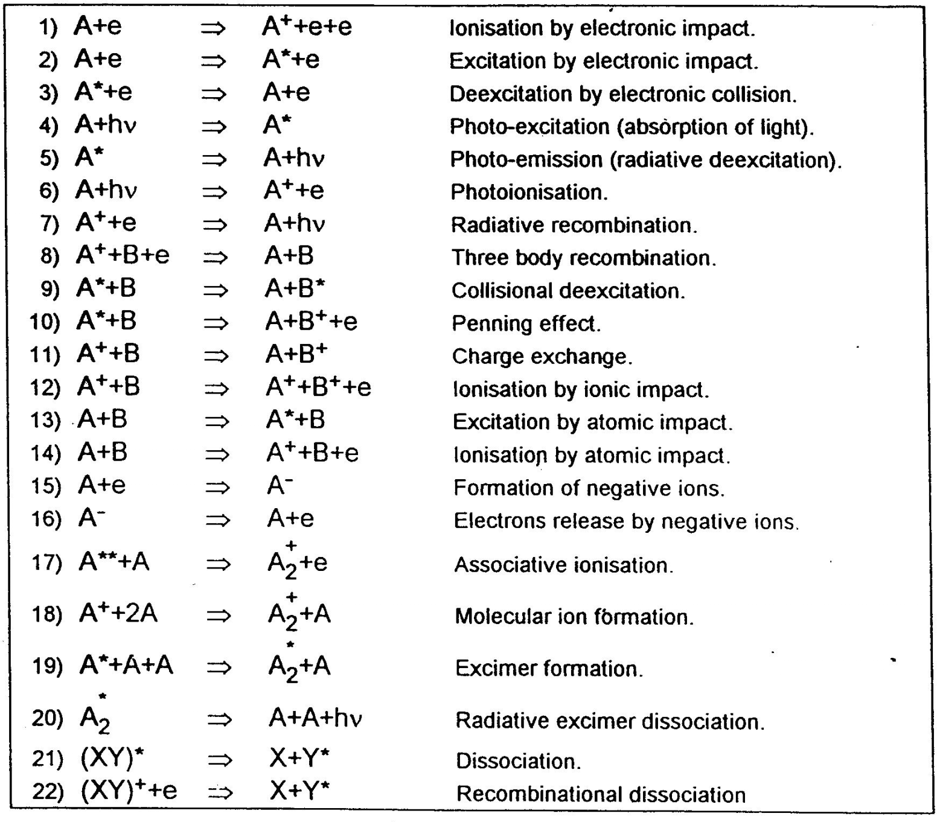
HIGH FIELD-INELASTIC COLLISIONS
L
-U₀
Amp
R
cathode
anode
J.Meek and J. D. Cragg, Electrical Breakdown of Gases (Clarendon Press, Oxford 1953)

Slide 6
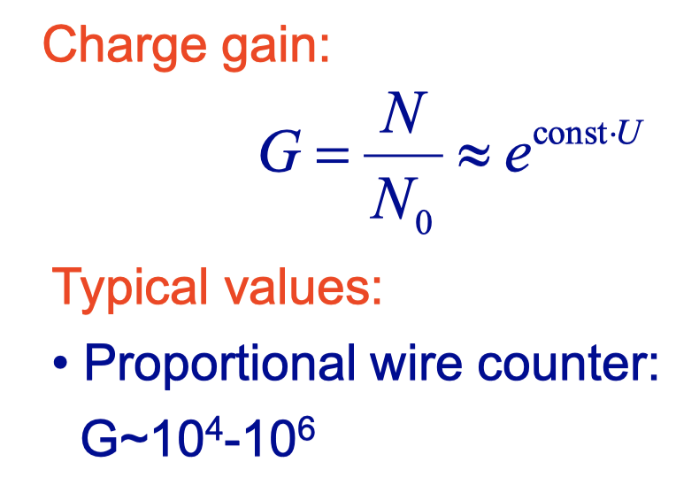
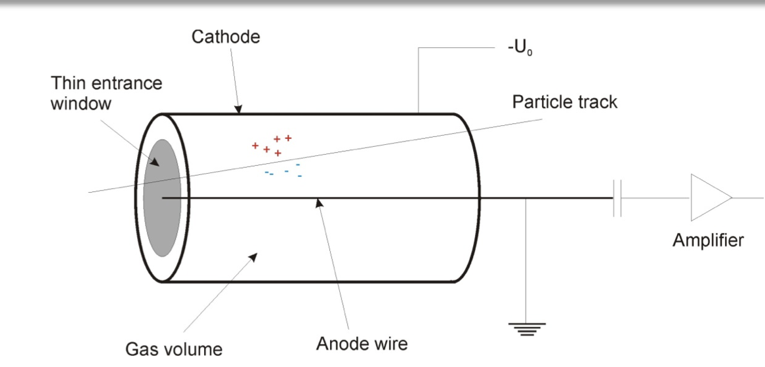
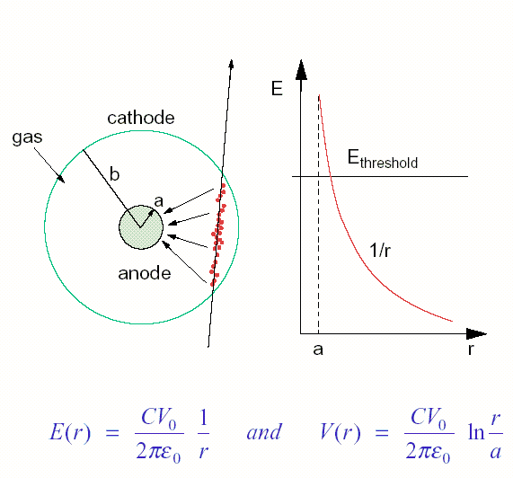
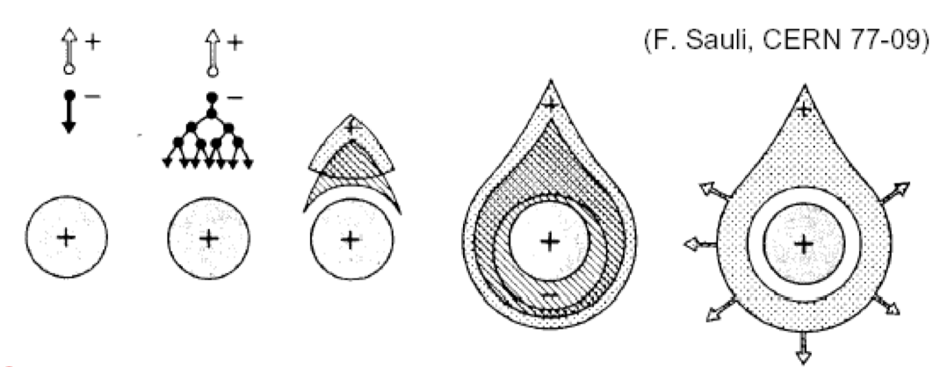

Drift Tube
Electric field

Slide 7
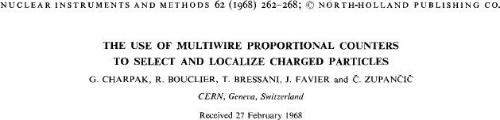
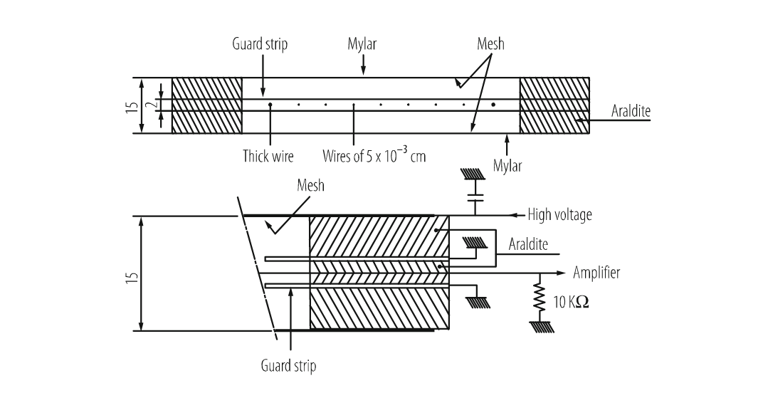
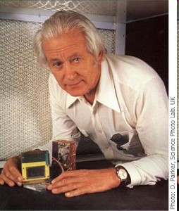
Multiwire proportional chambers
MWPC [G. Charpak et al., NIM 62, 262 (1968)]
Up to now (today and past lectures on Gas Detectors):
we have defined the ionization and avalanche multiplication process
we presented a single wire proportional counter
with it we can measure the pulse signal from ionization
Multi-wire proportional chamber
G. Charpak Nobel price (1992)

Slide 8
Multiwire proportional chambers
The invention of the Multi Wire Proportional Chamber (MWPC) by Georges Charpak in 1968 was a game changer, earning him the 1992 Nobel Prize in Physics. Suddenly, experimenters had access to large-area charged particle detectors with millimeter spatial resolution and staggering MHz-rate capability. Crucially, the emerging integrated-circuit technology could deliver amplifiers so small in size and cost to equip many thousands of proportional wires.
This ingenious and deceptively simple detector is relatively easy to construct. The workshops of many university physics departments could master the technology, attracting students and “democratizing” particle physics. So compelling was experimentation with MWPCs that within a few years, large detector facilities with tens of thousands of wires were constructed […].
C.W. Fabjan, CERN courier, March 22nd 2019
G. Charpak, F. Sauli and J.C. Santiard

Slide 9
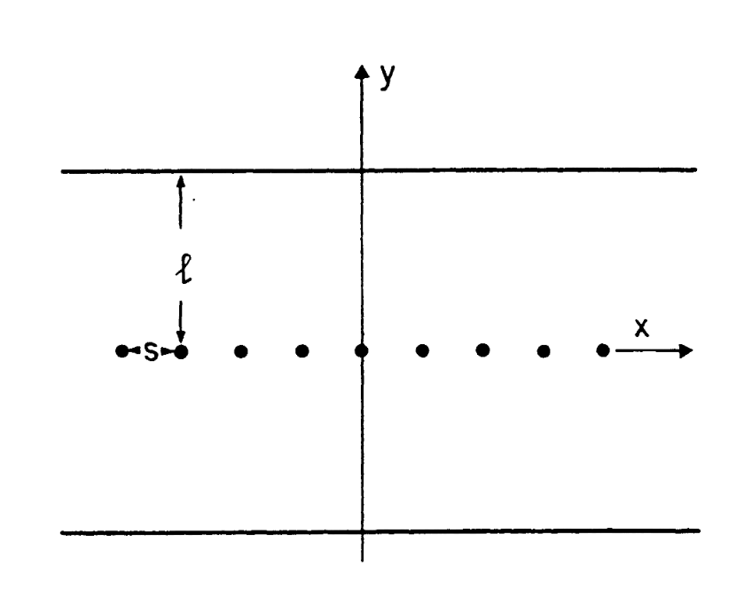
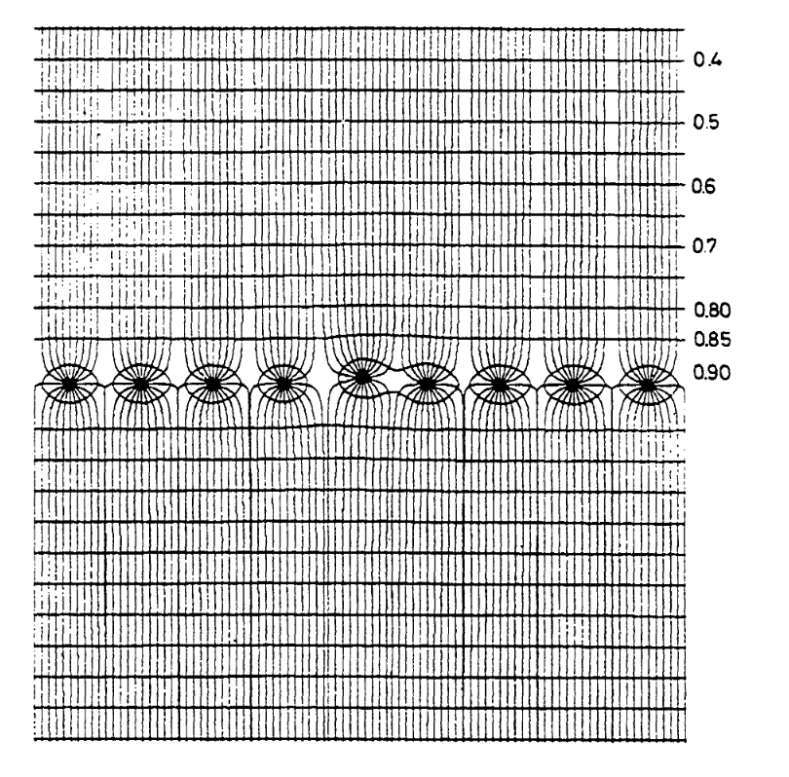
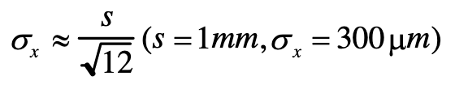
Multiwire proportional chambers
A MWPC consists of a set of thin, parallel and equally spaced anode wires, symmetrically sandwiched between two cathode planes.
For proper operation, the gap “l” is normally three/four times larger than the wire spacing “s”
Typical parameters are an anode spacing s, of 1 mm, anode to cathode distance of 3-5 mm, and diameter of anode wires ~ 20 μm.
With a digital read-out the spatial resolution is limited to:
Electrical field within a MWPC, around the wire and defect due to the misplacement of wires

Slide 10
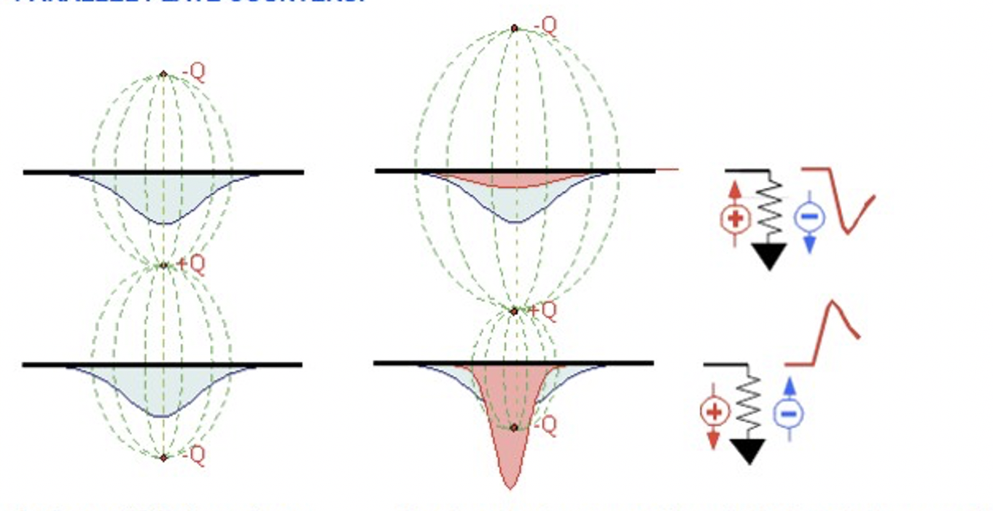
Cathodic Readout: Basic Principle
A charge +Q between two conductors induced two negative charge profiles (image charge)
A charge moving between the electrodes modify the induced charge profile on the conductors generating a detectable signals

Slide 11
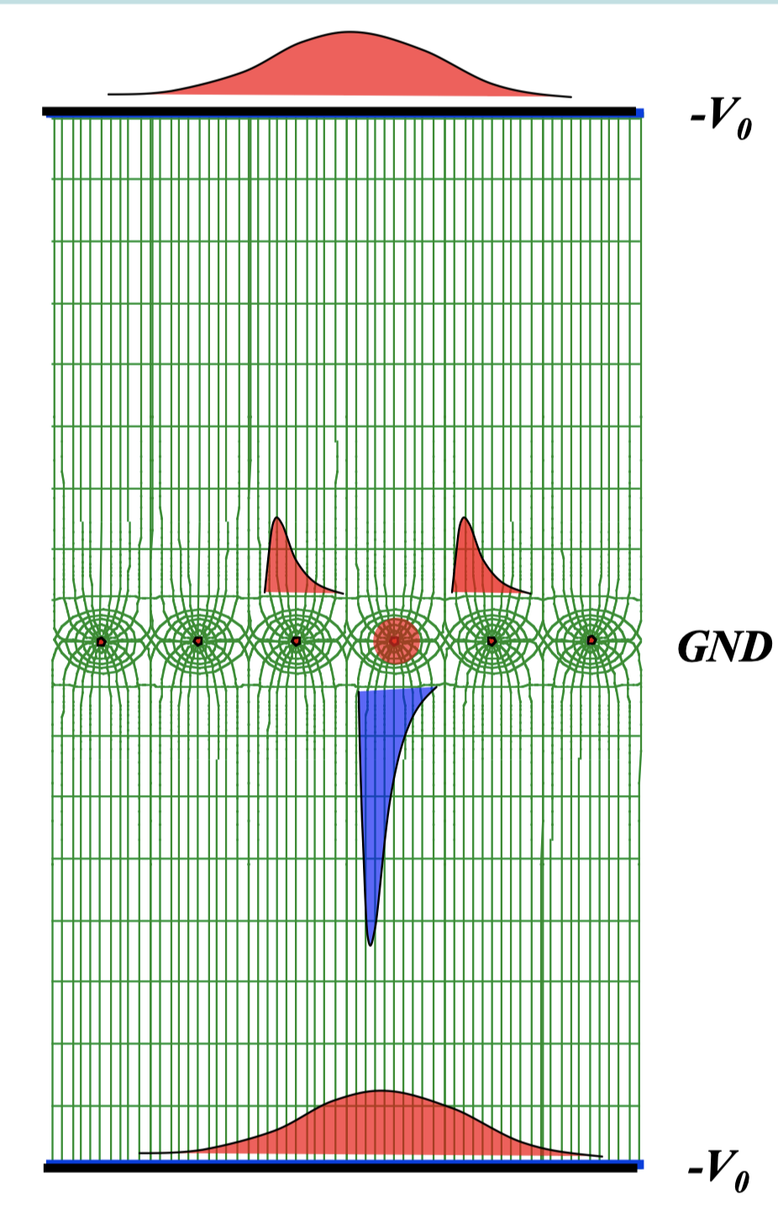
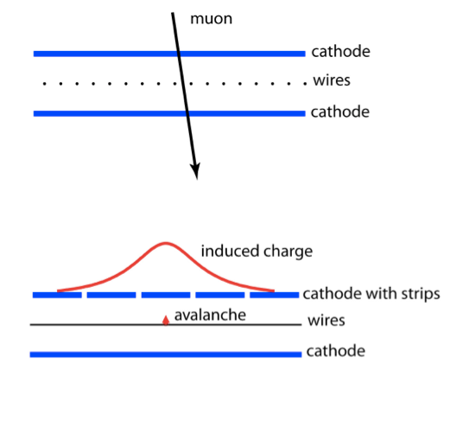
Cathode Strip Chambers
In 1968 Charpak with co-­‐authors investigated a possibility of detection coordinates by detecting the positive signals from segmented cathodes (strips).
It was found that the center of gravity of charge distribution gives very high space resolution along the wire(~50 μm).
The space resolution mostly depends on a wire-­‐cathode distance and the strip width.
The method needs measurements of strip signals with precision of ~1%. That was the main reason of sometime delay in developing CSC technique.

Slide 12
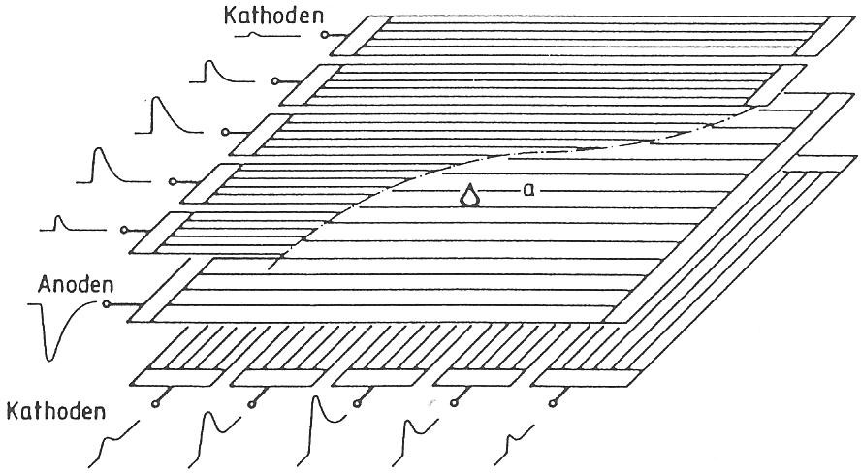
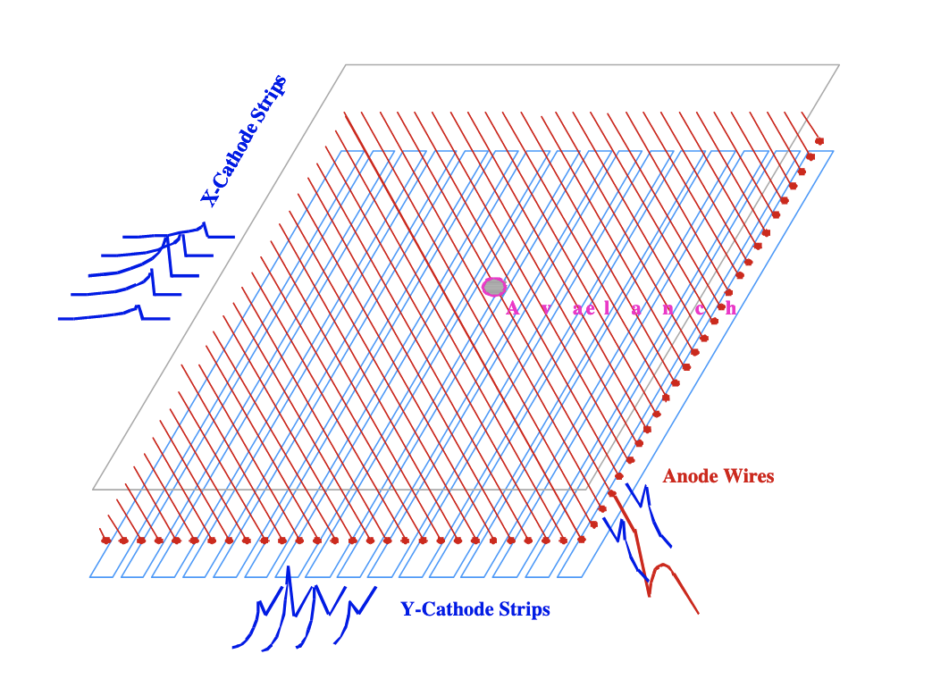
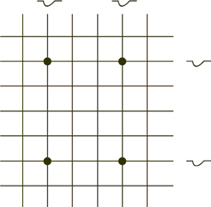
Cathode Strip Chambers
Segmented cathodes:
cathode strips (often perpendicular and parallel to anode wires)
cathode wires
Pads/Strips
Avalanche induces signals on cathode strips/pads with amplitude varying with the distance to the avalanche
Analog readout (ADC), allow for center-of-gravity method
𝜎~50 − 100 𝜇𝑚
with clusterization
Problem at higher particle rates: ambiguities (if >1 particle at the same time)
multiple projections, pads, pixels

Slide 13

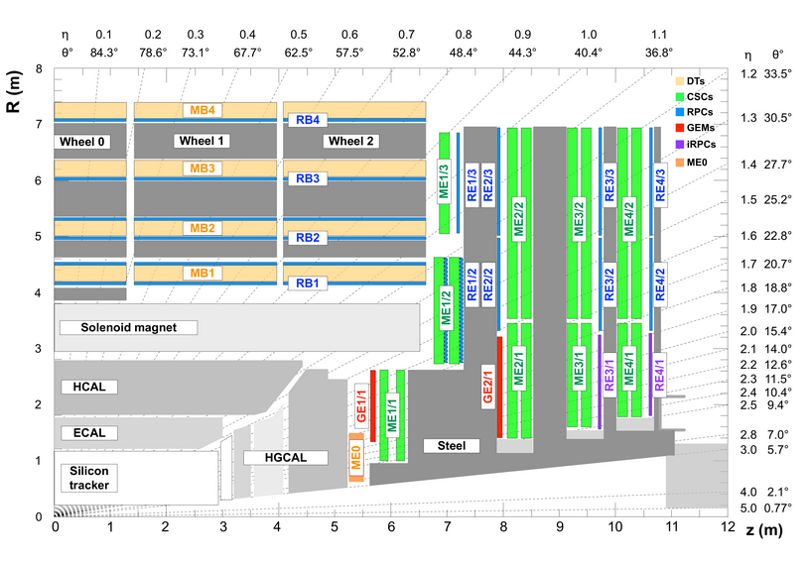
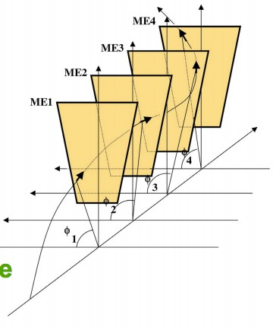
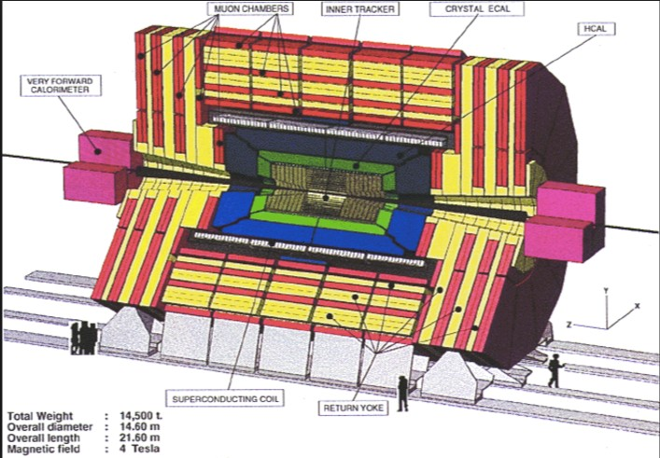


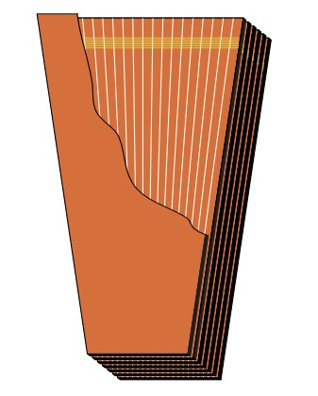
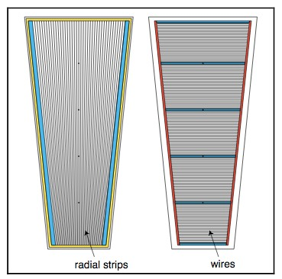
CMS Cathode Strip Chambers
φ
dB/dR
Main goal of endcap muon detectors is to define the bending angle of muon in the magnetic field of steel disks.
It means that a detector need a good space resolution in direction perpendicular to the radius of a disk (strip segmentation). Second coordinate is not very critical.
3 CSC rings in the station 1, and 2 rings in the stations 2-4.
Trapezoid in shape with 6 sensitive gas gaps each.
Strips radially and wires stretched across strips and joint in wire groups.

Slide 14





























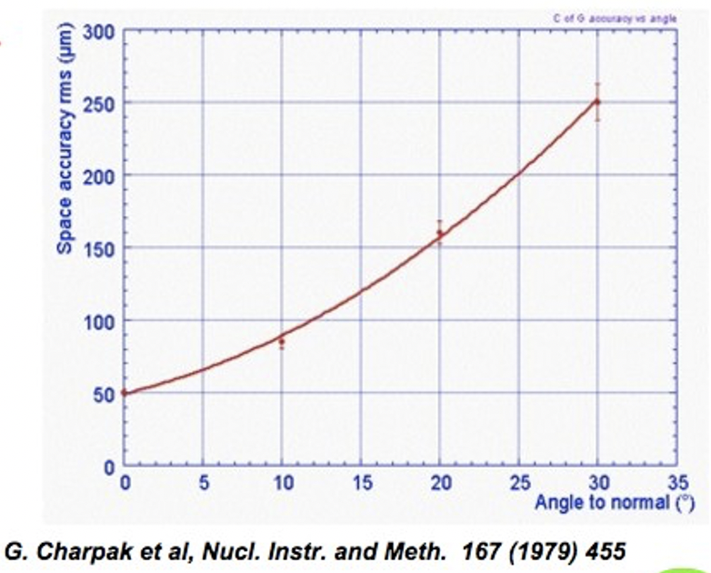
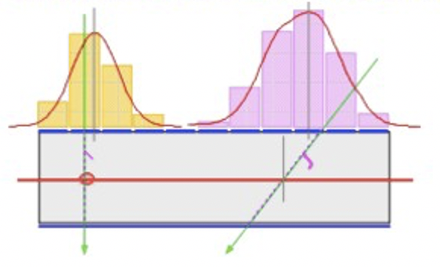
CMS Cathode Strip Chambers
CSC space resolution depends on where a muon crossed the chamber:
In between strips – the best resolution.
Through the center of a strip – the worst resolution (Due to the electronic noise)
CMS CSC have strips shifted ½ of strip width in neighbor planes
Strips
Wire
Wire
Avalanche
Common cathode
Position accuracy as a function of track angle to the normal to the chamber
Strips
Center of gravity of induced charge readout
Strong angular dependence on position accuracy

Slide 15
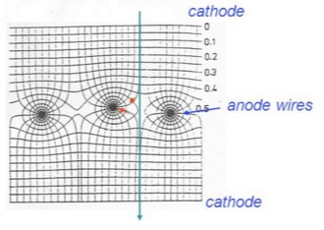

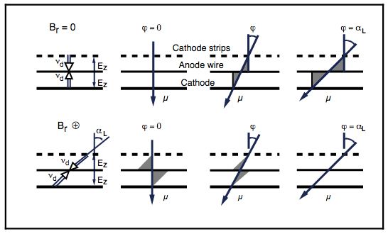
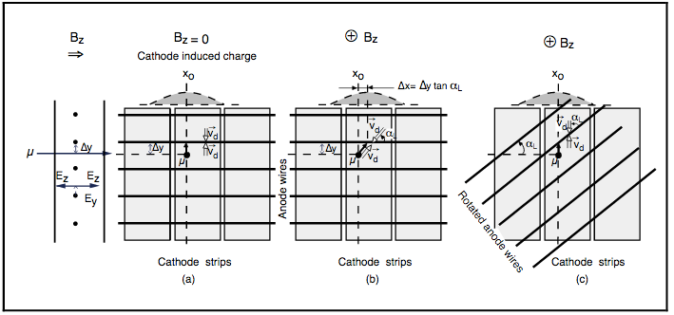
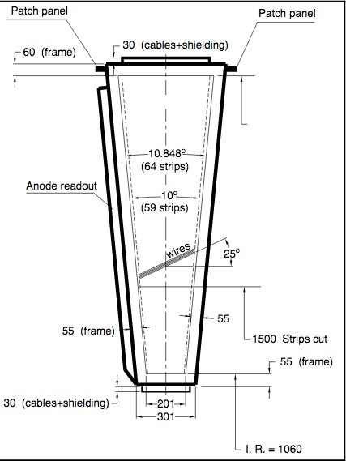
CMS CSC in Magnetic field
CSC in CMS axial magnetic ﬁeld:
Once primary electrons drift along magnetic ﬁeld lines nothing bad happens.
But near the wire plane they start moving almost perpendicular to the B ﬁeld.
Then the Lorenz force makes them drift to a diﬀerent place (Δx) along a wire.
Primary electrons arrive on a wire not in a single spot but distributed along the wire
The charge distribution on the strips gets wider reducing the space resolution.
B ﬁeld
If a chamber has wires tilted at an angle so that the drift in the wire plane happens along x axis (along strip direction) then there is no degradation in space resolution
ME11 have wires tilted at 29º.

Slide 16
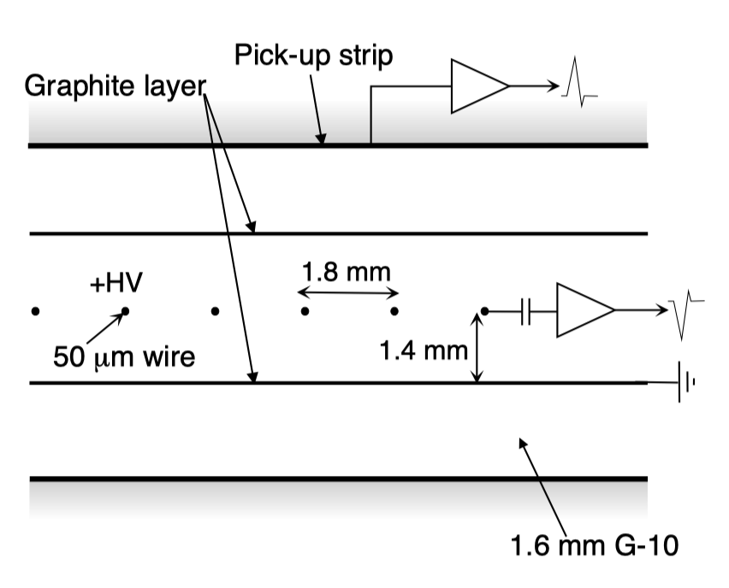
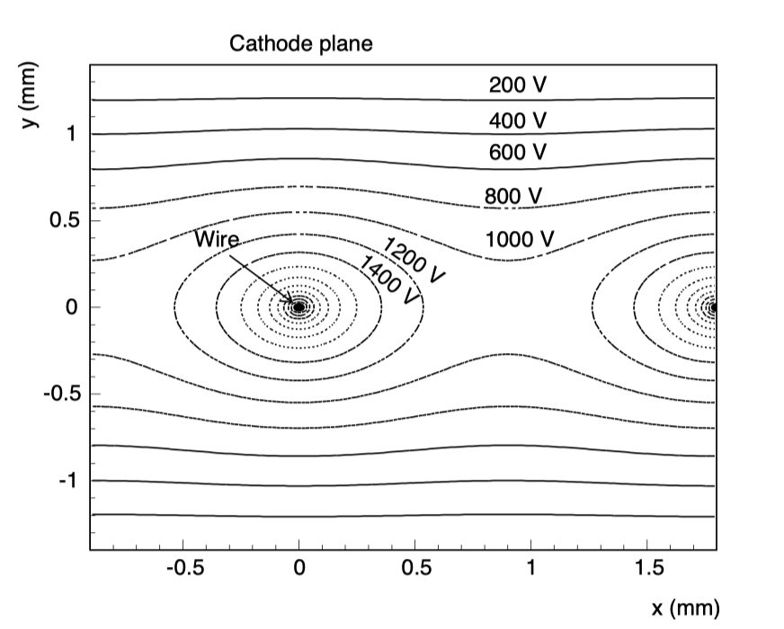
ATLAS TGC / sTGC
The ATLAS Thin Gap Chambers (TGC) operating in a saturated mode have a structure similar to Multi-Wire Proportional Chambers (MWPCs), except that the anode-to-anode, i.e. wire-to-wire, distance is larger than the cathode-to-anode distance
TGC were ﬁrst used on a large scale in the OPAL experiment. With the use of a highly quenching gas mixture of CO₂ and n-pentane (n-C₅ H₁₂ ), 55%:45%, this type of cell geometry allows operation in saturated mode. Saturated mode has the advantage of small sensitivity to mechanical deformations, which is important for large detectors.
TGC structure showing anode wires, graphite cathodes, G-10 layers, and a read-out strip orthogonal to the wires
Equipotential lines in the ATLAS thin gap chamber. The applied voltage is 3200 V, wire spacing is 1.8 mm, and wire-to-cathode gap is 1.4 mm.

Slide 17
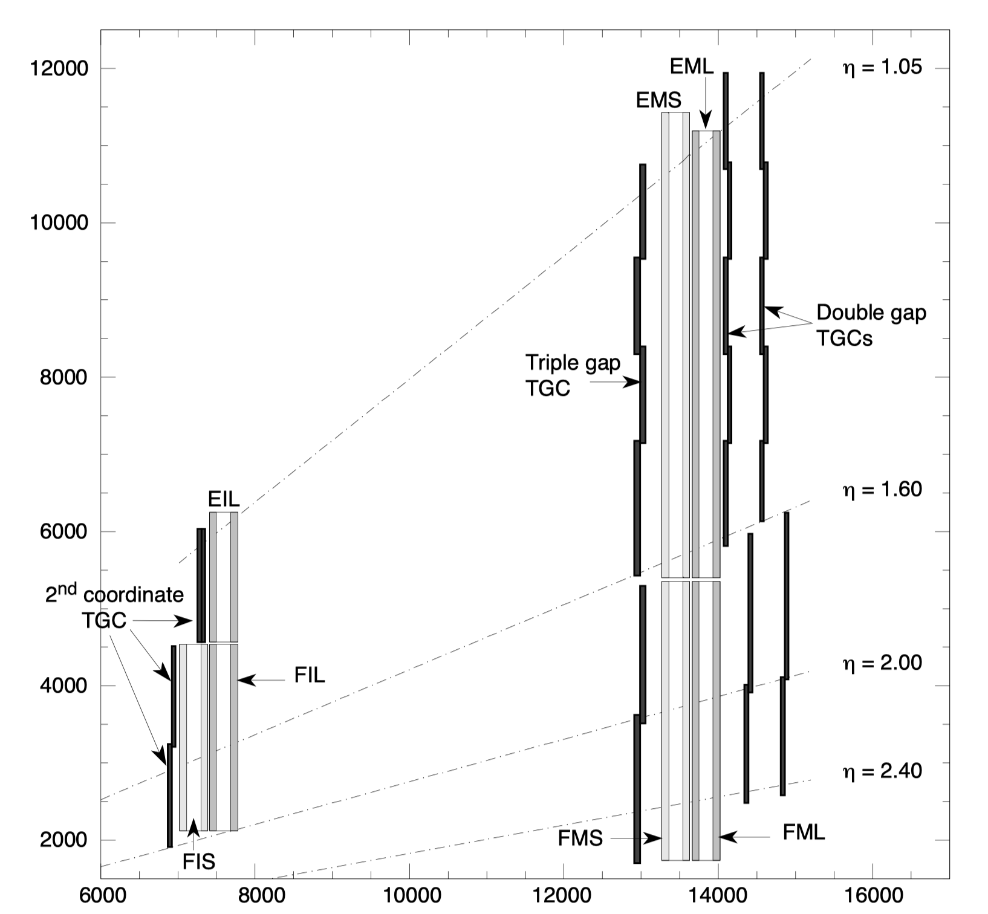
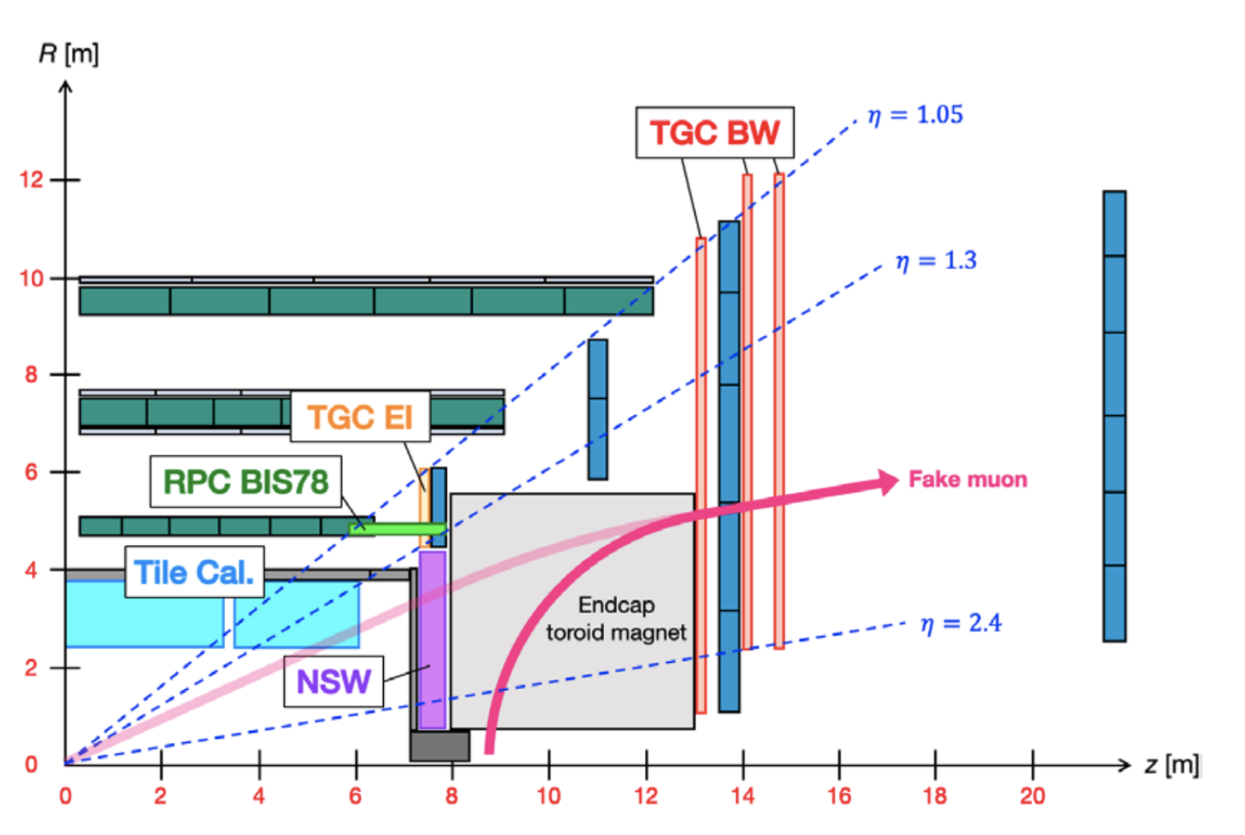
ATLAS TGC / sTGC
Second coordinate (w.r.t. MDT) and Trigger
sTGC in the ATLAS Muon Trigger
Second coordinate (w.r.t. MDT)
Longitudinal view of the TGC system. The TGCs in the FI station at 7000 mm from the interaction point are used for the second coordinate measurement only. The trigger function is provided by the triplet at 13 000 mm and the two doublets at 14 000–14 500 mm and 14 500–15 000 mm, respectively.
ATLAS NSW and sTGC system in the Muon selection logic, sTGC together with Micromegas chambers enhance the capability to select prompt muons.

Slide 18
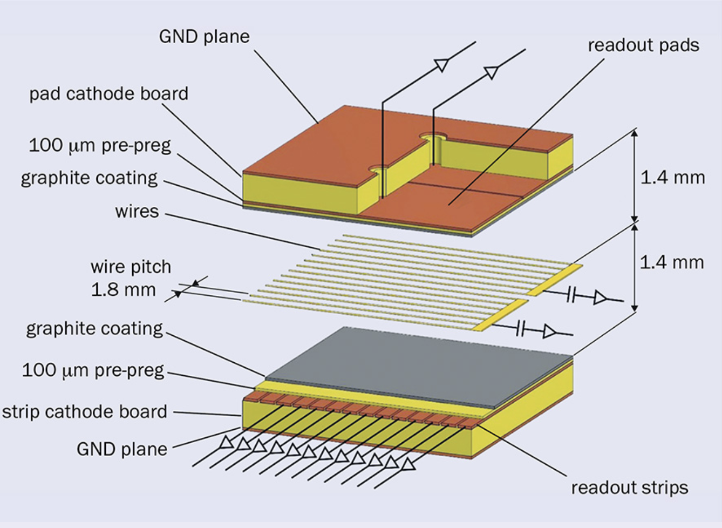
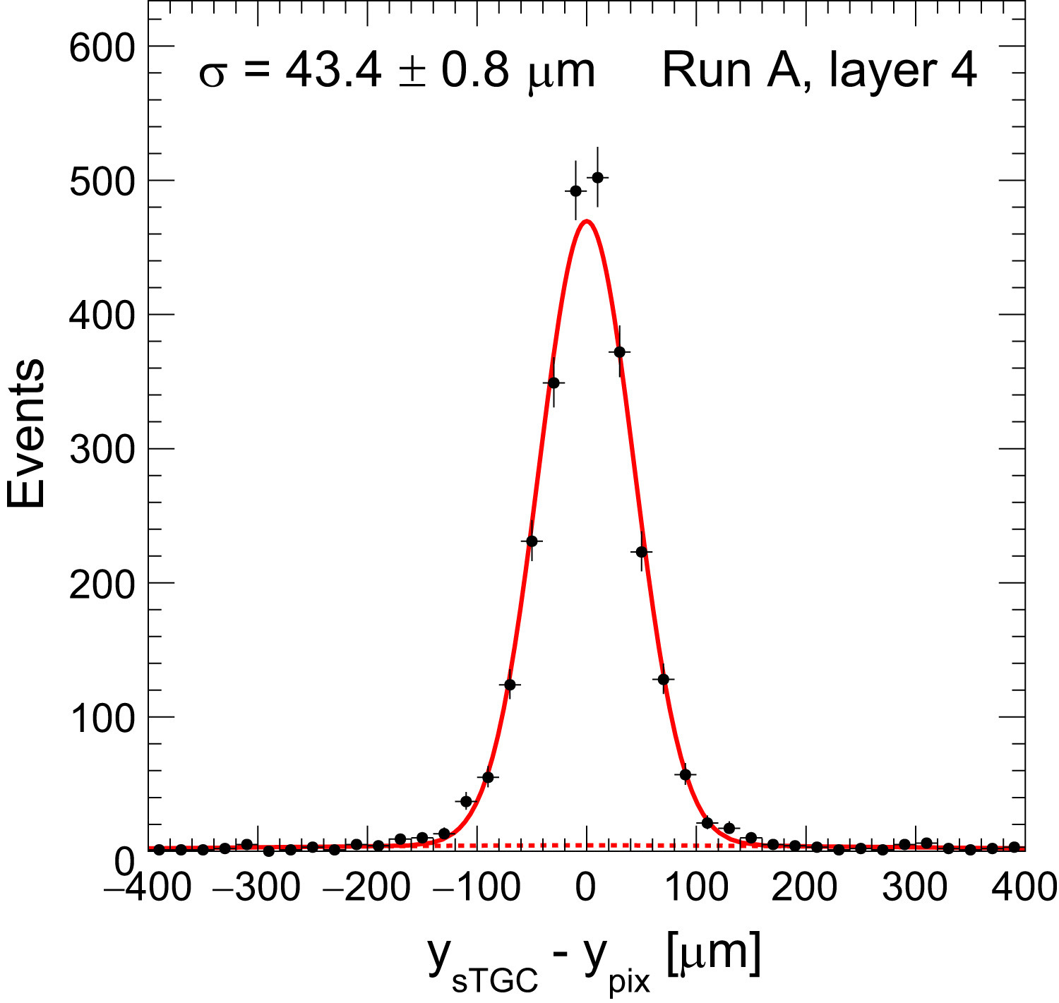
ATLAS TGC / sTGC
The basic Small strip Thin Gap Chamber (sTGC) structure consists of a grid of 50 μm gold-plated tungsten wires with a 1.8 mm pitch, sandwiched between two cathode planes at a distance of 1.4 mm from the wire plane. The cathode planes are made of a graphite-epoxy mixture with a typical surface resistivity of 100 kΩ/❏ sprayed on a 100 μm thick G-10 plane, behind which there are on one side strips (that run perpendicular to the wires) and on the other pads (covering large rectangular surfaces), on a 1.6 mm thick PCB with the shielding ground on the opposite side. The strips have a 3.2 mm pitch, much smaller than the strip pitch of the ATLAS TGC, hence the name ’Small TGC’ for this technology.
Gap structure of the small-strip thin-gap chambers (sTGC) showing the wires, readout pads and strips
Residual distribution of sTGC vs Pixel Tracking system with the result for the intrinsic resolution parameter σ

Slide 19
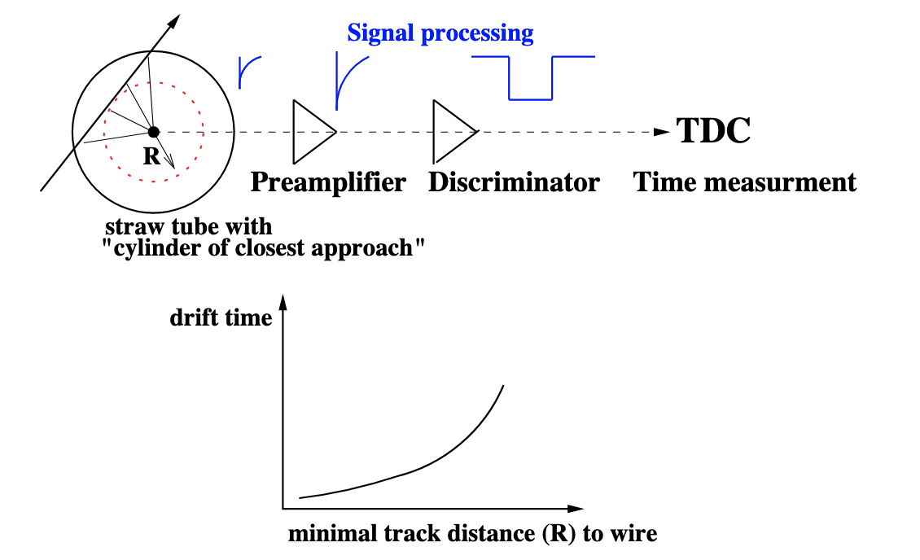
Straw Tubes
Despite the revolution started with the multiwire proportional chambers (MWPC), single wire tubes are still widely used, mostly as drift tubes
Straw tubes, has become very popular since several years. Straw tubes offer high-rate capability due to small diameters and
relatively little material in the particle path
Sort of proportional drift tube
  Tracking detector
Difference
  Low material budget
  Smaller in diameter (2-10 mm)
  Large number of detector elements crossed by particle
  Can be used also for particle identification (TRT)
    (tuned to sustain high particle rate)
How to recognize
  Fancy detector which looks like a stock of hay
  Distributor of straws for drinking your favorite potion

Slide 20
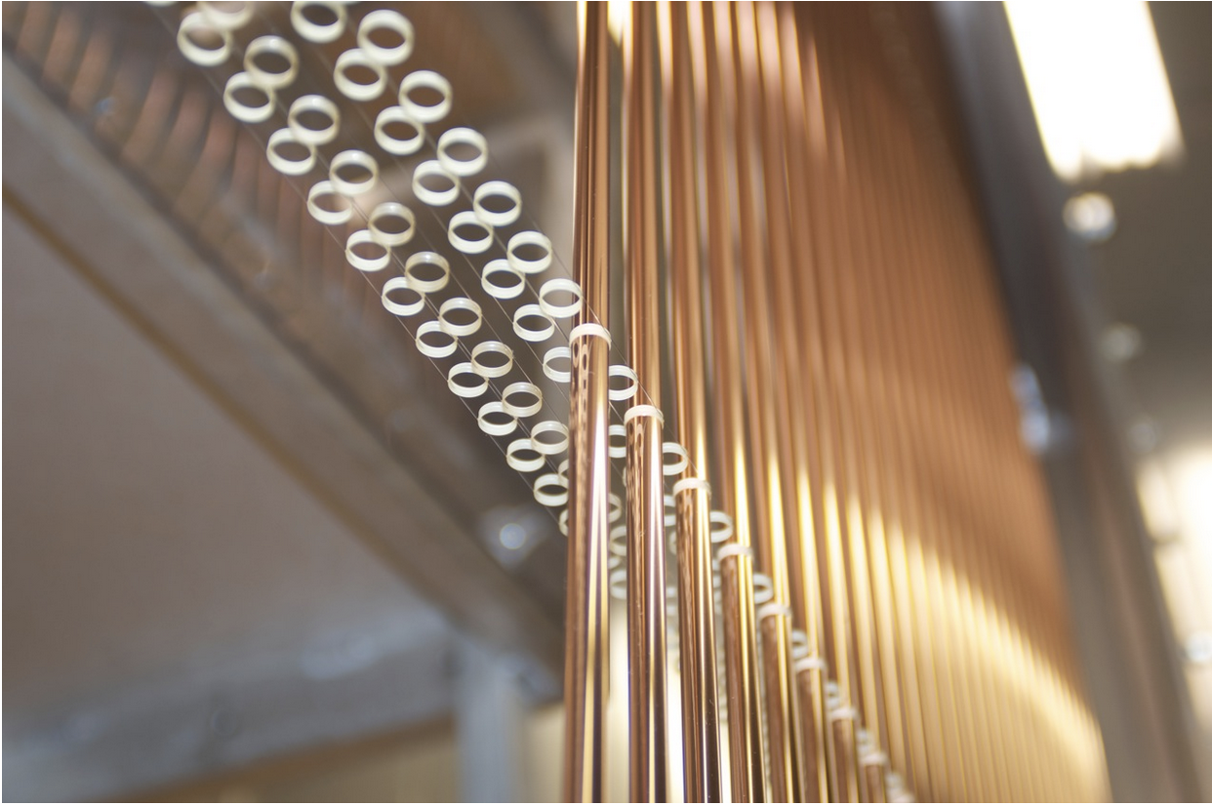
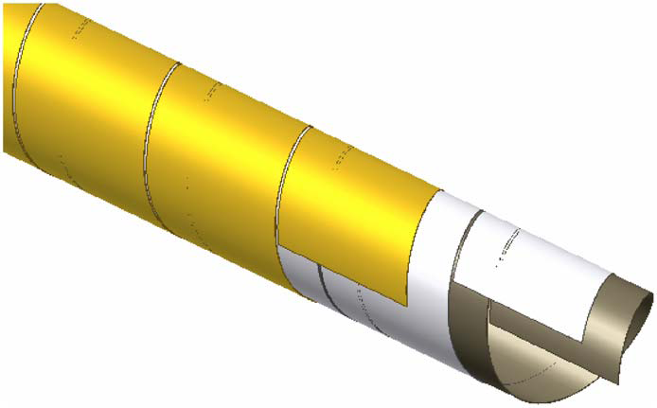
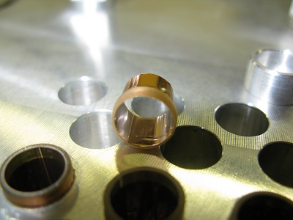
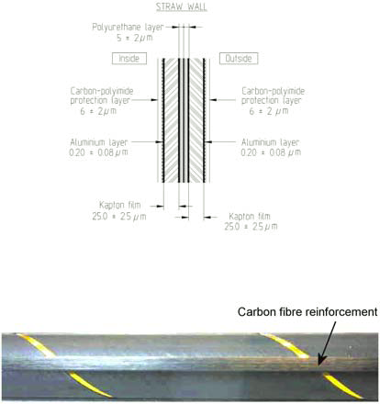
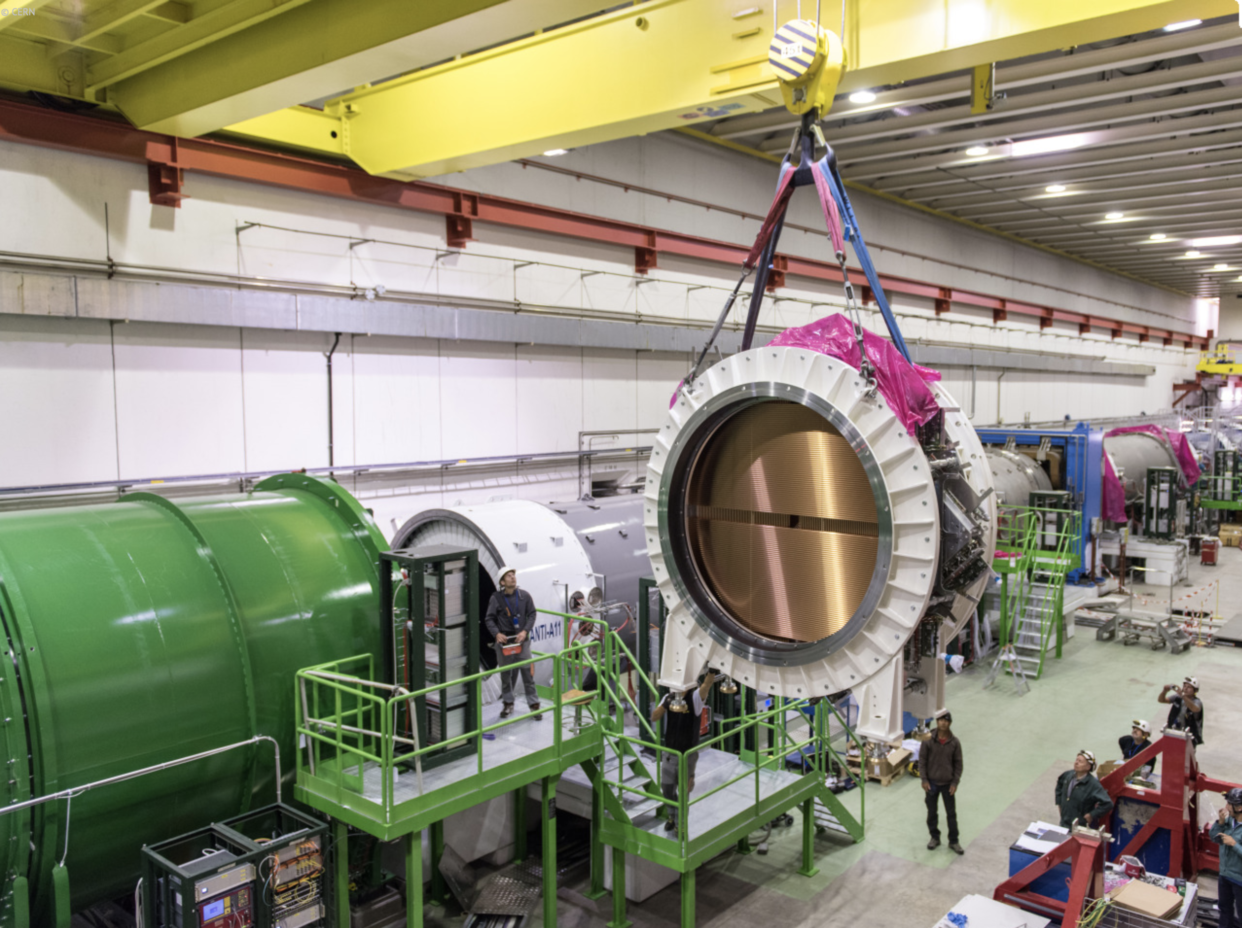
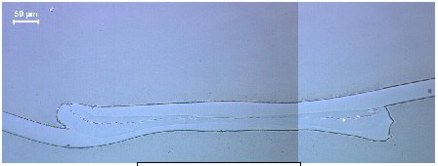
Straw Tubes
NA62 straws manufactured from 36 μm thin PET foils coated with two thin layers of Cu and Au.
1 strip ultrasonically or thermally welded (NA62)
Gluing 2 overlapping strips (COMPASS)
Glued and reinforced by carbon fibres
(also improving cathode resistivity)

Slide 21
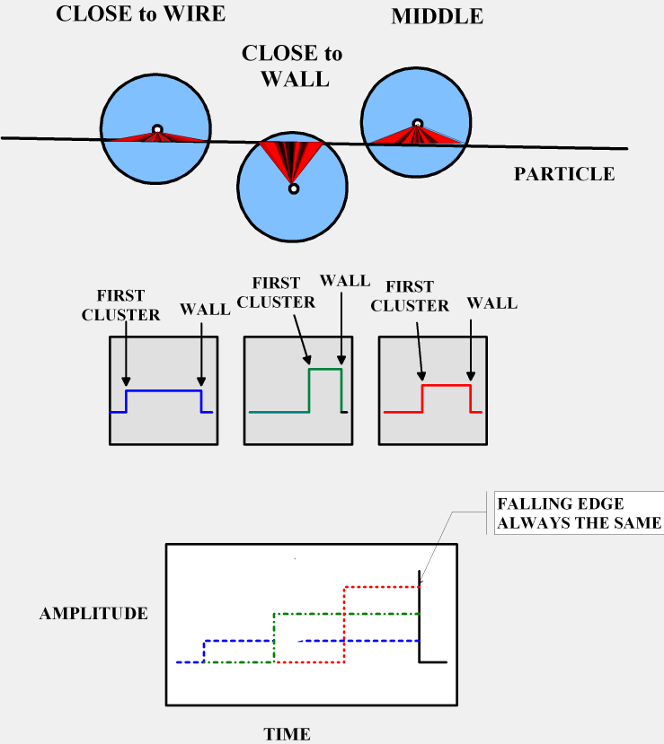
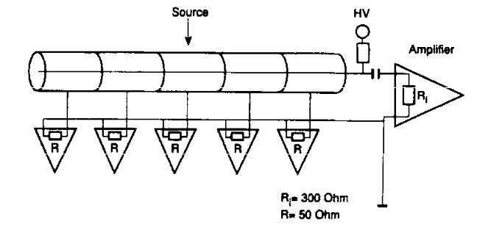
How does it work?
Readout concept
Improving rate capability
Precise tracks from drift time measurement
  Arrival of the first cluster
Track selection, identification and validation from the trailing edge
  Arrival of the last cluster
  ID attached to trailing edge should be used for matching with trigger ID
  All straws with matched IDs within time window (for straw propagation time) are on the track
  Straw propagation time should be subtracted from leading edge before calculating particle position
Trailing edge can be used for crude z-by-time measurement to help track reconstruction
Trailing edge can be used in fast trigger or as an anti-coincidence (VETO) on multiple tracks
Smaller diameter
  Less particles
  Less charge in gas volume
  Shorter collection time
Segmented straw
  Cathode segmentation
  Highly resistive inner coating
  External metallic rings on which signal is induced
  Anode segmentation
  ATLAS/TRT barrel 2 sections
Faster gas
Falling edge has the same time for all straws on track.
Rising edge gives the arrival time of the first cluster
The closer is the track to the wall, the bigger is the signal (clusters closer)
Don’t want to see clusters => shaping must be chosen in relation to gas properties
Tracks from drift time measurements
CERN EP-ESE Electronics Seminars Peter Lichard Straw detectors and their electronics

Slide 22
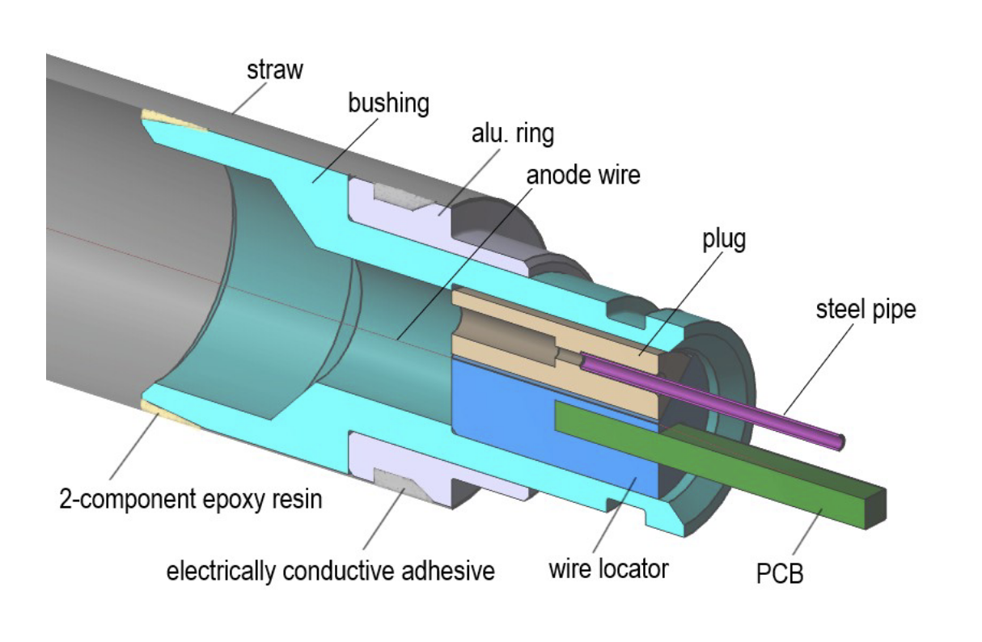
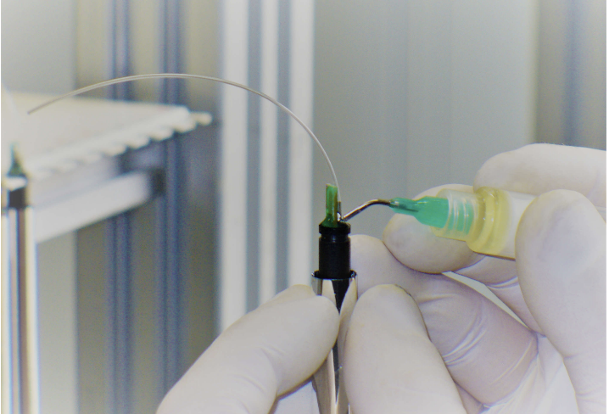


Straw Tubes PANDA
Straw tubes of 10.0 mm inner diameter and a total wall thickness of 27 μm
Two layers of 12 μm thick aluminized Mylar by wrapping two long strips around a rotating mandrel and gluing the two half-overlapping strips together
Aluminization at the inner tube wall used as a cathode whereas the aluminization of the second, outer strip layer used to screen light incidence
20 μm diameter gold-plated tungsten-rhenium wire used as anode
Scheme of the stand for tensioning an anode wire in a straw
Sealing of a plug with adhesive
Components of an end-plug and the assembled end-plug
The use of the relatively thin Mylar film as the straw material allows to achieve a very low material budget. In our straws filled with Ar-CO2 (90:10) gas mixture, at 2 bar absolute pressure, the mean thickness in radiation length X₀ of the straw is of 4.4 × 10−4 and the contributions from the foil, the gas mixture and the anode wire are 3.0 × 10−4, 1.3 × 10−4 and 0.1 × 10−4, respectively
PANDA Forward Tracker consisting of six tracking stations, and each comprising four double layers of straw tubes, the total material budget of the straw volume is only 2.1% X₀

Slide 23



Straw Tubes PANDA
Straw tube detectors are grouped into modules constituting independent mechanical and electrical units. A single module consists of 32 straw tube detectors arranged in a planar double layer
Straw tube performance validation (as proportional counters), with X-rays from ⁵⁵Fe source
Plateau curves for 32 straws in one module; two groups of curves, respectively, the first and second straw tube layer in the module looking from the source side
Main step, above 1500 V, correspond to the total absorption of the 5.9 keV X-rays from ⁵⁵Fe, the smaller step, around 1600 V, from the argon escape peak (energy deposit of 2.9 keV)
Low number of counts at low voltages → low level of pick-up noise
Same position of the main step for various straws → equal gas
Single layer of 16 straw tubes placed on a reference grooved plate
Double layer (32 straw tubes) with FE electronics

Slide 24


Drift Chambers
Drift Chambers are MWPCs where the time it takes for the ions to reach the sense wire is recorded. This time info gives position info:
t_{s}
x = ∫ v(t)dt t₀= start time, t_{s}=stop time=time electrons reach sense wire
t₀
By using the drift time information, we can improve our spatial resolution by a factor of 10 over MWPCs (1mm →100 μm).
Drift times are circles around the sense wires
Hex-cell drift chamber
The trajectory is given by the straight line tangent to all the circles

Slide 25
Drift Chambers
Advantages of a Drift Chamber compared to an MWPC:
Easier mechanical construction (larger wire spacing → reduced electrostatic forces)
Fewer wires → less readout electronics (though more sophisticated/costly)
Better spatial resolution (no longer limited by wire spacing / √12)
Key parameters:
Diffusion (should be as small as possible)
Drift velocity (ideally constant)
Typical drift velocities (Ar–isobutane 75%–25%, E ≈ 700–800 V/cm): → ~50 mm/µs
Additional considerations on drift chambers:
The diffusion coefficient decreases with increasing electric field → at typical fields (~1 kV/cm), the spatial resolution is ~100 μm for a 1 cm drift distance
In an electric field, increasing E reduces diffusion → “cold” gases (e.g. CO₂) maintain thermal electrons even at high fields → low gas gain (disadvantage) but long drift times (advantage)
“Hot” gases (e.g. Ar) produce non-thermal electrons even at low fields → anisotropic diffusion, typically D_{T} > D_{L}
In a magnetic field diffusion along B is unchanged while transverse diffusion is reduced, as electrons follow curved (helical) trajectories with radius v_{T}/ω

Slide 26


Drift Chambers
*
Spatial Resolution
Spatial resolution is not directly determined by wire spacing → fewer wires, less electronics, and simpler support structures
*
Particle Detection with Drift Chambers; W. Blum, W. Riegler, L. Rolandi

Slide 27

Drift Chambers
Principle of charge division method

Slide 28





Drift Chambers
Cylindrical drift chambers
In a collider experiment, it is advantageous to use cylindrical drift chambers, as they are gas-tight and allow easy coverage of a large solid angle.
Simplest setup that provides a less-than-optimal field.
Field quality can be improved with a closed cell setup
Cross section of a cylindrical chamber.
Wire layers (anode/sense wires) are separated by field-shaping wires (cathodes).

Slide 29



Drift Chambers
CDF drift chamber
Kloe drift chamber

Slide 30


Time Projection Chambers (TPC)
Quite sophisticated gas position detector with a 3D tracking detector capable of providing information on many points of a particle track along with information on the specific energy loss, dE/dx, of the particle.
The TPC makes use of ideas from both the MWPC and drift chamber.
The detector is a essentially a large gas-filled cylinder with a thin high voltage electrode at the center. (At high energy colliders, the diameter and length of the cylinder can be as large as two meters).
When voltage is applied, a uniform electric field directed along the axis is created. A parallel magnetic field is also applied.
The ends of the cylinder are covered by sector arrays of proportional anode wires arranged as shown. Parallel to each wire is a cathode strip cut up into rectangular segments. These segments are also known as cathode pads.
Particle trajectory
Cathodic pads
Anodic wire
B
gas
Readout plane
Central Electrode (≈ -50kV)

Slide 31

TPC
Because of the relatively long drift distance, diffusion, particularly in the lateral direction, becomes a problem.
B field confines the e- to helical trajectories about the drift direction. This reduce diffusion by as much as a factor of 10.
In order to avoid deviating the trajectories of the drifting e-, the B and E fields must be in perfect alignment and uniform over the volume of the drift zone down to about one part in 10⁴.
Requirements for a good TPC:
Accurate measurement of the z coordinate requires precise knowledge of the drift velocity (vₙ) → calibration using laser systems and corrections for pressure and temperature
Long drift distances → very pure gas and continuous monitoring are essential
Low material budget (gas only) → minimizes multiple scattering and photon conversions
The magnetic field suppresses diffusion perpendicular to the field (electrons follow helical trajectories around B).
E~ 50KV/m e B ~1.5 T ➔ Larmor radius ~1 μm

Slide 32



TPC
A problem which arises during operation is the accumulation of a space charge in the drift volume due to positive ions from avalanches drifting back towards the central cathode. These ions are sufficiently numerous that a distortion of the electric field in the drifting volume occurs.
This is prevented by placing a grid at ground potential just before the anode wires. Positive Ions are then captured at this grid rather than drifting back into the sensitive volume. The grid also serves to separate the drift region from the avalanche zone and allows an independent control of each.
Gate open
Gate closed
ALEPH TPC ΔV_{g} = 150 V
(ALEPH coll., NIM A 294 (1990) 121,
W. Atwood et. Al, NIM A 306 (1991) 446)

Slide 33


TPC
Since the Q collected at the endcaps is ∝ the energy loss of the particle, the signal amplitudes from the anode also provide information on the dE/dx of the particle. If p is known from the curvature of its trajectory in the B field, for example, then this information can be used to identify the particle In order for this method to work, however, sufficient resolution in the dE/dx measurement must be obtained.
This is much more difficult to realize as many factors must be considered, e.g., electron loss due to attachment, wire gain variations in position and time, calibration of the wires, saturation effects, choice of gas and operating pressure, etc.,. all of which require careful thought!
PEP4/9-TPC
ALICE -TPC

Slide 34

Limitations of Wire-based Detectors
Spacing of wires
  The maximum permissible length of the wire is also dominated by electrostatic and mechanical constraints such that the maximum stable length l_{c} is given by: l_{c} = s (4πε₀ T) / CV₀
    s : wire spacing
    V₀ : cathode voltage
    T : wire tension
Localization accuracy: typ. 100-500 μm
Volume / 2-track resolution: typ. 10×10×10 mm³ (signal induction on pads)
Rate capability: limited by build-up of positive space-charge around anode
Gas Mixture ( and GWP )
Ageing

Slide 35

Limitations of Wire-based Detectors: Gas Mixture
Recall of yesterday:
What to consider:
-) Primary ionization
-) Drift Velocity
-) Ion mobility
-) Diffusion
-) Magnet field
-) Recombination – attaching –electron capture
-) Penning effects
-) Safety (flammable/toxic gas)
-) Environment (GWP)
-) ….

Slide 36





Limitations of Wire-based Detectors: Gas Mixture
Transversal Diffusion
DRIFT VELOCITY IN ARGON-METHANE MIXTURES
Longitudina Diffusion

Slide 37
Limitations of Wire-based Detectors : Ageing
Blum, W. Riegler and L. Rolandi, “Gas Ionization by Charged Particles and by Laser Rays, in Particle Detection with Drift Chambers”
Drift and proportional chambers that have been in use for some time have a tendency to malfunction sooner or later – an increase in the dark current, a lowering of the gain, and a loss of pulse-height resolution are the typical symptoms. Once it has started, the problem seems to become worse and to spread from a few wires to many, until finally the chamber may no longer hold the operating voltage.
This behavior is intimately associated with the gas mixture in the chamber and with certain contaminants. However, the material properties of the anodes and cathodes as well as their size also play a role in this area which is far from being clearly understood. Given the practical importance of the subject and that the new accelerators will produce extremely high levels of radiation, efforts towards better understanding are under way. Workshops held at Berkeley [WOR 86] and Hamburg [WOR 01] summarized the experience. A comparison of the reports at the two proceedings shows that during the 15 years between them there was much progress towards mastering the high particle fluxes of modern times. On the other hand, there is still no fundamental understanding of ageing. Nobody can calculate the lifetime of a chamber to be built, and in most cases, one cannot even calculate what the result will be when some parameter is changed in a given chamber and its gas supply system
2008

Slide 38



Limitations of Wire-based Detectors : Ageing
Blum, W. Riegler and L. Rolandi, “Gas Ionization by Charged Particles and by Laser Rays, in Particle Detection with Drift Chambers”
Drift and proportional chambers that have been in use for some time have a tendency to malfunction sooner or later – an increase in the dark current, a lowering of the gain, and a loss of pulse-height resolution are the typical symptoms. Once it has started, the problem seems to become worse and to spread from a few wires to many, until finally the chamber may no longer hold the operating voltage.
This behavior is intimately associated with the gas mixture in the chamber and with certain contaminants. However, the material properties of the anodes and cathodes as well as their size also play a role in this area which is far from being clearly understood. Given the practical importance of the subject and that the new accelerators will produce extremely high levels of radiation, efforts towards better understanding are under way. Workshops held at Berkeley [WOR 86] and Hamburg [WOR 01] summarized the experience. A comparison of the reports at the two proceedings shows that during the 15 years between them there was much progress towards mastering the high particle fluxes of modern times. On the other hand, there is still no fundamental understanding of ageing. Nobody can calculate the lifetime of a chamber to be built, and in most cases, one cannot even calculate what the result will be when some parameter is changed in a given chamber and its gas supply system
Classical Ageing

Slide 39




Limitations of Wire-based Detectors: Ageing
Deterioration of performance under irradiation has been observed since development of Geiger and proportional counters (~100 years) and yet it remains one of the main limitations to use Gas Detectors in high rate experiments.
Deterioration in Performance:
  loss of gas gain
  loss of efficiency
  worsening of energy resolution
  excessive currents
  self-sustained discharges
  sparks
  loss of wires
  changes of surface quality…
Q [C] = Gain x Rate x Time x Primaries
  Rate of Aging: R(%) ~ slope of Gain vs. Q
  where Q is expressed in [C/cm] for wire detectors and [C/cm²] for strips or continuous electrodes.
Ageing depends on the total collected charge Q:
Gain
https://indico.cern.ch/event/122157/attachments/69728/99910/M_Capeans.pdf
Q or Time

Slide 40






Limitations of Wire-based Detectors : Ageing
Gaseous Detectors – Principle (once again!!!)
Principle of Gas Multiplication ~ Signal development
Anode wire
+
₋ ₋-₋
Let's consider standard gas mixture: Ar / CH₄
In a reaction with primary electron: e⁻ + CH4 → CH2: + H2 + e⁻
With free radicals: CH2:
And formation of polymer:
If the deposit is conductive, there is a direct effect on the electric field, which become weak (thick wire)
If the deposit is insulating, there is indirect effect, dipole charging up, the field close to the wire will be screened, as the new avalanche will accumulate on insulating layer
Solid, highly branched, cross linked
Excellent adhesion to surfaces
    Resistant to most chemicals
      Insoluble in most solvents
https://indico.cern.ch/event/122157/attachments/69728/99910/M_Capeans.pdf

Slide 41




Limitations of Wire-based Detectors : Ageing
Malter Effect
A positive surface charge deposited on a thin insulating film that covers a cathode can provoke the emission of electrons from the cathode through the film
A very high electric field may be created in the film between the deposited charge and the countercharges accumulated on the metallic cathode
Electrons are extracted from the metal through field emission
In a wire chamber, some thin insulating coating on the cathodes is charged up by the positive ions that are produced in the avalanches and drift to the cathodes
If second emission become self-sustaining process the dark current remains, even if the source of the primary radiation is removed from the chamber
To prevent the development of cathode deposits, better to keep low electrical field on the cathodes surface, plane cathodes and wires with larger diameters show smaller deposits
+ + + + + +
-
-

Slide 42

Limitations of Wire-based Detectors : Ageing
Whiskers
Whiskers as primarily consequence of gas composition
According to a test by the JADE group, moving from [1] Ar(89%) + CO 2 (10%) + CH4 (1%) to [2] Ar(90%) + CO 2 (5%) + CH4 (5%) produced whiskers which grew from the cathode wires in the field direction, Going back to mixture [1], the whiskers shrank and then disappeared
Other tests shown that whisker growth on cathode wires is supported by gas mixtures containing the lower alkanes, (CH 2)n-type polymers
On the other hand, no mixtures of carbon dioxide and argon support whisker growth; rather they make existing whiskers retreat and disappear
Whiskers

Slide 43

Limitations of Wire-based Detectors : Ageing
Whiskers
Whiskers as primarily consequence of gas composition
According to a test by the JADE group, moving from [1] Ar(89%) + CO 2 (10%) + CH4 (1%) to [2] Ar(90%) + CO 2 (5%) + CH4 (5%) produced whiskers which grew from the cathode wires in the field direction, Going back to mixture [1], the whiskers shrank and then disappeared
Other tests shown that whisker growth on cathode wires is supported by gas mixtures containing the lower alkanes, (CH 2)n-type polymers
On the other hand, no mixtures of carbon dioxide and argon support whisker growth; rather they make existing whiskers retreat and disappear
Whiskers
Whiskers ???

Slide 44





Limitations of Wire-based Detectors : Ageing
CMS CSC Gas Mixture: 40% Ar + 50% CO₂ + 10% CF₄
The main purpose of CF4 in the gas mixture – protection against anode wire aging : Si + F₄ → SiF₄
also breaking C-chains in polymer formation
F should be avoided due to Radical formation, but Si is even worst !!!
Ageing may occur for non-gold plated wires, which contain chemically active elements in the wire surface
Mechanism involves dissociation reactions in the avalanches and resulting in the oxidation of tungsten under the gold coating of the anode wire
  Stage #1: Production of oxygen and other active chemical radicals in the gas avalanche
  Stage #2: Oxygen penetration through the gold layer of the anode wire
  Stage #3: Anode wire swelling
The mechanism for the anode swelling effect
https://agenda.infn.it/event/30846/contributions/185024/attachments/99583/138277/Kuznetsova_Erice2022.pdf

Slide 45
Limitations of Wire-based Detectors : Ageing
Drift and proportional chambers that have been in use for some time have a tendency to malfunction sooner or later – an increase in the dark current, a lowering of the gain, and a loss of pulse-height resolution are the typical symptoms. Once it has started, the problem seems to become worse and to spread from a few wires to many, until finally the chamber may no longer hold the operating voltage.
This behavior is intimately associated with the gas mixture in the chamber and with certain contaminants. However, the material properties of the anodes and cathodes as well as their size also play a role in this area which is far from being clearly understood. Given the practical importance of the subject and that the new accelerators will produce extremely high levels of radiation, efforts towards better understanding are under way. Workshops held at Berkeley [WOR 86] and Hamburg [WOR 01] summarized the experience. A comparison of the reports at the two proceedings shows that during the 15 years between them there was much progress towards mastering the high particle fluxes of modern times. On the other hand, there is still no fundamental understanding of ageing. Nobody can calculate the lifetime of a chamber to be built, and in most cases, one cannot even calculate what the result will be when some parameter is changed in a given chamber and its gas supply system
3rd Workshop "International Conference on Detector Stability and Aging Phenomena in Gaseous Detectors"
took place at CERN, November 6th to 10th, 2023.
The Indico conference site is: https://indico.cern.ch/event/1237829

Slide 46
Why MPGD???
Let’s try to summarize the previous slides:
  Complexity in mechanical construction
  Resolution
  Relative low rate capability
  Ageing
A new family of detector (without wires) is needed!!!

Slide 47



Micro-Strip Gas Chamber (MSGC)
In 1988, Anton Oed, at the Institute Laue-Langevin (ILL) in Grenoble, introduced a novel concept in detection:
Micro-Strip Gas Chamber (MSGC)
Consisting of a set of tiny metal strips engraved on a thin insulating support, and alternatively connected as anodes and cathodes
Relies for its operation on the same processes of avalanche multiplication as the multi-wire devices
Photolithography technology used for manufacturing, permits to reduce the electrode spacing by at least an order of magnitude, improving the multi-hit capability.
Fast collection of most positive ions by the nearby cathode strips reduces space charge build-up and provides a largely increased rate capability
Introduced coincidentally with the first projects of high luminosity colliders, MSGCs filled a gap in the available detector technologies, between solid state strip detectors, having excellent performances but high costs, and the cheap but rate-limited traditional gas devices

Slide 48
Micro-Strip Gas Chamber:
A door toward a new era of gas detectors
Operating properties of MGCs manufactured with different metals and a range of geometrical parameters, as well as the resistance of the devices to local discharges have been widely studied
Several variants of the basic microgap structures have been tested to improve their performance and reliability, with particular attention to the onset of discharges, which was the major limitation for reliable application in HEP
Nevertheless, the detailed studies on their properties, and, in particular, on the radiation-induced processes leading to discharge breakdown, led to the development of more powerful devices with improved reliability and radiation hardness.
On the basis of the MSGC Photolithography technology have been further developed and used for manufacturing particle detectors and in particular gaseous based particle detectors
Modern MPGD structures can be grouped into two large families: hole-type structures and micromesh-based detectors
  The hole-type structures are GEMs, THGEM, RETGEM, Micro-Hole, …..
  The micromesh-based structures include: Micromegas, “Bulk” Micromegas, “Microbulk” Micromegas, ….

Slide 49
… one second back to wire detectors
The successful development of multiwire chambers has somewhat sidestepped the research on gas detectors that exploit the multiplication in uniform fields
Parallel-plate multipliers not only are mechanically sturdier but also have better energy resolution and higher rate capability
However, experimental data and theoretical considerations indicate that the maximum proportional gain in parallel-plate chambers is limited by the total amount of charge in the avalanche, around 10⁷–10⁸ , above this value, (Raether limit), transition to a streamer occurs, followed by breakdown.
The exponential dependence of gain on the gap has also discouraged the construction of large-area devices.

Slide 50
References:
-) Blum, W. Riegler and L. Rolandi, “Particle Detection with Drift Chambers”, Springer (2008)
-) Hilke, H.J., Riegler, W. (2020), “Gaseous Detectors”, In: Fabjan, C., Schopper, H. (eds) Particle Physics Reference Library. Springer, Cham. https://doi.org/10.1007/978-3-030-35318-6_4
-) G. Charpak et al., "The use of multiwire proportional counter to select and localize charged particle”, NIM 62, 262 (1968)
-) The ATLAS Muon Collaboration, “ATLAS Muon Spectrometer Technical Design Report” , CERN/LHCC 97–22
-) S. Majewski et al., “A thin multiwire chamber operating in the high multiplication mode”, NIM. 217 (1983) 265.
-) G. Mikenberg, “Thin-gap gas chambers for hadronic calorimetry”, NIM A 265 (1988) 223.
-) C. Beard et al., “Thin, high gain wire chambers for electromagnetic presampling in OPAL”, NIM A 286 (1990) 117.
-) Y. Arai et al., “Timing optimization of thin gap chambers for the use in the ATLAS muon end-cap trigger”, NIM A 367 (1995) 398.
-) G. Cataldi, F. Grancagnolo and S. Spagnolo, “Cluster counting in helium based gas mixtures” NIM A 386 (1997) 458-469
-) T. Akesson et al., “Study of straw proportional tubes detector/tracker for a transition radiation at LHC” NIM. A 361 (1995) 440-456

Slide 51
References:
-) A. Andronic, J.P. Wessels “Transition radiation detectors” NIM. A 666 (2012) 130-147
-) V.I. Razin, “The choice of the optimum gas mixture for high rate wire chambers” NIM A 367 ( 1995) 295-297
-) T. Ferguson, et al.,“Anode wire swelling--a possible phenomenon in anode wire aging under high-accumulated dose”, NIMA 483 (2002) 698–712
-) L. Benussi, S. Bianco, et al.,“Candidate eco-friendly gas mixtures for MPGDs” EPJ Web of Conferences 174, 05004 (2018)
-) J.H. Dieperink, et al, “Construction problems with large proportional wire chambers” CERN Internal Report 69-28
-) A. Oed, “Position-sensitive detector with microstrip anode for electron multiplication with gases”, NIM A 263 (1988) 351-359
-) F. Sauli, A. Sharma, “Micropattern Gaseous Detectors”, Annu. Rev. Nucl. Part. Sci. 1999. 49:341–88

Slide 52
Spare Slides

Slide 53

Transition Radiation
The Transition Radiation energy emitted when charged particle crosses a boundary between vacuum and a medium with plasma frequency ω_{p}
ΔE = α hω_{p}γ /3
α = fine structure constant ≈ 1/137
hω_{p} depends on the electron density in the material
~ 20 eV for a low-Z material such as plastic (e.g. polypropylene)
For a 10 GeV electron, γ ~ 2 ×10⁴, so
ΔE ~ keV (i.e. X-ray energy)
Low probability of photon emission at one interface (~ 1%)
so many layers of thin foils are used for the radiator
Low Z is important to limit re-absorbtion of the radiation
Radiation emitted in the very forward direction,
in cone of angle 1/γ around the particle direction
→ photons will be seen in same detector as the
ionization from the track
Local speed of light in a medium with refractive index n is c_{p} = c/n
If its relative velocity v/c_{p} changes, a particle will radiate photons:
  Change of direction v (in magnetic field) → Synchrotron
  Change of |v| (passing through matter) → Bremsstrahlung
  Change of refractive index n of medium → Transition Radiation
Transition radiation is emitted whenever
a relativistic charged particle traverses the border between two media with different dielectric constants (n ~ √ε)
The energy emitted is proportional to the boost γ of the particle
→ Particularly useful for electron ID
medium
vacuum
charged particle
e±

Slide 54






ATLAS Transition Radiation Tracker (TRT)
Transition Radiation Tracker: also acts as a central tracker using ~ 400 000 straw tubes
15 μm-thin polypropylene foils (radiator)
interleaved with straws → transition radiation
Xe as active gas for high X-ray absorption

Slide 55





ATLAS Transition Radiation Tracker (TRT)
Straw filled with xenon gas mixture
≈ 0.4 M channels give ≈ 30 two-­‐dimensional space-­‐points for charged particles with |η|<2 and p_{T} > 0.5 GeV
Single hit resolution: ≈120 μm
Particle identification (electron-­‐pion separation) by detection of transition radiation
Provides accurate p_{T} measurements
Works at high occupancy conditions
Stable performance in hard radiation environment
Straw wall (d=70µm) = cathode @ -1530V
Wire (d=30µm) gold-plated tungsten = anode @ 0V

Slide 56



ATLAS Transition Radiation Tracker (TRT)
Ionized electrons drift to straw wire to
create signal (~several 100 eV)
— Detect with Low Threshold (LT)
● TR photons generate signal ~10keV
— Detect with High Threshold (HT)
— Also with Time over Threshold (ToT)
● Readout granularity: 3.12ns
— 1/8 of 25ns LHC bunch crossing (BC)
— Readout 3 BCs / trigger

Slide 57


ATLAS Transition Radiation Tracker (TRT)
Energy deposition in the straw is the sum of ionization loss (~2 keV)
and the larger deposition due to transition radiation absorption (> 5 keV)
→ use two thresholds in the readout electronics
High threshold hits
identify electrons
5.5 keV
Readout
pulse
0.2 keV

Slide 58




ATLAS TRT – classical &modern design
ATLAS
12th century mosaic.
Otranto cathedral, Italy
“Original” classical design: 4 layers
Simulation particles + Missing Energy?

Slide 59


Cluster counting technique (excursus dE/dx)
Ionization is used in ~ all tracking detectors
Tracking measures the position of ionization for particle ID measure the amount of ionization (dE/dx)
This is subject to large fluctuations due to ejection of d-electrons (Landau distribution)
To avoid bias from the long tail, best to have many independent samples of the ionization, and perform a truncated mean
To get an excellent dE/dx measurements many samples and good energy resolution are needed (e.g., TPCs silicon detectors)
Lehraus’ plot
Dependence of dE/dx resolution vs.
truncated mean fraction
and number of samples (KLOE: He mix.)
σ_{dE/dx}/dE/dx = 5.4 L[m]^{-0.37} %

Slide 60
Cluster counting technique
Walenta
"It has been experimentally confirmed that the relativistic rise is mainly due to the increased number of the primary clusters, rather than due to the energy of clusters."
P. Reak and A.H. Walenta, IEEE Trans. Nucl. Sci. NS-27 (1980) 54
Note that the dE/dx plot as a function of momentum has a lot of overlap regions between the different mass hypotheses
→ limits usefulness for those momenta
Cluster timing in drift chambers consists in recording the drift times of all individual ionization cluster due
to the passage of an ionizing track in the active medium. With this information, space point resolution and particle identification can be radically improved.
Cluster Counting/Timing techniques may be beneficial to a variety of particle physics experiments, from rare decays search, where high resolution at low momentum (50-300 MeV) is of paramount importance, to flavor factories where accuracies of the order of a few percent in dE/dx are needed for particle identification and
flavor tagging; future high energy lepton collider experiments could also greatly benefit from both these improvements.

Slide 61


Cluster counting technique
G. Cataldi, F. Grancagnolo and S. Spagnolo, Nucl.Instrum.Meth. A 386 (1997) 458-469
Single out, in every recorded detector signal, the isolated structures related to the arrival on the anode wire of the electrons belonging to a single ionization act.
Pulses from electrons belonging to diﬀerent clusters must have a little chance of overlapping in time and, at the same time, the time distance between pulses generated by electrons coming from the same cluster must be small enough to prevent over-­‐counting.
Use of He as drift chamber gas promoted by the need of limiting the multiple scattering contribution:
X₀(He) = 5600 m as opposed to X₀(Ar) = 110 m
The Cluster counting concept could, profit of to the opportunities given by the lower primary ionization, N_{cl} ≈ 6/cm, a factor 5 vs Ar, and by the slower drift velocity, v_{drift} ≈ 2 cm/μs, a factor 2. 5 vs Ar (cluster time expansion)
8 mm diameter drift tube 90% He – 10% iC₄H₁₀
gas gain 4×10⁵
2 GHz – 4 Gsa/s No Ampl.

Slide 62

Cluster counting technique
μ⁄π separation at 200 MeV/c in He/iC₄H₁₀ – 95/5 100 samples 3.7 cm
gas gain 2×10⁵, 1.7 GHz – gain 10 amplifier, 2GSa/s – 1.1 GHz – 8 bit digitizer
single sample
20% truncated
mean
single sample
π
μ
π: σ/√N_{cl}=0.978
μ: σ/√N_{cl}=1.006
π
μ
test beam
data
sum over
100 samples
π: σ/√N_{cl}=1.35
μ: σ/√N_{cl}=1.45
sum over
100 samples
integrated charge
expected 2.0 σ separation
measured 1.4 σ separation
cluster counting
expected 5.0 σ separation
measured 3.2 σ separation

Slide 63
Cluster counting technique
He/iC4H10 90/10
δ_{cl}=12 cm⁻¹
σ(dE/dx)/(dE/dx)
=4.3%
σ(dN_{cl}/dx)/(dN_{cl}/dx)
=2.2%
80% cluster
counting efficiency
Expected from analytical calculation for IDEA (FCCee) Drift Chamber
2 m tracks
63
https://indico.cern.ch/event/996326/contributions/4200962/attachments/2191650/3704305/dEdx.pdf

Slide 64
Micro-Strip Gas Chamber (MSGC)
In 1988, Anton Oed, at the Institute Laue-Langevin (ILL) in Grenoble, introduced a novel concept in detection:
Micro-Strip Gas Chamber (MSGC)
Consisting of a set of tiny metal strips engraved on a thin insulating support, and alternatively connected as anodes and cathodes
Relies for its operation on the same processes of avalanche multiplication as the multi-wire devices
Photolithography technology used for manufacturing, permits to reduce the electrode spacing by at least an order of magnitude, improving the multi-hit capability.
Fast collection of most positive ions by the nearby cathode strips reduces space charge build-up and provides a largely increased rate capability
Introduced coincidentally with the first projects of high luminosity colliders, MSGCs filled a gap in the available detector technologies, between solid state strip detectors, having excellent performances but high costs, and the cheap but rate-limited traditional gas devices

Slide 65



MSGC
Cathode strips are arranged between the anode strips for an improved field quality and to improve the rate by fast removal of positive ions
  Reduced dead time between signals
Rate and spatial resolution improved w.r.t. MWPCs by more than an order of magnitude
  Spatial resolution can be a few tens of microns
Segmentation of the cathodes also possible to allow 2-dimensional readout
Close view of one of the first microstrip plates developed by Oed at the Institute Laue-Langevin. On an insulating substrate, thin metallic anode strips alternate with wider cathodes; the pitch is 200 μm.
Rate Capability comparison for MWPC and MSGC

Slide 66




Micro-Strip Gas Chamber (MSGC)
Considered by CMS experiment,
but ageing problems…(replace by Si)
Ar:DME 50:50
Resolution ~30 to 40μm
Gain <10000
Anode: 0V
Cathodes: -520 V
Drift Cathodes: -3500V
Rate up to 10^6 particles/mm²/s

Slide 67
home.cern

