Slide 1
Gaseous particle detectors
Michele Bianco, CERN EP-CMX-IC
PhD Lectures 2026, Siena, 13th-14th May 2026
1

Slide 2
Lecture #2: Gas selection and operation beyond the stability point
Gas properties and choices for gaseous detectors
Requirement on a gas mixture
Electron transport – Cold and hot gases
Electron attachment and impurities
Charge amplification – Townsend coefficients
Quenchers and saturated avalanches
Safety and GHG
… Beyond proportional mode
Cathode processes
How to release and electron from the cathode
Townsend breakdown mechanism
Streamer theory
Discharges in gas detectors (usually you don’t want them)

Slide 3
Why is the gas choice important
The gas is the fundamental part of a gaseous detector
It is where the detection takes place:
Ionizing particle produces primary ionization
Primary ionization is drifted to readout zone
Electron amplification leads to secondary ionization
The gas determines the size and the spatial and temporal extension of the electron cloud:
Sensitivity and energy resolution of the detector
Spatial resolution of the detector
Time resolution of the detector
The gas also determines other signal carriers like photons and ions

Slide 4
Requirements on a gas mixture
In principle: avalanche formation occurs in every gas, depending on the electric field.
Choice of gas determines substantially the properties of the detector!
What we need:
Sufficient primary ionization
Electron lifetime sufficiently long
Drift velocity preferentially at the maximum to be independent of field distortions, pressure, temperature
High drift velocity with small electron energy leads to small diffusion (cold gases, e.g. CO2)
Stable amplification process
Radiation hardness and chemical stability to avoid aging
Manageable Safety issues
Small ecological impact
partly contradicting each other
no ideal gas meeting all requirements

Slide 5

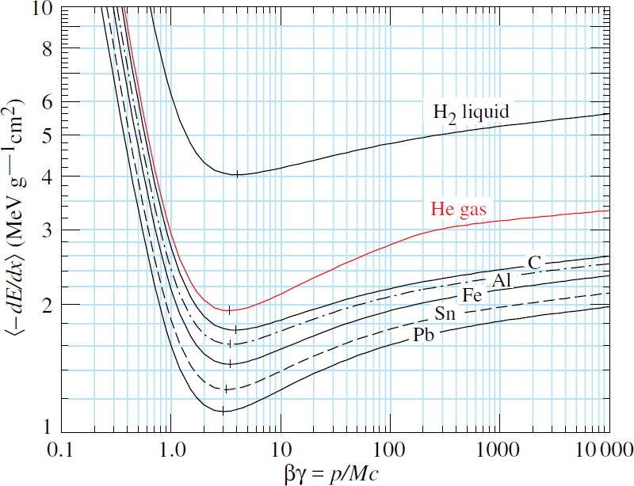
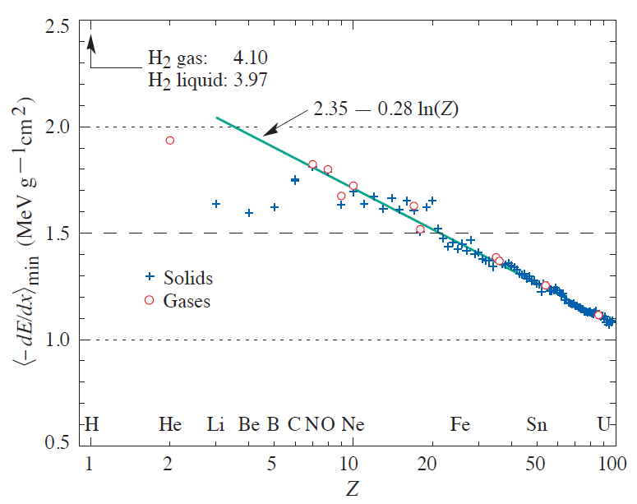
Ionization
Bethe-Bloch formula
Minimum ionising particle at
𝛽𝛾 ≈ 3 − 4
Shown is
𝑑𝐸/𝑑𝑥
𝜌
It is similar for gases and solids, but densities are very different:
S. Navas et al. (Particle Data Group), Phys. Rev. D 110, 030001 (2024)
𝑔
𝐶: 𝜌 = 2,3 _{𝑐𝑚3}
𝑔
𝑁₂: 𝜌 = 1,2 ⋅ 10⁻³
𝑐𝑚³
Example Argon:
𝑍 = 18, 𝜌 = 1.66 ⋅ 10⁻³𝑔/𝑐𝑚³ ⇒ 𝑑𝐸/𝑑𝑥_{𝑚𝑖𝑛} = 1.5 ⋅ 1.66 ⋅ 10⁻³𝑀𝑒𝑉/𝑐𝑚 = 2.5 𝑘𝑒𝑉/𝑐𝑚

Slide 6
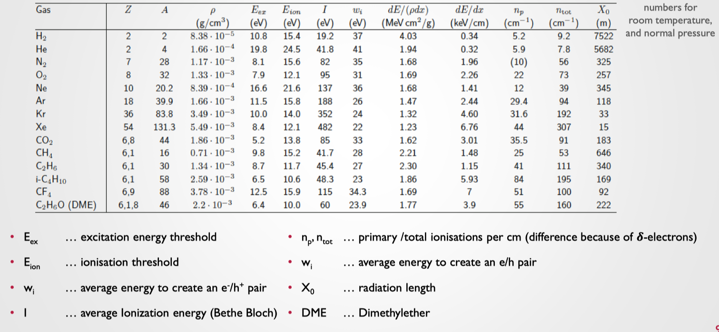
Gas properties

Slide 7
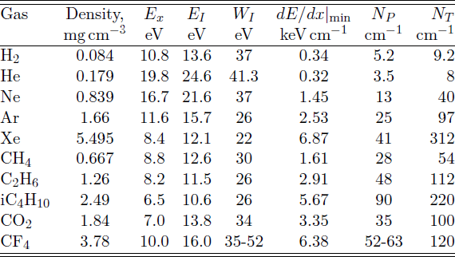


Gas ionization
Ionisation yield
Ionisation is a statistical process
Poisson statistics at small gas layer (mm)
Energy of ionised electrons with long tail
(Landau distribution)
High energy electrons can ionise further
𝑝 + 𝑋 → 𝑝 + 𝑋⁺ + 𝒆⁻
𝒆⁻ + 𝑋 → 𝑋⁺ + 𝒆⁻ + 𝒆⁻
Leads to clustering of charges
2-3 times less clusters than electrons
>50% of cluster have one electron
Energy is „lost“ in non-ionising processes:
molecule vibrations and rotations, heat, light, recombination
⇒ 𝑾_{𝑰} > 𝑬_{𝑰}
𝐸_{𝑥}: First excitation energy
𝐸_{𝐼}: Ionisation energy
𝑊_{𝐼}: Average energy for creation of electron-ion pair
𝑁_{𝑃} : Primary number of electron-ion pairs
𝒅𝑬/𝒅𝒙
𝑁_{𝑇}: Total number of electron-ion pairs
𝑵_{𝑻} =
𝑾
𝑰
𝑝
Gases with large primary ionisation statistics preferred,
but Xenon expensive, hydrocarbons flammable

Slide 8
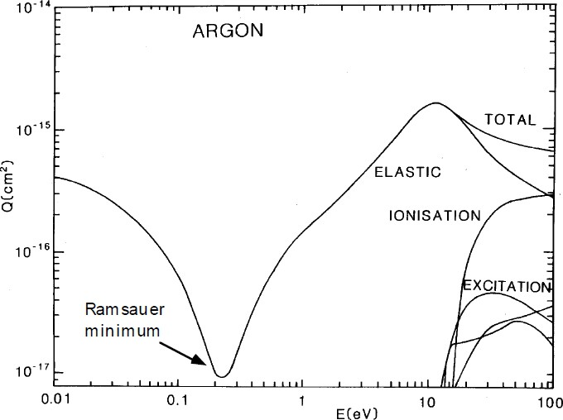
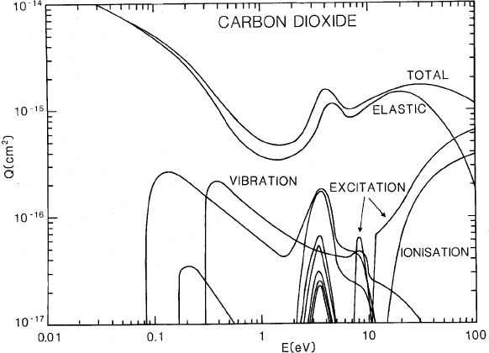
Electron transport
Electron transport is determined by the interactions with the gas molecules
Noble gases: elastic and ionisation cross section; clear Ramsauer minimum → hot and fast gas
Organic molecules: large excitation and vibration cross sections → cold and low diffusion gas
Ramsauer minimum explained: De-Broglie wavelength of the electron is in the size of the molecule
→ quatum mechanic tunneling → large mean free path

Slide 9
Electron transport – Cold and hot gases
Cold gases: Drift gases with electrons thermalized 𝑇_{𝑒} ≈ 300 𝐾
Thermalization due to low energy excitation states, organic molecules, Example: 𝐶𝑂₂
Cold gases have small diffusion
Cold gases have small Lorentz angle
Hot gases: Electrons gain energy due to electric field above thermal energy
Noble gases have no low energy excitation states, Example: 𝐴𝑟
Hot gases have large diffusion
Drift velocity saturates
Combine noble gas with organic molecular gas, gas is cooled, diffusion reduced and drift velocity even faster

Slide 10
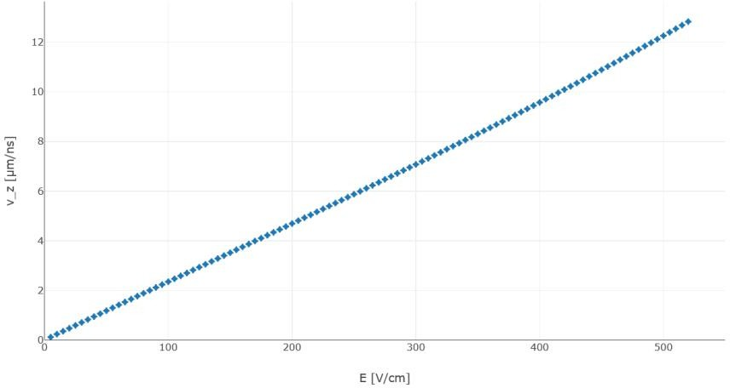
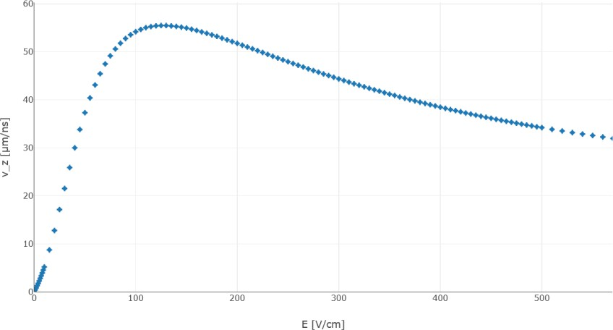
Electron transport – Cold and hot gases
Cold gases: Electrons thermalized
𝜇 = 𝑐𝑜𝑛𝑠𝑡
Example:
𝑇_{𝑒} ≈ 300 𝐾
⇒ 𝑣_{𝐷} ∝ 𝐸
𝐴𝑟/𝐶𝑂 (70/30): at ~100 𝑉/𝑐𝑚 we get ~2 ^{𝜇𝑚} = 0.2 ^{𝑐𝑚} = 2 ^{𝑘𝑚}
2
𝑛𝑠 𝜇𝑠 𝑠
Hot gases: Electrons gain energy due to electric field
1
𝜇 = 𝜇(𝐸) ∝ 𝜏 ∝ _{𝜎 𝐸}
𝑇_{𝑒} ≫ 300 𝐾
Example:
𝐴𝑟/𝐶𝐻 (90/10): at ~100 𝑉/𝑐𝑚 we get ~50 ^{𝜇𝑚} = 5 ^{𝑐𝑚} = 50 ^{𝑘𝑚}
4
𝑛𝑠 𝜇𝑠 𝑠
Drift velocity faster due to Ramsauer minumum
Warning:
Methane (CH₄) becomes flammable and explosive when its concentration in air is between 5% and 15% by volume.
Lower Explosive Limit (LEL): approximately 4.4%–5%. Below 5%, the mixture is too “lean” (insufficient gas) to explode.
Upper Explosive Limit (UEL): approximately 15%. Above 15%, the mixture is too “rich” (too much gas, not enough oxygen) to explode.

Slide 11
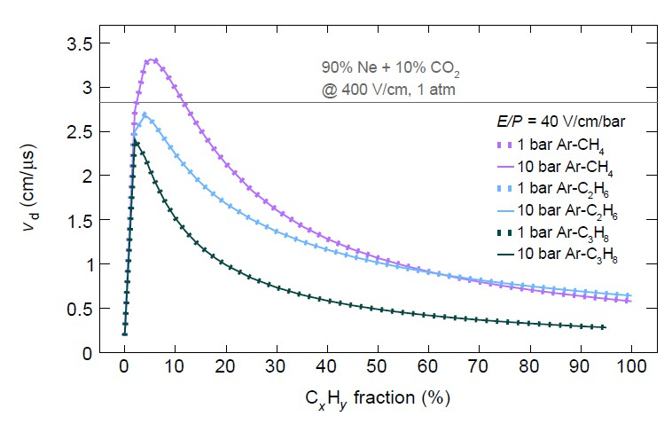
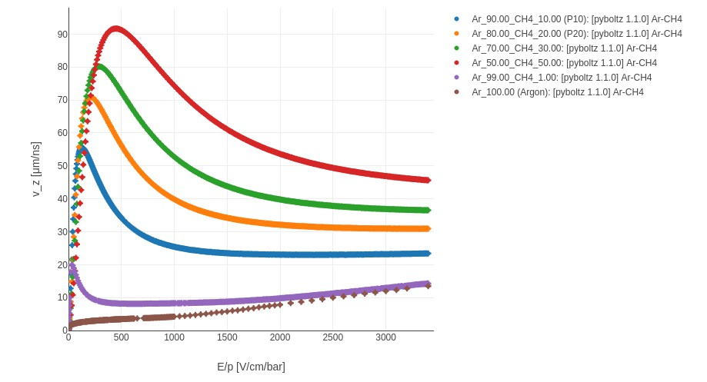
Drift velocity for gas mixture
Drift velocity of a gas mixture is not the weighted average of drift velocities in the components!
Small addition of gas with energy levels at 0.1 − 0.5 𝑒𝑉 enhances drift velocity and reduces diffusion
→ Both fast and low diffusion gas!

Slide 12
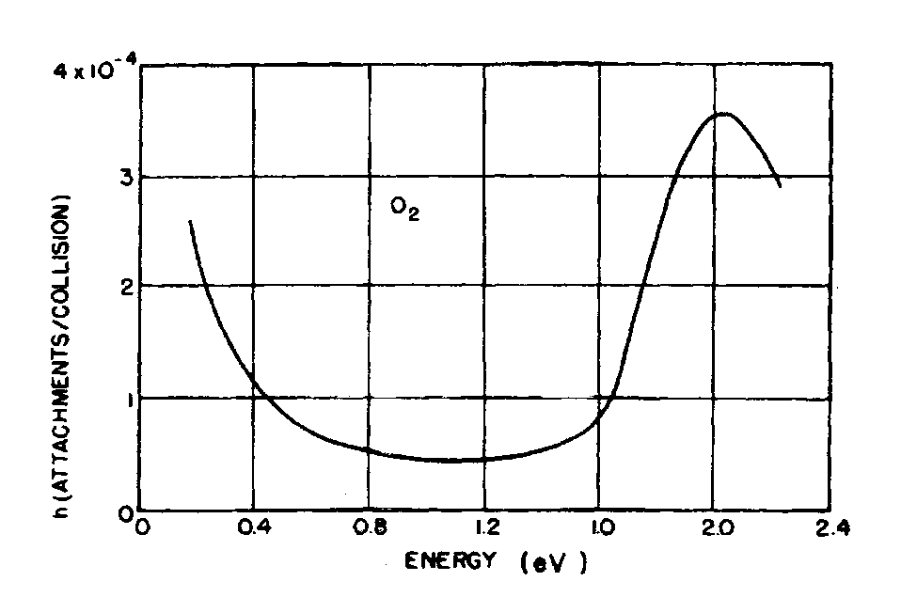
Electron attachment and impurities
Some gases, like O₂, Cl₂, H₂O vapour, etc., are characterized by a high probability to capture drifting electrons and form negative ions;
The net effect is reducing the total number of drifting electrons → electronegative gases
The probability of capture per collision (or per unit length) is called "attachment coefficient"
The attachment coefficient strongly depends on electron energy .
Attachment coefficient of electrons in Oxigen, vs. electron kinetic energy

Slide 13
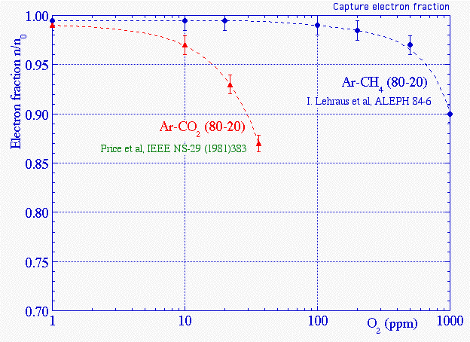
Electron attachment and impurities
Fraction of electrons surviving after a drift of 20 cm in two gas mixtures, as a function of the contamination of O₂, under the action of E = 200 V/cm

Slide 14
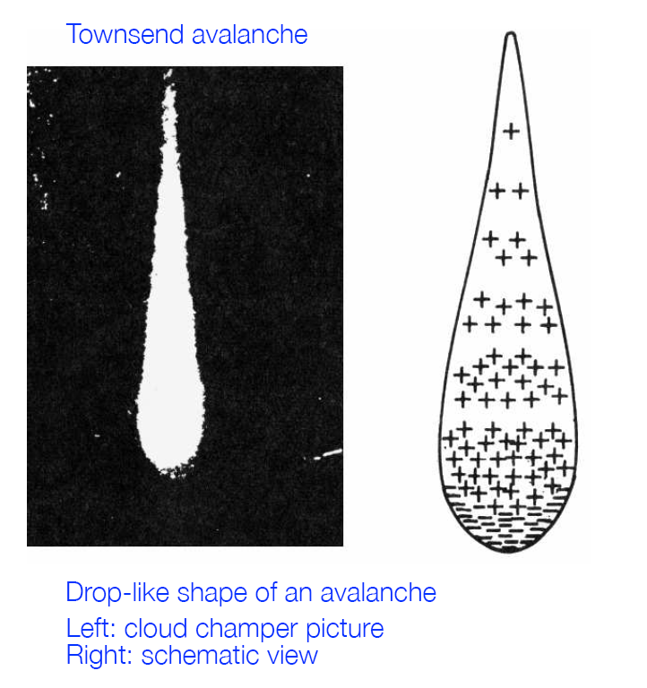


First Townsend coefficient
The first Townsend coefficient is defined as the inverse of the ionization mean free path:
It represent the average number of pairs produced per unit length
The ionization mean free path is given:
N = number of particles per unit volume
σ = ionization cross section
The first Townsend coefficient strongly depends on the electric field
The presence of electronegative gases (β = attachment coefficient), reduces the number of electrons → η = α-β = effective Townsend coefficient

Slide 15

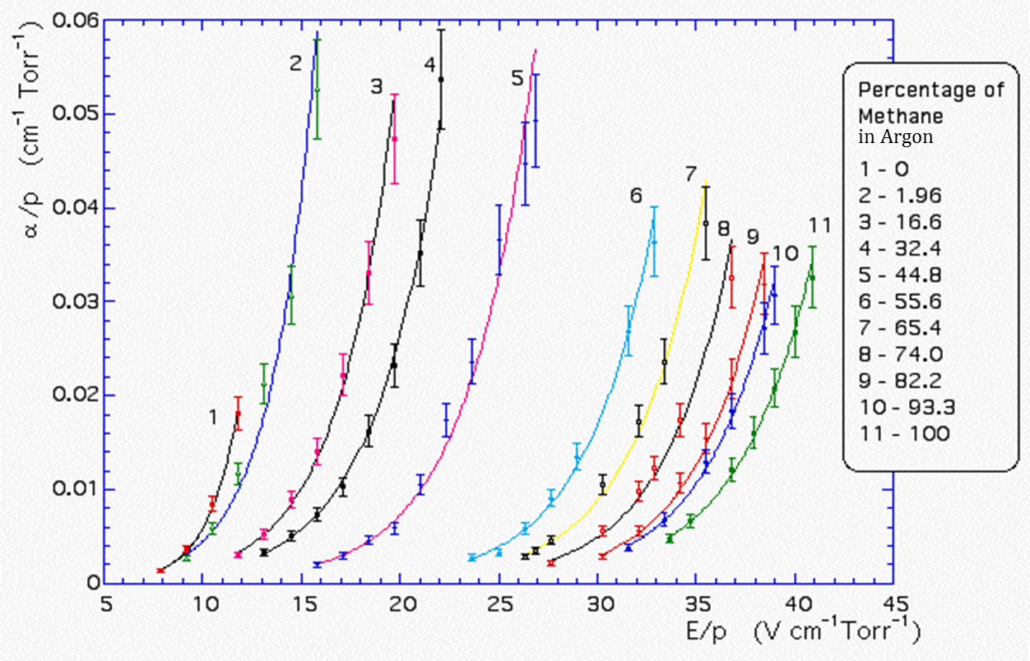

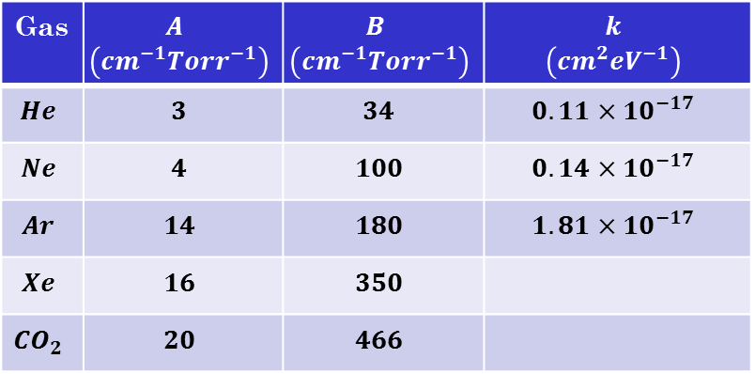
Korff approximation
Gas
A simple parametrization for the first Townsend coefficient was introduced by Korff:
A and B are numerical coefficients
An alternative model is the following:
k is a numerical coefficient; N is the number of gas molecules per unit volume and ε is the mean electron energy
First Townsend coefficient in Ar-CH₄
15

Slide 16
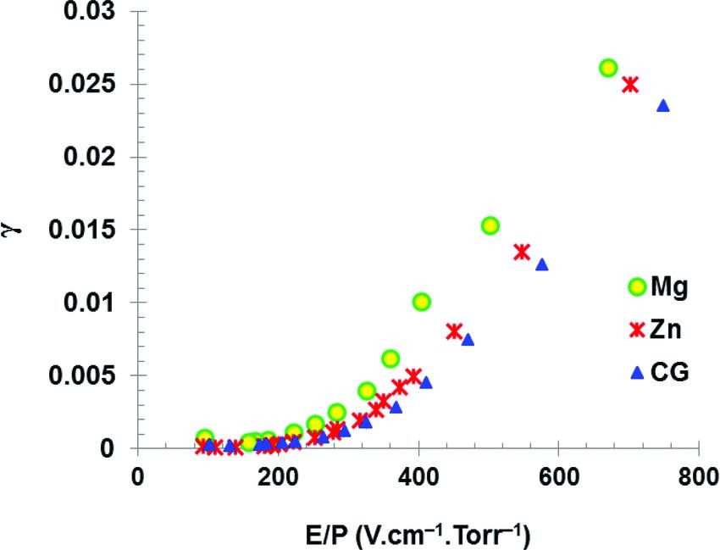
Second Townsend coefficient
Excited gas atoms produce UV photons
→ these photons produce electrons via photo-electric effect in gas and walls
→ gain increased
2nd Townsend coefficient:
_{𝛾 =} 𝑁_{𝑒} 𝑝ℎ𝑜𝑡𝑜 𝑒𝑓𝑓𝑒𝑐𝑡
𝑁_{𝑒} 𝑎𝑣𝑎𝑙𝑎𝑛𝑐ℎ𝑒
Townsend model:
F. Diab, et al., Canadian Journal of Physics, Vol 98, Nr 8 (2020)
2_{𝑁}
𝐺
𝑁 𝑥 = 𝐺_{𝛾}𝑁₀ = 𝐺𝑁₀ + 𝐺 𝐺𝛾 𝑁₀ + 𝐺 𝐺𝛾
0
+ ⋯ =
𝑁
0
1 − 𝛾𝐺
Discharge at
𝛾𝐺 = 1
𝛾 is not a constant of the gas!
Depends mainly on
material and geometry of chamber
2nd Townsend coefficient 𝛾 can be reduced with quencher gas which absobs UV photons: 𝐶𝐻₄, 𝐶𝑂₂, 𝐶𝐹₄, 𝑖𝐶₄𝐻₁₀

Slide 17
Choice of the gas filling

Slide 18
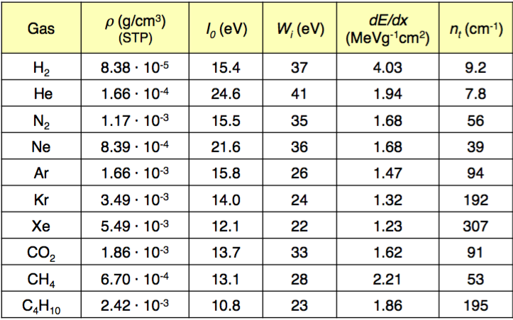
Choice of the gas filling
Noble gases are preferentially used due to the absence of vibrational and rotational states ➔ionization dominates.
Polyatomic gas have non-ionizing de-excitation modes available
Possible electron multiplication at low electric field
Choose cheap noble gases with low ionization potential
Expensive and rare
The drift velocity depends very strongly on the nature of the gas, namely on the detailed structure of the elastic and inelastic electron-molecule cross-sections. Sometimes it saturates at high electric fields.

Slide 19
Choice of the gas filling
If only a noble gas is used to fill the counter (e.g. Ar), it can operate at relatively low gains (M ≈ 10³ - 10⁴) before entering the permanent discharge regime
When the avalanche forms, excited Ar atoms are created, which can return to the ground state only emitting UV photons
The energy of these photons can be sometimes larger than the energy needed to extract electrons from the cathode walls (7.7 eV for copper)
Photoelectrons can be extracted from the walls, which cause farther ionization of the gas
Possible spurious delayed pulses due to ions neutralizing on the cathode
Ar⁺ ions reaching the cathode are neutralized and extract an electron from the walls
The neutral Ar atom is produced in an excited state, decays emitting UV photons
An additional electron can also be extracted from the wall
Both processes induce spurious delayed pulses

Slide 20
Use of quencher gases
The problem is solved by adding to noble gas percentages of other polyatomic gases, usually called "quenchers"
Gas quencher molecules have non-radiative (rotational and vibrational) mode and can absorb UV photons in a wide energy range.
CH₄ absorbs photons between 7.9 and 14.5 eV
Other polyatomic gases used are freons, CO₂, BF₃, C₄H₁₀, etc.
Polyatomic gases dissipate energy by elastic collisions
Sometimes quenchers can dissociate resulting in simpler molecules, sometimes harmful to the detector, like HF → AGING!!!
Even small quantities of quencher allow to operate these detectors up to gain of 10⁶ without discharges.

Slide 21
Use of quencher gases
Also, electronegative gases are used as quenchers, like many freons (CF₃Br), ethyl-bromide (C₂H₅Br), etc. which help operate detectors at high gain without discharges.
They are characterized by an electron capture mean free path that is less than typical anode-cathode distance (≈ 1 cm) and larger than avalanche size (few μm)
These gases capture electrons possibly extracted at the cathode forming negative ions, preventing the formation of spurios delayed avalanches
These gases can dissociate, sometimes forming solid or liquid polymers which can deposit on the electrodes, altering their properties
Malter effect, where the E field close to the electrode is distorted, causing undesired discharges
Aging effects (one of the main issues in all particle detectors)

Slide 22
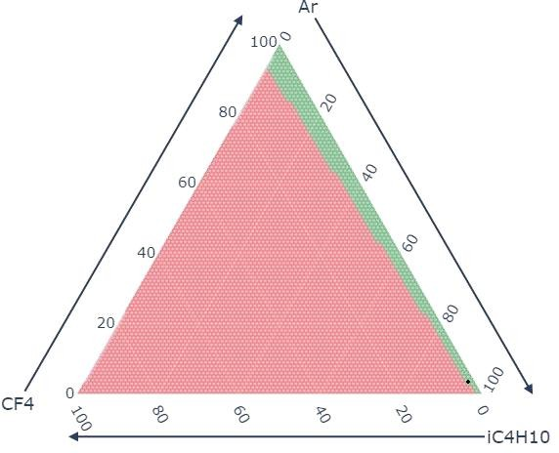
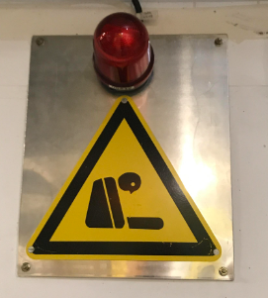
Gas selection: safety considerations
Hydrocarbons: flammable or even explosive
→ ventilation and safety systems required
Red point: flammable
Green point: non flammable
Safety measures against flammable gases:
Gas tight construction
Gas leak detection
Flammable gas sensors
Other hazards:
Toxic gases
Oxygen discplacement
Oxygen deficiency hazard (ODH)

Slide 23
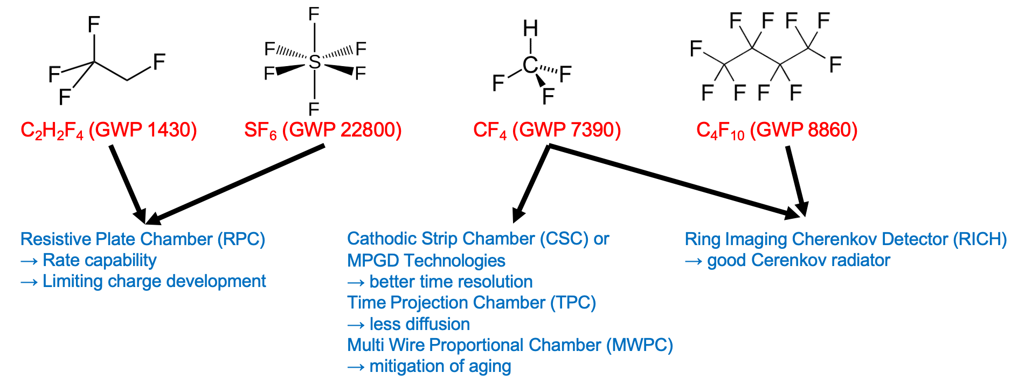
Environmental aspects (GHG)
Some of the gases used in particle detectors are Green House Gases (GHG)
The use of GHG gases should be reduced or avoided in future
Regulatory limits on emissions (Kyoto protocol)
Rising prices of GHGs
Ethical reason
Their impact is quantified via Global Warming Potential (GWP)
GWP gives the global warming effect of the gas relative to the same mass of carbon dioxide (CO₂)
Takes into account the absorption power of the gas and the lifetime of the gas in the atmosphere

Slide 24
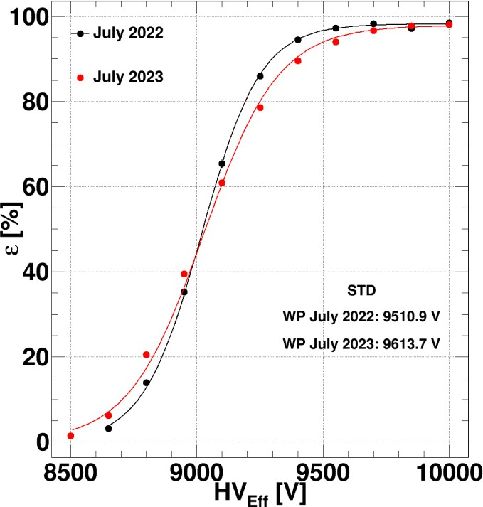
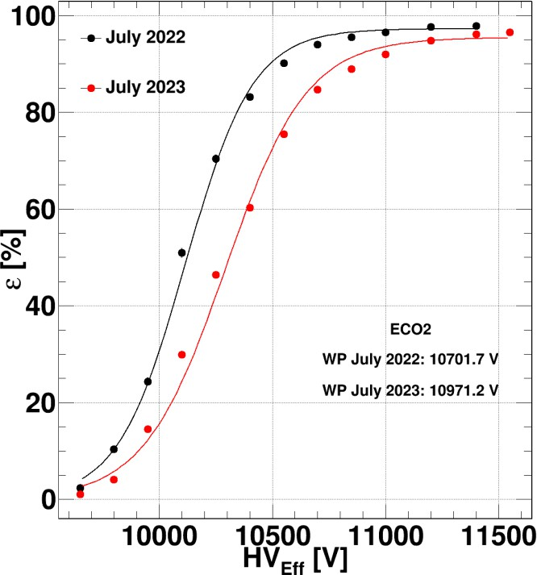
ALICE RPC approach
Efficiency before and after irradiation ALICE 2022 – 2023
Efficiency plateaus at the same level
Efficiency plateaus for ECO gas mixture
at higher voltage
Shift to higher voltages after irradiation
for ECO gas mixture
ECO1: 45% HFO, 50% CO₂, 4% iC₄H₁₀, 1% SF₆
ECO2: 35% HFO, 60% CO₂, 4% iC₄H₁₀, 1% SF₆
ECO3: 25% HFO, 69% CO₂, 5% iC₄H₁₀, 1% SF₆
Reduction of GWP to about 1/4 of standard mixture,
Remaining GWP almost completely due to SF₆

Slide 25
ATLAS RPC approach
Standard RPC mixture: 94.7% R134a - 5.0% iC₄H₁₀ - 0.3% SF₆
Gas search strategy
Replace a fraction of R134a (GWP 1430) with CO₂
Limit as much as possible the fraction of SF6 (GWP 22800)
Ageing test: monitoring through periodic performance measurements, observing in particular, ohmic current, exponential current, electrode resistivity
Validation in ATLAS: validating the performance results obtained in the laboratory with the RPC chambers in ATLAS cavern.
Since the beginning of Aug 2023 the ATLAS RPCs are operated with a new gas mixture:
Current mixture: 64% C₂H₂F₄ - 30% CO₂ - 5% iC₄H₁₀ - 1% SF₆ -> 64.5% C₂H₂F₄ & 0.5% SF₆
Environmental impact is reduced by ~14%

Slide 26
Environmental aspects (GHG)
How to proceed:
a) If you are planning to build a new gas detector and use GHG gases, do not waste time—you must engineer it properly from the very beginning. The detector must be truly leak-tight! The GHG must be returned to the supplier (provided they agree to supply it in the first place) at the end of its use.
b) To return the GHG to the supplier, it must be recovered; therefore, your gas system must be equipped with both recirculation and recovery systems.
c) Replace your GHG with gases with lower (or ideally zero) GWP

Slide 27
… Beyond proportional mode

Slide 28
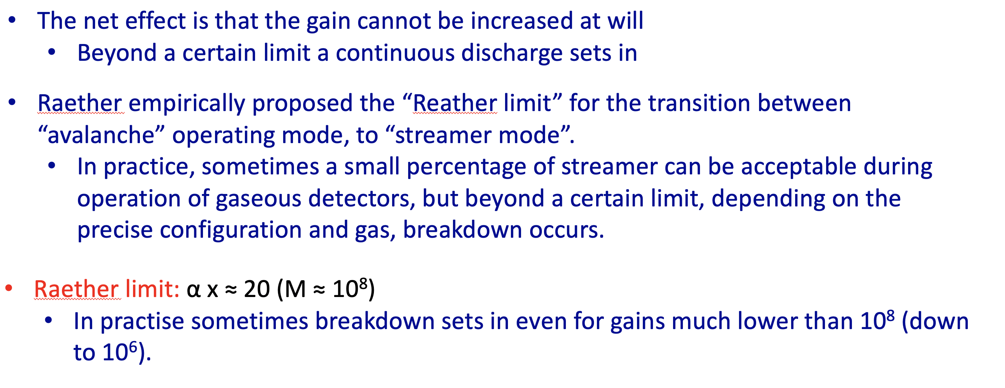
From lesson #1

Slide 29
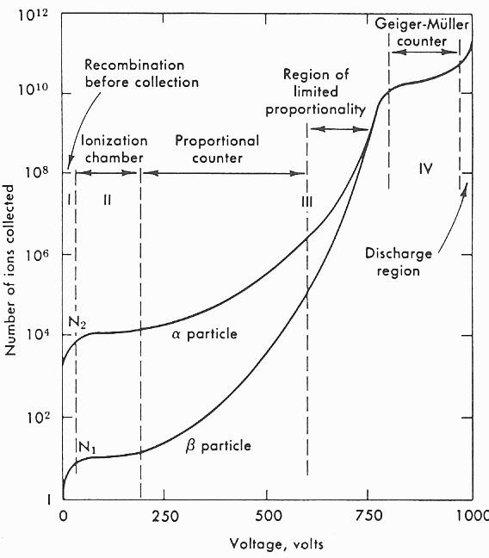
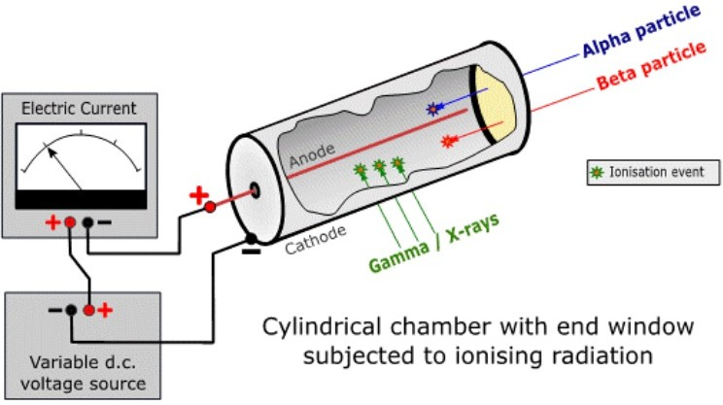
What is a discharge for gaseous detectors?
Gas discharge → all phenomena of current going through gas

Slide 30
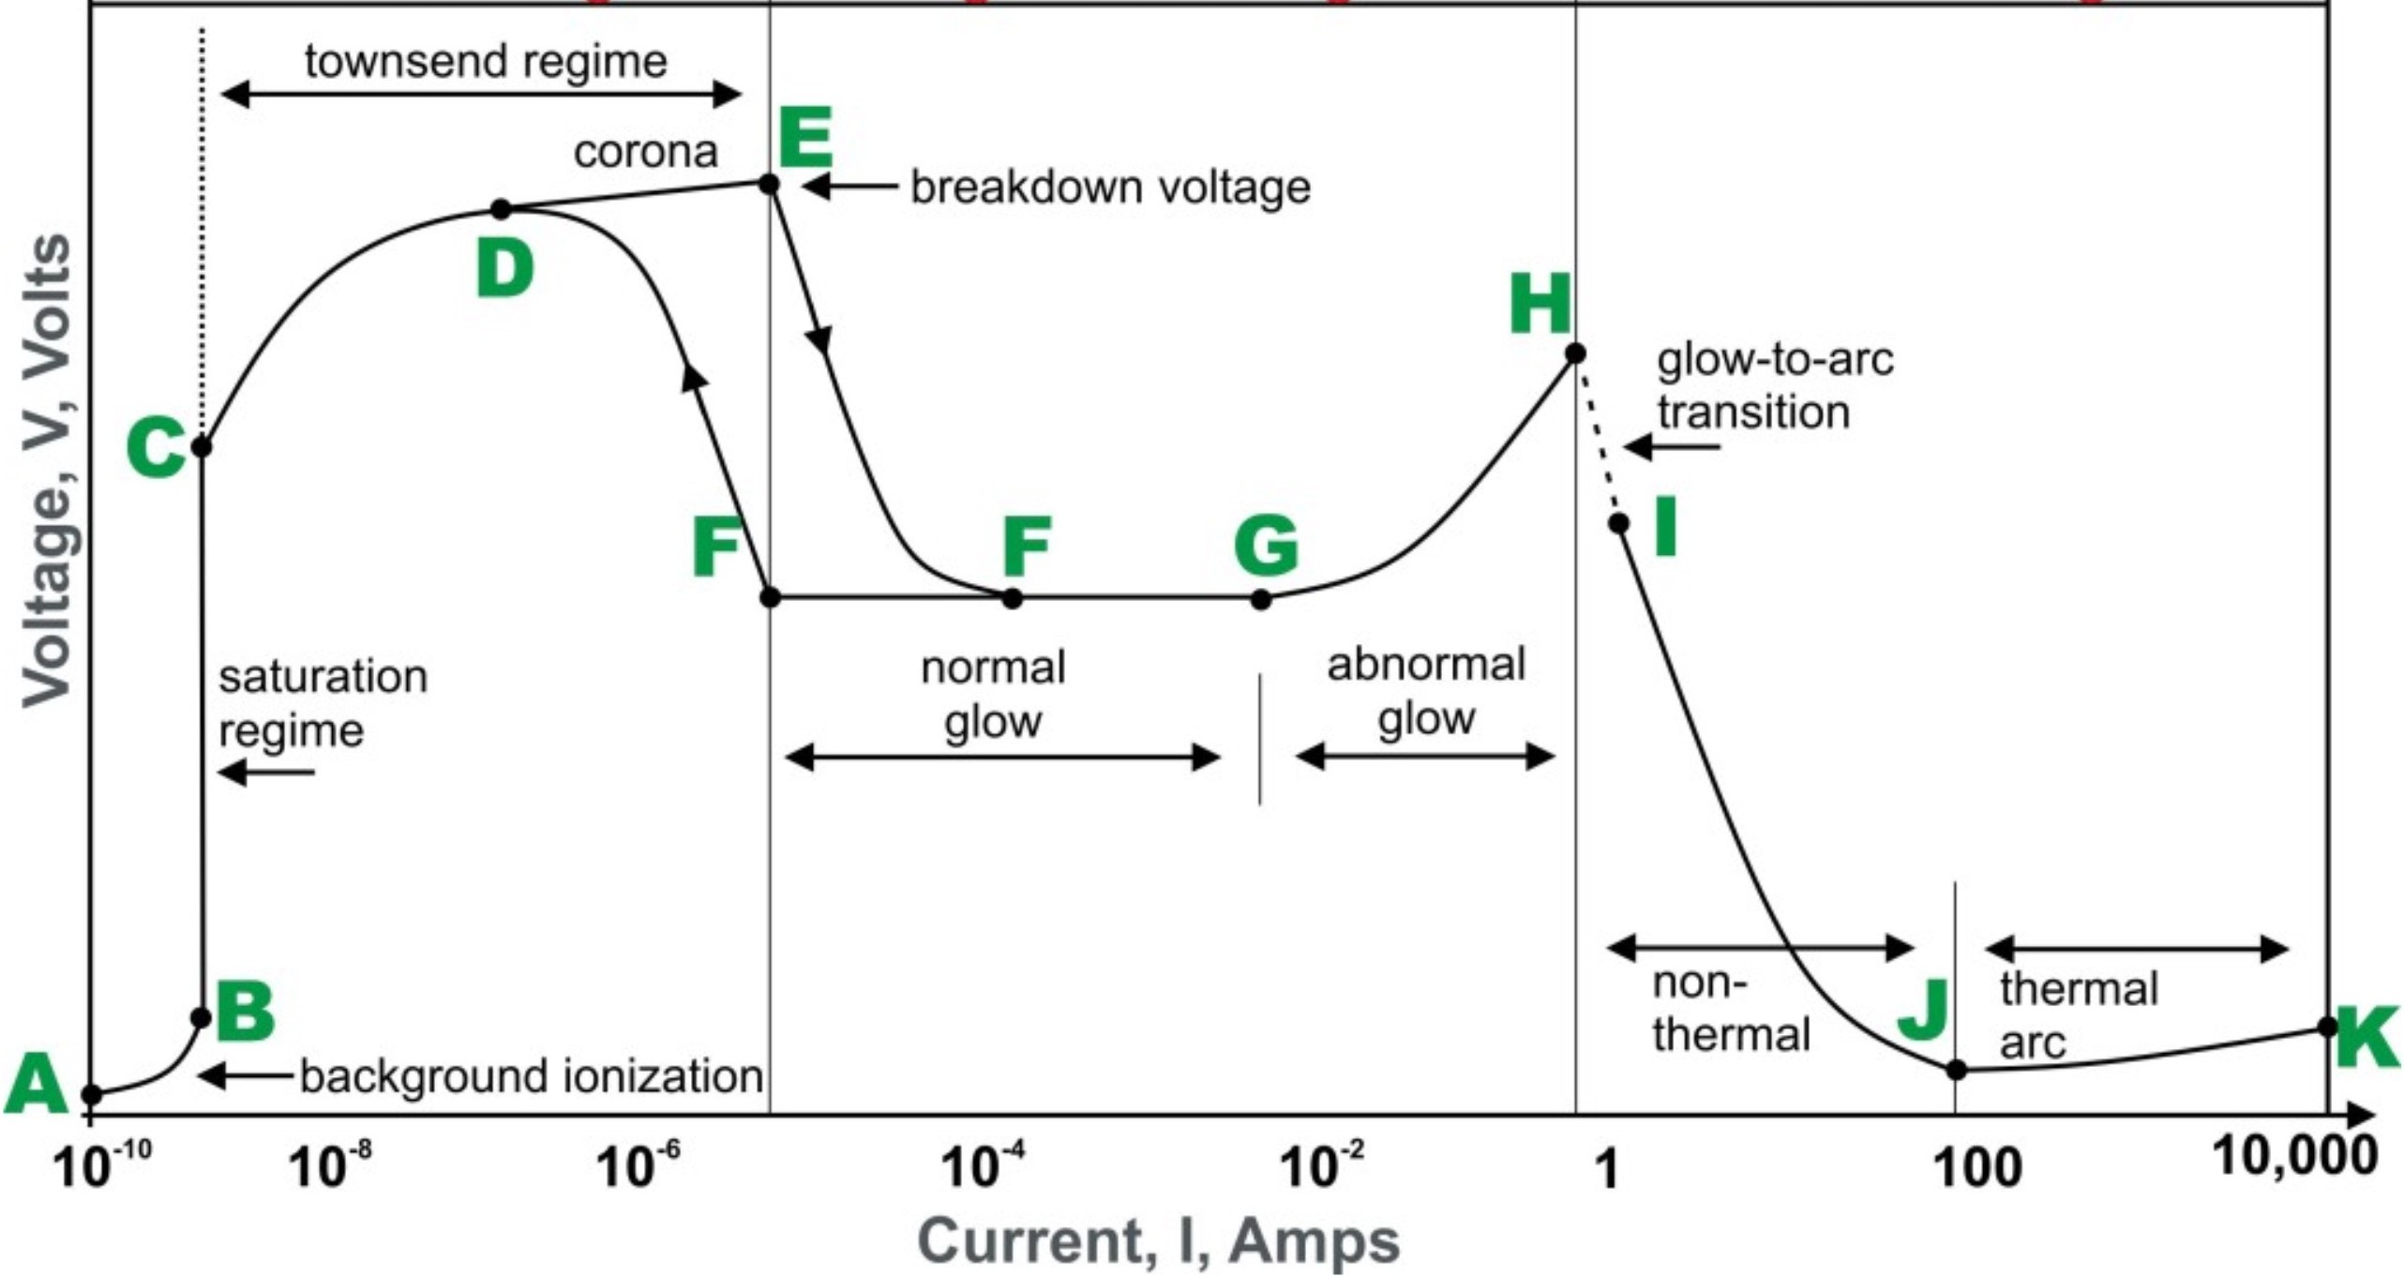
What is a discharge for gaseous detectors?
Non
self-sustained
Self-sustained

Slide 31
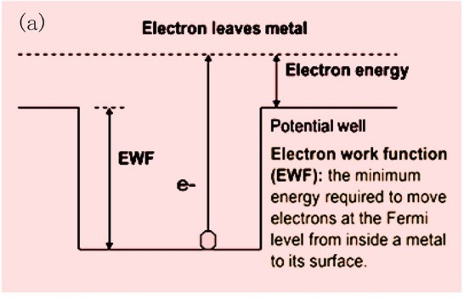
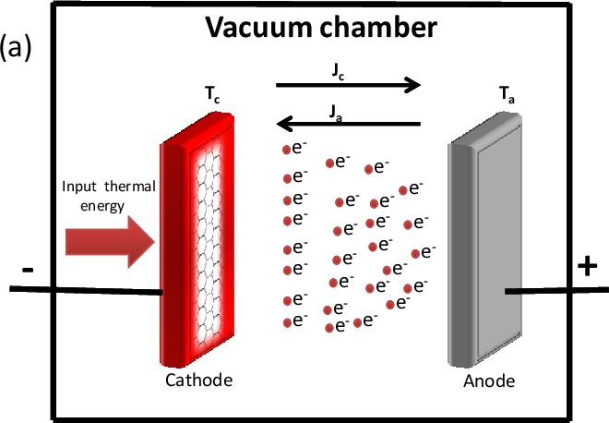
Cathode processes
Cathode plays an important role in gas discharges by supplying electrons for the initiation, sustenance and completion of a discharge
Metal, under normal conditions: electrons are not allowed to leave the surface as they are tied together in the lattice
Metal work function:
The energy required to knock out an electron from a Fermi level
Characteristic of a given material
Thermionic emission
Electron thermal energy not sufficient to leave the surface at room temperature
Above ∼1500 K electrons will receive energy from the violent thermal lattice vibration, sufficient to cross the surface barrier and leave the metal
2 –𝖶/𝑘𝑇
𝐴_{𝐺} = 𝜆_{𝑅}𝐴₀ and
4𝜋𝑚𝑘²𝑞_{𝑒}
Saturation current density: 𝐽 = 𝐴_{𝐺}𝑇 𝑒
with
𝐴₀ =
_{ℎ}3
W – work function, T – temperature, 𝜆_{R} – material-specific constant, A₀ – universal constant
Current density increases with decrease in work function and increase in temperature

Slide 32
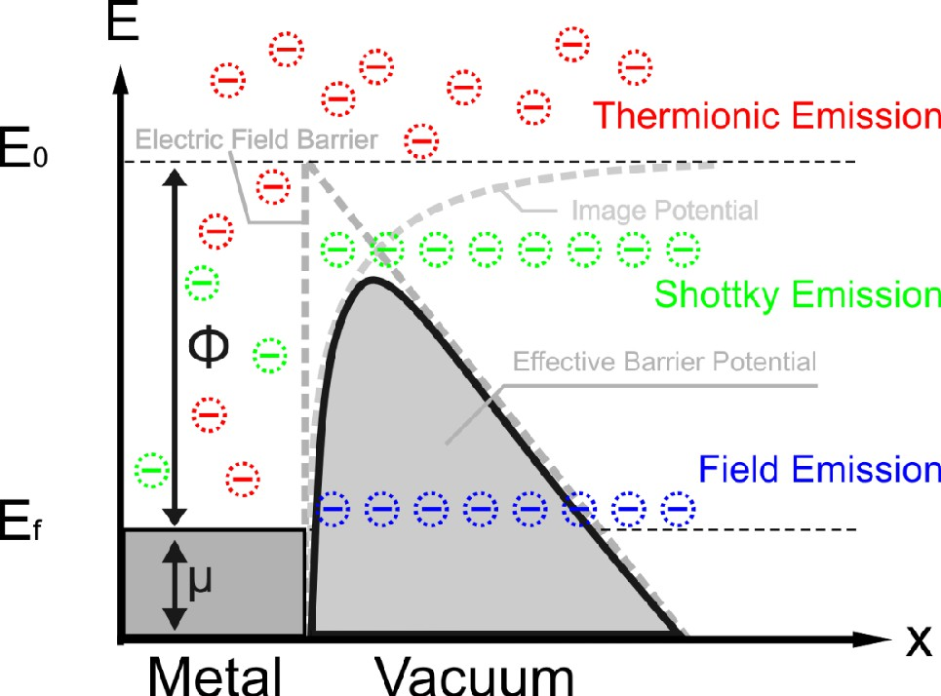
Releasing electrons from the cathode
Field enhanced thermionic emission - Schottky effect
If a strong electric field E is applied between the electrodes, the effective work function of the cathode decreases by
𝑞³𝐸/(4𝜋1 )
𝑒 0
Saturation current density: _{𝐽 = 𝐴𝐺𝑇}2_{𝑒}−(𝖶−Δ𝖶)/𝑘𝑇
Wide range of temperature and electric fields
Fowler-Nordheim tunnelling – field emission
For the fields >10⁸ V/m the cathode surface barrier becomes very thin and quantum tunneling of electrons occurs which leads to field emission even at room temperature.

Slide 33
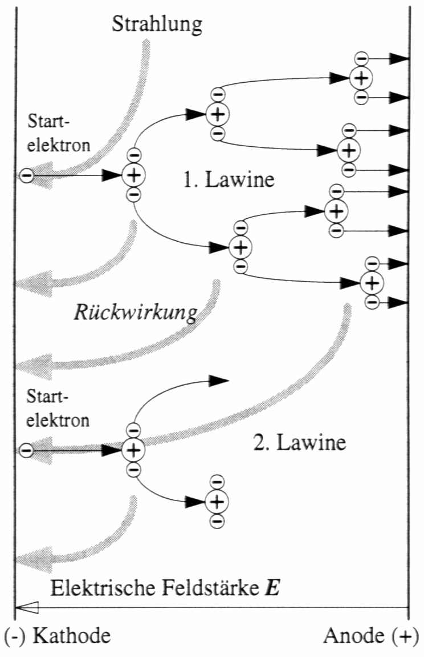
Releasing electrons from the cathode
Secondary emission
Electron emission by a positive ion and excited atom bombardment
Effective secondary emission by a positive ion with energy E_{ion} ≥ 2W
(one electron will neutralize the bombarding positive ion and the other electron will be released)
The additional current due to the presence of positive ions and photons (h𝑣 > W)
Number of photons approximately proportional to number of positive ions at breakdown electric field strength
Common secondary emission coefficient 𝛄
_{γ =} number of released free electrons from the electrode surface
number of positive ions
Positive ions, photons and metastable, all the three may participate in the process of ionization
There may be more than one mechanism producing secondary ionization in the discharge gap, γ = γ₁ +γ₂ +γ₃ +...
_{𝑁0𝑒}𝛼𝑑
1 − γ 𝑒^{𝛼𝑑} − 1
_{𝐼0𝑒}𝛼𝑑
1 − γ 𝑒^{𝛼𝑑} − 1
Townsend avalanche:
𝑁 =
𝐼 =

Slide 34
Townsend breakdown
Theoretically, the current become infinite when 𝜹 = γ(e^{𝘢d} – 1) = 1
Practically:
limited by the resistance of the external circuit
limited partially by the voltage drop in the arc
Townsend breakdown criterion
𝜹 < 1 - current flow is not self-sustained.
𝜹 = 1 - self-sustained discharge.
_{I e}αd
_{I =} 0
1 −γ (e^{αd} −1)
– 𝜹 > 1 - ionization produced by successive avalanche is cumulative.
Discharge grows more rapidly.
After gas breakdown the form of the discharge is related to the
shape of the electrodes, geometric distance, pressure and external circuits.

Slide 35
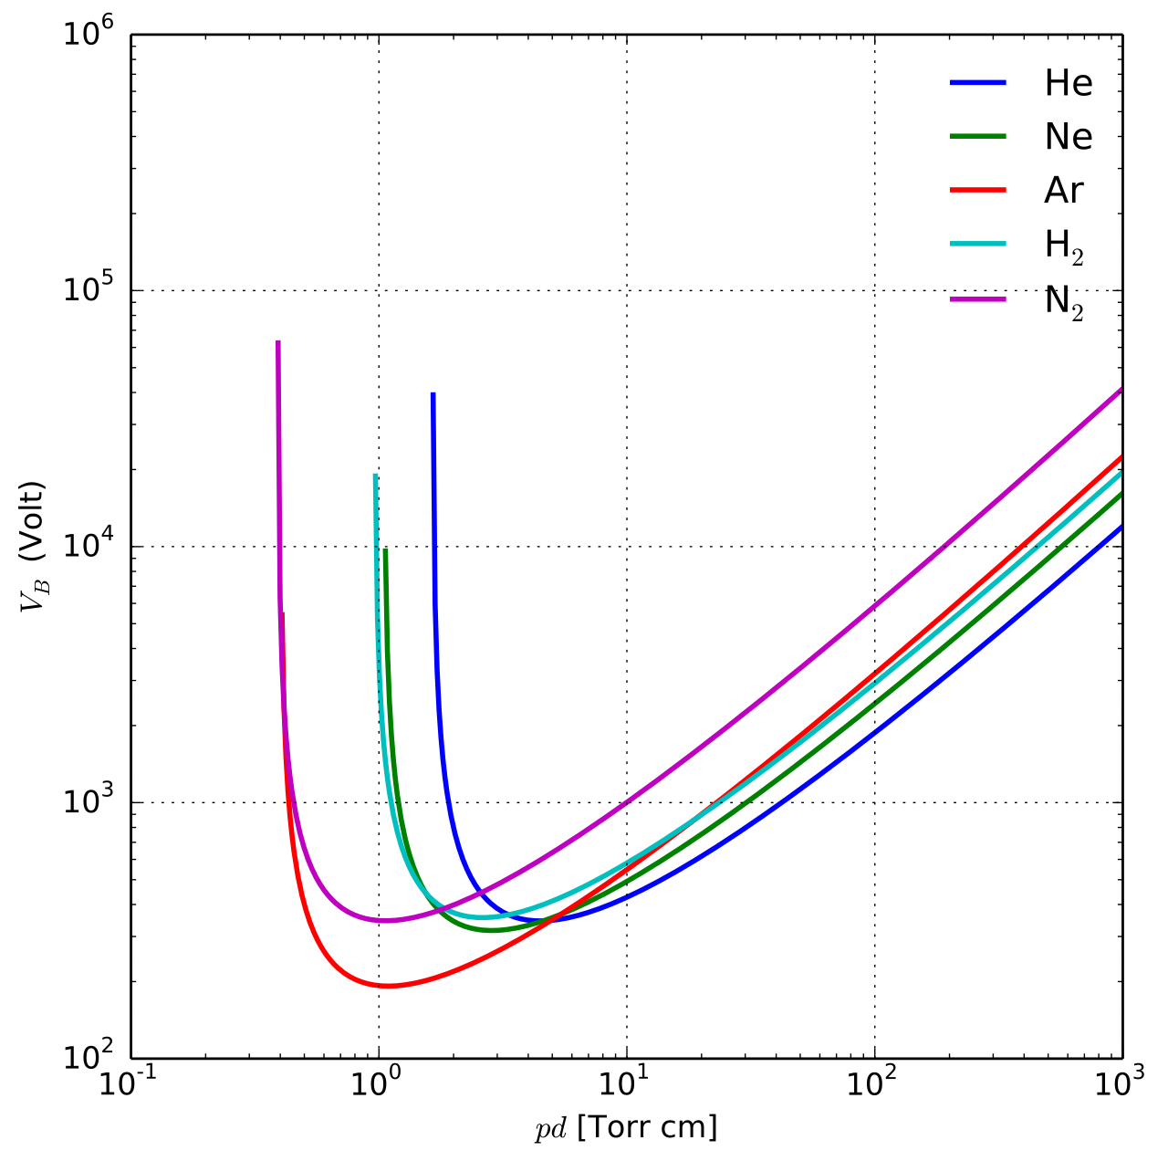
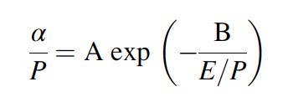

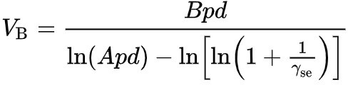
Breakdown, what tell us the Paschen’s Law
Paschen’s Law describes when a gas becomes conductive (i.e. undergoes electrical breakdown) instead of remaining insulating, it was discovered empirically in 1889, it states that the breakdown voltage depends on the product p·d (pressure × distance) and not on p or d separately: V_{s}=f(p⋅d) Vs = Breakdown voltage
Key point: the Paschen minimum
p·d too small (low pressure or very short distance)
few collisions → high voltage required
p·d too large (dense gas or large distance)
many collisions, but electrons cannot accelerate enough → high voltage required
optimal p·d
minimum voltage → breakdown occurs more easily
Derived from the 1st Townsend coefficient and breakdown criterion
If the type of gas and the cathode material are known, A, B, and γ are known constants,
V_{s} is only the function of the Pd product
The equation loses accuracy for gaps O(10 μm) at atmospheric pressure
V_{S}

Slide 36
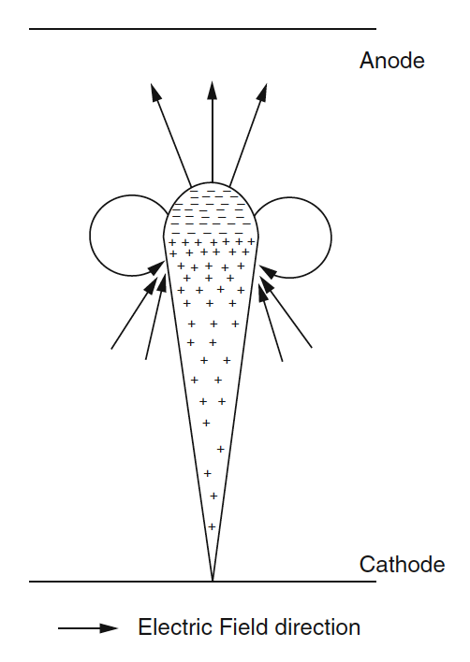
Streamer Theory
H. Raether, L.B. Loeb, J.B. Meek – streamer theory of spark discharge
A single e starting at the cathode builds up an avalanche (ionization) that crosses the gap
Electrons in the avalanche move very fast compared to the ions (regarded as stationary)
The space-charge E-field will cause significant distortions which
strengthen the electric field of the head and tail parts of the electron avalanche
weaken electric field between the positive and negative charge regions
Raether criterion: Q_{max} = e^{⍺d} > 10⁸ is the condition for streamer formation and self-sustained discharge (as in Townsend)
Meek criterion: radial E-field intensity of the space-charge (head of the avalanche) is ∼equal to the applied field; (Supplemented by Loeb condition on the electron density in the avalanche of 0.7 × 10¹² cm⁻³ to ensure sufficient photoionisation)

Slide 37
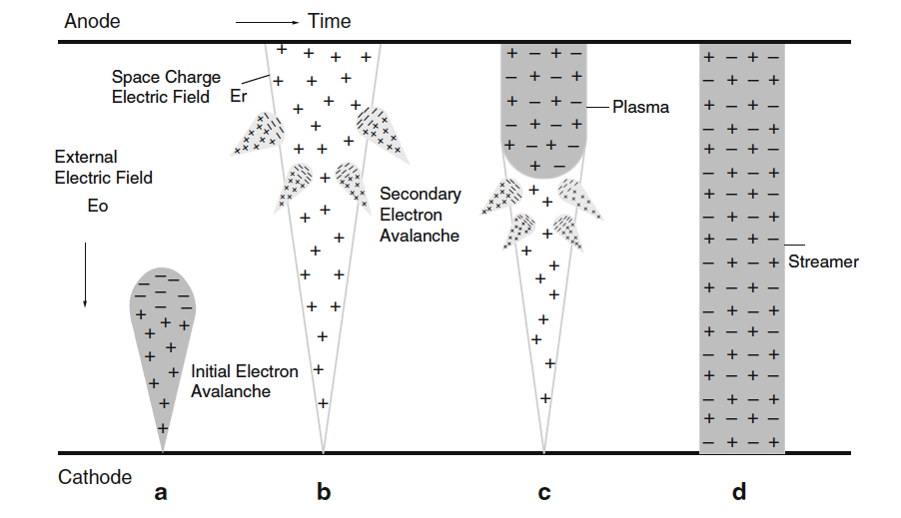
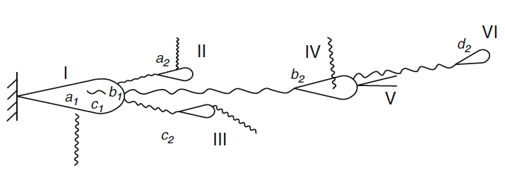
Streamer Theory
Applied voltage ∼breakdown voltage (V_{S}) → positive streamer formation
Applied voltage > breakdown voltage (V_{S}) → negative streamer formation
The electron avalanche is through the whole space, E-field of the tail is greatly strengthened
Photon radiation → photoionization → secondary electron avalanche (b)
Electrons form negative ions → creation of a plasma stream (c)
Streamer has a good conductivity, strong electric field in front, process grows rapidly
When streamer reaches the cathode, gap breakdown is completed (d)
No need for the electron avalanche to go through the gap
Ionization degree of the avalanche head part sufficient to form a streamer (photon emission)
Streamer develops towards the anode (volume- and photoionization)
Expansion speed of of the streamer much larger than avalanche

Slide 38
Discharges in gas detectors

Slide 39
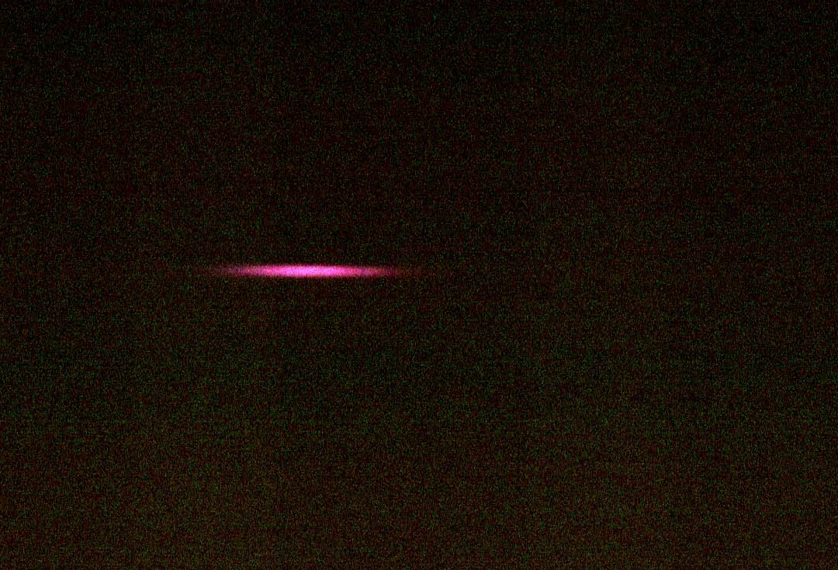
Operation beyond proportional mode
Geiger mode
Poorly quenched gases, low pressures
Photon mediated avalanche propagated in both directions along the wire
Quenched with an external circuit (R) or space-charge effects (quenched gases)
Self-sustained discharges (glow/corona)
Sustained discharge due to ion feedback mechanism (Townsend discharge)
He, Ne mixtures at atmospheric pressure (gain 10⁴-10⁵) glows below sparking limits
Quality, cathode, quencher → crucial!
From C. Garabatos

Slide 40
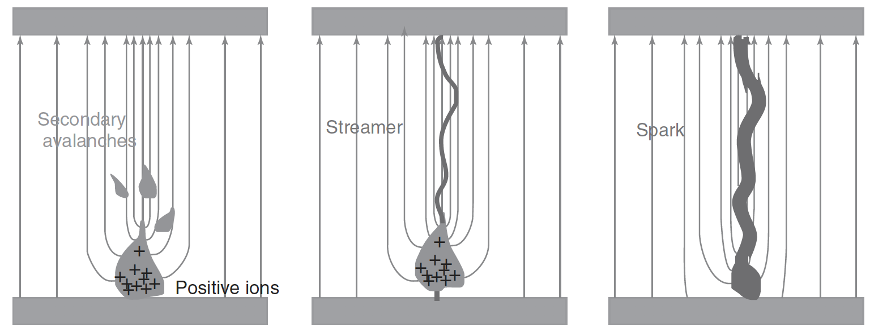
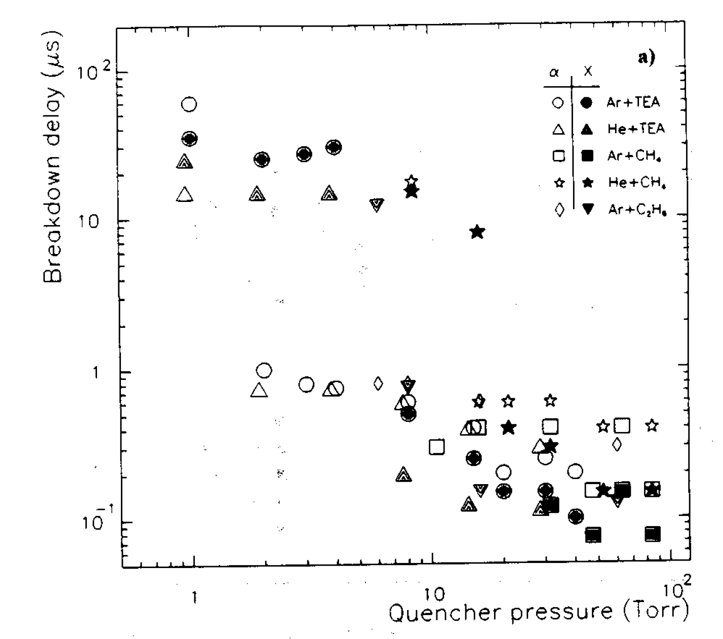
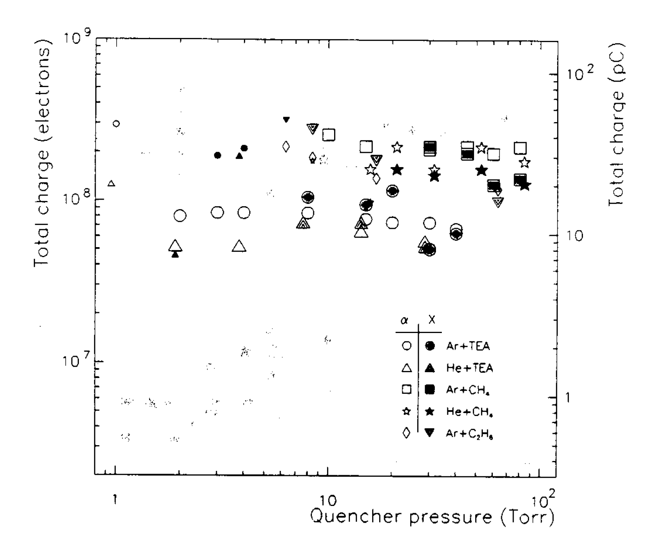
Discharges in parallel-plate avalanche counters
Both Townsend (slow) and Streamer (fast) breakdown modes observed
In uniform, parallel fields streamer develops until spark channel is created (no SQS, full breakdown)
Transition depends on the gas composition (photon feedback)
Critical charge for streamer/spark development ∼10⁸ (Raether limit?), but:
Differences up to factor of 5; quencher dependency (?) → no universal limit?
M. Abbrescia, P. Fonte, V. Peskov, Wiley-VCH Verlag GmbH & Co. KGaA, 2018
Pd = 760 cm Torr
Pd = 760 cm Torr
P. Fonte, V. Peskov, F. Sauli, NIM A 305 (1991) 91
P. Fonte, V. Peskov, F. Sauli, NIM A 305 (1991) 91

Slide 41
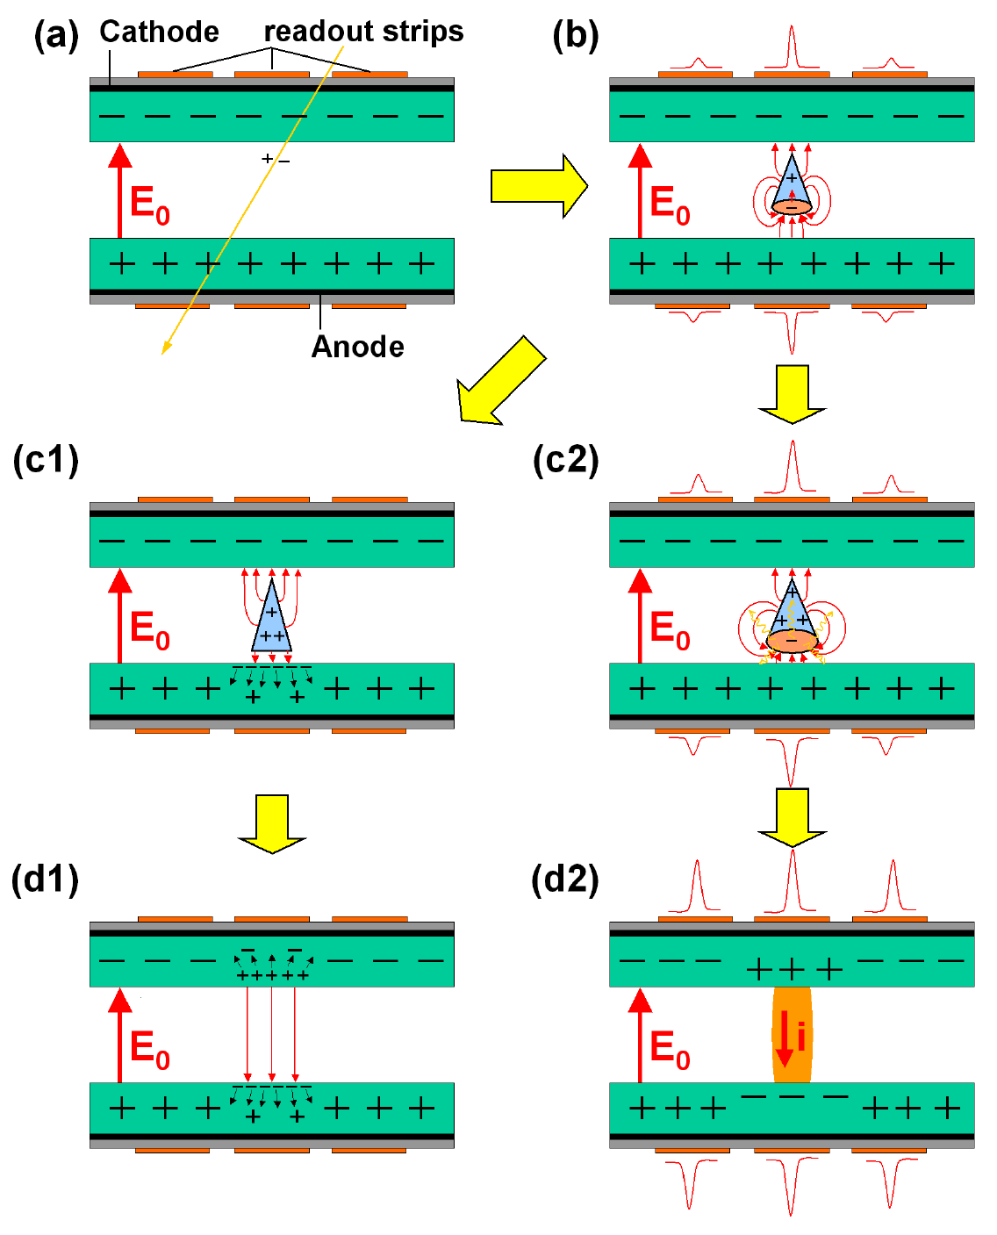
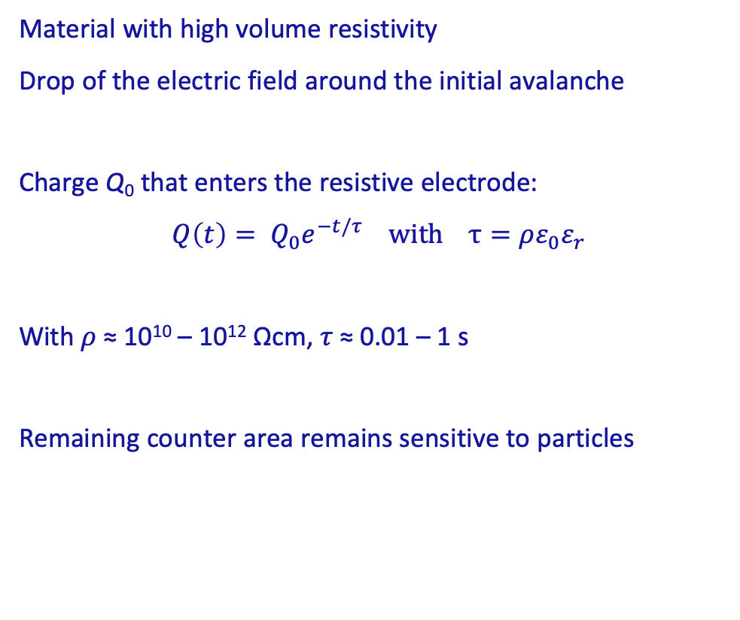
Streamer in RPC
Material with high volume resistivity
Drop of the electric field around the initial avalanche
Charge Q₀ that enters the resistive electrode:
$$Q\left(t\right)= Q_{0}e^{−t/τ} with τ=ρε_{0}ε_{r}$$
With 𝜌 ≈ 10¹⁰ – 10¹² Ωcm, 𝜏 ≈ 0.01 – 1 s
Remaining counter area remains sensitive to particles
© Courtesy of I. Deppner, GSI
Avalanche mode
Streamer mode

Slide 42
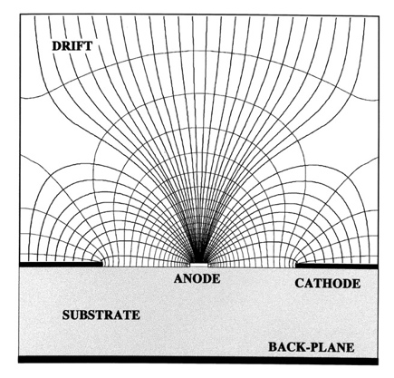
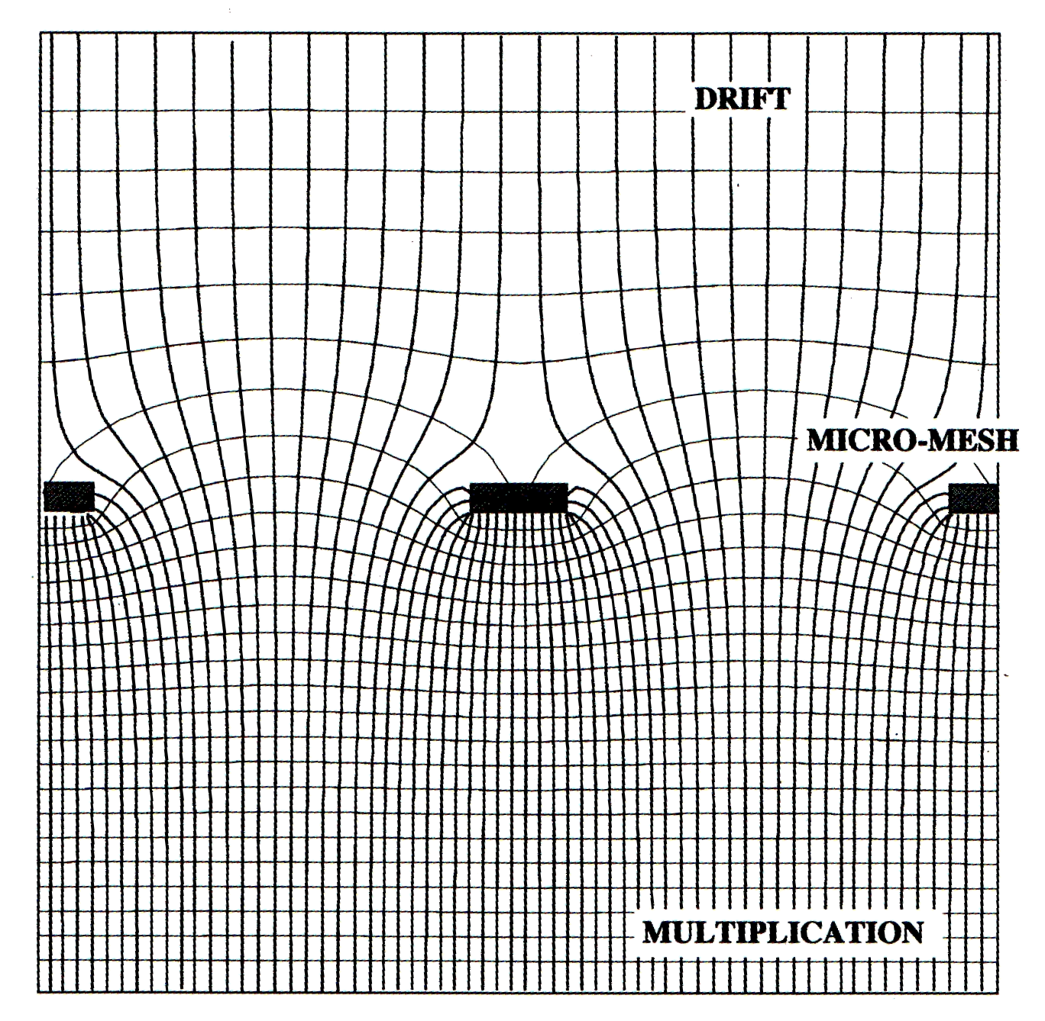
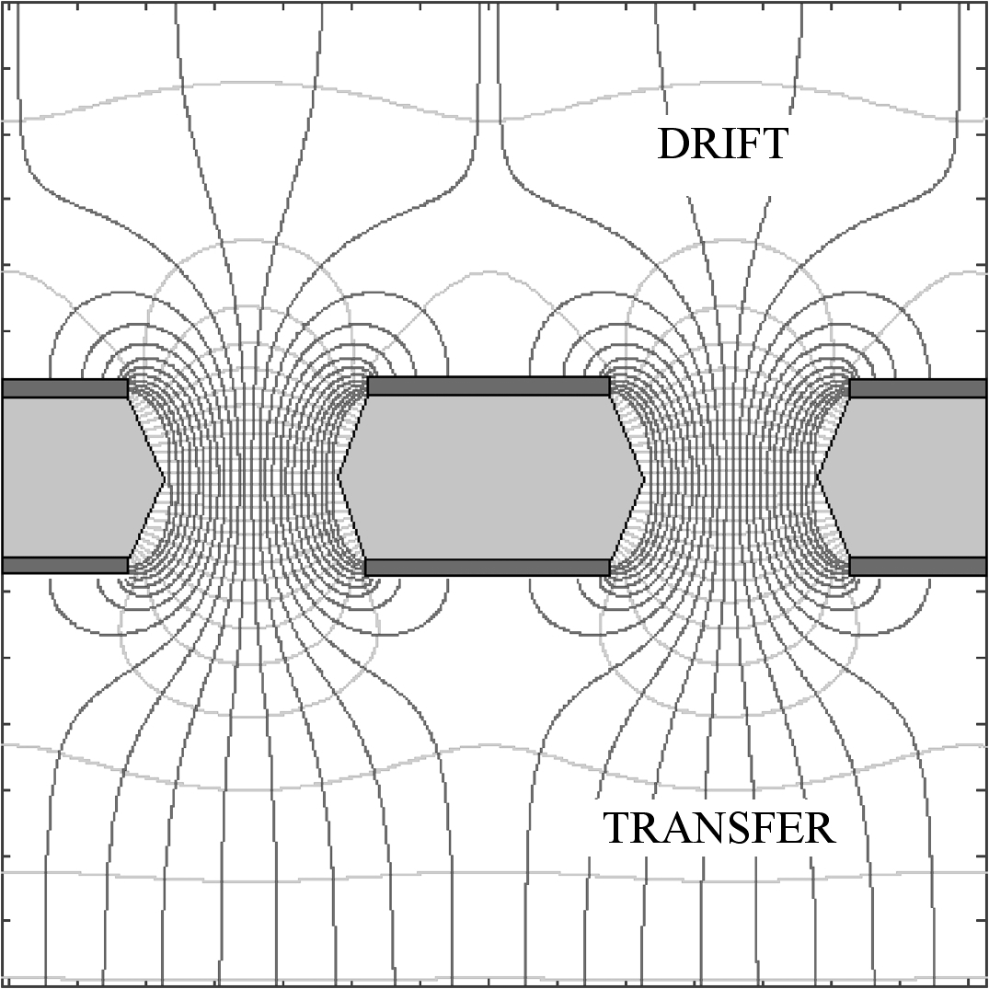
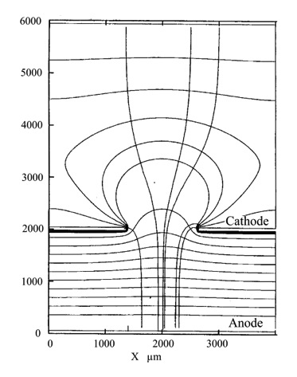
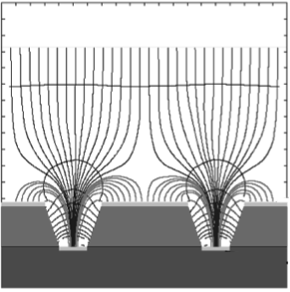
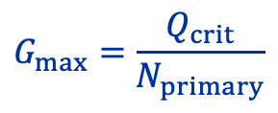
Discharge in MPGD
MSGC
Micromegas
GEM
CAT
MGC
Following: V. Peskov, „ Discharge phenomena in gaseous detectors “, RD51 Meeting, Munich 2018 (link)
In all these structures, there are regions with ∼parallel field lines
Streamers can develop by the same mechanism as in PPAC
No quenching by field reduction, when streamers reaches the cathode → full breakdown
F. Sauli, Report at the RD51 collaboration meeting in Amsterdam, 2008
P. Fonte, Simulations of discharge phenomena, RD51 meeting, Munich, 2018
 | DETECTOR | MAX GAIN | MAX CHARGE
i | MSGC | 2000 | 4 10⁷
ii | ADV PASS MSGC | 1000 | 2 10⁷
iii | MICROWELL | 2200 | 4.4 10⁷
iv | MICROMEGAS | 3000 | 6 10⁷
v | GEM | 2000 | 4 10⁷
In case of MPGDs we discuss mainly the (positive) streamer mechanism and a spark discharge
Critical charge measurements in MPGDs point to a limit of 10⁶-10⁷ e, depending on the reference
Different geometries, gases, source (x-ray, alphas)
$$G_{max}=\frac{Q_{crit}}{N_{primary}}$$

Slide 43
Discharge probability in MPGD
Clear gas dependencies
Abrupt drop of discharge rate for source distances larger than alpha range
Clear correlation between discharge rate and 〈Z〉 of a gas mixture → primary charge density
Alpha range in Ne longer than in Argon
W_{i} (Ar) < W_{i} (Ne)
MICROMEGAS
Hadron beam (10-15 GeV/c protons)
GEMs
Alpha particles
NIM A 478 (2002) 205
NIM A 870 (2017) 116

Slide 44
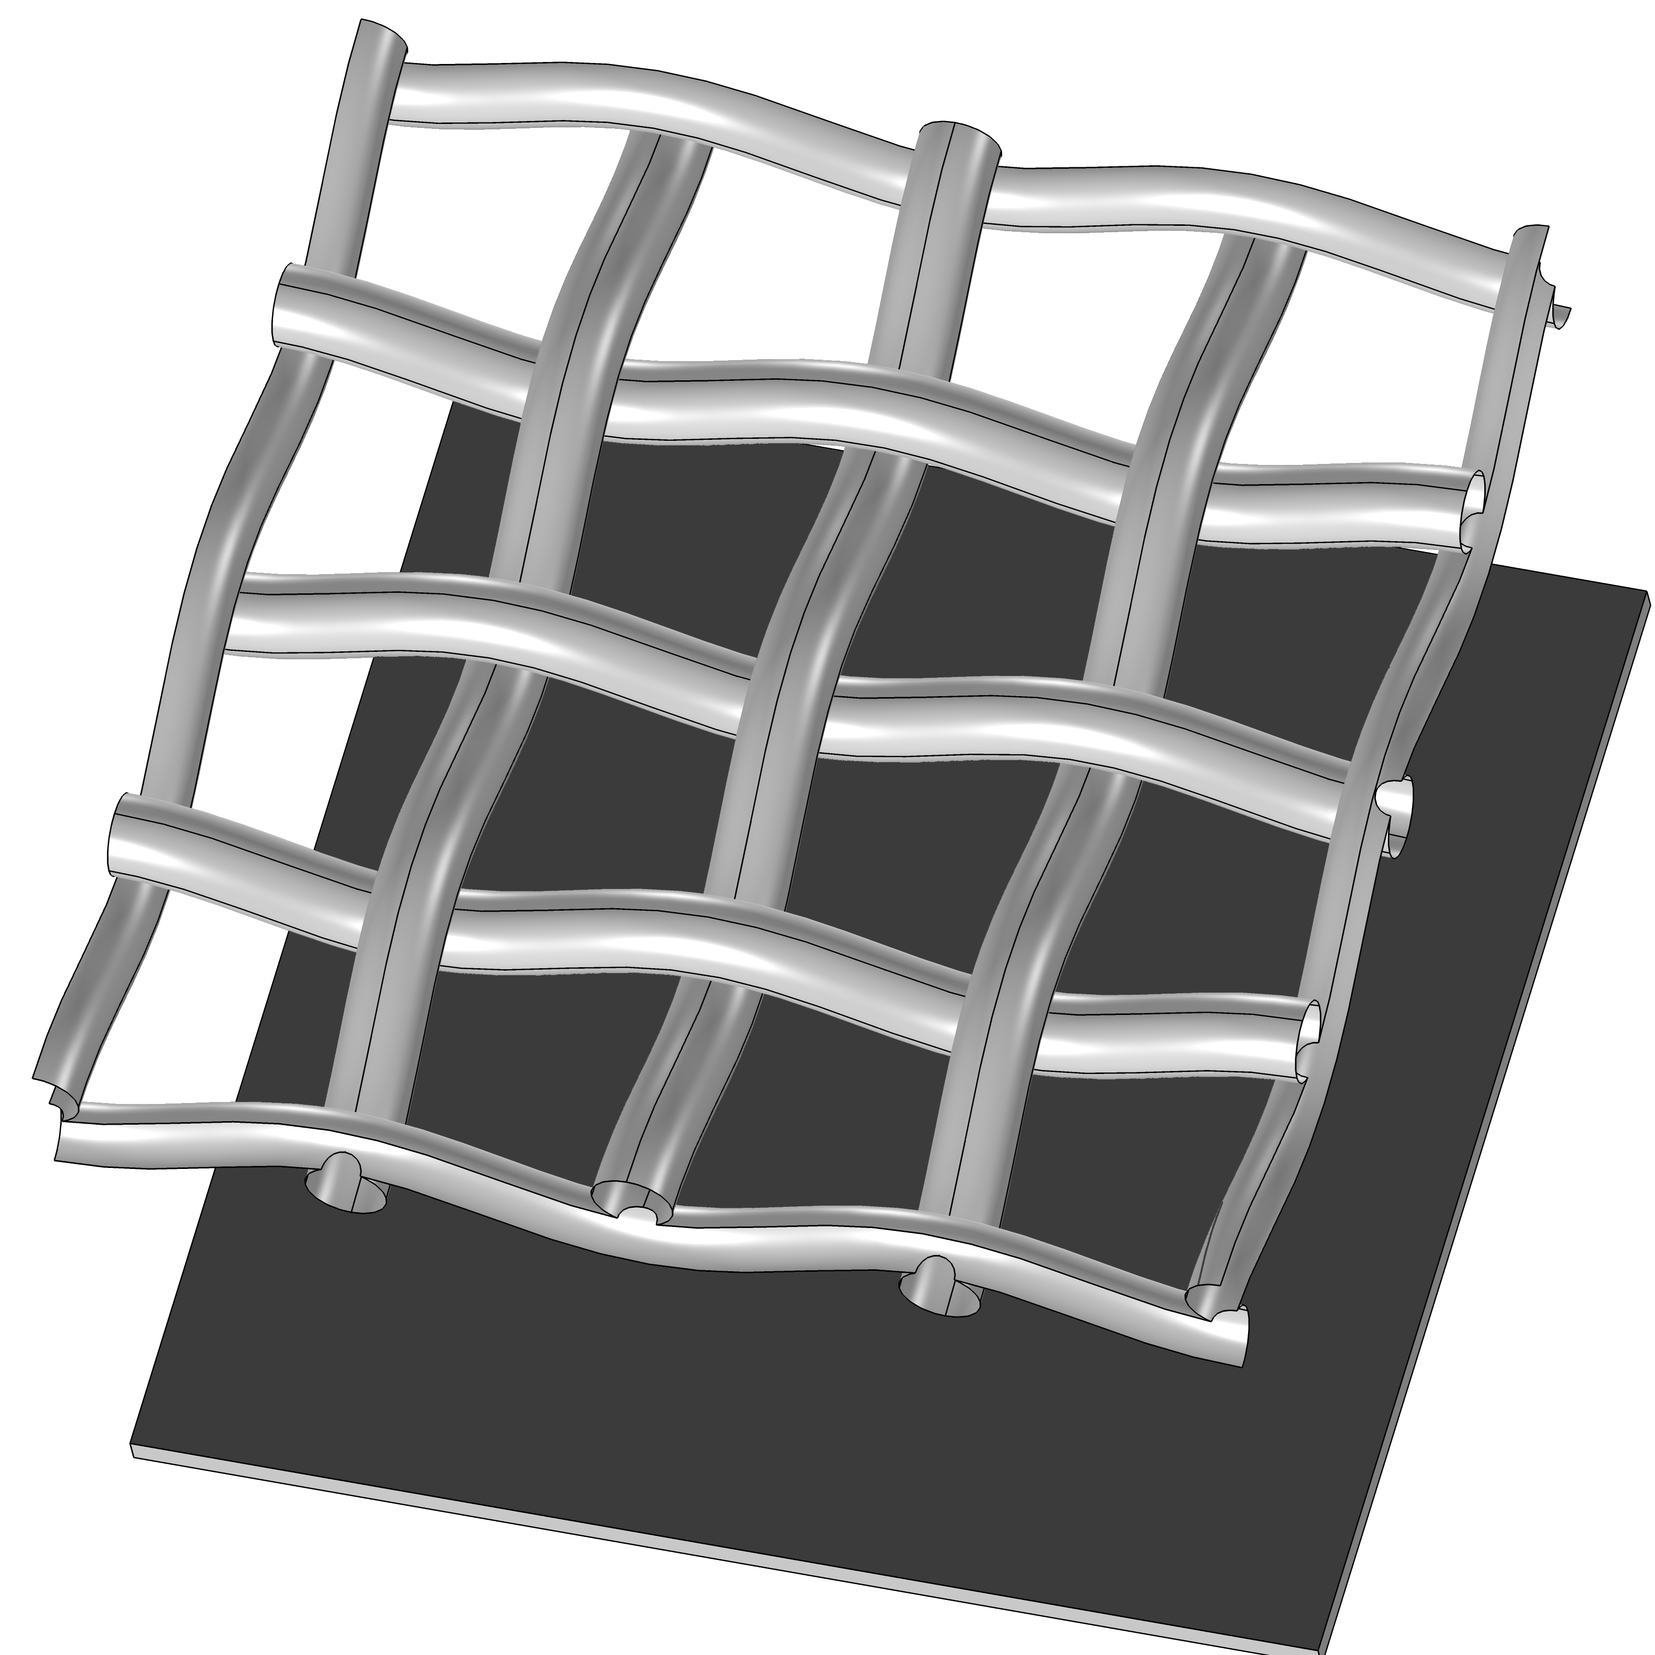
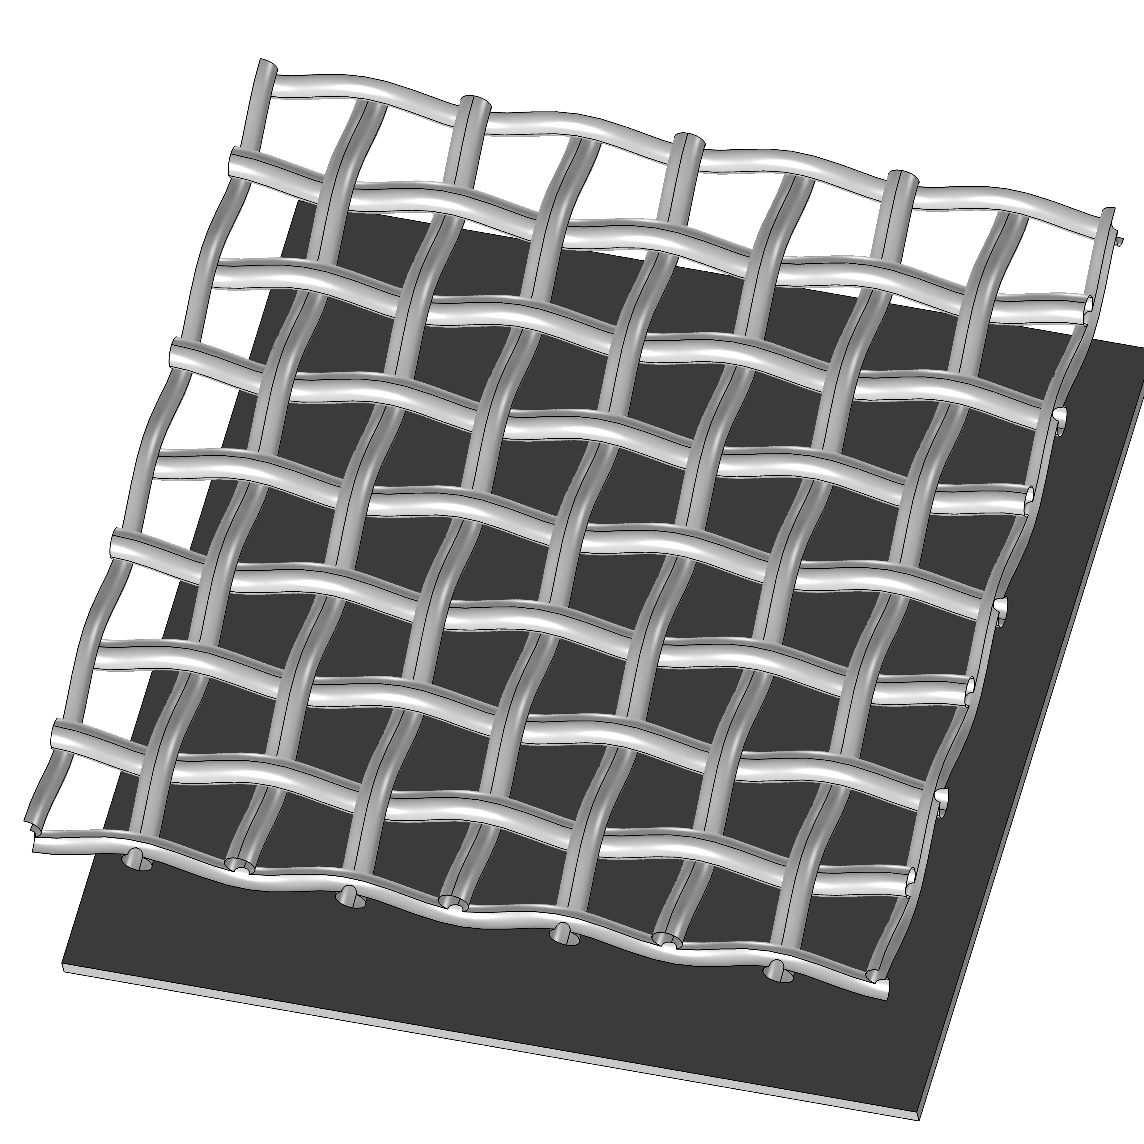



Charge Density
Discharge rate scales with the mesh cell size ➙ mesh cell as an independent amplification structure
Primary charge density is a more relevant parameter than the total number of electrons
Source inclination studies – higher charge densities per hole for perpendicular tracks impinging a GEM
B∥E studies – reduced transverse diffusion – higher charge density arriving at GEM holes
NIM A479 (2002) 294
JINST 18 (2023) C06011
730 LPI, T_{opt} = 39.5%
640 LPI, T_{opt} = 39.5%
400 LPI, T_{opt} = 51.0%
230 LPI, T_{opt} = 52.0%
Size of MMG cell

Slide 45

Reduce (diffuse) primary charge
GEMs are easy to stack
Pre-amplification stage – lower gain of single structures
Charge spread between independent holes – Q_{crit} per hole stays the same!
Small pitches preferable (more holes – more sharing)
GEM + MMG hybrids and multi-MMG stacks NIM A 834 (2016) 149 and NIM A 976 (2020) 164282, NIM A 623 (2010) 94
Clear influence of the pre-amplification stage on the stability of MMG
Lower charge densities reach (subsequent) MMG stages
Mesh cell as an independent amplification structure (see also JINST 18 (2023) C06011)
Optimized HV settings
Lower gain towards the bottom of a stack to increase overall stability! NIM A 479 (2002) 294

Slide 46




Use of resistive layers
Allow for charge sharing and create self-quenching mechanism
Delay the charge evacuation and force local field reduction ➞ rate capabilities
Resistive MICROMEGAS (NIM A 629 (2011) 66, NIM A 1025 (2022) 166109)
Reduces the charge released by MMG during spark formation.
Provides spark protection to electronics
New structures: μRWELL (JINST 10 (2015) P02008)
Single sided Gaseous Electron Multiplier (THGEM)
Coupled to the readout anode through material of high bulk resistivity
High rate capabilities restored by proper grounding of the DLC layers
Single amplification stage --> material budget, simplicity, industrialization, costs!

Slide 47


Discharge and back to the gas choice
Light noble gases are preferable
Quencher content – optimize primary charge density and electron transport properties.
Open geometries (e.g. Micromegas): UV photons feedback at high gains may lead to a Townsend discharge ➙ well-quenched gases preferable but watch out charge densities!
Reduce gain as much as allowed by the signal-to-noise ratio requirements ➙ trivial but most efficient method to minimize the discharge probability
$$G_{max}=\frac{Q_{crit}}{N_{primary}}$$

Slide 48


You need to find your equilibrium
Gain / Efficiency / Time Resolution/ …
Stability / Working Point / Long Term Maintenance / …

Slide 49
Backup

Slide 50
home.cern

