Slide 1
Gaseous particle detectors
Michele Bianco, CERN EP-CMX-IC
PhD Lectures 2026, Siena, 13th-14th May 2026
1

Slide 2
Lecture #1: Gas detector physics
Warm up
Interaction of particles with matter
Ionization
  Primary & Secondary Ionization
  Statistics of ion-electron pair production
Transport of charges in gases
  Diffusion and Recombination
  Drift of electrons and drift velocity
  Effects of Magnet fields
Signal development in gas detectors
Avalanche multiplication of charge
  Proportional mode
  … Beyond proportional mode

Slide 3
Why studying gaseous detectors?
Many times, the replacement of gaseous detectors by solid state detectors, and their progressive elimination was predicted: all the times, this prediction turned out to be wrong!
Silicon detectors have replaced gaseous detectors for vertex detection
Gaseous detectors are still dominating in the muon systems at large radii
  To date it is totally unrealistic to replace such a system by Si detectors
The Time Projection Chamber (TPC) for Heavy Ion Physics is unbeatable in terms of radiation length and channel number economy
Gaseous detectors have even regained territory that was occupied by other technologies
  Micro-Pattern Gaseous Detectors (MPGDs) proposed to be used for precision tracking or sampling calorimeter
Notes:
3

Slide 4
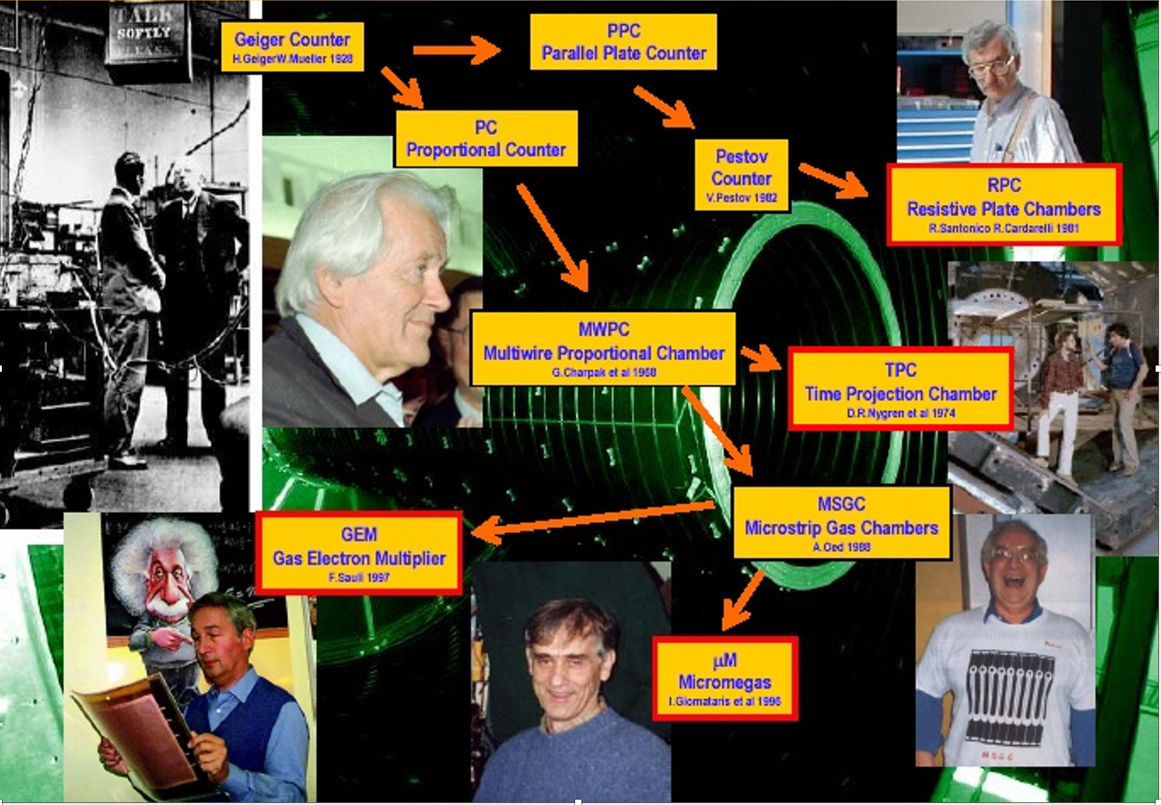
The journey of gaseous detectors

Slide 5
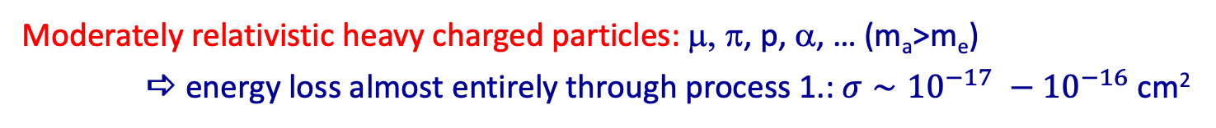
Interactions of Charged Particles
Interactions of Charged Particles
Inelastic collisions with atoms
 energy loss
 excitation (soft collision) or ionization (hard collision) of hit atom
 deflection: small
Elastic collisions with nuclei
 deflection
 energy loss: negligible, since normally m_{a}<<m_{b}
 no excitation of hit atom
Emission of Bremsstrahlung  important for e±
Emission of Cherenkov radiation / transition radiation in inhom. materials
Nuclear interactions
Moderately relativistic heavy charged particles: μ, π, p, α, … (m_{a}>m_{e})
 energy loss almost entirely through process 1.: $σ∼{10}^{−17} −{10}^{−16}$ cm²

Slide 6
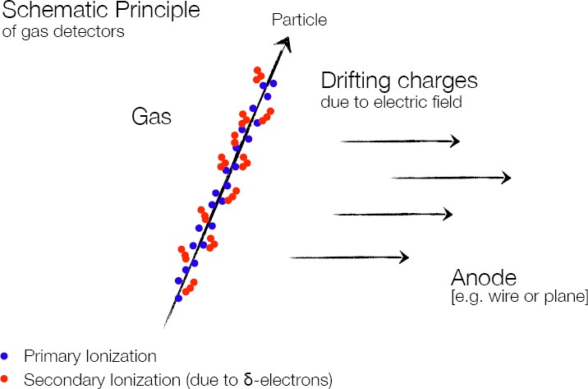
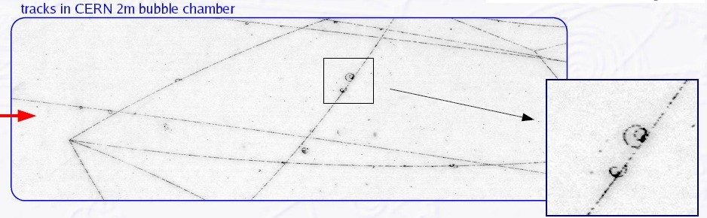
Where it all begins
“Core” of a gaseous detector is a volume of gas, or gas mixture, where a charged ionizing particle leaves a trail of ion-electron pairs. Some electrons can further ionize the gas, creating “clusters” of ions electron pairs.
δ-electron

Slide 7

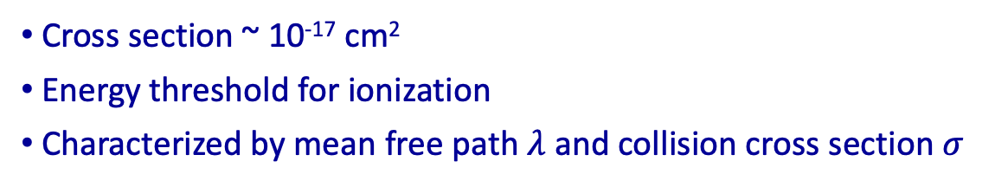
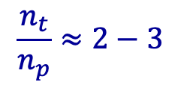
Ionization
Primary and secondary ionization:
Primary ionization: created by incident fast particle, e.g. π
Cross section ~ 10⁻¹⁷ cm²
Energy threshold for ionization
Characterized by mean free path $λ$ and collision cross section $σ$
$$π$$
Secondary ionization: electrons are ejected from atoms not
encountered by fast particle
  collision of ionization e⁻ with atoms (δ electrons)
  through intermediate excited states, e.g.
  Penning effect, Jesse effect
  through creation of excimers
$$\frac{n_{t}}{n_{p}}≈2−3$$
“ionization cluster”
 most of the total charge!

Slide 8
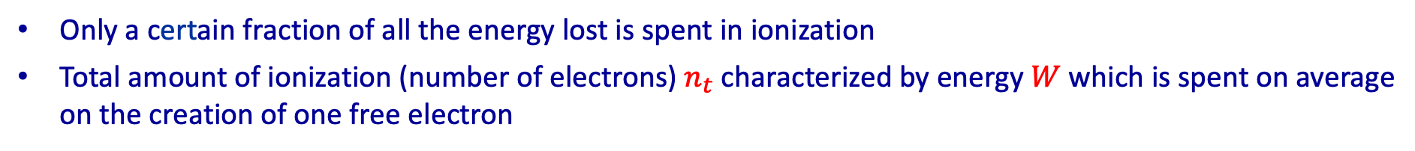
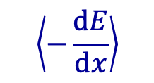
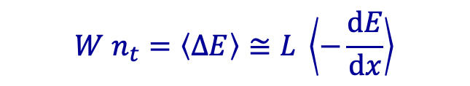
Ionizing Collisions
Only a certain fraction of all the energy lost is spent in ionization
Total amount of ionization (number of electrons) $n_{t}$ characterized by energy $W$ which is spent on average on the creation of one free electron
$$W n_{t}=\left\langle ΔE\right\rangle ≅L \left\langle −\frac{\text{d}E}{\text{d}x}\right\rangle$$
$$\left\langle −\frac{\text{d}E}{\text{d}x}\right\rangle$$
average energy loss per unit pathlength
“stopping power“ or “specific energy loss“
minus sign because the particle loses energy!
Caution:
Collisions are a statistical process, i.e. there will be fluctuations
The definition of an average requires that the fluctuations are not too large!

Slide 9
Mean Energy Loss: “Bethe-Bloch equation”
with
ze charge of incoming particle
n_{e} electron number density of material
m electron mass
β=v/c velocity of incoming particle
γ relativistic factor
T_{max} maximum kinetic energy imparted to electron in single collision
I mean excitation energy
δ density effect correction, important at high energies
C/Z shell correction, relevant for small β

Slide 10
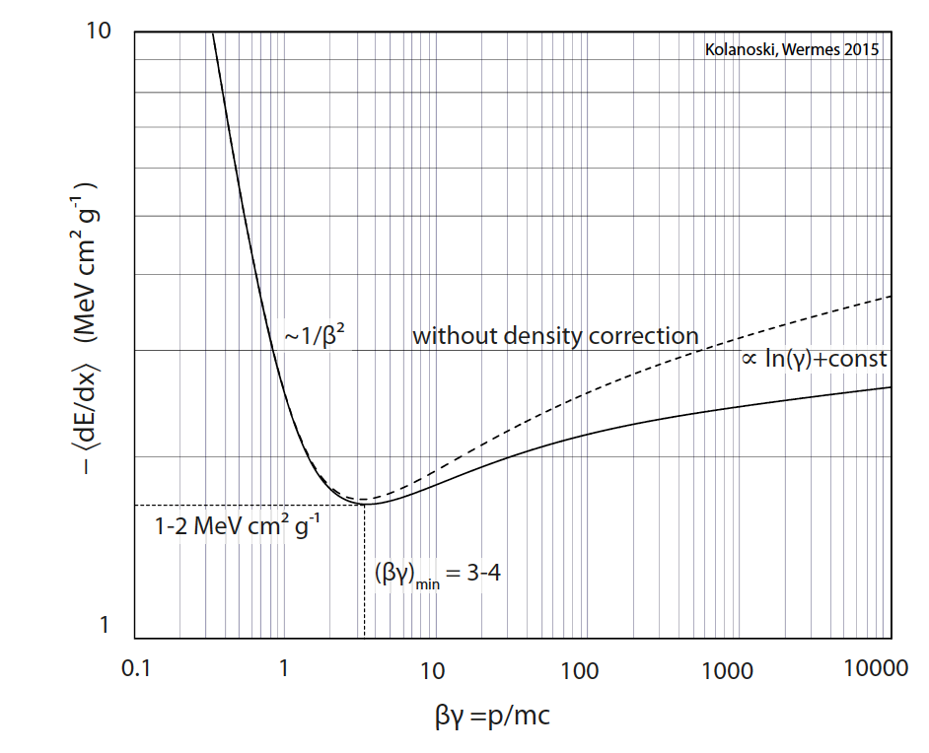
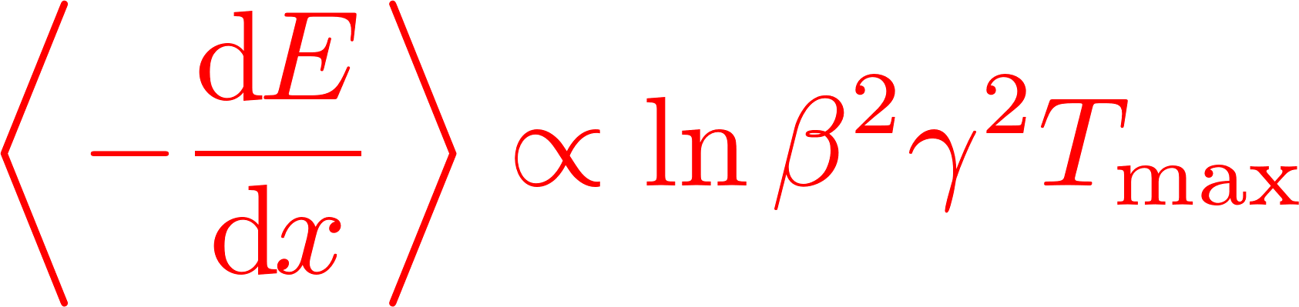

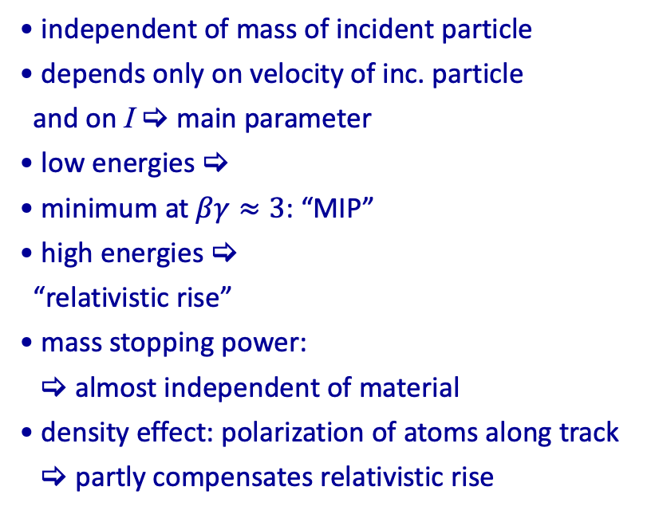
Mean Energy Loss: “Bethe-Bloch equation”
independent of mass of incident particle
depends only on velocity of inc. particle
and on I  main parameter
low energies 
minimum at $βγ≈3$: “MIP”
high energies 
“relativistic rise”
mass stopping power:
 almost independent of material
density effect: polarization of atoms along track
 partly compensates relativistic rise
$π^{±}$ in Si
minimum ionizing particle
universal curve for all particles with charge z=1

Slide 11
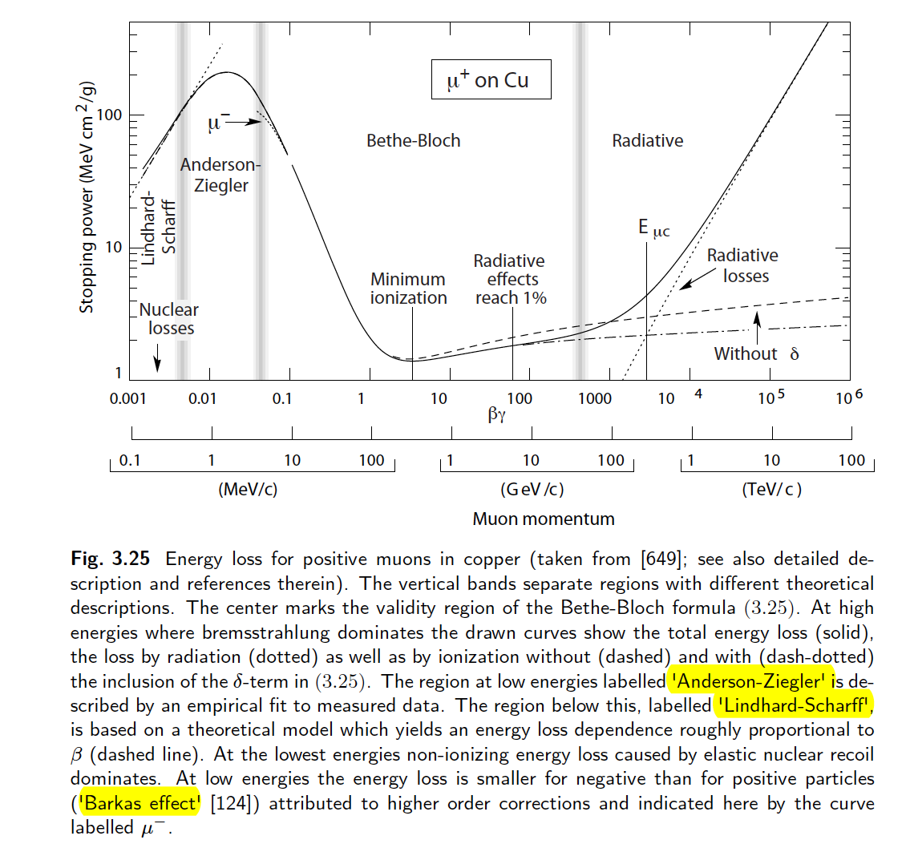
Bethe-Bloch equation and more
theoretical
model
bremsstrahlung
ionisation
only
empirical
fit to data

Slide 12
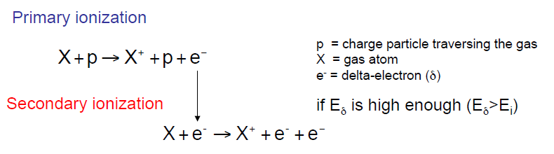
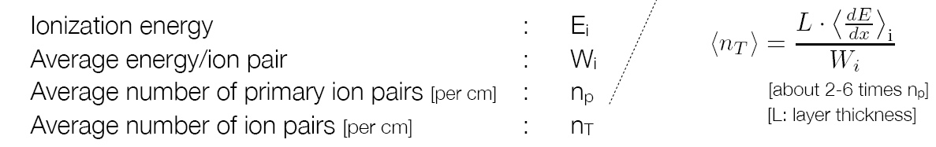
Ionization
I₀
Note: I₀ ≠ W_{i}, because not the whole energy lost by the impinging particle goes in ionization processes; a part (roughly half) goes in excitation of the gas molecules.
→ The average energy W_{i} needed to create an ion-electron pair is ≈ 2-3 I₀
Typical values: W_{i}≈ 30 eV → 100 e⁻/ion pairs for 3 keV of energy lost by the particle (~ 1cm of Ar for a MIP)

Slide 13
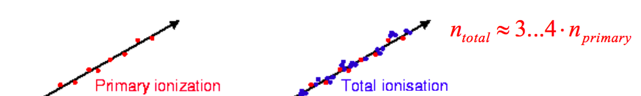
Secondary Ionization
Quite often the extracted electrons have kinetic energy enough to generate secondary ionization: they are usually called δ-rays. Other ion-electron pairs are produced close to the track.
− ΔE: total energy loss
− W_{i}: energy needed to create one ion/electron pair (tipicallly few tens of eV, depending on the gas)
− n_{T}: total number of ion/electron pairs generated (tipically 100 pairs/cm)
The total number of electron/ion pairs created is proportional to the total energy deposited in the gas, n_{T} = n_{P} + n_{S}.

Slide 14
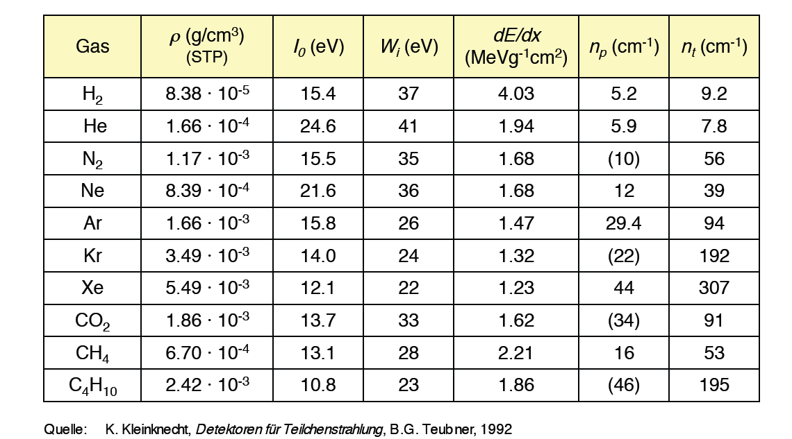
Most common gas parameters
for MIPs
The number of primary and totale ion-electron pairs in gas mixtures can be computed taking into account the fractional gas composition (in volume) and the values for the individual gases.
Example: gas mixture Ar/CO₂ 70/30
n_{P} = 0.7 x 29 + 0.3 x 34 = 30.5 pairs/cm
n_{T} = 0.7 x 94 + 0.3 x 91 = 93 pairs/cm

Slide 15


Statistics of ion-electron pair production
Primary ionization events are independent and follow Poisson statistics.
- Each time an impinging particle crosses a layer of gas, it has a certain probability to produce a certain number of primary electrons
- If n_{P} is the average number of primary electrons (ions), the probability P(k) to have k electrons (ions) is:
Therefore, there is always a finite probability to produce no electron-ion pairs:

Slide 16
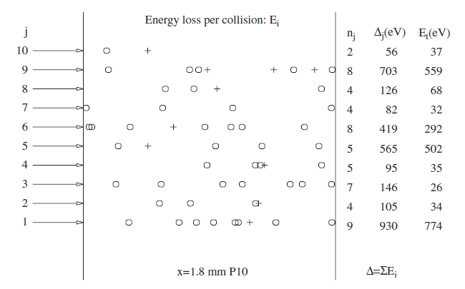
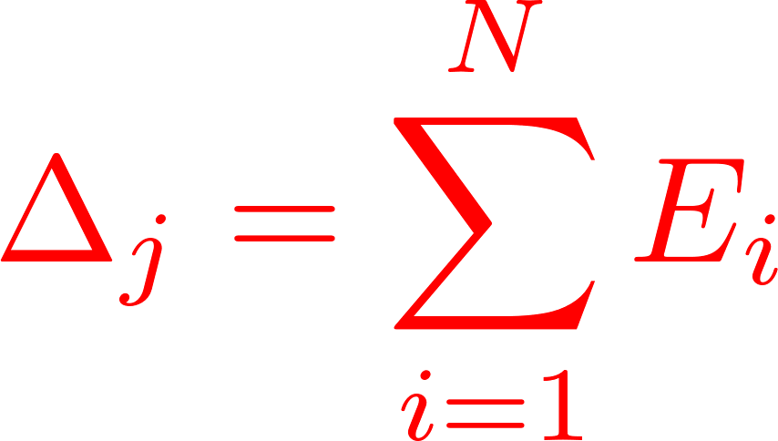
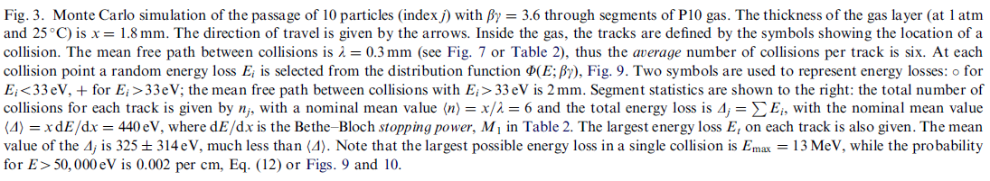

Fluctuation of Energy Loss
BBE determines average energy loss per path length
Energy loss is a statistical process involving many small energy transfers, subject to statistical fluctuations
Number of ionizing collisions
Energy loss in a single collision
Total energy loss for track $j$:
[H. Bichsel, NIM A 562, 154 (2006)]

Slide 17
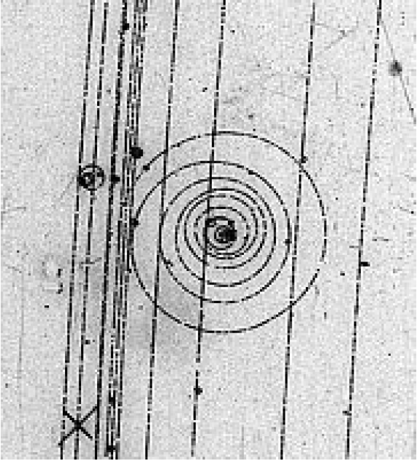
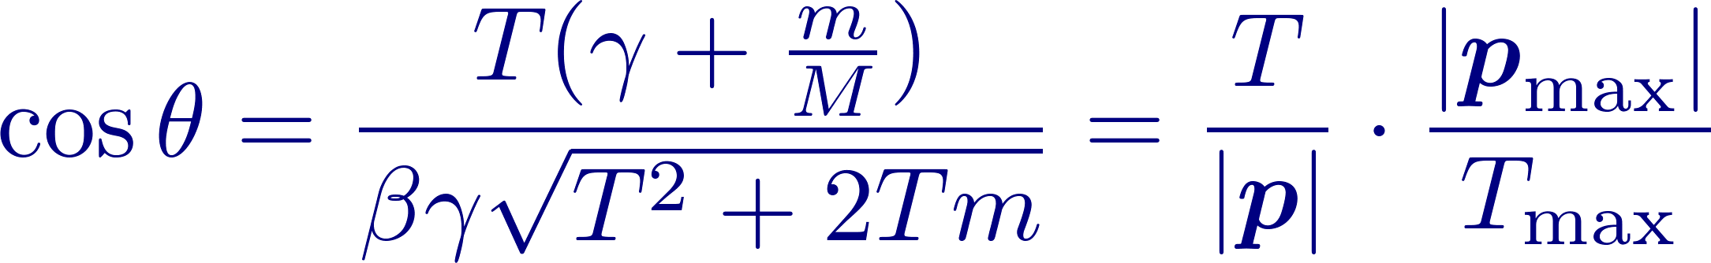
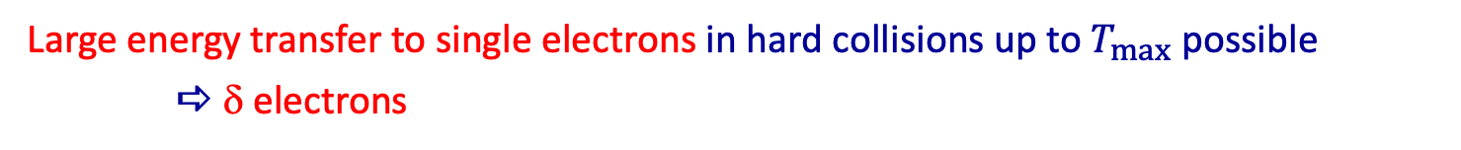



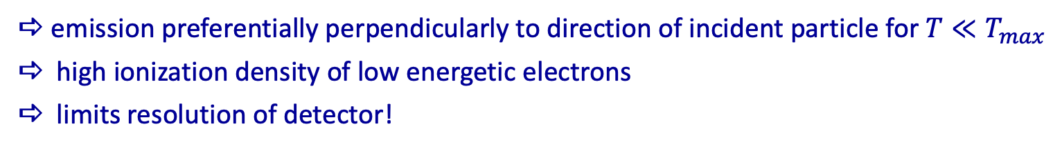
$δ$ electrons
Large energy transfer to single electrons in hard collisions up to $T_{max}$ possible
 δ electrons
Distribution of electrons with kinetic energies $I≤T≤T_{max}$
$$T≪T_{max}$$
$$\text{e}\text{−}\text{spin}\text{ (}\text{Mott}\text{)}$$
$$→1 \text{for} T≪T_{max}$$
Angular distribution of δ-electrons:
Non-relativistic e-:
emission preferentially perpendicularly to direction of incident particle for $T≪T_{max}$
high ionization density of low energetic electrons
limits resolution of detector!

Slide 18
$δ$ electrons
Electrodes (e.g. strips)
Signal on Electrodes
x
Delta Electron
x
True position
Traversing Particle
Q
Center of mass of charge cluster (not on particle trajectory)

Slide 19
Diffusion of electrons and ions in gas
Until now: creation of electron-ion (hole) pairs by ionizing radiation
Now: transport of electrons and ions (holes) to the electrodes
  diffusion
  drift in electric (and magnetic) fields
  loss of charges
   crucial influence on detector properties
  precision of measurement
  shape of electric signal

Slide 20


Diffusion of electrons and ions in gas
After ionization, electrons and ions quickly lose their energy due to collisions with the gas molecules → thermalize
Electrons and ions energy (and velocity) distribution are well described by a Maxwell distribution
Mean velocity according to Maxwell distribution:
Their average kinetic energy at room temperature is E ≈ 3/2 kT ≈ 26 meV

Slide 21
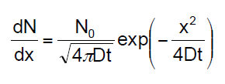

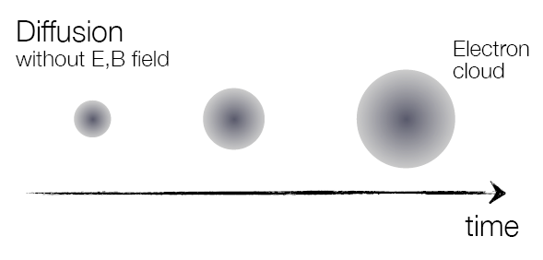

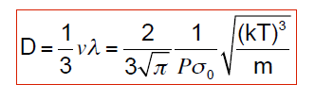
Diffusion of electrons and ions in gas
Diffusion processes in gases are well described by the kinetic theory of gases. After a time t from ionization, electrons (ions) density is well described by a Gaussian distribution:
whose σ is related to the diffusion coefficient D by:
r²
dr
Diffusion takes place in 3D:
- considering diffusion just in one direction:
Diffusion coefficient is given by the following expression:
D depends on gas temperature T and pressure P
λ = electron (ion) mean free path in the gas

Slide 22
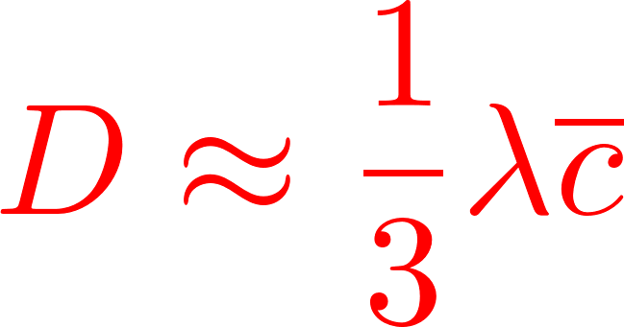
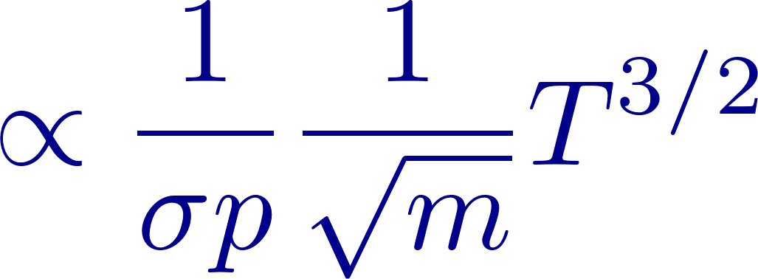
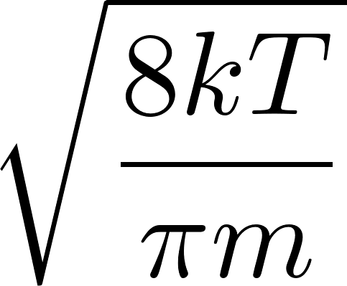
Diffusion of electrons and ions in gas
From kinetic gas theory:
ions: Diffusion is almost gas independent (D ≈ 0.1cm²/s):
σ_{x} ≈ 140 µm after 1 ms (typical)
electrons: very gas dependent: σ_{x} ≈ 100 µm to 1mm after 1 ms (typical)

Slide 23
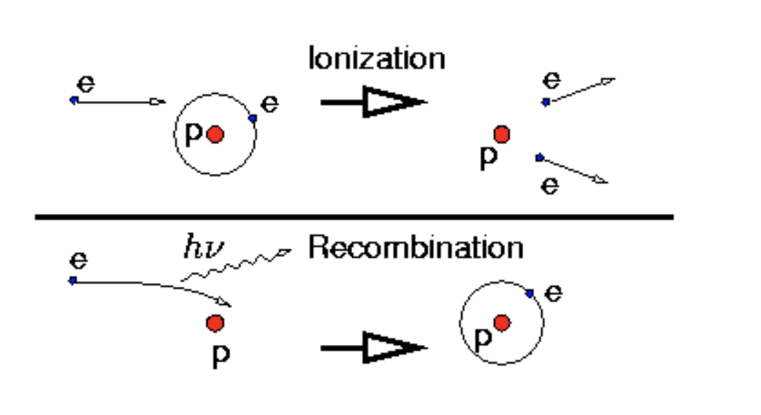
Charge in gaseous medium
Recombination: process in which a positive ion recombines with a free electron. In the absence of an electric field, electrons are not accelerated and all free charge recombines.
Collisions between positive ions and free electrons may result in recombination in which the electron is captured by the positive ion and returns it to a state of charge neutrality.
Alternatively, the positive ion may undergo a collision with a negative ion in which the extra electron is transferred to the positive ion and both ions are neutralized. In either case, the charge represented by the original pair is lost and cannot contribute further to the signal in detectors based on collection of the ionization charge.
X⁺ + e⁻  X + γ
X⁺ + Y⁻  XY+ γ
recombination and emission of 1 γ
molecular ions
Recombination and negative ions
Since we have only a small number of ion–electron pairs – on the order of O(100) – it is important not to lose them.
However, several processes such as electron attachment and ion recombination generally lead to a loss of charge.

Slide 24
Charge in gaseous medium
There are two general types of recombination loss: columnar recombination and volume recombination.
The first type (sometimes also called initial recombination) arises from the fact that ion pairs are first formed in a column along the track of the ionizing particle. The local density of ion pairs is therefore high along the track until the ion pairs are caused to drift or diffuse away from their point of formation. Columnar recombination is most severe for densely ionizing particles such as incident heavy nuclei with high Z compared with fast electrons that deposit their energy over a much longer track. This loss mechanism is dependent only on the local conditions along individual tracks and does not depend on the rate at which such tracks are formed within the detector volume.
In contrast, volume recombination is due to encounters between ions and/or electrons after they have left the immediate location of the track. Impurities are important and since many tracks are typically formed over the time it takes for ions to drift to the collecting electrodes, it is possible for ions and/or electrons from independent tracks to collide and recombine. Volume recombination therefore increases in importance with irradiation rate.
Charge separation and collection should be as rapid as possible in order to minimize recombination, and high electric fields are indicated for this purpose.

Slide 25
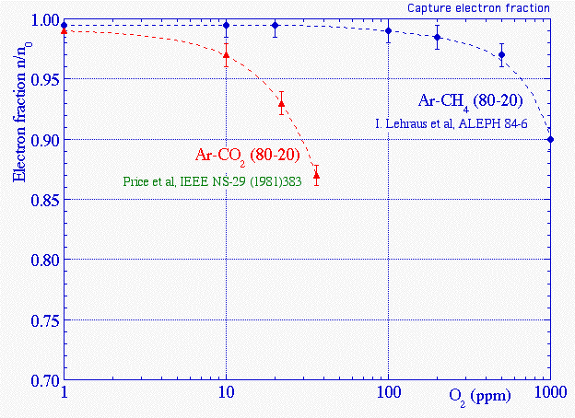
Charge in gaseous medium
Electronegative atoms
Electronegative atoms can capture a free electron, forming negative ions. These atoms have an almost full outer shell, so the addition of an electron results in an energy release.
The released energy is known as electron affinity. The presence of electronegative atoms reduces the ion–electron collection efficiency by capturing electrons before they can reach the readout electrodes.
Electronegative gases: O₂, H₂O, CO₂, SF₆ (→ filters for H₂O and O₂ are required).
Non-electronegative gases (negative electron affinity): He, Ne, Ar, Xe, Kr (noble gases).
Fraction of electrons surviving after a drift of 20 cm in two gas mixtures, as a function of the contamination of O₂, under the action of E = 200 V/cm

Slide 26
Charge transport in gaseous medium
Charge separation and collection should be as rapid as possible in order to minimize recombination, and high electric fields are indicated for this purpose.
L
-U₀
Amp
R
cathode
anode

Slide 27
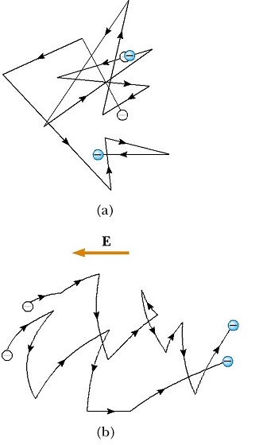

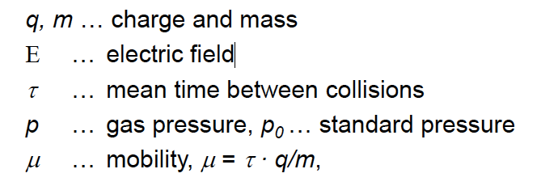
Drift in electric field
When an electric field is applied, the electron-ion pairs drift along the electric field lines, and this motion is superimposed to the chaotic thermal motion.
Acceleration is interrupted by collisions with gas atoms
This limits the drift velocity → mean drift velocity v_{D}
The drift velocity is roughly proportional to the time between two subsequent collisions
The mean drift velocity v_{D} is
where
and typical values 10-100 𝝻m/ns.

Slide 28
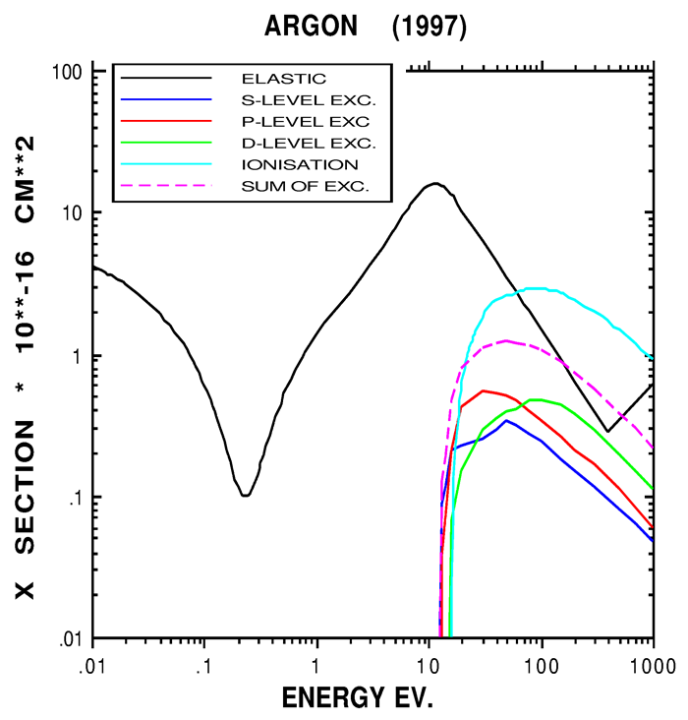
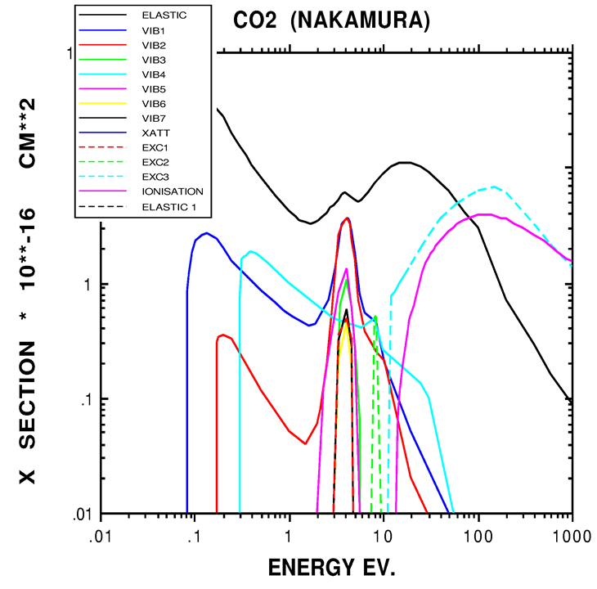
Drift in electric field
v_{d} is just the average velocity in the direction of the electric field; a random thermal movement is superimposed → diffusion while drifting
While drifting, electrons can undergo several processes (excitation, ionization, and others), whose cross section depends in complicated ways on the electron kinetic energy due to quantum mechanical effects and the structure of the molecules of the gas.
Ramsauer cross section (collisions) for electrons in Ar and CO₂ as a function of their energy

Slide 29
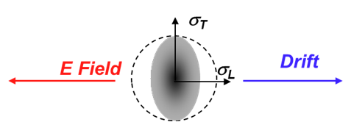
Drift in electric field
Drift in direction of E-field superimposed to statistical diffusion
Extra velocity influences longitudinal diffusion
Transverse diffusion not affected
Drifting induces a reduced diffusion in the longitudinal direction
Key Aspects of Electron Drift in Gases:
Drift Velocity (V_{D}): Under an applied electric field (E ), electrons do not accelerate indefinitely but rather reach a steady average drift velocity (typically 1mm/us or 10^5 /10^6 m/s in gas detectors) due to frequent collisions.
Mechanism: Electrons accelerate between collisions with gas molecules. While their thermal velocity is massive, their overall drift speed is slower, directed toward the anode.
Dependence on E/P: The drift velocity is a function of the reduced field, E/P (electric field E divided by gas pressure P). Increased field strength increases the drift speed.
Gas Composition: The type of gas drastically affects drift speed. For example, fast gases like CF4 are used for fast timing, while argon mixtures are common in detector technologies.

Slide 30
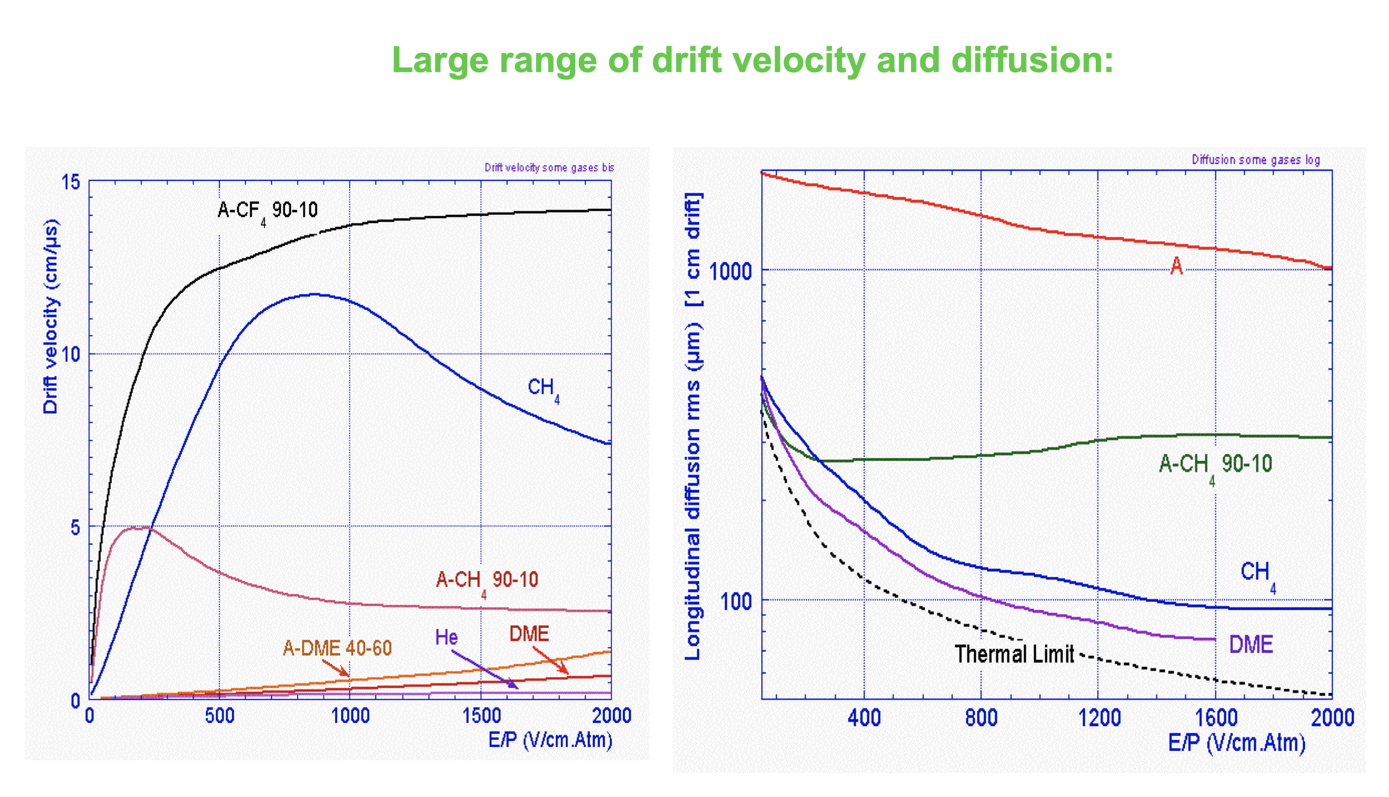
Drift and Diffusion of Electrons in Gases

Slide 31


Diffusion / Drift electrons in magnet field
The presence of a magnetic field changes the drift properties of a swarm of electrons
The trajectories between collisions are no more rectilinear;
The drift velocity is smaller with respect to the absence of a magnetic field and can approximated as:
where
is the Larmour frequency (ciclotrone frequency)
and τ is the average time between two subsequent electron collisions.
Electrons do not drift anymore along the electric field lines
- the angle between v_{D} and E is the Lorentz angle

Slide 32
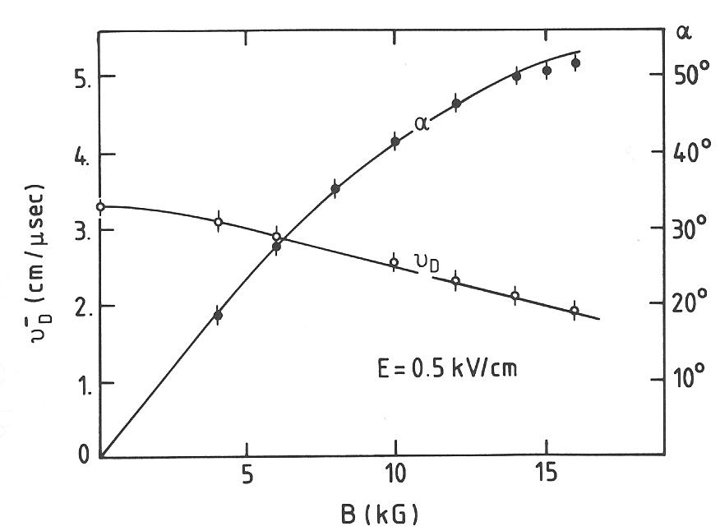
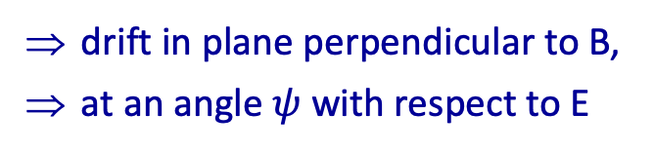
Diffusion / Drift electrons in magnet field
Dependance of the electron drift velocity and Lorentz angle on the magnetic field for a mixture of Ar/C4H10/methyal 67.2/30.3/2.5 (an electric field of 500 V/m is applied).
Case of E orthogonal to B:
z
B
y
E
ψ
x
u
Electron drift velocity and Lorentz angle
(E orthogonal to B)
[A. Breskin et al., NIM 124, 189 (1975)]
drift in plane perpendicular to B,
at an angle $ψ$ with respect to E
negligible for ions!

Slide 33
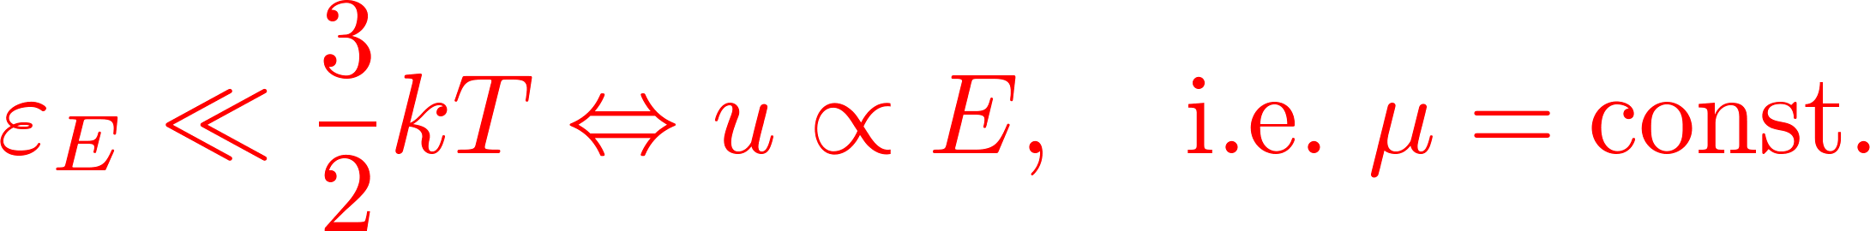
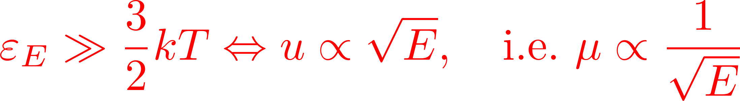
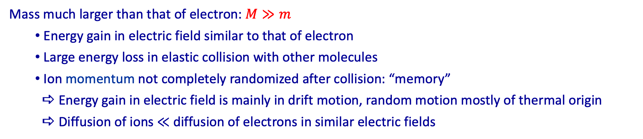
Ions drift
Mass much larger than that of electron: $M≫m$
  Energy gain in electric field similar to that of electron
  Large energy loss in elastic collision with other molecules
  Ion momentum not completely randomized after collision: “memory”
   Energy gain in electric field is mainly in drift motion, random motion mostly of thermal origin
   Diffusion of ions $≪$ diffusion of electrons in similar electric fields
Mobility of ions:
varies much less than that of electrons
small electric field:
large electric field:

Slide 34

Drift / Mobility of ions/electrons in gases
On average electrons/ions move along the field lines of the electric field E
Sometimes, one finds that v_{d} is roughly proportional to E-field, the mobility μ (for ions and electrons) is usually introduced, relating drift velocity and applied electric field:
[cm s⁻¹ V⁻¹]
Note: μ± usually depend also on gas T and p.
Mobility behaves differently for the case of ions and electrons.
μ₊ : ion mobility
- for ions v_{D} ∝ E, i.e. mobilty is really constant
μ₋ : electron mobility
- in cold gas approximation (T_{kin} ≈ kT) → v_{D} ∝ E → μ = const.
- in hot gas (T_{kin}>> kT) → v_{D} =, const.→ μ = not const.
Notes:
In un gas, mobility e drift velocity descrivono lo stesso fenomeno (moto ordinato di elettroni/ioni in un campo elettrico), ma a livelli diversi.
Drift velocity è la velocità media di deriva della particella sotto l’azione del campo elettrico. È una quantità fisica con unità di velocità (m/s) e dipende direttamente dal campo elettrico applicato:
vdv_dvd​ Mobility invece è una proprietà intrinseca della particella nel mezzo gassoso e misura “quanto facilmente” essa si muove nel gas sotto un campo elettrico. È definita come:
μ=vdE\mu = \frac{v_d}{E}μ=Evd​​ quindi ha unità di m2/(V\cdotps)\text{m}^2/(\text{V·s})m2/(V\cdotps).
In sintesi:
Mobility (μ): caratteristica del sistema gas + particella, indipendente dal campo (in prima approssimazione).
Drift velocity (v_d): velocità effettiva risultante, dipendente dal campo elettrico.

Slide 35

Mobility of ions/electrons in gases
Typical drift velocities for electrons are 3 orders of magnitude larger than drift velocity for ions (due to the different mass):
  Electrons, v_{d} of the order of cm/μs
  Ions, v_{d} of the order of cm/ms
Mobility of ions is related to diffusion coefficient by the Einstein equation:
valid for ideal gases in thermal equilibrium.
In principle, this should be valid also for electrons, but electrons immediately deviate from thermal equilibrium while drifting under the action of an electric field, execpt for very low fields.

Slide 36
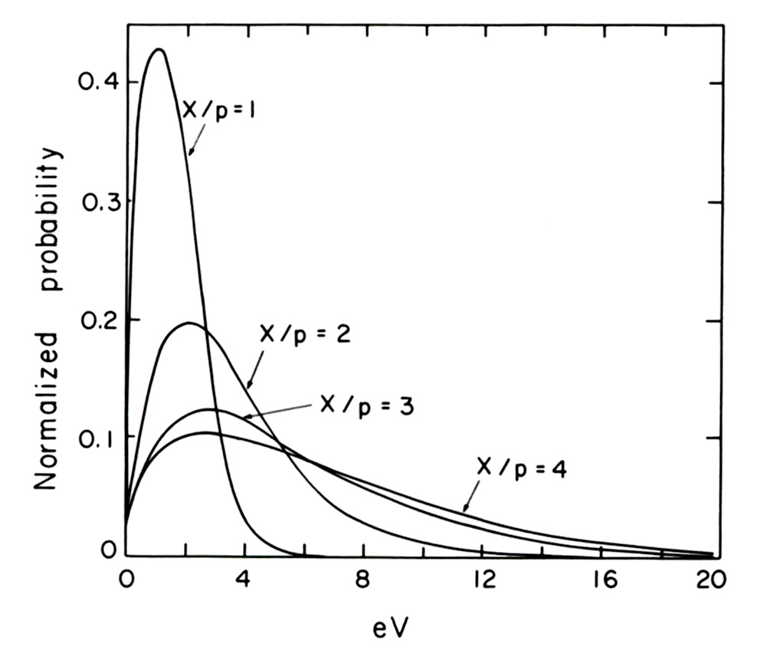
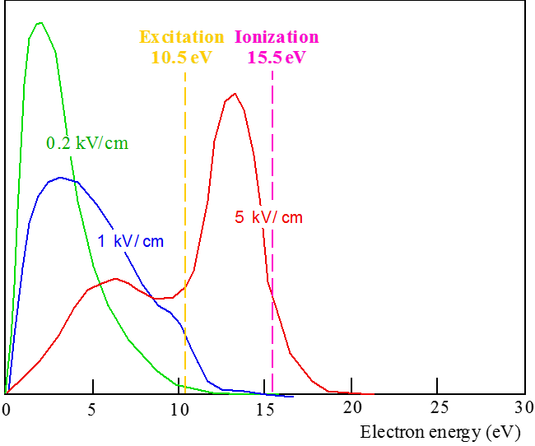
Electron in High Electric fields: Energy distribution & Ionization
1) Increasing the electric field, the electron energy distributions deviate significantly from the Maxwellian shape, and the average energy can exceed of several orders of magnitude the thermal value
The plot shows the energy distributions of electrons in He for different values of the reduced electric field E/p;
X is the electric field in units of V/cm and p is the pressure in units of 760 Torr
X/p = 1 means E=760 V/cm at atmospheric pressure
2) When the electric field exceeds few kV/cm, more and more electrons can reach enough energy
to produce excitation and ionization.
Energy distribution in Ar for three different values of the electric field, compared to the energy needed for excitation and ionization
3) When electron energy is above the first ionization potential, the collisions can yield new electron ion pairs, while the "primary" electrons continue their path
Ionization probability (in arbitrary units) as a function of the electron energy in various gases
The maximum ionization probability is reached around 100 eV

Slide 37
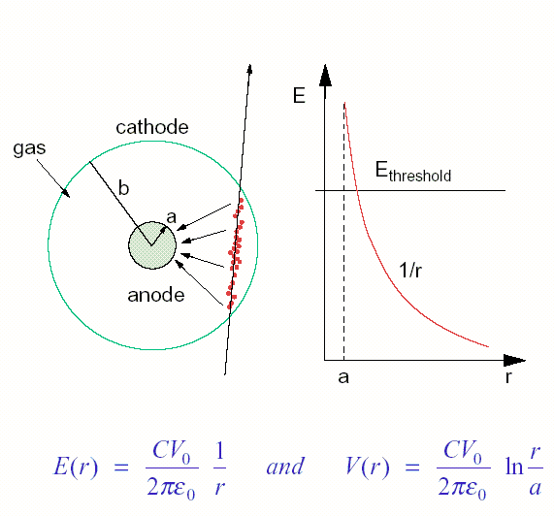
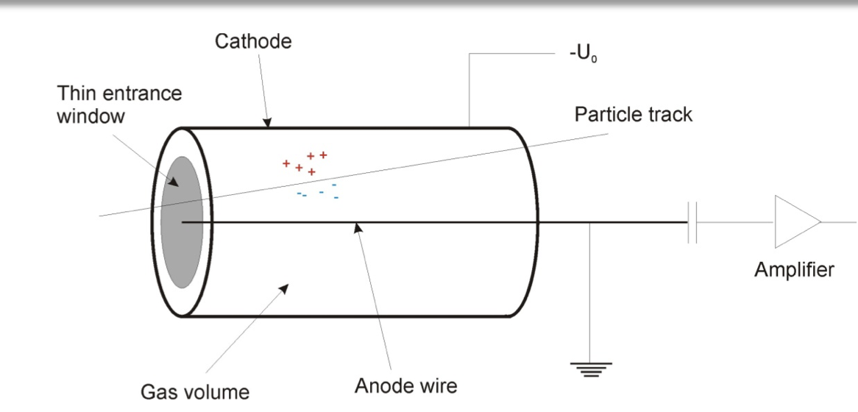
Avalanche amplification
Gas detectors generally use gas ampliﬁcation in the homogeneous ﬁeld of a parallel plate geometry or, more frequently, in the inhomogeneous ﬁeld around a thin wire. We shall start with the discussion of the second case.
Near a wire with a charge q_{s} per cm, the electric ﬁeld at a distance r from its center is
E = q_{s} / (2πε₀r)
Electric field

Slide 38
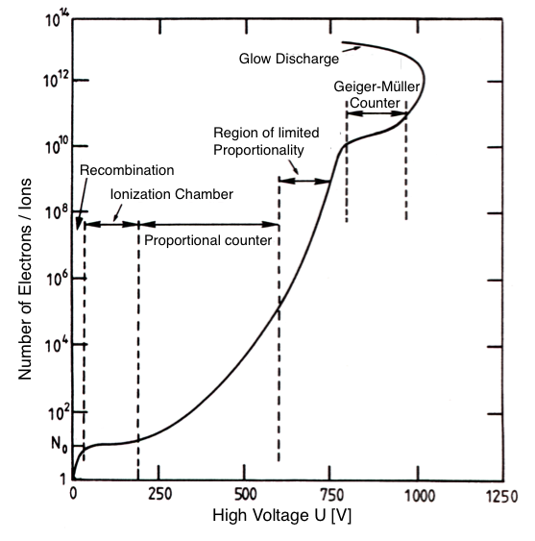
Amplification overview
The amplification G is defined as the ratio of collected electrons
at the anode wire N_{A} to the number of primary electrons N, G = N_{A}/N.
G<1: Recombination
  most of the e/ion pairs recombine because the field is too weak to separate them
G≈1: Ionisation chamber
  no amplification, only primary particles collected. Useful for dosimetry/flux meas.
G≈10³-10⁵: Proportional counter / proportional mode
  An avalanche develops and the total number of charge carriers is proportional to the number of primary carriers.
G≈10⁵-10⁸: Region of limited proportionality
  The slowly moving ions begin to shield the electric field around the anode. This effect increases with the primary ionization (nonlinear E dependence)
G ≳ 10⁸: Geiger (or saturation) region
  The signal is independent of the primary ionization.The detector counts.
note: numbers only exemplary.
Strong dependence on gas and geometry
Discharge operation: triggered by a single e⁻/ion pair, the electrodes connect by a streamer (extended avalanche in the direction of the E field) that develops into an extended plasma flux tube which fully discharges the electrodes.

Slide 39

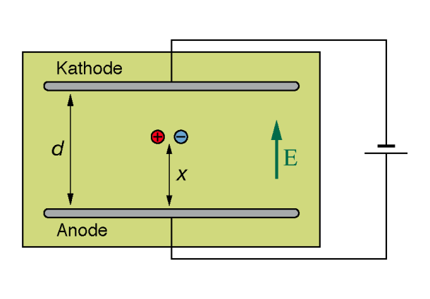
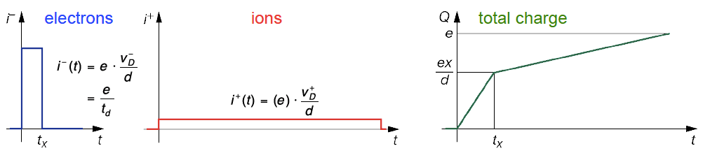


Ionization chamber and time dependence
An ionization chamber is operated at a voltage which allows full collection of charges, but below the threshold of amplification.
Shockley–Ramo theorem:
The instantaneous current i induced on a given electrode due to the motion of a charge is given by .
i is NOT given by the arrival of the electrons!
For a typical field strength 500 V/cm and typical drift velocities the collection time
for 10 cm drift is about 2 μs for e– and 2 ms for the ions.
Ionization chambers are used in nuclear industry but rarely in particle physics (too low signal, too slow, not possible to measure single particles: C_{min}≈10⁴e ≈1 fC).
Planar ionization chambers:
ICs illustrate how time dependence of the signal is dominated by the ions
Planar ionization chambers, continuous charge generation:

Slide 40




Electron gain `G` in gases
Indicating with n the electrons at the position x, the electrons produced between x and x + dx are:
If α is independent on x (uniform electric field), the previous differential equation can be easily integrated to get:
n₀ = initial number of electrons
In the general case of non-uniform electric field, the result is:
The multiplication factor (also simply called gain) is given by:

Slide 41


Proportional mode
Typical geometry: cylindrical cathode with thin central anode wire.
  Electric field in vicinity of the wire ∝1/r,
at r ≤ r_{krit} field strength high enough to cause secondary ionization.
  wire diameter 10 - 100 μm.
Cross section of a proportional counter and electric field E as function of the distance to the wire. typical:
a = 10𝝁m, b = 10mm, r_{krit} = 1𝝁m
Signal amplification through secondary ionization:
  electrons in a strong field acquire enough energy to create secondary electron/ion pairs
  The amplification factor in gas detectors operating in the proportional mode is independent of the primary ionization ⟶ signal is proportional to the primary ionization
  Amplification factors in proportional mode ≈ 10³ to 10⁵⁻⁶
  if p is known, can be used for dE/dx and thus particle Id
  Limit of the proportional mode is reached when the slowly moving ion cloud begins to shield the electric field and reduces the field strength locally.

Slide 42


Formation of signal from an avalanche
Electrons produced by the primary particle drift towards the anode wire.
These reach the area of high fields in the vicinity of the anode wire, where secondary ionization occurs
The positive ions and negative electrons separate
The electrons diffuse around the anode wire, the ion cloud resembles a droplet
The electrons reach the anode wire (timescale of ns) and the ions drift slowly to the cathode
generating the avalanche signal at the electrodes. Signal almost entirely due to ions!
The potential in a cylindrical tube predicts
(example on the previous slide):

Slide 43


Avalanche in uniform electric field
Uniform electric field
Ions
Electrons
Since the electron drift velocity is ≈1000 times larger than the ion drift velocity, at any given time electrons will be on the front of a drop-like distribution, while ions will be left on the tail

Slide 44




Streamer formation
Between the front and the tail of an avalanche an internal E_{int} forms, directly in the opposite direction as the applied E_{appl}. When the E_{int} = E_{appl….} the multiplication process stops.
- Ion and electrons recombine with photon emission.
- New secondary avalanches can be produced, forming a streamline of continuous flow of charges from one electrode: the “streamer”
-
Cathode
E_{int}
streamer
Avalanche
Anode

Slide 45

Beyond proportional mode
Amplification factors 10⁵–10⁸
Above proportional regime, electrons produced by the photo- effect are no longer negligible
The effect of photons is reduced with admixtures of a “quenching” gas (e.g. CH4, CO2) which absorbs UV photons, (saturated avalanche mode).
Geiger- Muller counter:
The UV photons are spreading transversal to the field and create photoelectrons in the whole gas volume: the discharge is no longer localized.
The produced total charge is independent from the primary ionization
Amplification factor 10⁸ – 10¹⁰
Discharge region: UV photons avalanches are created everywhere, discharge even without particle crossing

Slide 46
Breakdown
The net effect is that the gain cannot be increased at will
  Beyond a certain limit a continuous discharge sets in
Raether empirically proposed the “Reather limit” for the transition between “avalanche” operating mode, to “streamer mode”.
  In practice, sometimes a small percentage of streamer can be acceptable during operation of gaseous detectors, but beyond a certain limit, depending on the precise configuration and gas, breakdown occurs.
Raether limit: α x ≈ 20 (M ≈ 10⁸)
  In practise sometimes breakdown sets in even for gains much lower than 10⁸ (down to 10⁶).

Slide 47
References
W. Blum, L. Rolandi, W. Riegler: Particle Detection with Drift Chambers. Springer, 2008.
C. Leroy, P.-G. Rancoita: Principles of Radiation Interaction in Matter and Detection. World Scientific, Singapore 2012.
Specialized articles in Journals, e.g. Nuclear Instruments and Methods A, Ann. Rev. Nucl. Part. Sci.
C. Grupen, B. Shwartz: Particle Detectors. Cambridge Univ. Press, 2008.
K. Kleinknecht: Detektoren für Teilchenstrahlung. Teubner, Stuttgart 1992.
G. F. Knoll: Radiation Detection and Measurement. J. Wiley, New York 1979.
W. R. Leo: Techniques for Nuclear and Particle Physics Experiments. Springer, Berlin 1994.

Slide 48
Backup

Slide 49









Calculation of energy loss
Quantum picture: energy loss caused by a number of discrete collisions per unit length, each with energy transfer $E$
f (E) dE probability of energy loss per unit path length
between E and E+dE
and with
$n_{e}$ electron density
$E$ energy transfer in single collision
$\text{d}σ/\text{d}E$ collision cross section
differential in transferred energy
Mean free path:
$n_{p}$ number of primary collisions per unit path length
Spectrum of energy transfer
probability of energy loss in $\left[E,E+\text{d}E\right]$ per collision
 need a model for collision cross section!
[H. Bichsel, NIM A 562, 154 (2006)]

Slide 50



Drift Tube
Electric field

Slide 52
home.cern

