Slide 1
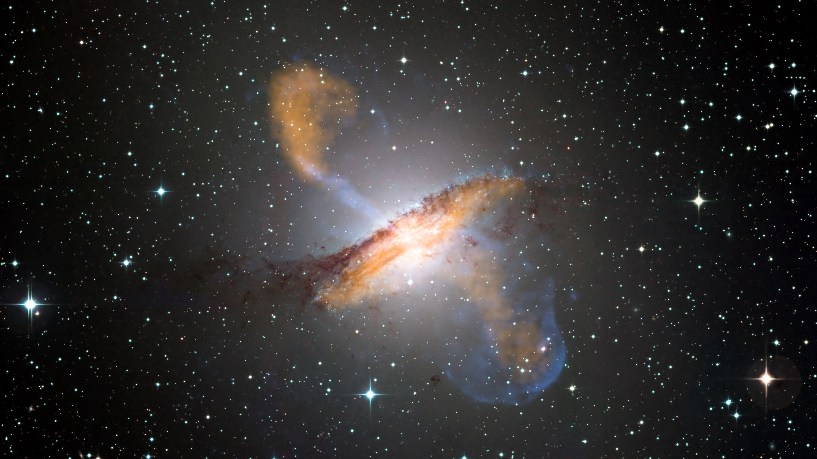
Entanglement Entropy in Quantum Black Holes
Muhammad Awais
University of Siena
m.awais3@student.unisi.it
By ESO/WFI (Optical); MPIfR/ESO/APEX/A.Weiss et al. (Submillimetre); NASA/CXC/CfA/R.Kraft et al. (X-ray)

Slide 2
Outline
What Is Black Hole
Evidence Of BH
Types Of BH
Difference Between Classical And Quantum BH
Entanglement Entropy
Area Law
Key Analytical Method
Conclusion

Slide 3
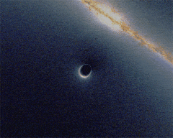
1. Construction of the Universe
What Is Black Hole
Definition: A black hole is a region in space with extremely strong gravity.
It forms when a massive star collapses under its own gravity.
Nothing (not even light) can escape from a black hole.
The boundary of a black hole is called the event horizon.
Black holes can range in size, from small to supermassive
https://science.howstuffworks.com/universe-made-of.htm
Notes:
ayy

Slide 4
Evidences for Black Holes
Gravitational Waves: Detected ripples in spacetime from black hole mergers (observed by LIGO and Virgo detectors).
X-ray Emissions: High-energy X-rays from material being heated as it falls into black holes.
Motion of Nearby Stars: Stars orbiting an invisible massive object (e.g., stars orbiting the supermassive black hole in the centre of our galaxy, Sagittarius A*).
Gravitational Lensing: Black holes bend light from objects behind them, distorting images.
Event Horizon Telescope (EHT): First direct image of a black hole's shadow, captured in 2019 from the black hole in the galaxy M87.

Slide 5
Types of Black Holes
Stellar Black Holes:
Formed from the collapse of massive stars, typically 3-10 times the mass of the Sun.
Supermassive Black Holes:
Found at the centres of galaxies, millions to billions of times the Sun's mass (e.g., Sagittarius A* in the Milky Way).
Intermediate Black Holes:
A middle ground between stellar and supermassive, ranging from hundreds to thousands of times the Sun's mass.
Primordial Black Holes:
Hypothetical small black holes, possibly formed just after the Big Bang, ranging from microscopic to planetary mass.

Slide 6
Difference B/W Classical and Quantum Black Holes
Classical Black Holes:
Described by General Relativity.
Defined by mass, charge, and spin (no additional internal structure).
Have an event horizon where nothing, not even light, can escape.
Singularities are points of infinite density, where the laws of physics break down.
No information escapes a classical black hole.
Quantum Black Holes:
Described by Quantum Mechanics and General Relativity (unified theory not fully developed yet).
Hawking Radiation: Quantum effects allow black holes to emit radiation and slowly lose mass.
Information paradox: Quantum theory suggests that information might escape from black holes (debated in physics).
May have "fuzzier" horizons or no singularities, based on quantum effects.
Could exist on very small scales (Planck scale) in theories like string theory.

Slide 7
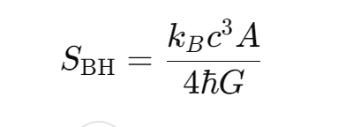
What Is Entanglement Entropy
Entanglement Entropy:
Entanglement entropy is a concept from quantum information theory and quantum mechanics.
It quantifies the amount of quantum entanglement between two subsystems of a quantum system.
In simple terms, it measures how much information is "shared" between these subsystems due to their quantum entanglement.
Quantum Entanglement:
This is a phenomenon where two or more quantum systems become correlated in such a way that the state of one system is dependent on the state of the other, no matter how far apart they are.
When systems are entangled, the full information of the system cannot be described by looking at the parts individually — you need to look at the whole system.
Entanglement in BH
In the context of black holes, entanglement entropy provides insights into the information content of black holes and the nature of spacetime at a fundamental level
One of the key connections is through the famous Bekenstein-Hawking entropy, which is related to the area of a black hole's event horizon.

Slide 8
What Is Area Law
Area Law:
The area law in black hole physics states that the surface area of a black hole’s event horizon never decreases over time.
It is analogous to the second law of thermodynamics, where the entropy of a closed system never decreases.
Proposed by Stephen Hawking and Jacob Bekenstein, it suggests black hole entropy is proportional to the event horizon's area.
During black hole mergers, the total area of the resulting black hole’s event horizon is always greater than or equal to the combined areas of the original black holes.
The area law helps bridge concepts between gravity, quantum mechanics, and thermodynamics, contributing to the field of black hole thermodynamics.

Slide 9
Theoretical Set Up
Cosmic Ray spectra
Lagrangian of a system of classical coupled harmonic oscillators is given by,
the diagonalized Hamiltonian reads,
Ground State of the system is,
Ground State density matrix is given by

Slide 10
Cosmic Ray spectra
Theoretical Set up
Outside system density matrix
We can then compute the entanglement entropy which turns out to be
Where

Slide 11
Area Law for Scalar Filed
Action for a scalar field propagating in a curved spacetime:
Line element for a spherically symmetric Schwarzschild-like metric:
Scalar field Hamiltonian in terms of spherical harmonics:
Hamiltonian after the canonical transformation:
Where,

Slide 12
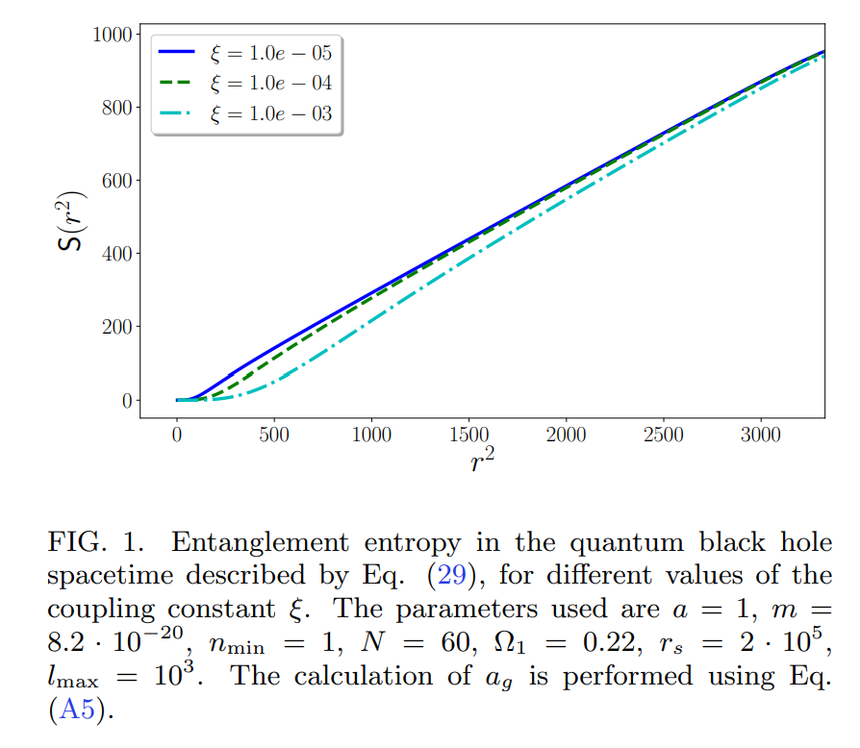
Quantum Corrected BH
The quantum-corrected Schwarzschild lapse function is given by:

Slide 13
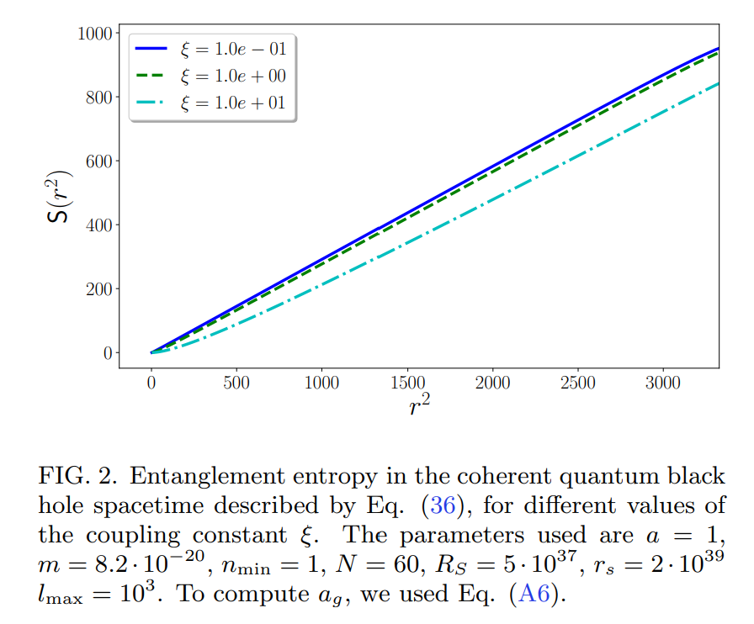
Coherent Quantum BH
The lapse function for a coherent quantum black hole metric is:

Slide 14
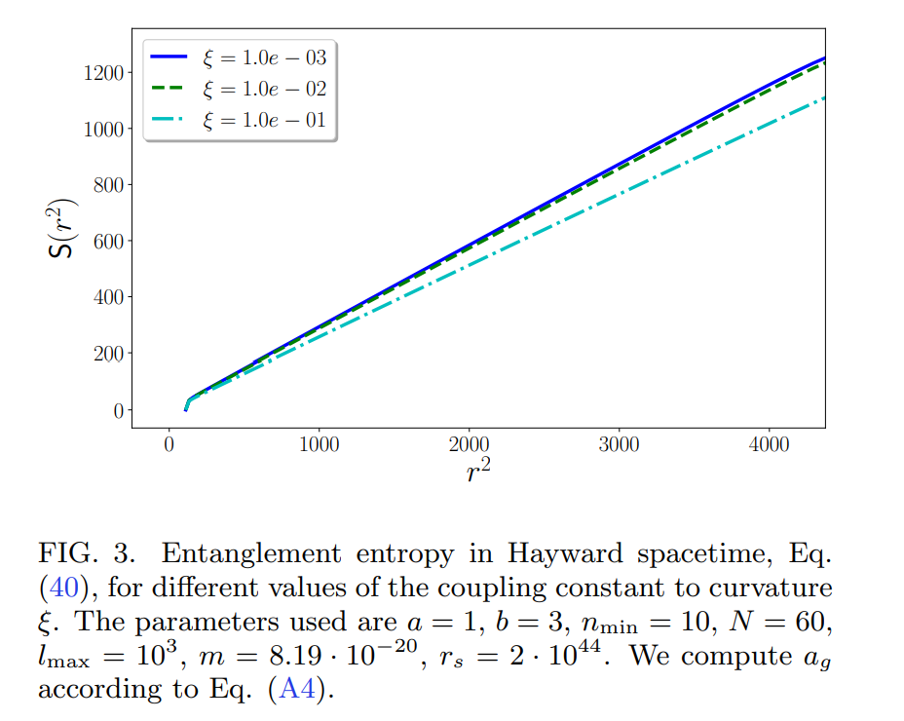
Comparison with Regular BH
Hayward
The lapse function for the Hayward metric, which describes a regular black hole, is given by:

Slide 15
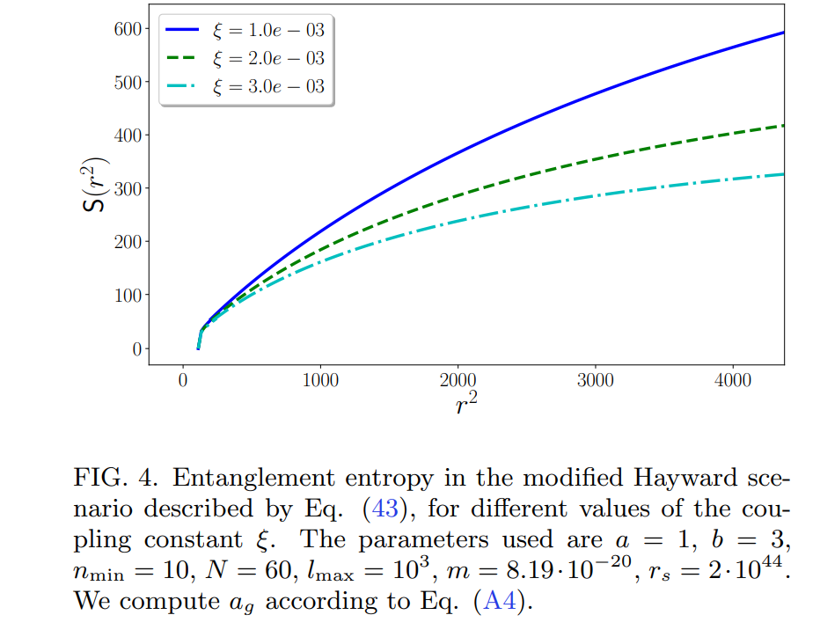
Corrected-Hayward
The corrected Hayward metric lapse function is given by:

Slide 16
Key analytical and Numerical Method
Hamiltonian Discretization:
The scalar field is discretized on a spherical lattice to compute the Hamiltonian, which forms the basis for the entanglement entropy calculation. This method could be seen as a precursor to numerical methods.
Ultraviolet (UV) and Infrared (IR) Cutoff:
These are regularization techniques used to handle divergences in the theory, often used in quantum field theory to limit infinite contributions from short (UV) or long (IR) wavelengths. In this paper, these cutoffs are employed to ensure meaningful results in the entropy calculations, similar to how statistical methods handle large datasets by limiting extremes.
Numerical Simulations:
The paper frequently uses numerical simulations to evaluate the behavior of entanglement entropy for various black hole metrics.

Slide 17
Error Estimation in Sum Truncation:
Although not labeled as a statistical method, the paper describes an error estimation approach for truncating infinite series sums, which is akin to a numerical approximation technique often used in computational statistics to estimate convergence or tolerance levels.
Statistical Interpretation Methods
Convergence and Error Tolerance:
The paper discusses methods to check the convergence of infinite sums (such as truncating the spherical harmonic expansion). This is similar to how statistical methods assess convergence in iterative algorithms.

Slide 18
Statistical Techniques Analogy:
While not traditional statistics, here are analogous concepts:
Regularization (UV and IR cutoffs): A technique to avoid infinities, similar to how statistical methods like Lasso or Ridge regression add penalties to control extreme parameter values.
Monte Carlo Simulation: While not used explicitly, the numerical methods in quantum gravity research often draw on Monte Carlo techniques in other contexts.

Slide 19
Summary
The paper investigates entanglement entropy in quantum black holes, focusing on a massive Klein-Gordon scalar field in Schwarzschild-like quantum black holes.
It examines how quantum effects modify classical black hole thermodynamics, particularly through non-minimal coupling between the scalar field and spacetime curvature.
The study explores two key quantum-corrected black hole metrics:
Quantum-corrected Schwarzschild metric
Coherent quantum black hole model
The paper compares these quantum black hole models with regular black holes, like:
Hayward metric
Corrected-Hayward metric, which regularize black hole singularities.
Entanglement entropy is calculated using a discretized system of spherical shells and Lemaître coordinates, tracing quantum effects at different scales.
Results show significant deviation from the area law near the black hole core, but entropy converges to the classical area law at larger distances.
The study contributes to understanding black holes at Planck scales and their connection to quantum gravity and black hole thermodynamics.

Slide 20
Bibliography
"R. Horodecki, P. Horodecki, M. Horodecki, and K. Horodecki. Quantum entanglement. Rev. Mod. Phys., 81:865, 2009.
L. Bombelli, R. K. Koul, J. Lee, and R. Sorkin. Quantum source of entropy for black holes. Phys. Rev. D, 34:373, 1986.
M. Srednicki. Entropy and area. Phys. Rev. Lett, 71:666, 1993.
M. M. Wilde. Quantum Information Theory. Cambridge University Press, Cambridge, 2017.
Sergey N. Solodukhin. Entanglement entropy of black holes. Living Rev. Rel., 14:8, 2011.
Alfred Wehrl. General properties of entropy. Rev. Mod. Phys., 50:221–260, Apr 1978.

Slide 21
Thank you!

